Slide 1

Supporting Youth Agency
ISL Program Staff Workshop
Created by
STEM Interest & Engagement
(STEM IE) Study
Presented by
ENTER NAME(S)
ENTER DATE

Slide 2
What is Agency?
Agency refers to a person’s perception that they can, and to skills that enable them to determine their own goals, actions, and intentions regarding learning or other endeavors.
A sense of agency is synonymous with feeling autonomous and in control. Youth vary in the extent to which they have developed the cognitive tools to achieve their goals.
Notes:
Possible questions: 1. In your own experience has a sense of agency been important to: (a) you when you were learning something or trying to accomplish a task? (b) youth with whom you have worked? 2. Have you ever noticed how youth respond when their autonomy is limited or when they experience authoritarians (opposite of agency supportive)?

Slide 3
Staff shares control with youth.
Youth work on creating a tangible product or preparing an event.
Youth participate in inquiry (exploring and discovering).
Activity leaders (ALs) include youth in planning.
ALs show regard for student perspectives.
Definition of Agency Support in the STEM IE Study
Notes:
The Youth Program Quality Assessment (YPQA) and the Classroom Assessment Scoring System (CLASS) instruments were used for coding.

Slide 4

Why agency support Matters in isl Programs
Notes:
Note: The Chinese symbol means autonomy.

Slide 5
Youth Agency
Some theorists believe that agency is a basic human need. Adolescents thrive on a sense of agency.
Notes:
Add: Research studies have consistently found that a sense of agency contributes to intrinsic motivation toward academic & other tasks and to overcoming obstacles.

Slide 6
Youth provided in-the-moment reports of control, engagement, & challenge during program activities.
Video was coded for agency support by activity leaders.
Youth rated agency- supportive practices they experienced during the program on post program survey.
ALs were interviewed about agency.
Research
Methods
How we learned about support for agency in ISL programs.
Notes:
Details to share: 1. Youth were signaled several times during their ISL learning and activity time. They used an app on a cell phone to provide in-the-moment reports of how they were feeling in the 15 minutes before being signaled. 2. Video coding shown on Slides 7 and 8.

Slide 7
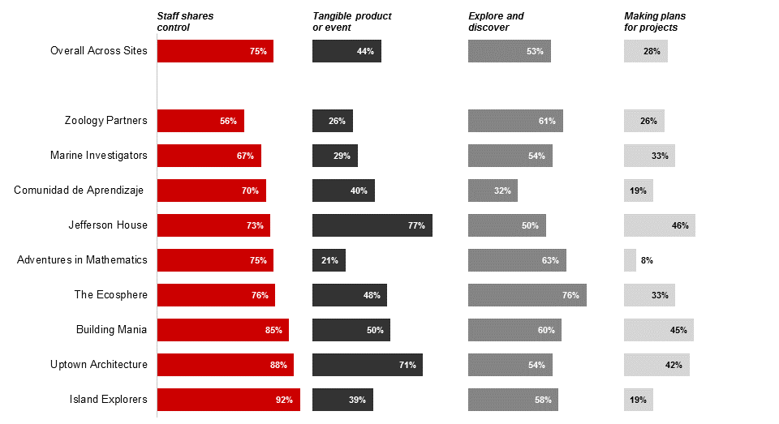
Agency Supportive Practices Observed in Programs: Percentage of Time during STEM learning time

Slide 8
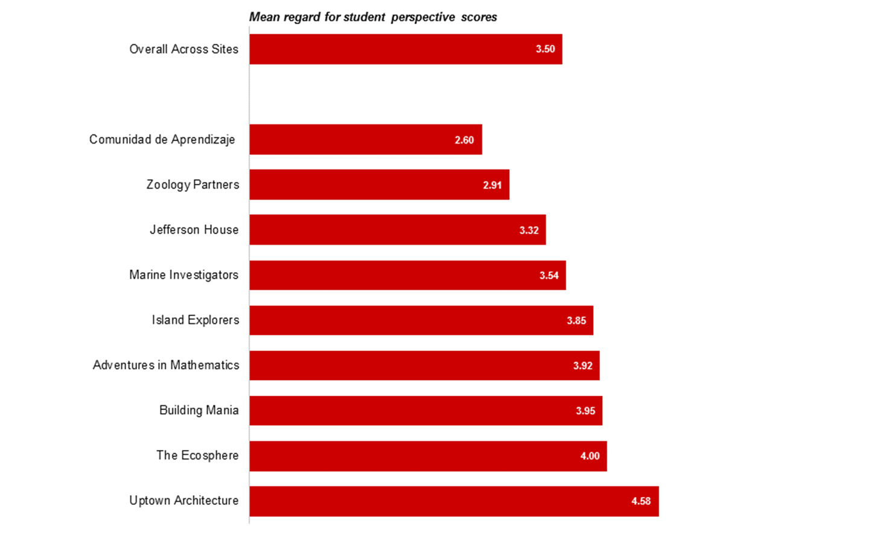
Activity Leader Regard for Student Perspective on (1-7 point) Scale

Slide 9
Research Identified Importance of agency Support
ALs agency support predicted youth being engaged and challenged in the learning task.
Girls felt less in control than boys. Like boys, they responded positively to agency supportive practices.
Youth in-the-moment reports of having control matched their reports of agency supportive practices on the post program survey.
Many ALs strongly endorsed the importance of supporting youth agency. Yet, some struggled with turning over control and keeping youth on task. Youth behavior was sometimes difficult to manage, which deterred ALs from sharing control.
Notes:
This slide summarized findings from STEM IE research.

Slide 10
How Activity Leaders can support youth agency

Slide 11

Large: What do you want to build/know/design and for whom?
“Here are the tools we have available: How can you do this?”
“The group needs to decide how you will break up these tasks.”
Moderate: “What do you know about cells?” Youth then generate questions and plan labs to answer those questions. “X, y, and z need to be done: Who wants to do x?”
Small: Youth can choose which order to complete things, where to work, and what color to use on a graph. Caution: choosing who to work with can lead to less engagement.
Types of Choices
Notes:
In a previous study conducted in classrooms, adolescents who were given either large or small choices reported feeling more agency than if they were not given any choices. However, the type of choice they were given did matter in terms of how engaged youth were in the activity. When young people got to choose who they were working with, they were more likely show universally low engagement in the task. When they were able to choose how to frame the problems and/or how to complete a course activity, they became fully engaged. Choosing materials was associated with having fun but did not lead to working harder.

Slide 12

This clip shows youth responses to the choices they are provided during a Science Technology Engineering Art & Math (STEAM) program.
Notes:
Ask participants to observe: What kind of choices youth were given in this program? After viewing have them share some examples. Can follow with the activity in the Facilitator’s Guide.

Slide 13

This clip shows girls in an ISL engineering and technology program being given choices and responsibilities in a program that intentionally builds a sense of agency and ownership.
Notes:
Ask participants to observe: What kind of choices youth were given in this program? After viewing have them share some examples. Can follow with the activity in the Facilitator’s Guide.

Slide 14
Provide opportunities to take responsibility & Contribute
How can you can give youth responsibilities within the program. What tasks and roles can they take on?
How can you extend responsibility beyond the program?
For example: Young adolescents can teach, assist, or present activities or projects to younger children attending adjacent or nearby programs. Alternately, they can use media to create books or videos teaching or demonstrating a concept for younger children.
Notes:
Tell participants that It is not surprising that when youth are provided choices, they feel that they have more control and ownership over their learning than if they are told exactly what to do and how to do it. The flip side of choice is responsibility—when youth are provided with choices, they also are expected to take responsibility. Typically, the more that youth are given responsibilities and expected to be active contributors, the more they feel a sense of ownership and belonging. See Facilitator’s Guide for two activities you can choose from related to this slide.

Slide 15
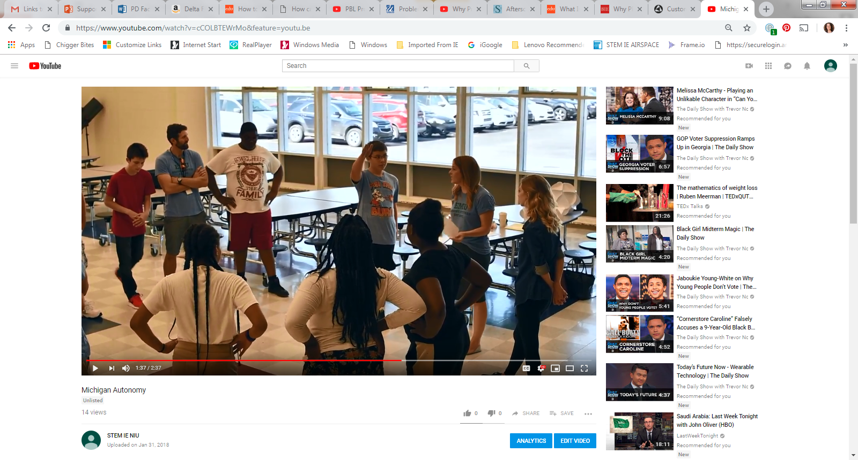
This clip shows an AL explaining how and why youth leadership and youth voice are encouraged in a summer STEM program.
Notes:
Show the video clip from a program that excels at fostering voice.

Slide 16
Show Regard For YOUTH Voice
Encourage youth to share their ideas. Listen and ask follow up questions of the speaker and of others (“can you add anything to what Kiera just said?” or “what are your thoughts about..?”
Provide think time before youth share.
Ask questions to help clarify thinking rather than saying “that’s wrong.”
Incorporate ideas from youth in programming.
Establish (with youth) norms for working and learning together.
Notes:
Introduce or remind the participants of an activity in the program. Ask them to brainstorm all the ways that the elements of regard for student perspective could be fostered throughout the activity in either large or small group.

Slide 17
Emphasize Youth Ownership of the Learning Process
Use an inquiry approach.
Careful planning and advance preparation of materials and procedures provides essential structure that enables youth to observe, ask questions, organize their investigations, interpret their data, and present their findings. Structuring these tasks is crucial for successful activities.
Set up opportunities for youth to ask questions and to formulate the questions into a plan to learn more.
Provide youth with materials to answer the questions and to solve the problems themselves, rather than telling them the answers to problems.
Arrange for youth to present their findings or products.
Notes:
See Facilitator’s Guide for choices of inquiry activities.

Slide 18
Challenges to Supporting Autonomy
Giving up control is scary.
Students may be reluctant to accept control.
Doing true inquiry is difficult for several reasons.
Finding materials and resources
Getting ideas
Supporting inquiry
Youth might be used to authoritarian management practices
Discuss: Are these concerns for you? Do you have other concerns? Strategies for overcoming these difficulties?
Notes:
Read through list. Ask participants to discuss. See Facilitator’s Guide for an optional activity to do with this slide.

Slide 19
Manage or empower?
Behaviorism
(Control) or
Self Determination
(Guide)
Notes:
If you used rewards, ask participants to discuss what they noticed about the discussion (see Facilitator’s Guide for prompts). Alternately, simply note that offering rewards (or negative consequences) come from the behaviorist paradigm and are designed to control behavior.

Slide 20

?
Rewards Are they all they are cracked up to be?
Notes:
[Share] There was a considerable emphasis on “rewards” and “winning” in our observations. [Ask] Think about how much you use rewards (praise, tokens, candy, or providing special privileges). Beyond the idea that they are controlling, are there other consequences? Click on the question mark to play this video from 1:50–8:11: http://www.ted.com/talks/dan_pink_on_motivation Ask for reactions.

Slide 21

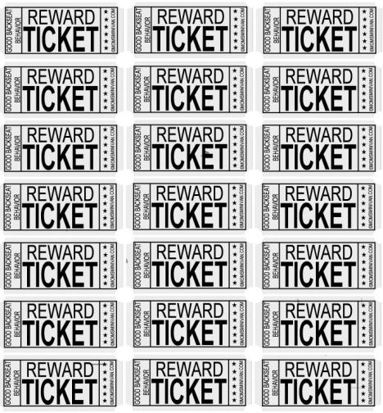

But does iT ever work?
Some studies found that boring tasks are sometimes necessary for learning. Offering an incentive can be useful in these cases.
Notes:
Another problem with rewards is that experimental studies have shown that they decreases intrinsic motivation UNLESS youth are being asked to do boring rote tasks.
Asks participants to share their own experiences with this phenomenon. Emphasize that an extrinsic focus does undermine students sense of control, decreases intrinsic motivation, and can increase learned helplessness. When necessary try to make it a logical/natural incentive. For example, when you are finished cleaning up your table, you can get a drink/have free time until x time, or whatever natural or logical incentive makes sense. See Facilitator’s Guide for a practice activity.

Slide 22
View Activity
Identify Support for Youth Agency

Slide 23
Summary: Practices for supporting Youth Agency
Provide opportunities for students to take responsibility.
Give students choices.
Show regard for student voice.
Emphasize student ownership (inquiry methodology).
Be authoritative, not authoritarian.
Work with your team or individually. How can you support youth agency during the first or next week of the program? Longer term?
Notes:
Place participants in small groups if there are naturally occurring teams or have them work individually to plan what they want to do to increase their support for youth agency during the first or following week of the program and what they would like to do long term. Have them write down their specific plans. Then, SHARE!!!

Slide 24



Researchers from three institutions collaborated on designing and implementing the STEM IE Project.
The project was funded by the National Science Foundation’s Advancing Informal STEM Learning (AISL) program. The material contained in this guide is based upon work supported by the National Science Foundation under Grant No: DRL-1421198. Any opinions, findings, conclusions, or recommendations expressed in this material are those of the author(s) and do not reflect the views of the National Science Foundation

