Slide 1
program Quality
ISL Program Staff Workshop
Created by
STEM Interest & Engagement
(STEM IE) Study
Presented by
ENTER NAME(S)
ENTER DATE
Notes:
Introduction(s)

Slide 2
Purpose: Share research findings about how program quality Impacts Youth’s interest and engagement in stem and How to apply that to your setting.
Motivating & Engaging Youth in Informal STEM Learning Programs
Notes:
Slide briefly shares the purpose of the professional development session.

Slide 3
Motivation & Engagement Are States Not traits
WHY?
Notes:
Discuss what this means. [Note] People are motivated and engaged in some situations and not others – being motivated or engaged is dependent on the context. It’s valuable for activity leaders to learn how to plan and create contexts that are most likely to motivate and engage youth in the programs.

Slide 4
1. What have teachers or activity leaders done that helped you to learn about something you did not know about or know how to do previously?
2. When you are working on a project and get “stuck,” what is the best way for a more skilled other to help you?
Talk To Your Neighbor
Share your answers to the questions on the slide.
Notes:
Introductory Activity. Have participants read and think about their answers to the questions. Be sure everyone has a partner and that they take turns as teller and as listener/questioner. Have the dyads share out. Ask the group to identify any patterns that emerge in the responses. (10-15 minutes) Alternately, conduct a group discussion to answer the questions.

Slide 5
What is Quality?
In the afterschool field the term “quality” often refers to specific assessment tools that define quality, allow self-assessment of how well programs meet these criteria, and guide plans to improve.
Notes:
Broad definition of quality in the afterschool field focuses on creating developmentally appropriate settings for youth, where youth feel safe, form meaningful relationships, and experience belonging. Add that the STEM Youth Program Quality Assessment (YPQA) and the Dimensions of Success are often used as assessment tools in afterschool STEM programs. See facilitator’s guide for optional activities.

Slide 6
Interactions with youth likely to facilitate learning:
Set clear learning goals, display interest, encourage participation;
Promote youth understanding of key concepts and how they are relevant;
Provide opportunities to analyze, solve problems, plan, and reflect;
Scaffold, give constructive feedback, encourage persistence, and recognize accomplishments;
Foster discussion;
Maintain productive learning environment with few disruptions.
Program Quality Definition in STEM IE Study
Specific Dimensions
of CLASS
Notes:
The STEM IE study using specific dimensions of CLASS (Classroom Assessment Scoring System) to measure quality. STEM IE researchers recognize the importance of quality broadly defined (see previous slide) but focused only on aspects of quality that were likely to facilitate learning directly in this study .

Slide 7
Why Quality Matters

Slide 8
Importance of Quality in STEM Programs
Quality criteria are associated with positive youth development and learning. Awareness of quality criteria helps staff to plan and implement practices that facilitate STEM learning.
Notes:
The slide briefly reviews reasons that program quality is important for youth.

Slide 9
Youth provided in-the-moment reports of learning, challenge, engagement, and relevance.
Video was coded for program quality during the 15 minutes prior to signal.
ALs were interviewed to gather their perspectives about practices associated with program quality.
Research
Methods
How we learned about support for agency in ISL programs.
Notes:
Details to share: 1. Youth were signaled several times during their ISL learning and activity time. They used an app on a cellular phone to provide in-the-moment reports of how they were feeling in the 15 minutes before being signaled. STEM learning and activity time was videotaped. Video segments were coded for quality elements shown on slide 6.

Slide 10
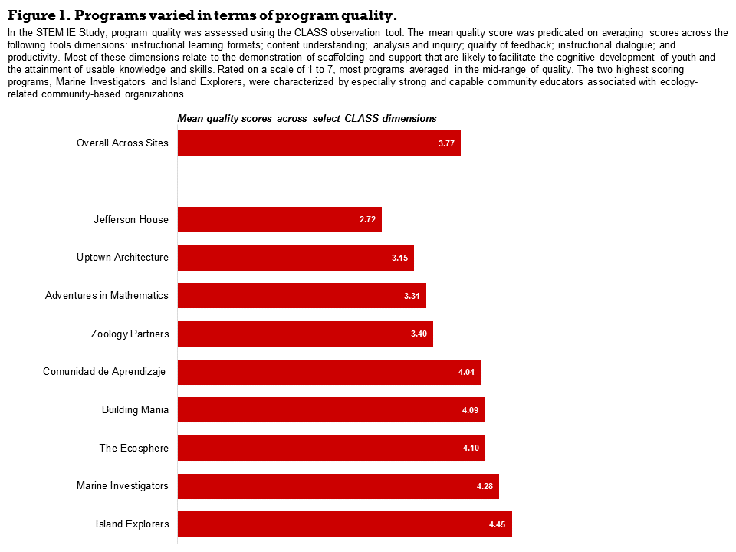
Average Quality Scores For programs
Notes:
Ask participants to study the chart and discuss what they are seeing. Share with participants: The CLASS scale ranges from 1-7. The average shown on the chart comes from averaging the dimension scores shown on Slide 10. Most programs were, on average, in the mid-range of quality. The two highest scoring programs, Marine Investigators and Island Explorers, were characterized by especially strong and capable community educators associated with ecology organizations.

Slide 11
Findings: Program Quality was associated with youth Experience
Youth reported more learning, engagement, challenge and relevance when quality was higher.
Notes:
Review findings

Slide 12
Impact of Program Quality on Youth with Low Motivation to attend
Youth who were not motivated to attend at the onset of the program found STEM activities more relevant when attending higher quality programs.
Program Quality
Red = not initially motivated to attend
Blue = initially motivated to attend
Notes:
Review findings presented on the slide. Many want to know how to engage youth who are not motivated to attend an educational program. These findings suggest that the quality elements studied were important for engaging those youth.

Slide 13
How ALS can facilitate program quality

Slide 14
Use Time-tested Strategies For Effective Lessons
Clearly communicate what youth will know, be able to do, or understand.
Plan a variety of activities. Watch ALs connect STEM concepts in classroom and field experiences.
Monitor the pace. If too fast youth may seem confused or if too slow youth may disengage. Accommodate according to their response.
Notes:
Review the three strategies. Click the link “Watch ALs” and ask the participants to talk about how the AL connects classroom and field learning. Practice Activity: Select a topic that youth learn in your program. Plan a “classroom” lesson and a “field” experience that tie content together. Write a clear statement about what youth will know, be able to do, or understand after participation in the classroom and the field experience.

Slide 15
Promote content understanding
Connect content to prior knowledge, real world examples, BIG Ideas, and multiple perspectives.
Provide examples AND non-examples of concepts.
Assign meaningful practice.
Notes:
View and discuss video of activity leader connecting physics content to real world examples and big ideas. [Add} Example of BIG IDEAS are conservation of energy, homeostasis, infinity. Examples of assigning meaningful practice are calculating distances for a field trip or halving a recipe. Practice Activity: Continue working with the topic(s) from the Slide 14 planning activity. Apply the suggestions for promoting content understanding to content youth are expected to learn about the topic(s).

Slide 16
Ask Youth to Analyze and Inquire
Have youth:
Generate hypotheses,
Explain their thinking,
Analyze evidence, and
Reflect on their progress.
Notes:
Review practices that entail analysis and inquiry.

Slide 17
Give High Quality Feedback
Scaffold Assist as needed. Lead youth to solve their problem(s). Do not do it for them.
Give targeted feedback – tell them what they have done well and help them determine what they still need to do.
Notes:
Click on the scaffold link to view a brief video. Discuss the way that the activity leaders assisted youth with their projects. What challenges have you encountered (or might you encounter) with scaffolding?

Slide 18
Ask Youth to explain Their Thinking
Make a list of strategies and questions activity leaders could ask that would prompt youth to explain and elaborate.
Notes:
Have participants work individually for a few minutes and then in small groups to generate lists. Have them write their questions on post it notes that they will post on the board. Distribute handouts if desired (see guide). Optional: Have those who are finished first, organize the questions by grouping those that are similar on the board .

Slide 19
Facilitate Instructional Dialogue
How does the teacher facilitate instructional dialogue?
Notes:
View the video by clicking on the link. Discuss the question on the slide (instructional dialogue is verbal interaction about content youth are learning). Consider distributing and discussing a handout on norms to establish in your program.

Slide 20
Summary Of Practical Suggestions for Facilitating Program Quality
Communicate clearly, plan a variety of activities, monitor the pace.
Promote Content Understanding.
Ask Youth to Analyze, Explain, Reflect.
Give High Quality Feedback.
Facilitate Instructional Dialogue.
Notes:
Quickly review these research based suggestions. Use this slide in the next activity.

Slide 21
View Activity
Review FacilitatingProgram Quality
Notes:
Discuss: How do activity leaders facilitate program quality in this link? Provide copy of summary slide to participants or use link to display summary as participant’s discuss.

Slide 22
Researchers from three institutions collaborated on designing and implementing the STEM IE Project.
The project was funded by the National Science Foundation’s Advancing Informal STEM Learning (AISL) program. The material contained in this guide is based upon work supported by the National Science Foundation under Grant No: DRL-1421198. Any opinions, findings, conclusions, or recommendations expressed in this material are those of the author(s) and do not reflect the views of the National Science Foundation

