Slide 1
Enhancing Early Adolescents Engagement in STEM
National Summer Learning Association
National Conference
Phoenix, Arizona
Neil Naftzger
October 24, 2017
October 2017
Copyright © 2017 American Institutes for Research. All rights reserved.

Slide 2
STEM Interest and Engagement Study
Notes:
4 year study
Funded by the AISL program at NSF
9 Summer Learning Programs Supported by PASA and BASB

Slide 3
Study Background – Research Team
Notes:
AIR – More work in afterschool and OST
NIU/MSU – Middle and High School Science and methodological expertise

Slide 4
Study Goal
Interest
Engagement
Notes:
What practices and activities drive in the moment interest and emgagement

Slide 5
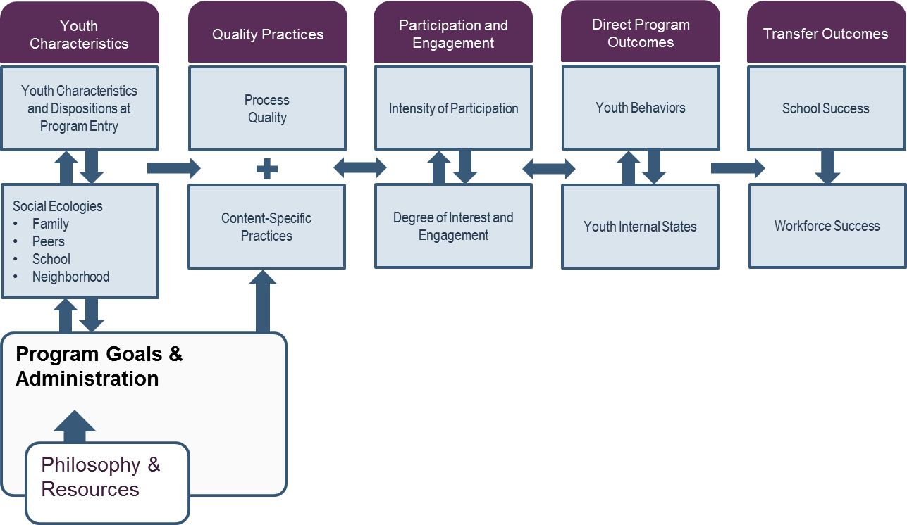
A Conceptual Framework for How Out-of-School Time Programs Can Have an Impact on Youth Participants
Notes:
Youth in study – minority youth from high poverty communities, rising 5 to 9 graders
Quality – PASA the PQA, BASB the APAS system
Universal process quality vs content specific practices
4 to 6 week programs
STEM portion lasted about 3 hours per day, both in classroom and community settings
Triad teaching model at PASA
Content knowledge, SEL, and interest development

Slide 6
Rationale
Experience Sampling Method
Video
Notes:
ESM process and video

Slide 7
Hypothesis
Challenge
Affect
Relevance
Learning
Notes:
Based on past work

Slide 8
Value
Autonomy

Slide 9
Nevada State Board of Education Sate Goals
Interest in STEM declines with age (science most). Decline starts in middle school & slide continues in high school.
Most Adolescents see little value in science. Often fail to see relevance. Perceiving something as relevant predicts engagement.
Girls may see less value than boys – Beliefs about task relevance and ability interact, especially for girls.
Activity Leaders miss many opportunities to promote relevance and value.

Slide 10
What does it mean to value STEM?
Intrinsic Value = Interest (Personal & Situational)
Utility Value = Relevance, Usefulness
Attainment Value = Identity/Identification
Cost Value = Worth effort vs alternatives?
Activity leader value statements predicted belief that the activity was important

Slide 11
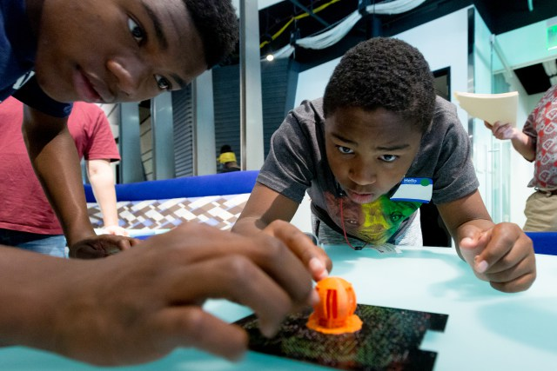
Intrinsic - Finding Interest in STEM
Situational vs. Individual Interest
How do you and how can you learn about participants interests?
Sparking Situational Interest
Teacher Enthusiasm!!!!!!!!!!!!!!!!!!!!!!!!!!!! The awesome wonder of science
Sharing YOUR interests
Using the community as a learning space
Notes:
Surveys
Effective use of icebreakers – name game where they had identify some they were interested that started with the first letter of their name
William Damon – Path to Purpose, Community Educators

Slide 12
What can we anticipate to find in terms of essential skills? Utility – STEM is useful for some purpose
Understanding or explaining natural phenomena or how things work
Self-Oriented
Classes to take in high school or college
Career options
When to use
Self-Transcendent
Project to help the broader community
Explaining/solving a local problem
Notes:
Most common was the first – Squid break example, Tridis feel and smell it

Slide 13
What can we anticipate to find in terms of essential skills? Ways to Promote Utility Value
Connecting Content to LIFE
Say how and ask them to make connections
Use analogy and common materials
Storytelling
Tell stories about how the topic mattered
Problem Based Learning
Why do PBL?
Notes:
EtB story about the storm sewers
EtB story about the watershed

Slide 14
Attainment – Related to identity/self-concept
Identification/Identity – Key task in adolescence
Role Models they see as similar to themselves
Opportunity to play roles (during activities)
Connection to their community, family, ….
Notes:
DcD example

Slide 15
Discuss Two Possible Ways to Structure STEM Activities to Promote the Value of Specific Content

Slide 16
Summary of Value Practices
Model enthusiasm (rekindle your interest/passion)
Associate content being studied with individuals’ interests - Need to learn what these are
Connect content to everyday life
Use analogy and common materials
Tell stories about how the topic mattered
Use inquiry and PBL
Involve others (parents, other activity leaders, professionals in the field)

Slide 17
Program Participants and Setting
Autonomy
Notes:
Some believe humans have a basic need to feel autonomous – this need for self determination underlies behavior.
Adolescents thrive on autonomy. Those who feel autonomous, have more intrinsic motivation toward academic tasks and are less deterred by obstacles

Slide 18
Agency
“By ‘‘agency skills’’ we refer to cognitive tools, including insights, precepts, knowledge, and action schemas that youth might employ to help them achieve goals. Adolescence is a particularly important period to study development of agency skills because of teenagers’ new potentials for higher order reasoning, including reasoning about the dynamics of complex systems and executive control of one’s own thought processes. Youth’s development of agency skills that incorporate these advanced capabilities could be expected to provide them with more powerful, flexible, and dynamic tools for realizing goals.” (Larson & Angus, 2011, p. 277)

Slide 19
What We Were Looking For
Staff shares control with youth,
providing guidance
Explore and discover new things on their own
Creation of a tangible product or culminating event
Make plans for projects or activities

Slide 20
What can we anticipate to find in terms of essential skills? Study Findings
Considerable variation in autonomy support and opportunities for agency
Each positively related to participant reports of challenge and engagement

Slide 21
What can we anticipate to find in terms of essential skills? Study Findings
Replication
Notes:
In a similar study, items found on the Youth PQA and Youth Survey pertaining to agency were especially related to youth-reported daily engagement
PQA Example – Program activities lead or will lead to tangible products or performances that reflect ideas or designs of youth
Youth Survey Example – Youth get to help plan activities for the program

Slide 22
What does quality OST programming look like? – Project-based & Inquiry
‘‘Arc of work’’ that includes planning, monitoring, adjusting plans, and receiving authentic feedback
Help youth envision where their work is headed
Provide encouragement with realism and honest feedback
Real world challenges and demands
Opportunities for youth to experience ownership over their project
Freedom and choice
Support youth decision making but provide initial structure for work
Notes:
Larson has written about the importance of providing honest feedback

Slide 23
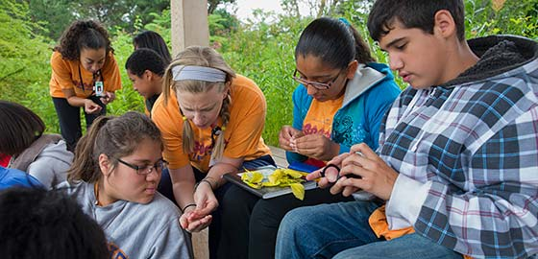
Autonomy Examples
Youth explains how she has responded to opportunities to take responsibility and show initiative related to her science class
Meg supports student autonomy during a problem based learning project

Slide 24
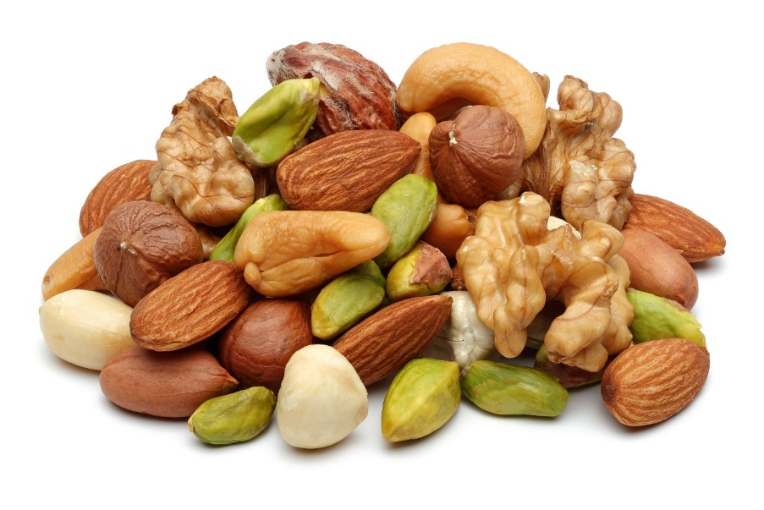
Challenges to Supporting Autonomy
Giving up control is scary
Students may be reluctant to accept control
Doing true inquiry is difficult
Materials & resources
Getting ideas
Supporting inquiry
Notes:
Is there a relationship between cumulative, youth-reported daily experiences in 21st CCLC programs and changes in key youth development outcomes?
Efforts to connect cumulative youth engagement scores with changes in pre-post youth survey outcomes were mixed
Other measures of youth experience in programming collected on the post-survey were more commonly associated with changes in pre-post youth survey scores
Relationship with other kids in the program associated with improvement in all four scales
Opportunities to experience youth agency - Associated with improvement in the:
Positive Mindset scale
Self Management scale
Interpersonal Skills scale
Mixed finding - See table 2 from the preliminary findings document – weaker relationships, connection to higher levels of attendance not consistently demonstrated
Caveat – Caution should be exercised when interpreting findings related to Other Kids and Youth agency results since some of this relationship may be driven by the fact that youth outcomes and these experiences were collected using the same instrument; however, the finding from slide 1 does validate the predictive validity of the youth survey-based youth agency scale when engagement is used as an outcome using a different measure, so it’s picking up something that goes beyond the measure variance is shares with the outcomes

Slide 25
What Autonomy Support and Agency Can Do

Slide 26
Provide opportunities for students to take responsibility
Give students choices in class activities
Emphasize student ownership of the learning process
Provide students with materials to solve problems themselves, not answers to problems
Use inquiry methodology
Table Talk
What steps do you take to ensure quality in your program? Are there any particular tools you are using?
How do you include your staff in quality improvement efforts?
What strategies have you found that really move the needle on quality?

Slide 27
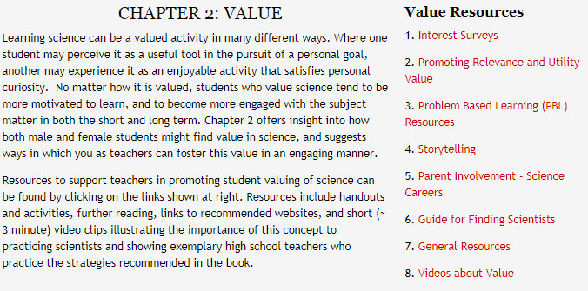
Resources
http://www.niu.edu/eteams/

Slide 28
Neil Naftzger
630-649-6616
nnaftzger@air.org
1120 E. Diehl Road, Suite 200
Naperville, IL 60563
General Information: 312-288-7600
www.air.org

