Slide 1
Making Content Relevant
ISL Program Staff Workshop
Created by
STEM Interest & Engagement
(STEM IE) Study
Presented by
ENTER NAME(S)
ENTER DATE

Slide 2
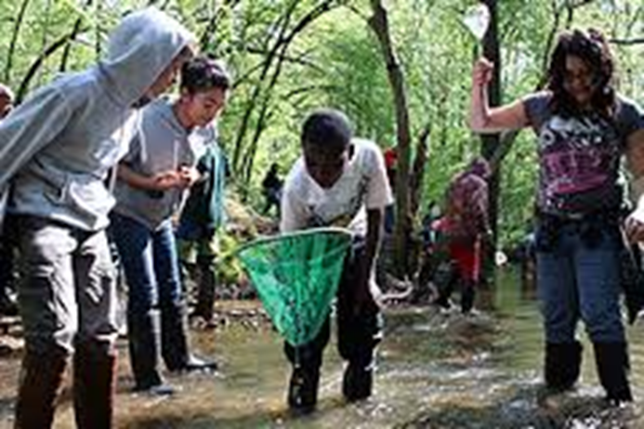
Motivation & Engagement Are States Not traits
You can influence states!
Notes:
Make the point that motivation and engagement vary with the context. They are not an individual trait but are often a state that can be influenced.

Slide 3
What Engages You In Learning? Motivates You?
Think for 1 minute.
Discuss with partner for 2 minutes.
Share with group.
Notes:
Ask participants to think individually about what engages them in learning and motivates them. Have them discuss that with a person sitting next to them. Share out to the whole group. Note how many responses have to do with the content being important or relevant to them. Reiterate how content was relevant to them. If few mention relevance, acknowledge what they identified and mention that often people say that content being relevant is engaging. Ask them whether that pertains to them, too, and why they think that only a few mentioned that.

Slide 4
What is Relevance?
Perception that content applies beyond the activity to one’s: daily life, future goals, self perception, interests, and concerns.
Notes:
Show this slide and move on or prompt group discussion with these questions (recommended): 1. Are you familiar with the daily lives, goals, interests, and concerns of the youth with whom you work/will work? How can you learn about these if you are not familiar? 2. Have you ever noticed how youth react to learning about things that matter to them? Can you share an example?
(

Slide 5
RELEVANCE Statements STEM IE Study
How STEM content relates to or is useful for:
Career(s)
Education (future, long & short-term/other camps)
Daily needs & routines (e.g., food, personal health, hygiene)
Problems in the world outside of program
Local/regional phenomena
Current or historical events or news stories
Social relationships
Interests – sports, hobbies
Notes:
[Share with participants:] This slide lists what was coded as relevance statements in the STEM IE study. Optional Activity: Print and use this slide as a handout. Click the word Relevance (underlined) in the title to go to a slide containing links to videos. Have them listen for “relevance” statements in 1 or more videos. What relevance statements. Click Relevance in the slide title to return to slide 5.

Slide 6
Why Making Content Relevant Matters in isl Programs

Slide 7
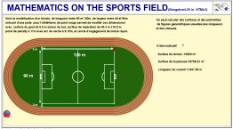
Relevance
Both theory and research suggest that youth benefit when they perceive STEM content as relevant to their lives. Youth are more motivated and learn more when they can connect content to their lives.
Notes:
[Share with Participants:} Youth are more interested, motivated, engaged, and persistent when they perceive what they are learning as relevant. Few youth in the United States perceive STEM content as relevant to their lives. This negatively impacts their STEM learning, which, in turn restricts career options and everyday decision making.

Slide 8
Youth provided in-the-moment reports of how much they were learning and how important what they were doing was to them, their future, and their life outside the program.
Videos of Activity Leaders (ALs) coded for number and type of relevance statements made during the 15 minutes prior to signal.
ALs were interviewed to gather their perspectives.
Research
Methods
How we learned about support for agency in ISL programs.
Notes:
Youth were signaled several times during their ISL learning and activity time. They used an app on a cell phone to provide in-the-moment reports of how they were feeling in the 15 minutes before being signaled. A link to Slide 5 allows the facilitator to go to that page (if desired) to review how specifically the video was coded.

Slide 9
Percentage of Sessions Relevance statement were made
Notes:
Ask those attending the following questions about the figure: What do you notice about the variation between programs? The three programs in which the fewest statements were made focused on mathematics and the top three focused on biological and ecological sciences; might that explain this pattern? Why do you think so?

Slide 10
Average Number of Relevance Statements per Coded Session
Notes:
The average number of statements that were made by each activity leader during the portion of the program that they led are shown. The program name is abbreviated before the leader number on the figure. Notice the individual CDA (Communidad de Aprendizije) activity leaders as well as the four individual JH (Jefferson House) leaders. Ask those attending the following question about the figure: What does this tell you about the role of the activity leader despite the content that the program focuses on?

Slide 11
Findings About Relevance
ALs sometimes missed opportunities to promote relevance.
Youth rated creating a product, field trips (including expert speakers), and focus on basic skills as having higher relevance than other activities.
Youth reports that what they were doing was relevant to them were predicted by AL talk about relevance AND by the nature of the setting. Experiencing authentic field-based settings alone promoted sense of relevance without talk.
Girls reported learning more when ALs emphasized the relevance of what they were doing.
Youth who said they were not motivated to attend when the program started benefited the most from ALs’ focus on relevance.
Notes:
Review the findings on the slide.

Slide 12
How Leaders can Make Content Relevant

Slide 13
Talk about connections between content & youth experience
Tell youth how content is relevant; better yet, ask them to make the connections.
Show youth using resources like: Spark 101, Science 360, and NBC Learn.
Use Storytelling: Tell youth about how the topic mattered.
Notes:
Some studies have found the greatest benefits when youth are asked to make the connections in response to prompts by teachers. Story telling is an excellent way to make the connections. The “tell stories” link contains storytelling resources which can be shown. The link “how the topic mattered” is connected to a video of a high school AP Biology teacher and her students. What they say about storytelling is universally applicable and a great example.

Slide 14
Relevance Activity: Analyze Statements
Do you notice any missed opportunities to promote the relevance of the content during this activity: Hide & Seek: Geocaching/GPS?
What could the AL say or do?
Notes:
Relevance link in title goes to slide 4 which contains what was coded as relevance statement (consider printing and distributing ). Hide & Seek link goes to 10 minute video. You could show only part.

Slide 15
Spark Connections
To spark connections between STEM and home or community of youth, use:
Analogies that relate something that youth are learning with something familiar to them;
Common materials as in this trebuchet building activity; and Familiar settings.
Notes:
The video clip that Botanic Value Analogies shows Duane talking about why he uses analogies together with an example of him using analogies when introducing a lab activity. See Facilitator’s Guide for an analogy activity. Engagement in activities related to everyday lives facilitates transfer of learning to other contexts. Tools and other everyday items seem to spark connections between home and school science. Trebuchet building video is 11 minutes. Can preview and show only part to save time.

Slide 16
STEM activities that Address Community & Social Problems
Project-Based Learning is a method for making content relevant AND addressing community and societal needs and issues:
PBL entails posing an authentic problem, question, or issue for youth to learn about and work on resolving.
Youth have choices and voice in choosing or refining the project.
Inquiry, reflection, revision, and collaboration are part of the process.
A tangible product or action is created and presented.
Notes:
Present content on the slide

Slide 17
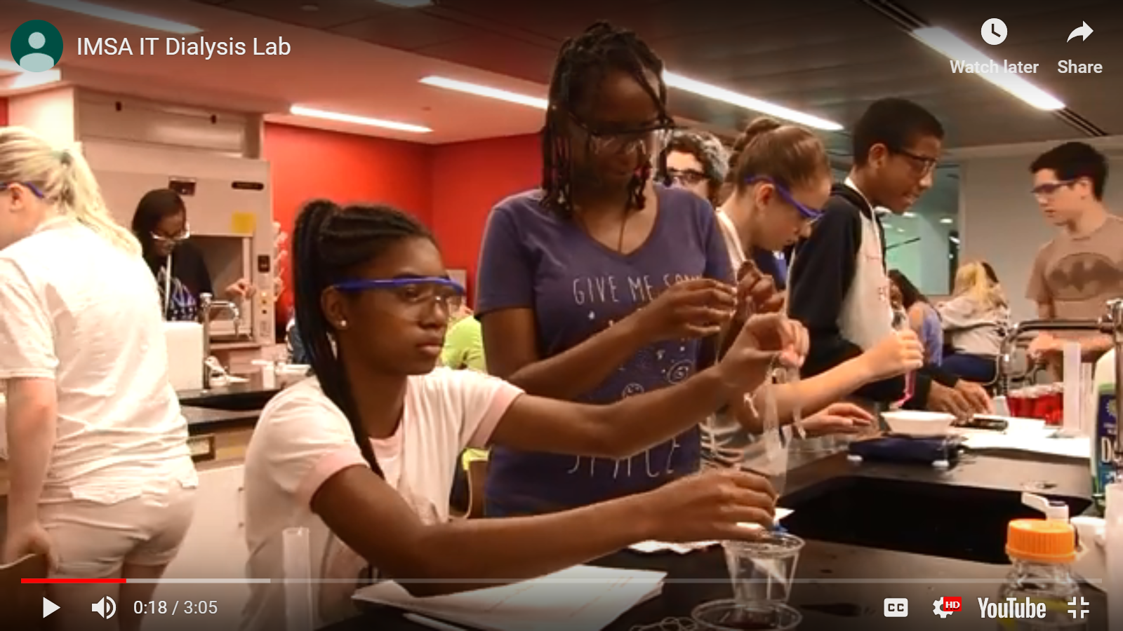
PBL
Summer STEM program for Middle School Youth
Identify the elements of PBL in this dialysis lab.
Notes:
View video (3 minutes) of dialysis lab in a summer STEM program lab activity. Ask participants to ID elements of PBL (prior slide) and share the examples..

Slide 18
Working in Groups
List the STEM topics, content, & skills that are learning goals for youth in your program.
Choose one or more of the items from the list and brainstorm ways those skills or topics have relevance in the community, school, or families of youth in your program.
How can you determine which of the ideas in #2 are important to youth and in what way(s)? How is this related to THEIR world?
Notes:
Ideally, place participants in groups from the same program or from programs with similar content.

Slide 19
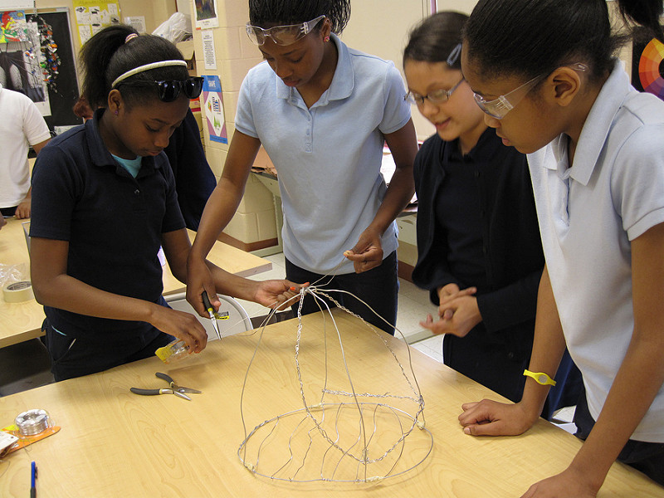
PBL Practices
DESIGN &
Plan
Photo by Intuit
Note aspects of designing and planning
PBL activities in this video from the Buck Institute.
Notes:
View video by clicking on link.

Slide 20
Getting Started
Select a general project or problem topic to do in your program.
What choices and voice will youth have in this project? How will they be able to refine and focus the project?
What resources and tools are available for youth to use in completing their project?
What experts are available in the community? Guest speakers? Field trips?
What form will the product they create and/or their presentation about the project take?
Notes:
Instructions for individuals or small groups appear on the slide.

Slide 21
Review
Identify how Activity Leaders promote relevance: Michigan Bright Futures
Notes:
See this slide and previous one to select best program for your participants to review how activity leaders ask participants to notice and then discuss the ways that these activity leaders promote relevance. Link “Activity Leaders promote relevance” goes to slide 20, which can be shown during the discussion

Slide 22
Review
Identify how IMSA Integrated Science Activity Leaders promote relevance
Notes:
Review this slide and next to select best program for your participants to review how activity leaders can promote relevance. Ask participants to notice and then discuss the ways that these activity leaders promote relevance. Link “how Activity Leaders promote relevance” goes to slide 20, which can be shown during the discussion.

Slide 23
Planning Activity Relevance As a Motivator for Science
Get together with your Group.
Develop 2 concrete ways to promote relevance of specific content.
Notes:
Assign participants to groups based on content they are responsible for in the ISL program. Have them develop two concrete ways of making specific content relevant to youth. Either assign the content or provide a choice of concepts or skills youth will focus on learning in the program. The goal is to plan things they can try with youth. The next slide summarizes ways to promote relevance.

Slide 24
Summary of Practical Suggestions & Resources for promoting relevance
Learn about youth’s interests. Associate content with those (sports, food);
Connect content to everyday life or other school subjects;
Use analogy and common materials/settings;
Tell stories about how the topic mattered;
Study local issues, possibly using PBL, or;
Involve others (parents, community members) as professionals/experts.
Notes:
Show this slide while the small groups are working on the culminating activity and/or when groups share their ideas.

Slide 25
Sharing Plans
Notes:
Each group will share their ideas with the larger group and receive feedback.

Slide 26
Relevance Activity: identify & extend
Watch: Identify Value Statements by Activity Leader/Teacher
Charts Maps & Graphs: Finding Treasure
Charts & Graphs
Notes:
Extra activity: Practice identifying relevance statements by activity leaders and suggesting more that could be made. RELEVANCE is linked to categories of relevance statement

Slide 27
Researchers from three institutions collaborated on designing and implementing the STEM IE Project.
The project was funded by the National Science Foundation’s Advancing Informal STEM Learning (AISL) program. The material contained in this guide is based upon work supported by the National Science Foundation under Grant No: DRL-1421198. Any opinions, findings, conclusions, or recommendations expressed in this material are those of the author(s) and do not reflect the views of the National Science Foundation

