Slide 1

Fostering Interest
ISL Program Staff Workshop
Created by
STEM Interest & Engagement
(STEM IE) Study
Presented by
ENTER NAME(S)
ENTER DATE
Notes:
Introduction

Slide 2

Motivating & engaging Youth in Informal stem Learning programs
Purpose: Share findings about how fostering interest in
STEM engages youth, and how that can be applied to your setting.
Notes:
Slide briefly shares the purpose of the professional development session.

Slide 3
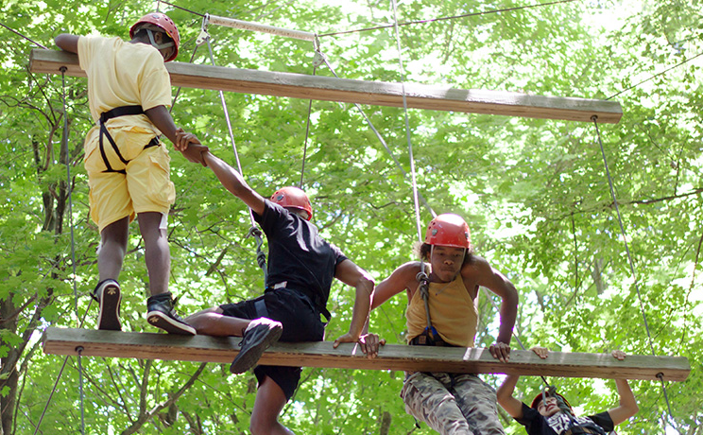
Motivation & Engagement Are States Not traits
WHY?
Notes:
Discuss what this means. [Note] People are motivated and engaged in some situations and not others – being motivated or engaged is dependent on the context. It’s valuable for activity leaders to learn how to plan and create contexts that are most likely to motivate and engage youth in the programs.

Slide 4

Interest is a subjective state of attraction to, curiosity about, enthusiasm for, and pleasure in a topic, subject, or thing. It can be situational (fleeting) or it can grow into a personal/individual (enduring) interest.
What is
Interest?
Notes:
Read slide. Optional: Have the participants discuss in pairs or small groups. Ask: 1. In general, how interested are the youth with whom you work when they enter the class or program?
2. In your experience, do any particular things tend to foster youth interest? 3. Have you led activities interested youth in the moment, but did not sustain their interest?
How about when situational interest grew into personal interest? Be sure everyone has a partner and that they take turns as teller and as listener/questioner. Have the dyads share out. Ask the group to identify any patterns that emerge in the responses and what they might do to foster situational developing into personal interest.

Slide 5
Think about two or three interests you had as a young adolescent. These should be things you enjoyed doing.
What were your interests?
How were those relevant to you? How did you get interested?
What opportunities did you have to further your interest(s)? Did anyone encourage or foster your interests?
Did you persist in any of these? What contributed to that?
Talk to Your Neighbor
Share your answers to questions on the slide.
Notes:
Have participants read and think about their answers to the questions. Be sure everyone has a partner and that they take turns as teller and as listener/questioner. Have the dyads share out. Ask the group to identify any patterns that emerge in the responses. Note the differences between those activities that led to enduring interest and the patterns they may have noted on fleeting interest here and in reference to the previous slide’s discussion.

Slide 6
Phase 1. Triggered Situational: Person gets excited about topic and pays attention.
Phase 2. Maintained Situational: Person realizes topic is relevant to them and continues to be engaged.
Phase 3. Emerging Individual: Person is independently engaged and enthusiastic.
Phase 4. Well-developed Individual: Person takes responsibility for learning and perseveres through set backs.
Interest Develops
In Phases
Hidi & Reninger identified four phases of interest development
Notes:
Review material presented on slide. The link “in phases” is to a 3 minute video exemplifying support for the first 2 phases of interest development. Ask participants to identify how the program fosters the phase 1 and 2. Share with participants: Not all youth will reach phases 3 or 4. A reasonable goal is to expose youth to high-quality learning environments, providing them with the opportunity to discover an interest and passion for this field that they otherwise may not have known they had.

Slide 7
Why Interest Matters

Slide 8
Importance of Fostering Interest in STEM
STEM interest begins to decline in middle school.
Interest often leads to engagement, persistence, and use of deep learning strategies in STEM classes.
Disengagement limits learning, thereby reducing future opportunities to pursue STEM majors and STEM careers.
Many jobs require competence in some area of STEM. Demand for workers with STEM competence is expected to grow.
Notes:
. The slide briefly reviews reasons that interest in STEM is important for youth.

Slide 9
Youth provided in-the-moment reports of affect, control, interest, challenge, and relevance during program activities.
Video was coded for activities youth were doing.
Youth reported on their interest in STEM and their future aspirations in science on pre and post surveys.
Activity Leaders (ALs) were interviewed about fostering interest.
Research
Methods
How we learned about support for agency in ISL programs.
Notes:
Details to share: 1. Youth were signaled several times during their ISL learning and activity time. They used an app on a cell phone to provide in-the-moment reports of how they were feeling in the 15 minutes before being signaled. Youth in-the-moment responses during the program measured their “situational” interest. The surveys measured their personal or individual interest.

Slide 10
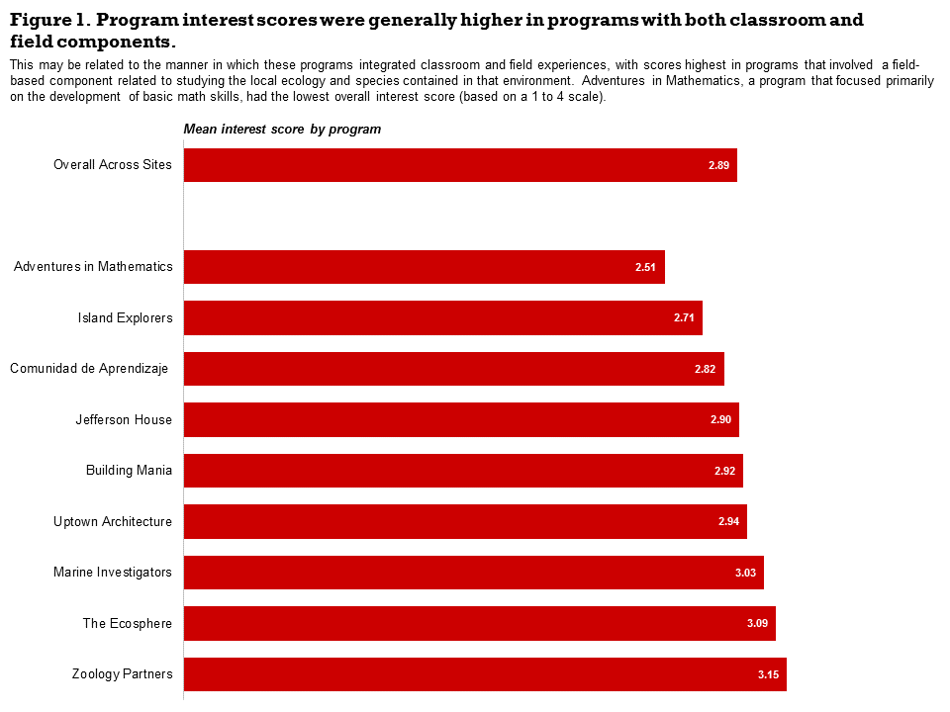
Youth Interest During STEM Learning Time
Notes:
Lead a discussion of the chart. Add these additional piece of information: The interest scale ranged from 1-4. Interest scores were highest in two programs with a field-based component related to studying the local ecology and animals in that environment. Adventures in Mathematics (which had the lowest score) was a classroom-only program that focused on the development of basic math skills. Island Explorers, which had the 2nd lowest score, had a passionate activity leader in the field. Youth rated that part of the program as interesting but the classroom portion as low in interest.

Slide 11
Study linked Program Experiences and Situational Interest
A number of studies have shown that Activity Leader (AL) Enthusiasm for a topic predicts youth ratings of both relevance and learning.
When youth did tasks they perceived as relevant and challenging, they reported more situational interest regardless of reported level of STEM interest when program began.
Interest in STEM (pre-program survey) predicted reports of positive affect while doing STEM activities.
Notes:
Review findings.

Slide 12

Study linked Program experiences and growth in individual interest
Youth who spent more total time doing labs and creating products reported increased individual STEM interest from pre- to post-survey (but not higher in-the-moment interest).
Youth who reported feeling greater control during program activities showed significant increases in individual interest in STEM and in STEM career aspirations over the course of the program.
Notes:
Review and emphasize these findings

Slide 13
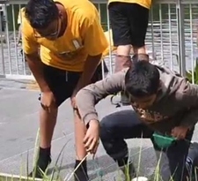
How ALs can foster Interest in STEM

Slide 14

Be Enthusiastic
Enthusiasm is infectious! How do you keep your interest alive in order to communicate your enthusiasm and interest to youth?
Notes:
Many STEM professionals credit an educator’s enthusiasm as the reason they pursued their career. Emphasize that researchers rarely observe enthusiasm. Can this be rectified? Recognize difficulties w/ always being “up” but have the group discuss the question on the slide. Take ideas from participants. Add these if they are not mentioned: 1. Keep up with new developments by reading magazine or news articles or by watching educational films. 2. Visit museums, nature preserves, open-houses or talks at local institutions related to content you teach. 3. Put yourself in the shoes of young people seeing or experiencing the content for the first time.

Slide 15


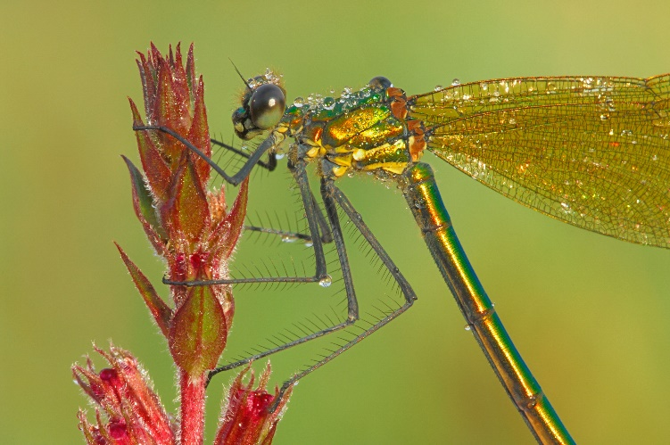
Introduce Youth to the Wonders of STEM
Novel and dramatic phenomenon are inherently interesting.
Choose a topic or content from your program that inspires wonder in you. Search for videos, photographs, and local examples using your preferred web browser. List questions you could ask youth after they have viewed the media.
Notes:
Have participants work alone or in teams, depending on the make-up of the group. Ask participants to share any ideas that they think are especially exciting.

Slide 16

Connect Activities to Youth Interest
How do you? and/or How can you learn about youth interests?
Notes:
Have participants discuss how they do and can learn about youth interests in the whole group, small groups, or with a partner. You can distribute the youth and/or parent report interest inventories available on the STEM IE website and have them review and customize either or both of them for their programs. If there were small group or partner discussions, have them share.

Slide 17



Connect Activities to Youth Interests
Select a topic or activity from your program.
Choose several common interests of youth who attend or are likely to attend the program (e.g. computer games, sports, music, animals) and plan how youth interests can be incorporated into the activity.
Notes:
Ideas might include using examples of how STEM concepts relate to interest categories or how youth projects could be individualized to incorporate an interest area. At the least, small groups of youth could select a name or logo representing shared interests of group members. If possible, find ways to allow some participant choice in variations of the activity to increase personal interest. Do your activities or choices allow for variations among your participants in age, gender, ethnicity, as well as existing STEM interests?

Slide 18
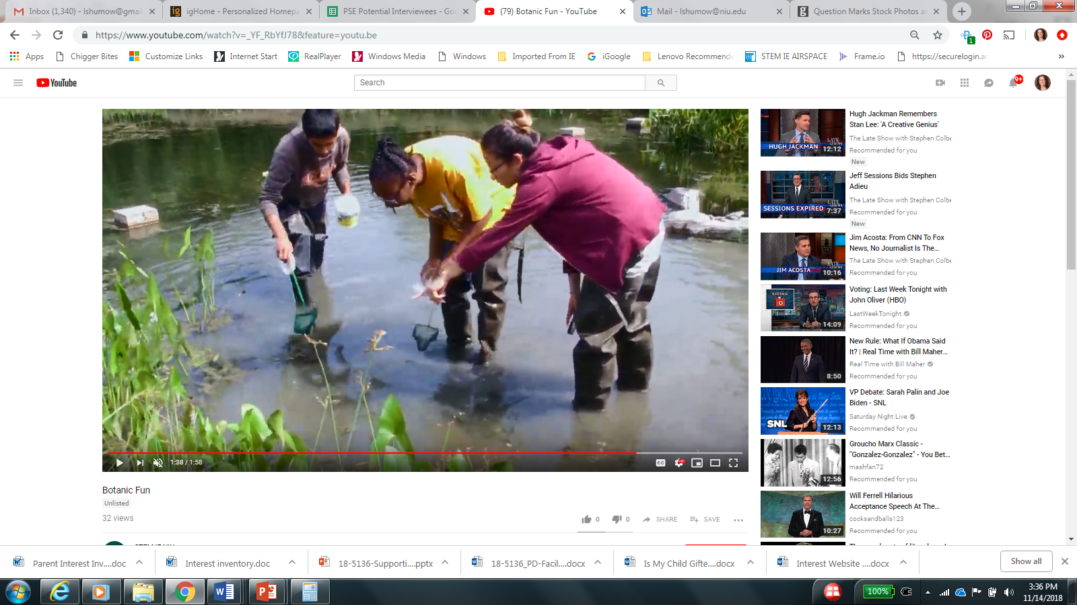
Plan Fun Learning Experiences
ALs said that it was important to make activities fun.
We observed that ALs often tried to make the activities educational, meaningful, and fun simultaneously. This is important because youth tend to value meaningful and educational activities.
Notes:
View the ~ 3 minute video clip by clicking on the “make activities fun” link. Ask: How important do you think it is to plan educational and meaningful activities that are also fun? Share with participants this research finding: students sometimes rate activities high in “fun” but simultaneously low in learning and value. What experiences do the youth in the video identify as fun?

Slide 19

Help Youth to Realize their ideas and overcome challenge
Creating products and participating in labs is associated with development of individual interest. AL support through the design and implementation process is crucial. This video presents AL practices that facilitate youth making in an ISL program.
Notes:
Click on the “this video” link to view video. Ask participants to discuss the ideas presented in the video. Consider providing a handout on managing frustration linked to the Faciliator’s Guide, Slide 19. Have participants find projects for youth that are appropriate for their context at: https://www.instructables.com/teachers Instructables is free for educators and is an outgrowth of the MIT Media Lab.

Slide 20
Summary Of Practical Suggestions for Fostering Interest
Be enthusiastic.
Introduce youth to the wonders of STEM.
Plan fun learning experiences.
Associate content with individuals’ interests.
Support youth to realize their ideas and overcome challenges in creating products and labs.
Promote relevance and a sense of agency.
Notes:
Quickly review these research based suggestions. Use this slide in the next activity.

Slide 21
View Project & Program
Review Aspects of Fostering Interest
Notes:
Discuss: Show both project and program video. How does this activity and this program foster youth interest? Provide copy of summary slide to participants or use link to display summary as participant’s discuss.

Slide 22



Researchers from three institutions collaborated on designing and implementing the STEM IE Project.
The project was funded by the National Science Foundation’s Advancing Informal STEM Learning (AISL) program. The material contained in this guide is based upon work supported by the National Science Foundation under Grant No: DRL-1421198. Any opinions, findings, conclusions, or recommendations expressed in this material are those of the author(s) and do not reflect the views of the National Science Foundation

