Slide 1
Planning Activity Settings
ISL Program Staff Workshop
Created by
STEM Interest & Engagement
(STEM IE) Study
Presented by
ENTER NAME(S)
ENTER DATE
Notes:
Introductions

Slide 2
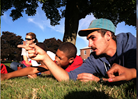
Motivating & engaging Youth in Informal stem Learning programs
Purpose: Share what we learned about the role of activity settings in engaging youth and apply that to your setting.
Notes:
Slide briefly shares the purpose of the professional development.

Slide 3
Motivation & Engagement Are States Not traits
WHY?
Notes:
Discuss what this means. [Note] People are motivated and engaged in some situations and not others – being motivated or engaged is dependent on the context. It’s valuable for activity leaders to learn how to plan and create contexts that are most likely to motivate and engage youth in the programs.

Slide 4
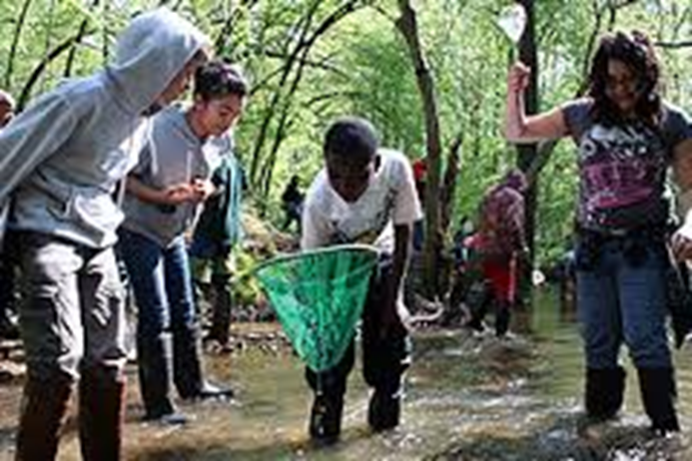
What Kind of Activities Engage You in Learning?
Think for 1 minute.
Discuss with partner for 2 minutes.
Share with group.
Notes:
Follow instructions on side of slide. As people share, note and then briefly reiterate what was said. [Ask:} What patterns do you and the participants notice in what was said?

Slide 5
What is An activity setting?
Activity Settings refer to the physical settings - the places where youth and staff spend time.
Activity Settings also refer to the type of activities in which youth participate.
Notes:
Can show this slide and move on (approximately 1 minute to introduce) or you can choose to prompt group discussion with these questions (recommended):
1. How do the youth with whom you work respond to different types of activities?
2. Do they prefer certain settings over others?

Slide 6
Physical Locations
Classroom
Indoors at Program
Outdoors at Program
Indoors at Community Space
Outdoors at Community Space
Vehicle
Activity Types
Not STEM focused,
Basic Skills,
Creating a Product,
Program Staff Led,
Field Trip Speaker,
Lab
Opportunities to Collaborate
Individual Work,
Small Group,
Whole Group
Definition of Activity Settings in
the STEM IE Study
Notes:
This slide presents how activity settings were coded in the STEM IE study

Slide 7
Why activity settings Matter in Informal Science learning Programs

Slide 8
Youth provided in-the-moment reports of engagement, challenge, learning, and relevance.
Video was coded for physical location of activity, type of activity, and opportunities to collaborate during 15 minutes prior to signal.
ALs were interviewed to gather their perspectives.
.
Research
Methods:
How the
STEM IE Project studied activity settings in ISL programs
Notes:
.

Slide 9
Time Spent By Location
Notes:
Print a copy of this page for each pair of participants. Ask participants to examine chart. Ask them to note the variation of time spent in the different locations across programs. The classroom space was the most utilized space overall. Zoology Partners and Island Explorers spent the most time outdoors in the community compared to other programs. Uptown Architecture stands out in their use of indoor community space and outdoor program space.

Slide 10
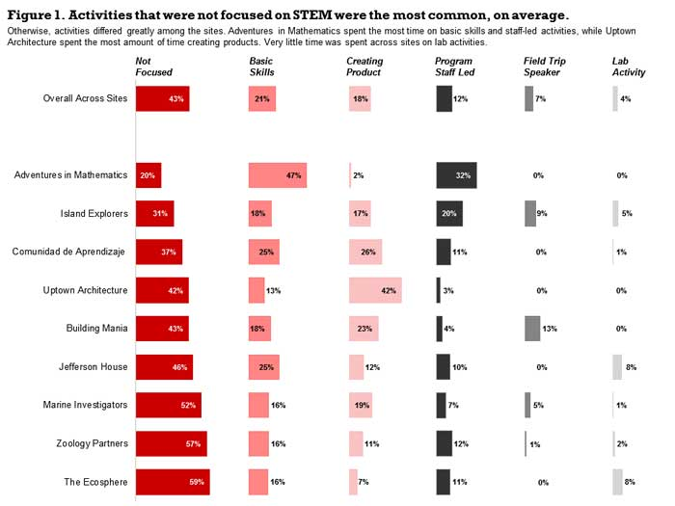
Activities During STEM Learning Time
Notes:
Print a copy of this page for each pair of participants. Ask participants to study the chart and discuss what they are seeing. The columns are the type of activity that was coded; the top row is the average across sites with remaining rows showing individual sites. Share observations with group. If any notice that youth were NOT focused on STEM content or activities 43 % of the time and that it was the most common use of time, on average., emphasize that. If they notice, ask questions: 1a. What was the most common activity, in general? 1b. How much time, on average was not focused? 1c. Does this surprises them? 1d. What are possible reasons and drawbacks?. 2. Unfocused time varied a lot across both programs & ALs. How did time use categories vary across programs?

Slide 11
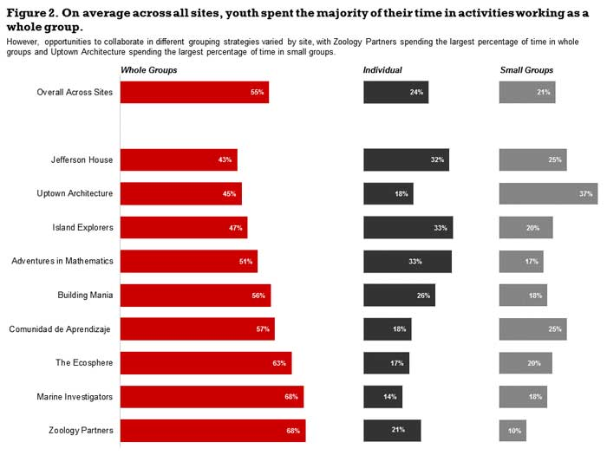
TIME SPENT BY OPPORTUNITIES TO COLLABORATE
Whole group Individual Small Group
Overall across sites
Notes:
Ask participants to study the chart and discuss what they are seeing. How much time was spent in each type of grouping? How did this vary by program? What are the advantages and disadvantages of these groupings? Do certain types of activities work better with one of these groupings?

Slide 12
Youth Experience was related to Activity Type
Creating a product stood out from all other activities. Youth were more engaged when they were creating products. They also reported greater challenge, relevance, and learning.
Youth reported substantially higher learning when they were doing basic skills activities than other activities. They perceived basic skills as relevant, but did not report being particularly challenged by basic skills activities.
Youth rated listening to a field trip (expert) speaker as more relevant than any other activity. This highlights the importance of engaging community partners in youth activities.
Notes:
Ask participants: Why was creating a product so well received? Has this been their experience with youth? Optional: Select, show, and talk about video most relevant to your program(s) from the list in the Facilitator’s Guide. Other Discussion Questions: Why do participants think doing basic skills was perceived as relevant to the youth? Is it a problem that they reported low challenge in that activity? Why or why not? How about field trip speakers? Why did youth think that was the most relevant activity they did?

Slide 13
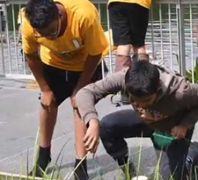
How Activity Leaders can enhance Activity Settings

Slide 14
Y
Collaborate with STEM-rich local agencies
Bring local experts into your program to help with projects.
Use local area
Expose Youth to
Community
Settings &
Experts
Notes:
Three options for exposing youth in your program to the type of experience which the youth in our study rated as the most relevant activity they did in their ISL STEM program are demonstrated by brief videos embedded in this slide.

Slide 15
Activity 1A: Plan Activities Youth Found Engaging
Creating a Product
Field Trips/Speakers
Review learning targets and content of program
Each person will brainstorm product(s) youth might create to learn or apply those targets.
Share and discuss ideas. Choose one or more to try with youth.
Review learning targets and content of program
Develop a list of places in the community that might exemplify or elaborate on learning. Consult the ETEAMS website & The Connectory for ideas
Share and discuss ideas. Choose one or more to try with youth.
Notes:
Divide group roughly in two. One half will work on planning an activity or activities in which youth create a product. The other half will work on planning field trips/speakers and related learning activities. They can use the STEM IE (www.niu.edu/stemie) webpage as a resource.

Slide 16
Activity 1b: Planning a Lesson
Plan an activity for your program identified during Activity 1A.
Go to the National Center for Afterschool Quality toolkit planning link. Click on the “Planning Your Lesson” tab. Read and consider the questions.
Access and complete the planning template
Notes:
Can be completed individually or in small group(s). Share after 15 – 20 minutes.

Slide 17
Maximizing Time use
Time Loss Situations
Solutions
Transitions (both within and between settings)
Youth finish at different times
Unprepared materials
Unclear directions
Assign riddles, games, discussions, field sample activities
2. Provide options for
individual work
3. Set up, organize in
advance, use helpers
4. Plan directions
carefully
Notes:
Emphasize: 43 % unfocused time was during the STEM learning time sessions and did NOT include scheduled breaks and other planned time for recreation and routines.
Add this information: Down time is not all bad, youth need time “off” but this is often provided in program scheduling of breaks. Youth do sometimes need time to reflect or “compile” what they have learned. Provide activity leaders with prepared games and discussion ideas appropriate to your activities.

Slide 18
Find, share & discuss concrete ways you can manage time loss given situations 1, 2, 3, and 4 in your particular program. Select a specific lesson and apply solutions for maximizing time use.
~10 minutes to find and
~ 5 minutes to share
Activity
Stemming
Time Loss
during
Transitions
Notes:
Ask participants for and be prepared to provide examples for things youth can do during transitions to continue learning and options for when youth finish at different time. Give them 5- 10 minutes to go to the time use section of How ALS can Maximize Youth Experience within Activity Settings on the STEM IE website and look for ideas to share from the time use section of that page. https://niu.edu/stemie/activity/als-maximize-youth.shtml

Slide 19
Opportunities to Collaborate
Cooperative work is part of STEM.
What is the value of working individually? In small groups? In whole groups? What does this mean for planning?
Notes:
View brief video of activity leader talking about cooperative groups Can have a large group discussion of this or have participants work in small groups or with a partner (person sitting next to them). Ask follow-up question about implications for planning activities

Slide 20
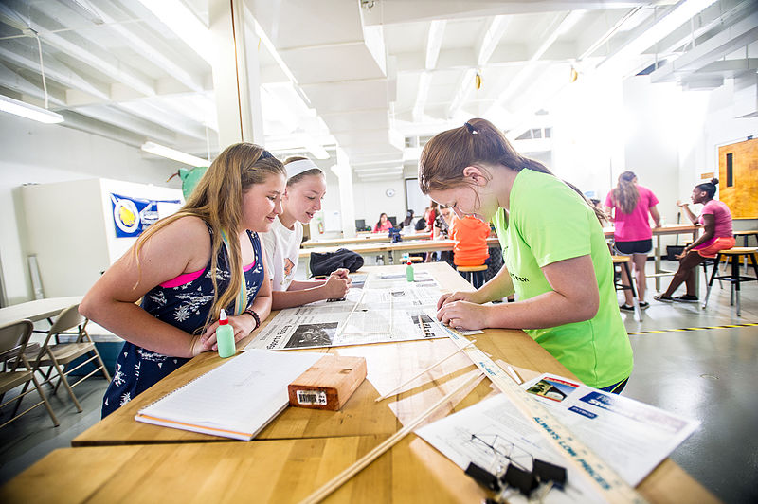
Collaboration in Action
Photo by: Texas A&M
View:
Encouraging Group Collaboration
See the Activity Unfold
How do the Activity Leaders promote collaboration?
Do you use or can you use any of the strategies you observed?
Notes:
Click on link that appears in the left side of the slide to watch a two minute video about encouraging group collaboration in STEM programs. Then click on the link and view the video on the right side of the screen. Ask participants the questions on the slide. (3-5 minutes). Consider the 2 minute video on slide 21 as either a substitute or an additional example. Optional: distribute the handout linked to Slide 20 in the facilitator’s guide & have them watch the video(s) looking for examples of whether and how the leader uses such language to facilitate youth collaboration.

Slide 21
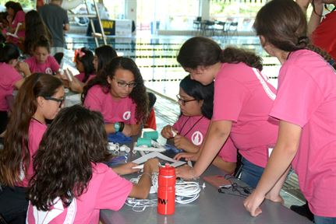
Collaboration in Action 2
View:
Modeling Effective Collaboration
Photo By: Burrell Parmer
Notes:
View the video (click link) to see another example.

Slide 22
View 1 Program & Another
Review Aspects of Activity Settings
Notes:
Discuss: How is time spent in these programs; what do youth do? What about location? Did youth have opportunities to collaborate? From what you can tell, what aspects of the activity setting do you think are engaging? Provide copy of slide 6 to participants.

Slide 23
Researchers from three institutions collaborated on designing and implementing the STEM IE Project.
The project was funded by the National Science Foundation’s Advancing Informal STEM Learning (AISL) program. The material contained in this guide is based upon work supported by the National Science Foundation under Grant No: DRL-1421198. Any opinions, findings, conclusions, or recommendations expressed in this material are those of the author(s) and do not reflect the views of the National Science Foundation

