Slide 1
Research Administration and Grants Management for Department Administrators
Session: 1
Introduction to Research Administration and Grants Management

Slide 2
Meet and Greet
Introductions
  How long have you been with NIU?
  What is your role with grants?
  What is one thing that you hope to learn from this program?
Notes:
Get to know each other a little bit – spending the next 6 weeks with each other.
Brief intro/background on research administration
Overview of SPA teams and what we do
Sponsored Programs Basics
Roles and Responsibilities for sponsored programs
Policy framework – our bread and butter

Slide 3
Brief Introduction to Research Administration

Slide 4
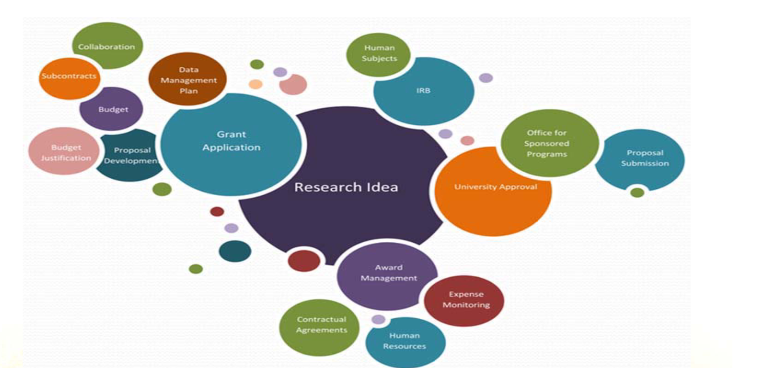
What is Research Administration?
Notes:
Spans many different areas and functions but all to support the research (included in the term research is also instruction, service creative programs)
Research administration may be tied to grant funding –but may not.
E.g., a faculty has internal or start up funding to conduct a study on whether virtual reality experiences can reduce stress – working with human subjects they still need to obtain IRB approval.

Slide 5
Why Research Administration
Enhance faculty success
Be good stewards of funding
Protect the institution and researchers
Notes:
Most funding taxpayer dollars, our money. And even if not, we have an obligation to do what we tell the sponsors we are going to do with their money.
Compliance but also trust.
When we are seen as trustworthy, sponsors are more inclined to continue funding us.
More flexibility in managing the award.
Compliance is at the heart of what we do
Grants to the institution, not the PI.
172% increase in new or significantly modified federal regulations governing research in last 10 years. That’s a lot for faculty to keep up on.
42% admin burden
Find a way to manage this environment without creating undue barriers to faculty research – let them focus on the research.
Long term competitiveness.

Slide 6
Lifecycle of a Sponsored Award
SPA Processes Begin
Find Funding and Proposal Development (ORD)
Guidelines and Budget Review
InfoEd Routing and Sponsor Submission
Award Negotiation and Acceptance
Award Set Up and Subaward Issuance
Safety and Research Compliance
Amendments and Budget Revisions
Cost Share and Effort Reporting
Billing & Reporting
Compliance and Award Close Out
Auditing
Grants management is a long game that spans many years and begins at pre-award
Notes:
A lot under the hood of a sponsored award
All in the lifecycle of a funded project spans anywhere from 3 to 10-15 years when we consider that potential for audit and oversight even after the award ends
Audit starts pre-award – why there has been a shift in pre-award emphasis and structure for proposal support in the last few years.
ORD office

Slide 7
A Language of Its Own
Research Administration has its own set of acronyms and jargon. If we ever use any without defining them, please always stop us and ask for clarification.
Link to Common Acronyms
https://osp.msu.edu/PL/Portal/946/AcronymsinResearchAdministration
(Source: Michigan State University)
Link to Glossary of Commonly Used Terms
https://www.niu.edu/spa/_pdf/spa-terms-and-definitions.pdf

Slide 8
Sponsored Awards

Slide 9
5 Year Amounts by Source

Slide 10
Sponsored Expenditures

Slide 11
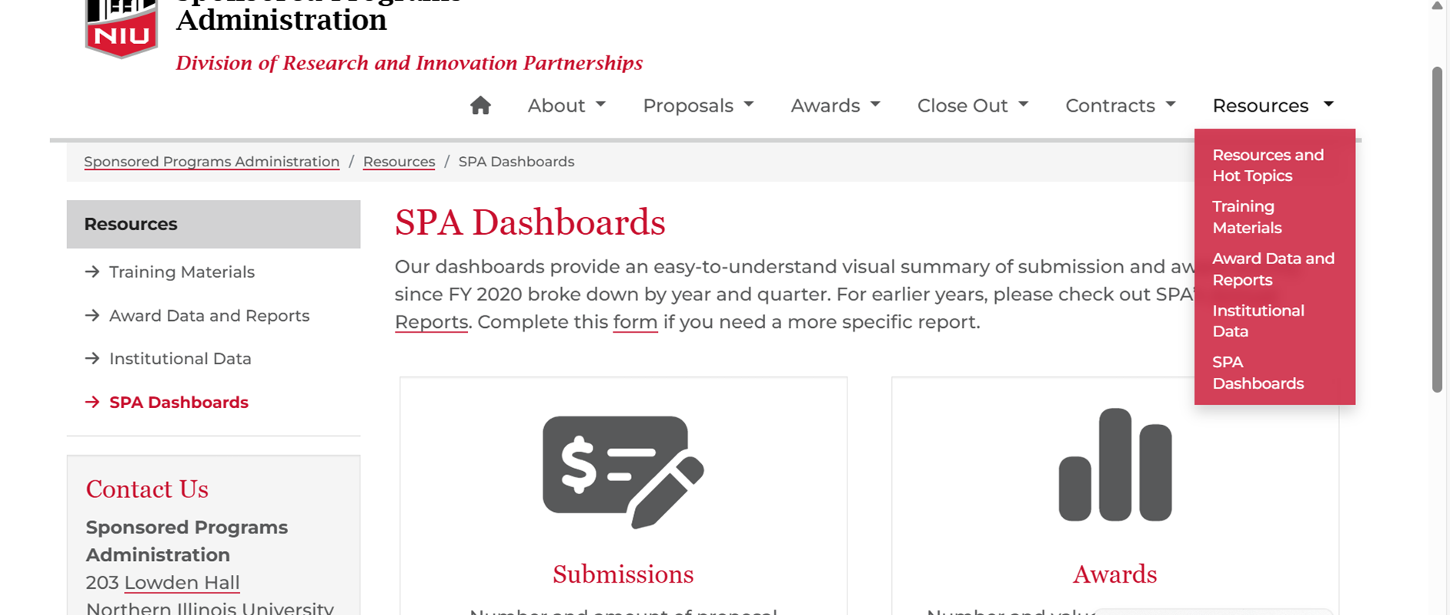
SPA Dashboards

Slide 12
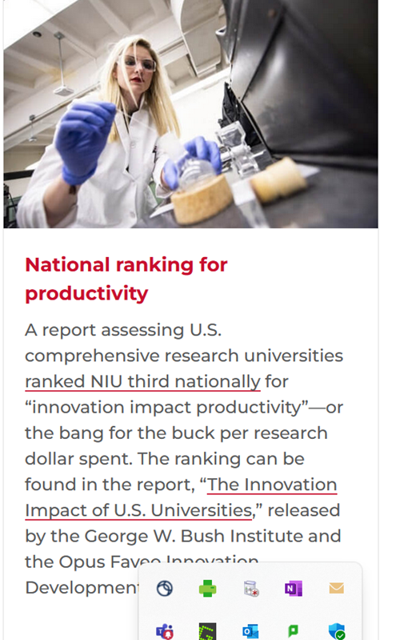
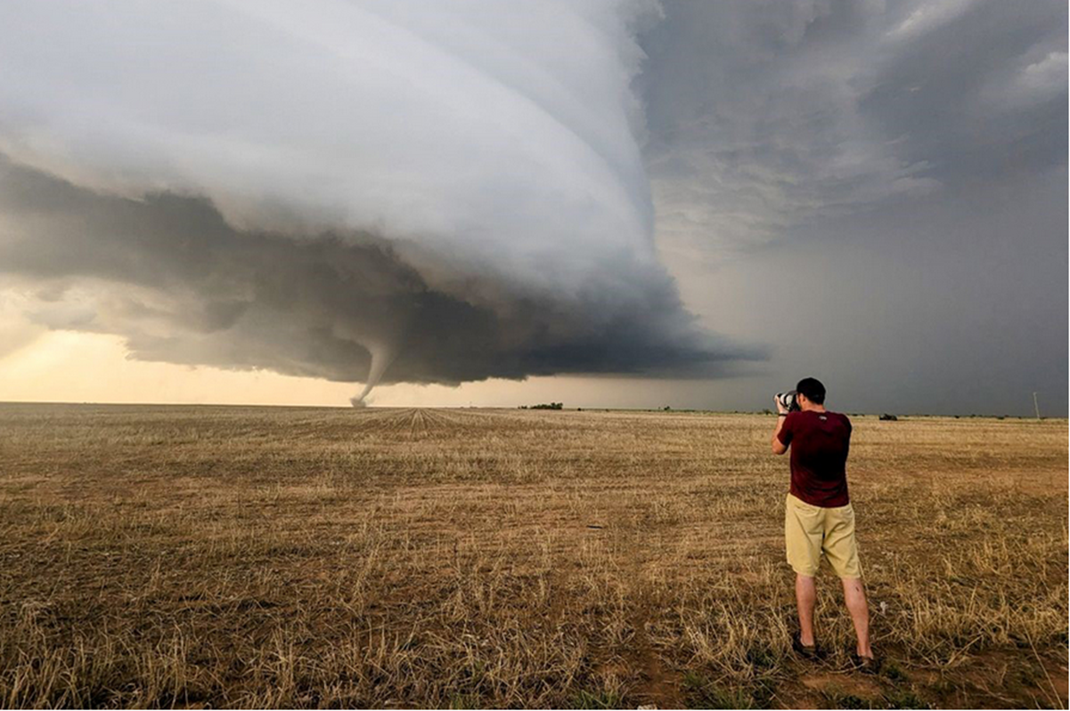



Why Administrative Support Matters
Notes:
Brain to Brain Interface -the ability to communicate with someone else simply by thinking—no speaking or physical gesture. This research could lead to important breakthroughs, like helping doctors communicate with patients who can’t speak or move, helping people recover after a stroke, or even creating new ways for healthy people to share ideas quickly.
Team at Northern Illinois University in Dekalb is helping lead a research study to change that.
A group of 100 scientists, including professors and students from NIU and several other universities, will chase hailstorms next spring with the goal of advancing hail forecasting.
Project flex program operates in three state facilities and has a team of graduate students, alumni, and researchers who are dedicated to using sports as a way to make a positive impact on the lives of incarcerated youth.

Slide 13
SPA Teams

Slide 14

Pre-Award
Team Lead: Maria (Rai) Nihei
Provide budget rates and calculations for proposals
Confirm non-technical proposal components meet administrative requirements
Provide final administrative review of proposals
Submit proposals as the NIU Authorized Organization Representative
Record proposals in InfoEd, NIU’s grant tracking system
Review and submit sponsor information requests prior to award

Slide 15

Award Acceptance and Contracts
Team Lead: Sarah Senechalle
Review grant and contract award terms and conditions
Address problematic terms and conditions
Negotiate sponsored contracts
Accept grant and contract awards as the NIU Authorized
Organization Representative
Record awards in InfoEd
Approve and submit progress reports
Review and approve nonfinancial award changes
Prepare and execute subaward agreements
Notes:
Reminder again that awards are made to the institution, not the faculty or department. SPA has been delegated signature authority from the BOT and President to enter into these agreements. This includes signing proposals.

Slide 16

Post Award
Team Lead: Katie Mowers
Set up awards in NIU financial system (PeopleSoft)
Monitor and approve grant expenses including payroll
Monitor subaward agreements
Financial reporting
Cash management (e.g., invoicing, drawdowns)
Calculate and distribute indirect cost recovery
Time and effort reporting
Monitor and calculate cost share
Audits
Notes:
Notify SPA if you or any of your faculty are contacted by auditors or their sponsor to do a program review..
Internal audits – yearly
Single audit

Slide 17
What are Sponsored Projects?
Projects and/or activities that are conducted by NIU faculty and staff members and supported by external funds awarded to NIU.
Sponsored projects are classified by program type:
  Research
  Instruction
  Public Service
Funding can take multiple forms – e.g., grant, contract, cooperative agreement, purchase order, etc.
This is VERY important!
Notes:
Instruction
Any project for which the purpose is to instruct any student at any location and can include NIU students or staff, teachers or students in elementary or secondary schools, or the general public.
Curriculum development projects at any level, including projects that involve the evaluation of curriculum or teaching methods.
Programs involving NIU students in community service activities for which they are receiving academic credit.
General support for the writing of textbooks or references books, video or software to be used as instructional materials.
Research
All research and development activities that are sponsored by Federal and non-Federal agencies and organizations including the training of individuals in research techniques (commonly called research training) where such activities utilize the same facilities as other research and development activities. The definition does not include sales and service or testing activities.
A systematic study directed toward the fuller knowledge or understanding of the fundamental aspects of phenomena and of observable facts without specific applications towards processes or products in mind.
A systematic study to gain knowledge or understanding necessary to determine the means by which a recognized need may be met or to apply knowledge towards the production of useful materials, devices and systems or methods.
Dissemination of project findings to advance the knowledge and understanding of a particular phenomenon, field or program. This includes support for the writing of books or conferences when the purpose is to publish research results.
External funding to maintain research facilities or incur the purchase of research equipment.
Activities intended to promote the active participation in research projects and train individuals in research techniques or methods.
OSA
Programs and projects sponsored by Federal and non-Federal agencies and organizations which involve the performance of work other than instruction and organized research.
Other Sponsored Activities/Public Service include (but are not limited to):
Public service programs designed to make available to the public the various unique resources and capabilities of the institution for the specific purpose of responding to a community need or solving a community problem.
Student support programs designed to enhance the emotional and physical well-being of NIU students as well as to their intellectual, cultural, and social development outside of the context of the institution’s formal instruction and research activities.
Testing and evaluation activities that are conducted for the primary benefit of the sponsor that do not meet the definition of research.*
Personnel agreements supporting the joint hiring and salary support of NIU faculty and staff (e.g. Joint appointment agreements with Argonne National Lab and Fermilab).
Workshop and travel grants that do not meet the definition of research.

Slide 18
Sponsored Programs Basics

Slide 19
Various Funding Streams/Activities
Sponsored Programs
Outside Activities/Consulting
Sales and Service
Gifts
NIU Foundation
Sponsored Programs Administration
Controller’s Office
Provost’s Office

Slide 20
Gift or Sponsored Project
GIFT/PHILANTHROPIC GRANT | SPONSORED PROJECTS
Source of Funds
Individuals, Foundations, Non-Profit Organizations, Corporations, Corporate Foundations, Donor Advised Funds | Government Agencies, Research Foundations, Non-Profit Organizations, Corporations, Corporate Foundations, Other Universities
Purpose
The donor may provide support for a particular activity, program area or purpose. These can include outreach programs, professorships, scholarships, non-federal capital projects, research and instructional programs. | Sponsor requires specific research or program plan and/or deliverables that benefit the sponsor (e.g., final technical report, evaluation, grant progress reports, financial reports, data and data sets).
Reporting
The donor may require or request a broad summary or stewardship report of the results from the participant. | The sponsor requires reporting for specific award activities that often includes progress, budget, inventory, and patent or invention reports.
Deliverables
Deliverables for gifts/philanthropic grants should be charitable in nature and not benefit the funder. Examples include: grant stewardship report which can include research reports, marketing/visibility, and philanthropic engagement opportunities. | Deliverables for sponsored projects are not charitable in nature and benefit the funder/sponsor. Examples include: grant progress reports, financial progress reports, data and data sets.
Notes:
Gifts can also be for research, instructional programs etc.
Program directed gifts
What we evaluate in determing when something is a gift or sponsored project is who ultimately benefits from the exchange and certain criteria helps us make these determinations. Which we need to do in order for the university financials to be presented accurately.
Reporting
Deliverables – funding contingent on deliverable ie progress report
Return of funds, rebudgeting
IP ownership

Slide 21
Continued
Budgeting
Budgeting is general in nature and terms, and funder pre‐approvals are not required as long as funds are used for the stated purpose. | Budgets are specific, and variances from proposed budgets (within designated parameters such as percentage between line items) may require sponsor prior approval.
Unused Funds
Generally very difficult for donor to recoup, except in cases of deliberate, proven use of restricted funds inconsistent with terms of a restricted gift. Penalties for non-performance are per the terms in the gift agreement. | The sponsor requires return of unexpended funds or written approval to spend beyond the project period, or retain final balances.
Value Exchange & Intellectual Property
The donor receives no or nominal value in exchange for the funding provided other than recognition. The donor makes no claims on the patents, copyrights and other intellectual property rights that may result from activities associated with the gift. | The sponsor may impose restrictions on intellectual property rights, such as prior review of publications or use of results. The sponsor may have certain rights to intellectual property and works created under the award.
Funding Documentation
Gift or philanthropic grant agreement, donor acknowledgement letter, and/or tax receipts to the donor. | Notice of Award and/or grant or contract agreement.
Performance Period Terms
Per terms in philanthropic grant application and/or the gift/philanthropic grant agreement. | Typically requires a specific time period for conducting projects.
University Process
Managed through NIU Foundation or NIU Research Foundation. | Managed through Sponsored Programs Administration.
Notes:
Gifts can also be for research, instructional programs etc.
Program directed gifts
What we evaluate in determing when something is a gift or sponsored project is who ultimately benefits from the exchange and certain criteria helps us make these determinations. Which we need to do in order for the university financials to be presented accurately.
Reporting
Deliverables – funding contingent on deliverable ie progress report
Return of funds, rebudgeting
IP ownership
Sometimes clear at pre-award and sometimes not. Do our best to make the right judgement call at pre award and working with the Foundation to direct the request appropriately.

Slide 22
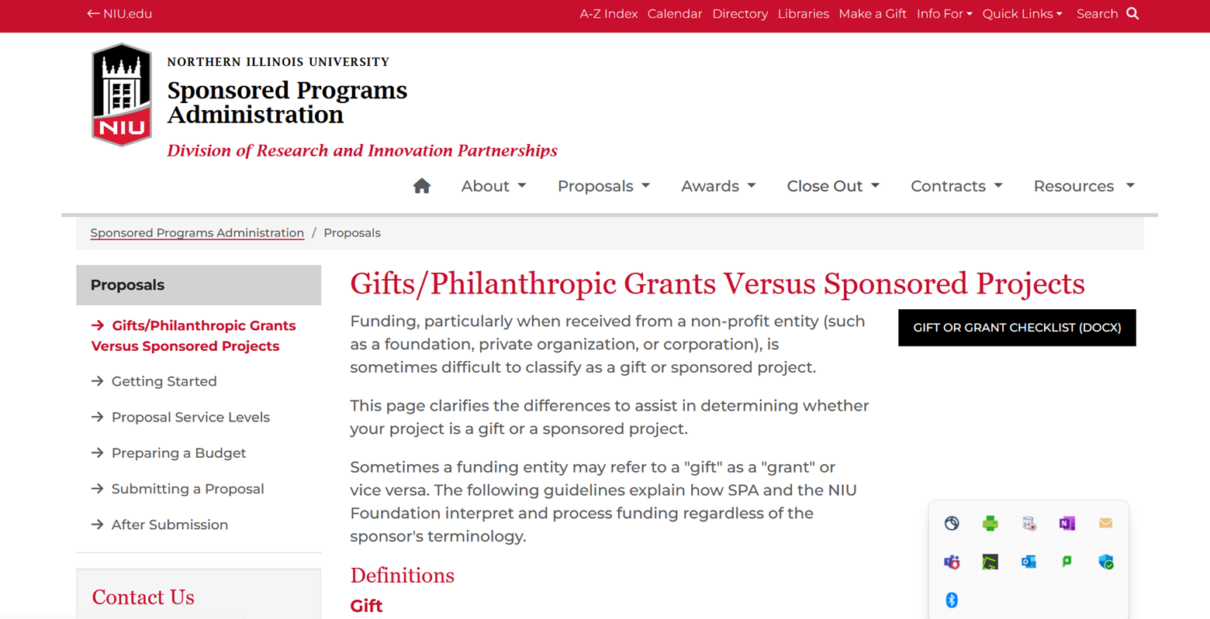
Gift or Sponsored Project

Slide 23
Key Roles in Research
Principal investigator
Department/Unit
College/Division
Central Administration
Sponsor
Notes:
A lot of stakeholders in ensuring faculty success for sponsored funding and managing all the rules that govern these funds.
Focus on the primary roles

Slide 24
Principal Investigator/Project Director
The individual designated to direct the project both scientifically/programmatically and administratively
The individual serving as PI must have access to university resources needed to conduct the project
Tenured and tenured-track faculty and research faculty automatically have PI status. Others may serve with Department/College approval. Non-NIU employees requires VPR approval.

Slide 25
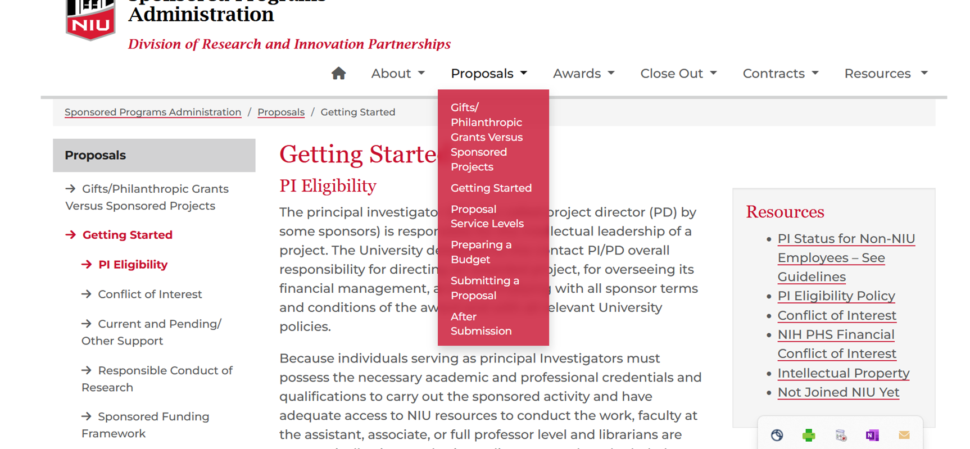
Getting Started

Slide 26
Role of the Principal Investigator
Project Leadership
Proposal Preparation
Compliance
Financial Management
Reporting
Team Coordination
Data Management
Dissemination
Ethical Conduct
Notes:
**Project Leadership**: Direct and oversee the research project, ensuring it aligns with the grant's objectives
**Proposal Preparation**: Develop and submit grant proposals, including detailed research plans, budgets, and timelines
**Compliance**: Ensure the project complies with all applicable laws, regulations, and institutional policies
**Financial Management**: Manage the grant budget, including tracking expenditures and ensuring funds are used appropriately
- **Reporting**: Prepare and submit all required progress and final reports to the funding agency
- **Team Coordination**: Lead and coordinate the research team, assigning tasks
- **Data Management**: Ensure proper collection, storage, and analysis of research data
- **Dissemination**: Publish and present research findings to the scientific community and other stakeholders
- **Ethical Conduct**: Uphold ethical standards in research, including obtaining necessary approvals and informed consent

Slide 27
Role of College/Department
Mentorship
Resource Allocation
Conflict Resolution
Workload and Effort
Compliance

Slide 28
Role of Sponsored Programs
Provide institutional leadership and support for management sponsored programs through advising and training
Assist PIs in the preparation of nontechnical proposals components (especially budgets!)
Facilitate institutional review of proposals
Sign and submit proposals on behalf of NIU
Negotiate, accept and sign award agreements on behalf of NIU
Oversee effort reporting and other non-financial compliance actions
Calculate and distribute indirect revenue
Authorize expenditures for allowability
Monitor charges recorded in PeopleSoft Financial Management System (FMS)
Draw down funds and invoicing
Complete and submit periodic financial reports
Issue and monitor subaward agreements
Maintain InfoEd and other agency systems necessary for the submission and/or receipt of external funding
Represent SPA in all audits of sponsored awards and agency site visits

Slide 29
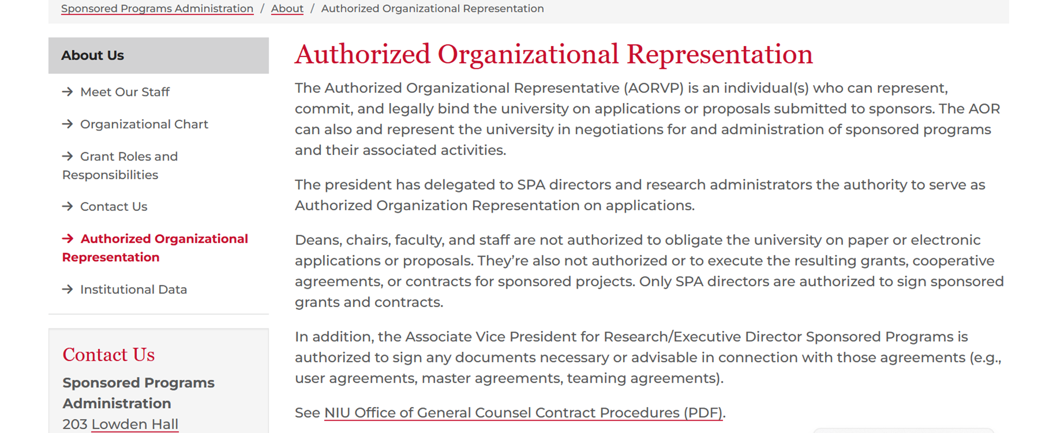
Authorized Organizational Representative
Notes:
Only very roles have the authority to bind the institution
Proposals and awards are contracts between NIU and external sponsors
SPA delegated authority from the BOT and President

Slide 30
Shared Responsibility
We are all a team in the lifecycle process. Communication is key.
For more info: SPA Roles and Responsibilities Matrix
Notes:
But it is a shared responsibility
Awards are to the institution

Slide 31

Policy Framework

Slide 32
“It Depends”
Award
Agency Policy and Terms and Conditions – Including Research Terms and Conditions
Federal Regulations/Uniform Guidance (UG)/Federal Acquisition Regulations (FAR)
Program Announcements
Public Laws
University Policies
Notes:
Review framework
We are really not trying to be difficult nor are we ignoring you when it takes a while to answer a question or we give you the ‘it depends’.
It may also mean we can encounter new information that may require us to take a different look at something that we previously did.
172% increase in 10 years
University policy - consistency

Slide 33
False Claims Act (FCA)
What Is It?
Established during the Civil War to combat fraud against the government
Allows whistleblowers to report fraudulent activities (qui tam suits)
Why It Is Important:
As grantees, we attest to the government that our organizations can comply with all terms and conditions of the award
There does not need to be an intent to defraud the government
How It Can Cost Us:
Damages (Including treble damages)
Penalties
Institutional Reputation
Increased Administrative Burden

Slide 34
Uniform Guidance Breakdown
Subpart A – Acronyms and Definitions
Subpart B General Provisions
Subpart C Pre-Award Federal Requirements
Subpart D Post-Federal Award Requirements
Subpart E Cost Principles
Subpart F Audit Requirements
Appendices and FAQs

Slide 35
Subpart C: Pre-Award
Grantee Risk Evaluation
Notice of Funding Opportunity (NOFO) Details
Notice of Award (NOA) Details
Suspension and Debarment
Notes:
States how the federal agencies must announce funding opportunities and the information they are required to include
Funding opportunities should be available 60 calendar days before the deadline – but agencies can reduce this to 30 when determined by the agency head.
Federal award info
Eligibilty
Review criteria
Terms and Conditions
Notice of Award Details – next page
Suspension and Debarrment
Suspension - A disqualification from government contracting and subcontracting for a temporary period of time because a company or individual is suspected of engaging in criminal, fraudulent, or seriously improper conduct. Suspension is to be used on an interim basis pending debarment proceedings.
Debarment - An exclusion from government contracting and subcontracting for a reasonable, specified period of time because an individual or vendor failed to perform, or their performance was inadequate
NIU Principal Investigators and Co-Principal Investigators
Consultants and contracts (Contractors) >$25k
All subrecipients
SPA staff working with proposals and awards
Pre-Award Certification

Slide 36
Notice of Award Details
Recipient name (which must match the name associated with its unique entity identifier as defined at 2 CFR 25.315);
(2) Recipient's unique entity identifier;
(3) Unique Federal Award Identification Number (FAIN);
(4) Federal Award Date (see Federal award date in § 200.201);
(5) Period of Performance Start and End Date;
(6) Budget Period Start and End Date;
(7) Amount of Federal Funds Obligated by this action;
(8) Total Amount of Federal Funds Obligated;
(9) Total Approved Cost Sharing or Matching, where applicable;
Total Amount of the Federal Award including approved Cost Sharing or Matching;
(11) Budget Approved by the Federal Awarding Agency;
(11) Federal award description, (to comply with statutory requirements (e.g., FFATA));
(12) Name of Federal awarding agency and contact information for awarding official,
(13) Assistance Listings Number and Title;
(14) Identification of whether the award is R&D; and
(15) Indirect cost rate for the Federal award (including if the de minimis rate is charged per § 200.414).
Agency Terms and Conditions

Slide 37
Subpart E Cost Principles
1. Allowable | 2. Reasonable | 3. Allocable | 4. Consistently Applied
Necessary and reasonable for the conduct of the award. | Does not exceed that which would be incurred by a prudent person under the circumstances prevailing at the time the decision was made to incur the cost. | Is incurred for the specific benefit award. | Is routinely budgeted as a direct cost or an indirect cost (“like circumstances” test)
In accordance with provisions of 2 CFR and the terms of the award. | Is necessary for proper and efficient performance of the award. | Can reasonably be distributed in proportions based on benefit to the award and other NIU activities. | Is consistent with the policies and procedures of your organization for both federally-financed and non-federally financed activities.
Adequately documented. | Is in-line with market prices. | Is not used to overcome fund deficiencies, to avoid restrictions imposed by Federal statutes, regulations or terms of the award or for convenience.
 |  | When benefitting two or more projects, can be distributed to each without undue burden.
Notes:
Nature of the work, unique situation, or programmatic purpose creates an unlike circumstance.
The cost must be specifically associated with the sponsored project with a high degree of accuracy.
The cost must meet all general criteria for be charged to a sponsored award (i.e., allowable, reasonable, allocable and properly documented)
Overcome deficiencies, convenience
This is why put so much emphasis on documenting cost transfers
Like and unlike circumstances – Military services grant to outfit a learning space for veteran students. Purchases of general office equipment likes desks and chairs.
Also where SPA can help to make sure these costs are 1) appropriate and 2) adequately documented in the budget justification.

Slide 38

Example of Common Direct Cost & Indirect Cost
Salaries and Wages for Project Staff Effort
Fringe Benefits
Human Subject Payments
Travel to Disseminate Results
Department Administration
Sponsored Programs Administration
Lab Utilities
Library Costs/Journal Subscriptions
Computing
Institutional Research Board
Environmental Health/Hazardous Waste
IT Services
Notes:
Research project that investigates the effects of a new cognitive-behavioral therapy (CBT) program on reducing anxiety in adults. This project would involve human subjects who participate in the therapy sessions and complete various assessments.

Slide 39
Direct V. Indirect Costs
Direct Costs | Indirect Costs
Salaries, Wages and Fringe Benefits | Department Administration
Project Supplies | Sponsored Programs
Travel | General Subscriptions
Specialized Equipment | Office Supplies
Participant Support | General Purpose Equipment
Human Subject Payments | University Facilities
Vendor/Professional Services | Library
Subawards | Utilities
Notes:
A participant is defined as a non-NIU employee who is the recipient, not the provider, of a training associated with a workshop, conference, seminar, symposium, or other short-term instructional or information sharing activity. Participants are not required to provide any deliverable to NIU, and they are not subject to NIU human resources policies (e.g., they cannot be terminated for failure to perform). Participants may include students, scholars, and scientists from other institutions, representatives of private sector companies, teachers, and state or local government agency personnel.
Stipends
Travel
Subsistence
Fees
Not Human Subjects

Slide 40
Indirect Costs Explained a Bit Further…
https://www.youtube.com/watch?v=V_glHzUE8qM
Notes:
Our effective rate

Slide 41
Indirect Costs @ NIU
Indirect costs are based on NIU’s federally negotiated indirect cost rate agreement (NICRA) with the Federal Government or other rate allowed by sponsor.
  52% - On campus research and instruction rate
  37% - On campus other sponsored activity rate (e.g., service projects)
  26 % - All off-campus projects
Indirect costs for departments and centers are distributed to the college – with the college distributing internally to local units.
  10% College
  10% Department
  5% PI
  15 % Research Centers (when applicable)
Indirect recovery is driven by good direct charging practices:
Until expenses post to the grant account, NIU cannot recover indirect costs!
Notes:
Our effective rate 14%

Slide 42
Subpart D Post Award Requirements
Financial Management & Internal Controls
Federal Payment
Cost Sharing
Revisions to Budget and Program Plans
Performance and Financial Reporting
Subrecipient Monitoring
Close Out
Notes:
Adequete control environment to make sure that our financial system and records can identify the source and application of funds of federally funded activities.
(4) Effective control over, and accountability for, all funds, property, and other assets. The non-Federal entity must adequately safeguard all assets and assure that they are used solely for authorized purposes. See § 200.303.
(5) Comparison of expenditures with budget amounts for each Federal award.
(6) Written procedures to implement the requirements of § 200.305.
(7) Written procedures for determining the allowability of costs in accordance with subpart E of this part and the terms and conditions of the Federal award.
Federal payment – cost reimburseable
Subrecipient monitoring – ballooned in new requirements in the last 5-10 years
Revisions to Budget and Program Plans

Slide 43
Cost Share
The portion of costs necessary to conduct the project that are not borne by the sponsor.
3 types of cost share:
  Mandatory – required by the sponsor as a condition of receiving an award.
  Voluntary Committed – cost share that is not required by the sponsor but is a financial commitment quantified in the proposal budget or narrative.
  Voluntary Uncommitted – effort provided to the project that is above and beyond that which is quantified in the proposal budget or narrative.
Per UG, NIU must document that mandatory and voluntary committed cost share commitments were met.
Documentation may be provided directly to the sponsor or requested by auditors.
Failure to meet cost share commitments can result in repayment of funds to the sponsor and audit findings to the university.
The same rules apply to cost share as to grant funding.
Notes:
Rai Carrie will go into this more from the pre and post standpoint but just want to call this out early.

Slide 44
Compensation/Payroll
Salaries charged to grants must be proportionate with the level of effort required to perform the work. This is validated as part of NIU’s Effort Reporting process.
Salaries are budgeted based on the individual’s NIU Institutional Base Salary (IBS).
IBS is the annual compensation set by NIU for the employee’s regular appointment regardless of whether the person’s time is spent on research, instruction, service or other activities.
Most faculty charge academic year (AY) effort and/or summer (SU) effort to a grant.
All effort charged to a grant must be based on the IBS.
  AY: (9 mo. IBS * % effort = salary to grant)
  SU: (3 mo. @ 9 mo. IBS * effort = salary to grant)
  CY (12 mo. IBS * % effort = salary to grant)
Under no circumstances can an individual’s time exceed 100% for all university duties – including sponsored activities. 100% time does not = 40 hrs. a week!
Notes:
Salary and fringes are the largest expense on grants, which also means they are the most scrutinized.
Donna and Rai will cover this more for budgeting and Carrie with post for effort reporting but getting these main concepts out

Slide 45
Top Considerations for Departments
Compensation
Effort Reporting
Cost Transfers
Cost Share
And it all STARTS at Pre-Award

Slide 46

Questions

