Slide 1
Pre-Award Proposals and Just-in-Time
Getting the Proposal to Review so
YOUR RESEARCH Can SHINE

Slide 2
Introduction
General Topics:
Proposal Submission Deadlines and Timelines
Budgeting for your proposal
Institutional Review Process
Navigating Critical Proposal Information in InfoEd
After Submission

Slide 3
Quick notes on InfoEd proposals
Confidentiality of proposal
PI's intellectual property

Slide 4

Section 1
Deadlines and Timelines

Slide 5
Proposal to Award Timeline
D -3 months: PI Works with Research Development Office
D + 3-9 months: PO Communicates award to PI and/or SPA
Award goes to post-award team
Ready, Set, Go!
D -2 weeks: Internal Routing
D -1 day: Proposal submitted to sponsor
Research
D -1 month: PI completes proposal intake form
D -1 week: Final documents submitted for compliance review
Proposal is review by the sponsor, review panels, congress approves funding levels, etc.
Award/Contract is negotiated
Subawards are set up
IRB/IACUC & research training is completed if needed

Slide 6

Proposal Deadlines – 30+ days
Full Assistance, at least 30 days before the deadline
Review guidelines, eligibility, requirements
Provide tailored submission checklist
Draft budget and provide Current & Pending reports
Prepare Tuition or F&A waiver requests
Assist with cost share budgeting as required
Review documents for compliance with requirements
Upload documents into sponsor system
Coordinate subaward documents
Initiate Institutional Routing
Submit the proposal on time

Slide 7
Proposal Deadlines – 15-30 days
Full Review, 15-30 business days before the deadline
Review guidelines, eligibility, requirements
Provide tailored submission checklist
Draft Review budget and provide Current & Pending
Prepare Tuition or F&A waiver requests
Assist with cost share budgeting as required
Review documents for compliance with requirements
Upload documents into sponsor system
Coordinate subaward documents
Initiate Institutional Routing
Submit the proposal on time

Slide 8
Proposal Deadlines – 6-15 days
Limited Review, 6-15 business days before the deadline
Review guidelines, eligibility, requirements
Provide tailored submission checklist
Draft Review budget and provide Current & Pending
Prepare Tuition or F&A waiver requests
Assist with cost share budgeting as required
Review documents for compliance with requirements
Upload documents into sponsor system
Coordinate subaward documents
Initiate Institutional Routing
Submit the proposal on time

Slide 9
Proposal Deadlines – 5 or less days
Limited Review, 5 or less business days before the deadline
Review guidelines, eligibility, requirements
Provide tailored submission checklist
Draft Review budget and provide Current & Pending
Prepare Tuition or F&A waiver requests
Assist with cost share budgeting as required
Review documents for compliance with requirements
Upload documents into sponsor system
Coordinate subaward documents
Initiate Institutional Routing Record in InfoEd
Might Submit the proposal on time
If awarded we will review and rebudget as needed

Slide 10
Proposal Deadlines – few than 5 business days
Proposals received ≤15 business days before deadline
  Assistant Director determines if SPA can submit and the level of support & review provided.
Proposals received ≤5 business days before the deadline
  referred to AVP & Assoc. Dean or Division Head. Investigators may contact the AVP & Associate to discuss
  evaluate the proposal, determine if it should proceed.
  Marked “high risk” proposals, no compliance review.
SPA will not assist or submit proposals received less than two business days before deadline.
  Any exceptions must be approved by the Vice President for Research and Innovation Partnerships (VPR).
Deadline | Referred to | Status
≤15 days | Assistant Director, Pre-Award
≤5 days | Associate Vice President for Research/Exec Dir SPA Associate Dean or Div Head | At-risk
≤2 days | Vice President for Research and Innovation Partnership | At-risk
Link: Proposal Service Levels | Sponsored Programs Administration | Northern Illinois University (niu.edu)

Slide 11
Proposal Submission Deadlines
Note: Pre-Award work is uneven, often unexpectedly so. Sometimes we have many proposals in one week. Sometimes we have more time to dedicate to individual proposals. Priority is given to those meeting internal deadlines.
Plan ahead for major sponsor deadlines – like NIH R15/R16/R21/R01, NSF MRI, DOE deadlines, IIN

Slide 12
Proposal Timelines
30 business days before deadline– Notice of Intent to Submit
10 business days before deadline – Internal Review Process
5 business days before deadline – Final Documents received by SPA
Proposal Coordinator will work with PI to create additional internal deadlines as required. Cost share approval may require additional time, for example.
When planning, expect to propose project dates 9 to 12 months later
  Some things move more quickly from receipt of proposal to awarding a request.
Administrative Review and Approval for Proposals | Policy Library | Northern Illinois University (niu.edu)

Slide 13
Keep in Mind…
A proposal budget is always a best estimate, given the information we have right now, of the total project/sponsor costs
Your proposal coordinators are well-trained to know and translate sponsor guidelines and NIU policy. They are your guide, trust them.
Quality of budgeting and review based on the time we have between intake and submission

Slide 14

Section 2
Request for Proposal (RFP) and Contents of a Proposal

Slide 15
Important Elements in an RFP
Funding Sources
Pre-Proposal/Letter of Intent
Deadlines
Eligibility
Limited Submission
Budget or Time limits
Cost share requirements

Slide 16

What is a proposal?
A grant proposal is a request for funding an organization submits to grant-making bodies. In grant proposals, the university presents an initiative, explain its objectives, timeline, and importance.
SPA processes both grant and contract proposals.
Contracts are often used for providing specific services that benefit the funder.
https://www.niaid.nih.gov/grants-contracts/sample-applications

Slide 17
So I want to submit a proposal…
Complete the Proposal Intake Form
Sponsored Programs Administration Proposal Intake Form (qualtrics.com)

Slide 18
Common Parts of a Proposal
Abstract / Executive Summary – What’s the big picture?
Narrative / Project Descriptions – What’s the idea, how will our plan make a difference or make things different, who will benefit?
References -- On whose work are we building?
Facilities, Equipment & Resources -- Do we have the needed tools/resources/capacity?

Slide 19
Common Parts of a Proposal
Dissemination of Research – How is data being protected and how will results be distributed?
Research Compliance – is there adequate protection of animals or human subjects and other scientific safety protocols needed?
Subrecipient documents – Additional expertise needed for the project

Slide 20
Common Parts of a Proposal
Budget -- How much will it cost?
Budget Justification -- Why do you need the money? How do you know?
Letter of Support – when allowed may provide access or commit resources

Slide 21
Common Parts of a Proposal
Personnel -- Who will do the work? Are they qualified?
CV or Biographical Sketch (Biosketch) – Evidence of qualifications of key personnel
Current & Pending Support – Do the senior personnel have time for this project? What are their current awards and other pending support? Are they already doing this same project for other sponsors?
Other Sponsor Specific Documents

Slide 22

Section 3
The Budget and Budget Justification

Slide 23
Budget and Budget Justification
Common Categories
  Senior Personnel
  Other Personnel
  Equipment
  Travel
  Participant Support Costs
  Materials & Supplies
  Publication Costs
  Subawards
  Tuition Remission
  Indirect Costs
Budget Justification/
Budget Narrative
This document is used to describe how budget values are calculated and why the costs are important and allocable to the project.

Slide 24
Allowable Costs
Permitted by the sponsor and NIU policy
Incurred solely to support the proposed project and are necessary for its completion.
Cost allocation: When a cost benefits more than one project or activity.
Able to withstand public scrutiny, i.e., would someone not affiliated with the university find the cost reasonable and appropriate?
Applied consistently as a direct or indirect cost.

Slide 25
Things not generally allowable…
Check the funding announcement
Religious or Political activities
Food and Entertainment
Alcohol

Slide 26
Be careful how you manage funds…
Purchasing unallowable items or not accurately reporting spending can result in fines, being temporarily or permanently barred from seeking federal funding or even imprisonment.

Slide 27
Key Personnel
Think about how much and when time is required
  E.g. time monitoring student researchers, gathering data, writing and presenting findings
  Budget as Summer, Academic Year (AY), or calendar
Contracts often have dedicated research time
Time should be budgeted when it is needed and appropriate
Top out at 95% of summer (2.85 months)
Additional pay is rarely allowed

Slide 28
Sr. Personnel Effort Calculations
A “person month” is the metric for expressing the effort (amount of time) personnel devote to a specific project.
To calculate:
25% of a 9 mo academic year | 10% of a 12 mo calendar appt | 35% of a 3 mo summer term | 10% of a 0.5 FTE 12 mo appt
9 x 0.25= 2.25 | 12 x 0.10 = 1.2 | 3 x 0.35= 1.05 | 12 x .5 X .1 = 0.6

Slide 29
Budgeting Effort
AY effort is generally budgeted as a course release, but may also be “release time”
  the grant pays the department for the person to be released from certain duties, someone else is employed to do those instead
Course Releases:
  15% of salary in the CLAS, max $15K plus benefits
  10% of salary in HHS plus benefits
  12.5% of salary CEET, COE, COB, Law, VPA, plus benefits
  discussed by the PI with their department chair

Slide 30

Key Personnel
Most faculty are on 9-month appointments
Administrators and Staff are mostly on 12-month appointments
Effort is based on 100% effort for NIU
  9/12 effort months
Very rarely is someone 100% on grant funding

Slide 31
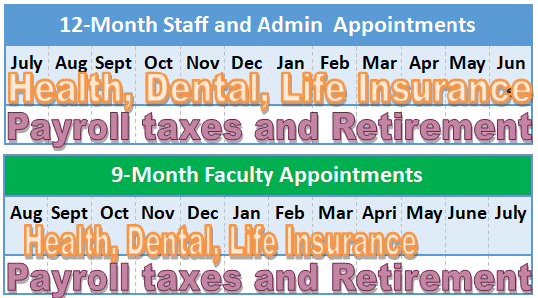
Fringe Benefits
Fringe is budgeted as a percent of salary
Faculty insurance benefits are fully paid in 9-month contract
AY/Calendar fringe rates are calculated on choices
Summer fringe includes SURS & Medicare, 14.5%
Ask your proposal coordinator for your fringe benefits rate

Slide 32
Other Positions
New Positions on the grant
  Rates of pay are chosen by PI (with input from department or HR) as appropriate for the position and the region
  Undergrad and Extra help budgeted hourly with limited fringe (7.65%)
    Total = (# of hours/week) x (# of weeks) x (rate of pay) x 1.0765 [for FB]
  Full-time, salaried, we use a chart of benefit choices
    Yes, it IS high. This is done to protect your project.
    Fringe benefits are a real cost to the university/project and can add up

Slide 33

Other Personnel: Postdocs
Post Doctoral Fellows
  Salary rates for Postdocs vary from unit to unit
    Ask a colleague for a rate, not your proposal coordinator
    When in doubt you can reference the NIH rates (Salary Cap, Stipends, & Training Funds)

Slide 34
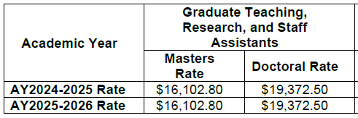
Graduate Research Assistants
Most 20 or 10 hours per week, but may also be for 5 or 15 hours per week
Academic year, summer, calendar year
University minimum rates vary by level
  Masters: $1789.2/mo; Doctoral: $2152.5/mo
  When in doubt budget for the higher rate
  Check on Departmental rates
When a GRA is budgeted, tuition remission is too
  Tuition waivers/cost share must be requested early and are not likely to be approved
No Fringe Benefits
^ 9 months appointments ^

Slide 35
Unbudgeted Effort
Some wages are paid from indirect costs
  Office manager that does routine paperwork to hire and pay students
  Lab director who takes care of the animal colony
  IT that makes sure your devices are working
  Sponsored programs for tracking and reporting spending
Faculty contracts generally include research time

Slide 36

Equipment
UG definition: Tangible personal property having a useful life of more than one year and a per-unit acquisition cost that equals or exceeds the lesser of the capitalization level established by the recipient or subrecipient for financial statement purposes, or $10,000.
  At NIU, a single item or useable system that has a value ≥ $5,000 (anything less is supplies)
  In 2026, limit will change to ≥ $10,000
Consider getting quotes for equipment
Justify a Single Source provider

Slide 37

Participant Support Costs (PSC)/Trainee Costs
These are costs that allow participants to participate in the project
Common costs include subsistence stipends, food, housing, travel, and materials
Stipends are not wages, because they do not work for stipends
NIU employees are not typically participants

Slide 38
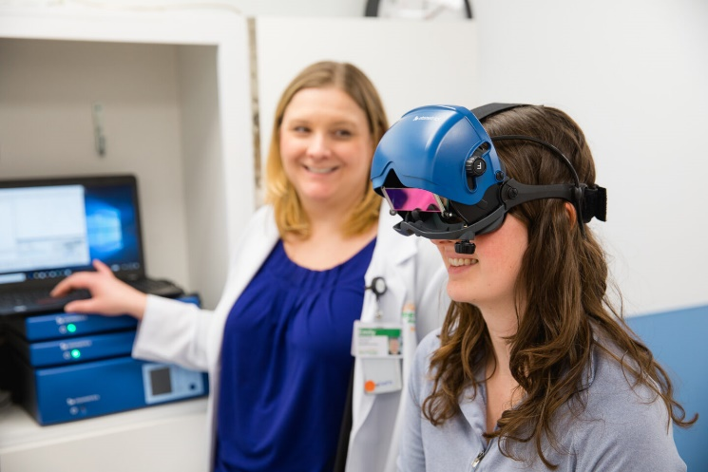
Budgeting PSC vs. Human Subject Incentives
Someone is taking part in the research, by testing a process or taking a survey, as a human subject
  Payments are incentives or payments
Someone training or on program grants as a participant
  May get subsistence & travel allowances, temporary dependent care, and per diem.

Slide 39

Travel – Common Types
Conference Travel
  Awards won’t typically fund attendance at professional meetings, but do support travel for dissemination of findings and collaboration
Travel to research or training sites
Travel is categorized federally as Foreign or Domestic, In-state & Outside
Rate for travel found at Per diem rates | GSA

Slide 40

Travel Costs
Common costs include:
Airfare
Lodging
Per diem
Conference registration
Visas
Luggage
Budgeted costs should be reasonable, but enough to cover costs
GSA rates act as limits, but cost may be budgeted lower based on PI experience

Slide 41
Other Costs

Slide 42
Materials and Supplies
Make meaningful estimations of these costs
Describe specific costs in your budget justification
Don’t include office supplies (these are covered by indirect costs)

Slide 43
Publication Costs
Funds for the costs of documenting, preparing, publishing or otherwise making available to others the findings and products of the work to be conducted under the award.
Also, storage, preservation, indexing of specimens
Proposal coordinator likely will not have information on how much is required
Budget from experience. Be reasonable, but request what is needed.
Notes:
This generally includes the following types of activities: reports, reprints, page charges or other journal costs (except costs for prior or early publication); necessary illustrations; cleanup, documentation, storage and indexing of data and databases; development, documentation and debugging of software; and storage, preservation, documentation, indexing, etc., of physical specimens, collections, or fabricated items.

Slide 44
Consultants
Rate of Pay based on:
  The level and difficulty of the work to be performed;
  The qualifications of the expert or consultant;
  The pay rates of comparable individuals performing similar work in Federal or non-Federal sectors; and
  The availability of qualified candidates.
A “consultant” is a person who can provide valuable and pertinent advice generally drawn from a high degree of broad administrative, professional, or technical knowledge or experience. – OPM
Mostly paid hourly or daily – provide a letter to document rate

Slide 45
Computer Services
The cost of computer services, including computer-based retrieval of scientific, technical, and educational information, may be requested only where it is institutional policy to charge such costs as direct charges.
A justification based on the established computer service rates at the proposing organization must be included.
The proposal budget also may request costs for leasing of computer equipment.

Slide 46
Subrecipients (vs. Vendors)
Subrecipients have a meaningful impact on the proposal’s science and/or decision making
FDP Subrecipient vs Contractor
SPA will facilitate communications with sub
From the subrecipient, SPA gets a:
  Subrecipient form
  Letter of Commitment
  scope of work
  budget and budget justification
  proposal specific docs
Longer timeline to integrate multiple institutions

Slide 47
Tuition Remission
Budgeted for ALL graduate research assistants
Expected by federal agencies
Current rate is $369.24/credit hour, with 3% annual increase, budgeted at $380/credit hour for Fall 2025
  Fall: 9 credit hours
  Spring: 9 credit hours
  Summer: 3 credit hours
Prorated for half time and quarter time appointments

Slide 48
Other Costs
Off-campus Room rentals
Vendor services
Human subject incentives
Renovations
Non-NIU personnel travel
Translators
Etc.

Slide 49
Federal Indirect Costs
Indirect costs (overhead, facilities and administrative F&A costs) are the infrastructure and administrative costs associated with sponsored projects that cannot be attributed to any one individual project with a high degree of accuracy (e.g., buildings and maintenance, utilities, departmental administration, sponsored programs administration, library resources, etc.) but are real costs university incurs to support these programs.
Understanding the Real Costs of Research on Vimeo

Slide 50
Federal Indirect Costs
Rate based on type of work and the resources used
  52% Research and Instruction
  37% Other Sponsored Activities
  26% Off-Campus (Admin Only)
MTDC Base – excludes tuition, equipment, capital expenditures, rentals off-campus, subaward costs beyond $25,000
NICRA – Negotiated Indirect Cost Rate Agreement
rate-agreement.pdf

Slide 51

Other Indirect Costs
A common non-NICRA rate is the training rate used by Department of Education and some state organizations like ISBE or IBHE
8% on MTDC Base

Slide 52
Other Indirect Costs
Some sponsors – especially foundations – do not allow indirect cost, or limit indirect costs to 10%
Work with Proposal coordinator to understand the limits and how to calculate them
TDC Base – no exclusions

Slide 53
Indirect Cost allocation
When no individual departments of units exist withing a college/division will receive the departmental share of indirect costs. Similarly, the college/division will also receive the department share when the PI’s primary appointment is at the college/division level.
In InfoEd, see the Personnel tab. Information is only entered if there is F&A/Indirect Costs allowed by the sponsor.
Policy online at:
  https://www.niu.edu/policies/policy-documents/indirect-cost-distribution.shtml
Unit | Allocation
Principal Investigator | 5%
College/Division | 10%
Department/Unit | 10%
Research Centers | 0/15%
Office of the Vice President for Research | 55%/40%
General Fund | 20%
Total | 100%

Slide 54
Other Things to Look for
Special allocations of costs in guidelines
  Examples:
    “65% of total direct cost must be used for training costs” - ED
    “Researcher salaries and fringe may not exceed 30% of total costs” – IIN
    “Only travel and supplies may be charged to the grant”
Specific prohibition
  Example: No fringe benefits maybe paid by this fellowship

Slide 55
Cost Sharing
Cost sharing is always a risk for the university, so:
  NIU will only cost share when it is required or strongly recommended
  Only commit as much as you are required to commit
  Be mindful of changes or shortfalls that might occur
  Faculty time is often cost shared (committed or uncommitted)
  Other ways and places to show institutional support, unquantified (facilities, narrative)
https://www.niu.edu/policies/policy-documents/cost-sharing.shtml

Slide 56
Budget Justification
Structure your budget justification like the sponsor budget (headings, subheadings, etc)
Describe why each cost is necessary to the budget.
Describe how the total cost was calculated.

Slide 57
Budget Categories
Excel template on SPA website includes 1-5 years; unhide columns for cost share entry.
Budgets may be developed either in InfoEd or as an Excel file.
SPA website:
  Excel Budget template and guidance: https://www.niu.edu/spa/proposals/preparing-budget/index.shtml
  Policies, forms and resources: https://www.niu.edu/spa/resources/index.shtml

Slide 58

Section 4
InfoEd Database -- the Records of proposals

Slide 59
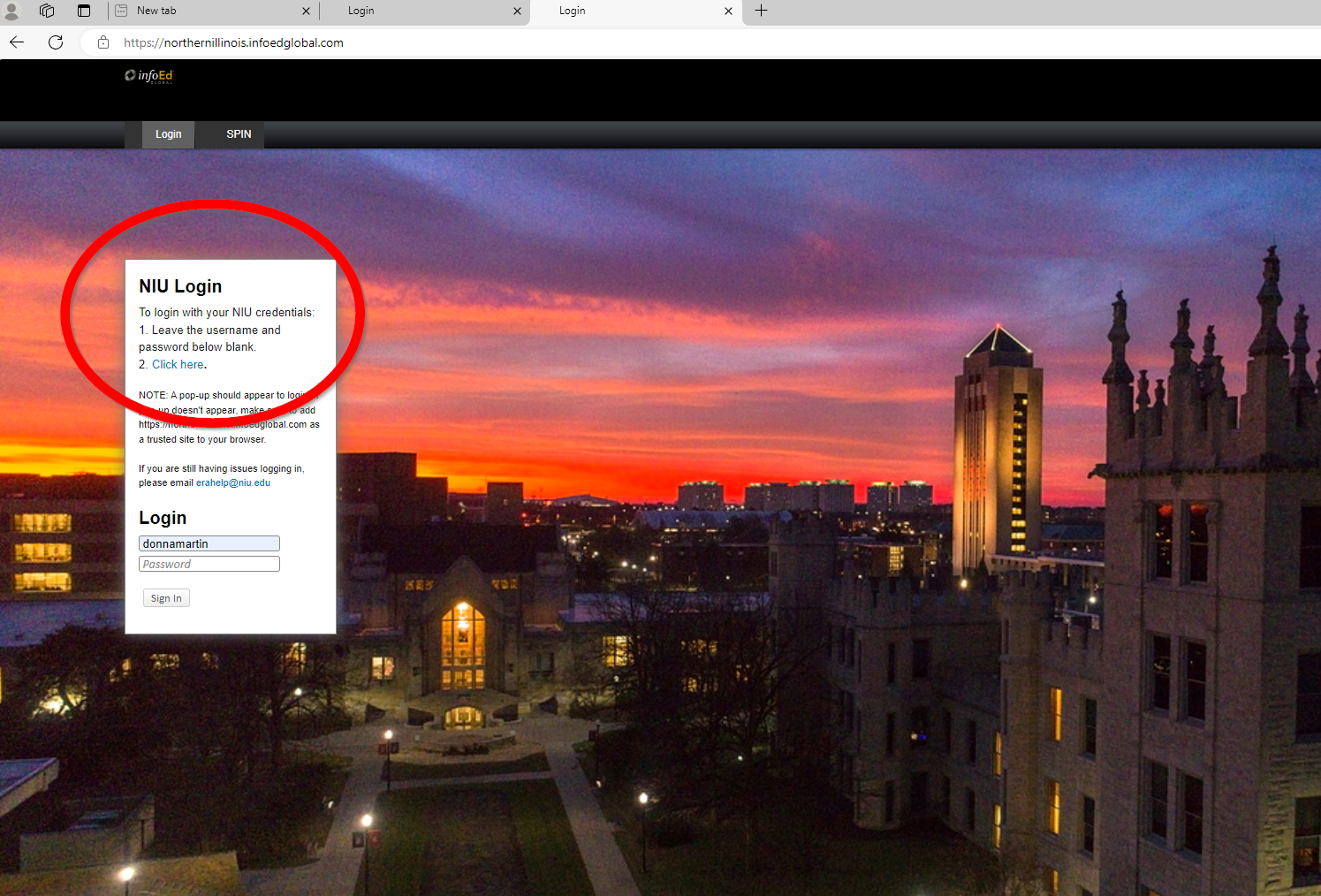
InfoEd database
https://northernillinois.infoedglobal.com/

Slide 60
Institutional Review Process
Proposals are routed through InfoEd system
Internal Routing record includes:
  Personnel and Departmental Information
  F&A distribution information
  Institutional Data
  Detailed project Budget
  Budget Justification
  Scope of Work/Narrative Document
  Subrecipient Documents as needed

Slide 61
Institutional Review Process
How final are routing documents?
  Routed budget should be final
  Budget Justification and Narrative Scope of Work document can still be edited and updated
  Scope of project should not change significantly after routing

Slide 62
Institutional Review Process
Who sees a proposal during routing?
  Route includes the PI/co-PIs, Chair, Assoc Dean, SPA
  May include Center Director, Research Compliance, or Facilities
  Approvals are done in order, everyone at a level must approve before it moves forward

Slide 63
Institutional Review Process
What if there is a problem?
  If you see a document or item that needs updated:
  you may contact the Proposal Coordinator to update
  Conditionally Approve of the Proposal
  Stop the route (last resort)

Slide 64
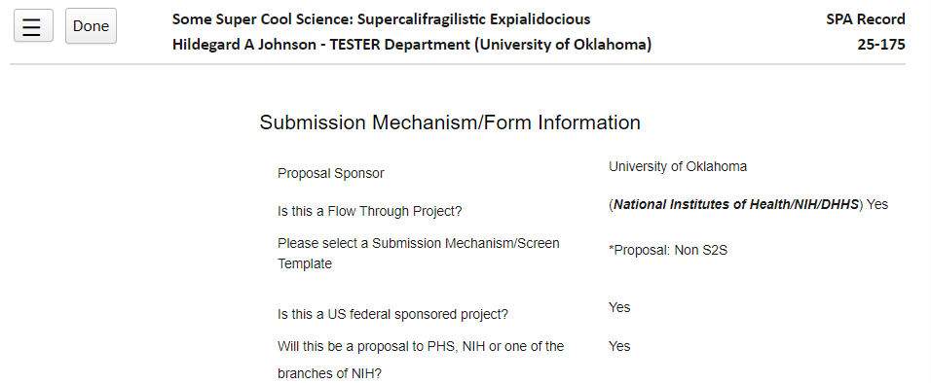
Proposal in InfoEd: Setup Tab
PI – PI Department (Sponsor)
Title
Record #
Our Sponsor/ Prime Awardee
Prime Sponsor

Slide 65
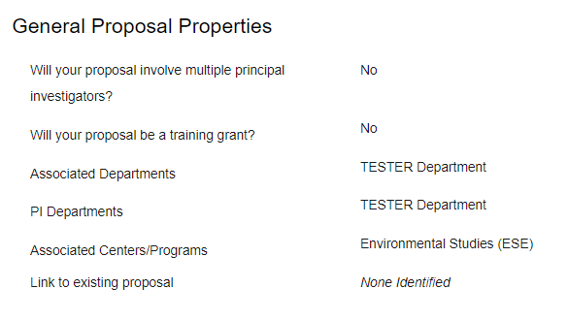
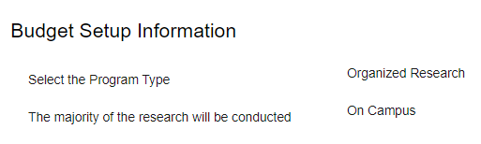
Proposal in InfoEd: Setup Tab
Associated Department(s)
Associated Center(s)
Proposal Type:
Organized Research
Instructional
Other Sponsored Programs
On-Campus or
Off-Campus
https://www.niu.edu/spa/proposals/budgeting-f-and-a.shtml

Slide 66
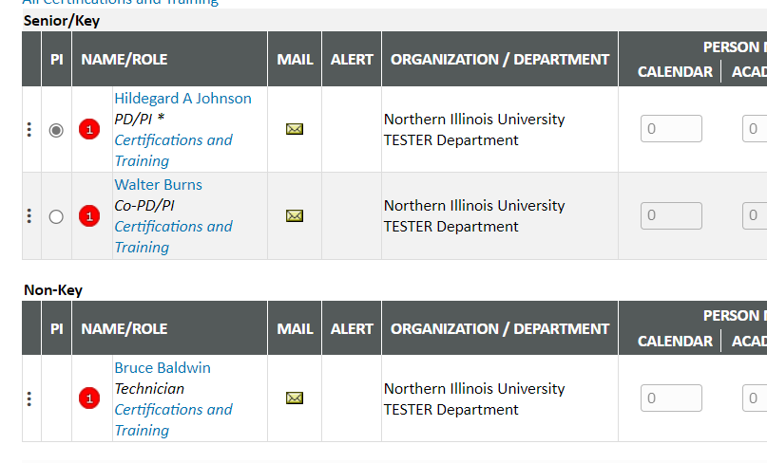
Proposal in InfoEd: Personnel
Proposal Team – Key Personnel
PI and Co-PI
Other Personnel – Graduate Assistants
Extra Help
Student Workers
Technicians

Slide 67
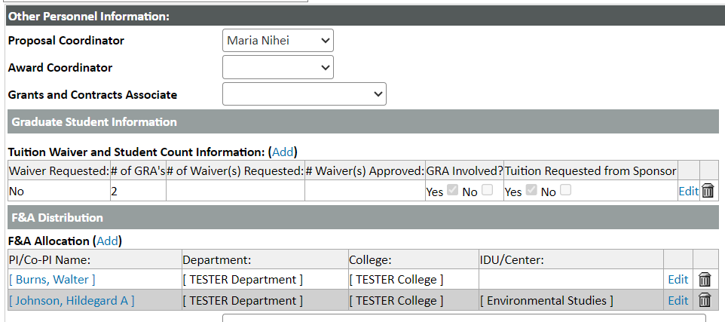
Proposal in InfoEd: Personnel
SPA Team:
Proposal Coordinator, Others blank at routing
Info on Graduate Assistants & Tuition
F&A Table information
VPR:
40/55%
General Fund: 20%
PI & co-PI:
5%
Department:
10%
College:
10%
Research Centers:
15%

Slide 68
Proposal in InfoEd: Institutional Data
Proposal Summary (255 characters)
Other Interesting Information:
  Activity Type
  Subawards, consultants, vendors
  Intellectual Property
  Foreign components
  Human Subjects or Vertebrate Animal Research
  SBIR/STTR
  Environmental Impact
  Drones

Slide 69
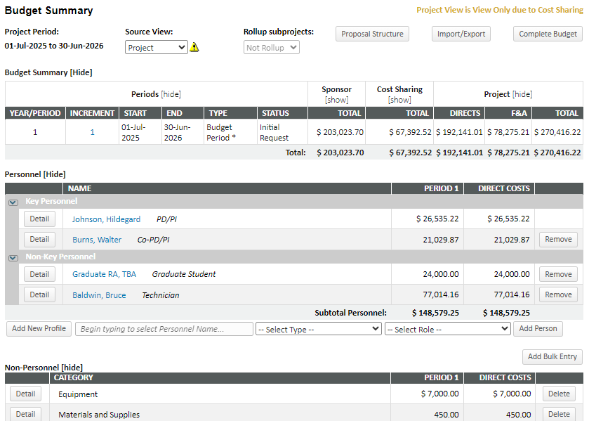
Budget Info for Review
Start and End Dates
Sponsor Request
Cost Sharing
Direct Costs: Costs Specific to Project
Total Project Budget
Indirect Costs: Costs not readily assigned to a single project
Personnel Costs: Salary & Fringe Benefits

Slide 70
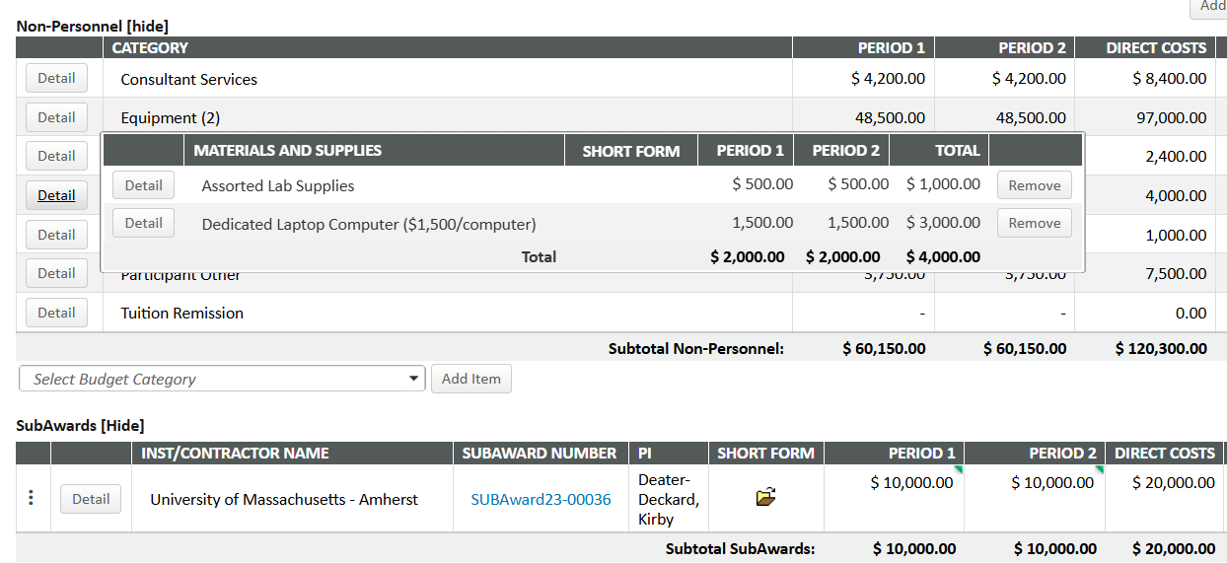
Budget Info for Review
Non-personnel costs
Click “Detail” to see calculations and description
“Detail” can also show multiple lines in a category
View a sub budget as a single line or (maybe) view the detail

Slide 71
Budget Info for Review
1st row shows total direct costs
2nd row shows the calculated F&A
3rd row shows total budget request

Slide 72
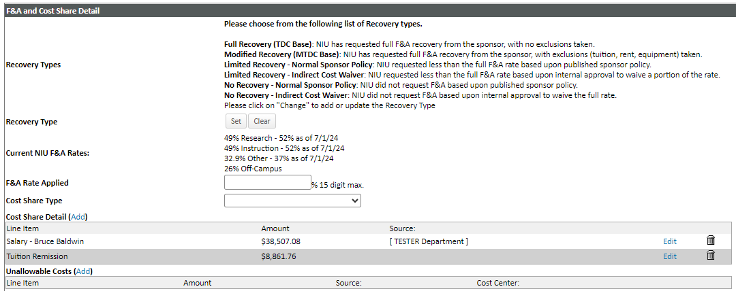
Budget Info for Review
Base types: TDC – often for Foundations
MTDC – for federal and state
No F&A – Sponsor or Waiver
Cost Share Types: Mandatory
Mandatory & Voluntary
Voluntary Committed
None
Rates
Specific Cost Share and Source

Slide 73
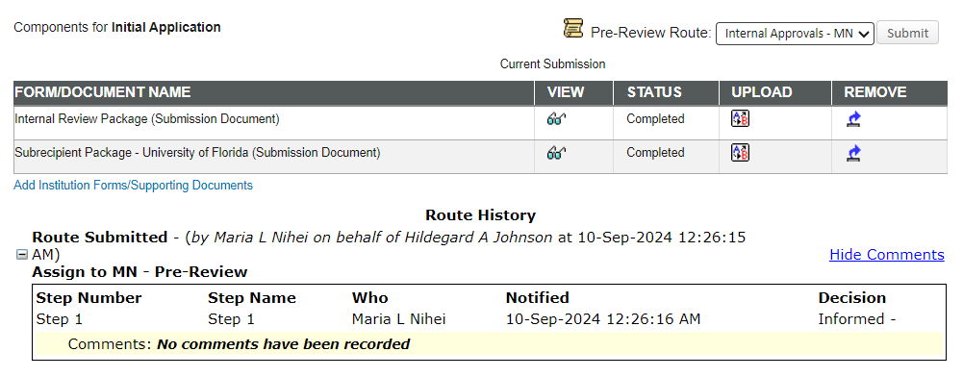
Proposal in InfoEd: Submit for Review
Internal Review Package:
Budget Justification
Narrative Scope of Work
sometimes Budget
Subrecipient Package:
Sub Budget
Sub Budget Justification
Sub Scope of Work
Sub Form and Information
One or More Route table:
Show various steps
Each step must be completed to going to next step

Slide 74
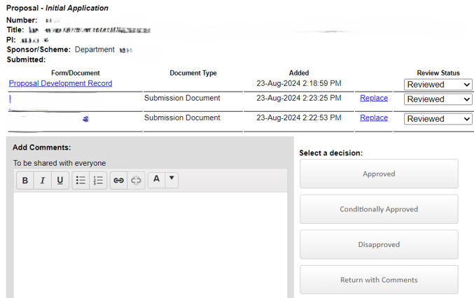
Reviewer Dashboard
Proposal Information
Proposal Record Access
Proposal Documents for Review
Decision Options
Area to leave a comment

Slide 75
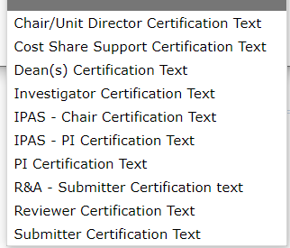
Email sent with Certifications
* If you are approving the record, you must scroll all the way down on the Certification Page to activate the Accept button

Slide 76
Budgeting Effort Demo
Let’s look at a record: 25-175
https://northernillinois.infoedglobal.com/

Slide 77

Section 5
Submission of Proposals to Sponsors

Slide 78
Submission
Most submissions – especially federal – require submission by the Authorized Organizational Representative (AOR)
Many require access to proposal systems
These typically require SPA submission
But PI can access applications in many of the systems to review forms, enter information, and upload documents
  Grants.gov, Research.gov, ASSIST, PAMS

Slide 79
Submission
Some foundations and other organizations have systems that allow/require a PI to submit proposal on their own
If possible submitter should save a PDF of the submitted proposal
Some submissions done by email

Slide 80

After Proposal Submission…
…Before it becomes an Award

Slide 81
After Submission
Recording Submission
Receipts and Confirmation of Submission
Record Completion
Proposal Pending Status

Slide 82
For More Information
Quarterly Reports, Annual Reports
Sponsor Reviews/Scores/Awards/Declines
  Just-in-Time Requests (NIH)
  Budget Revisions before awarded
    at agency request
    if awarded less than requested

