Slide 1
Monday Money Matters & More
Two Types of Costs on Sponsored Projects
Indirect Costs

Slide 2
Two Types of Costs on Sponsored Projects
Direct
Indirect
Expenditures directly tied to a specific project or activity
Similar costs must be consistently categorized as direct or indirect.
Also known as Facilities & Administrative (F&A) Costs or Overhead
Costs not directly linked to a specific project but necessary for the university’s general operations and activities.

Slide 3

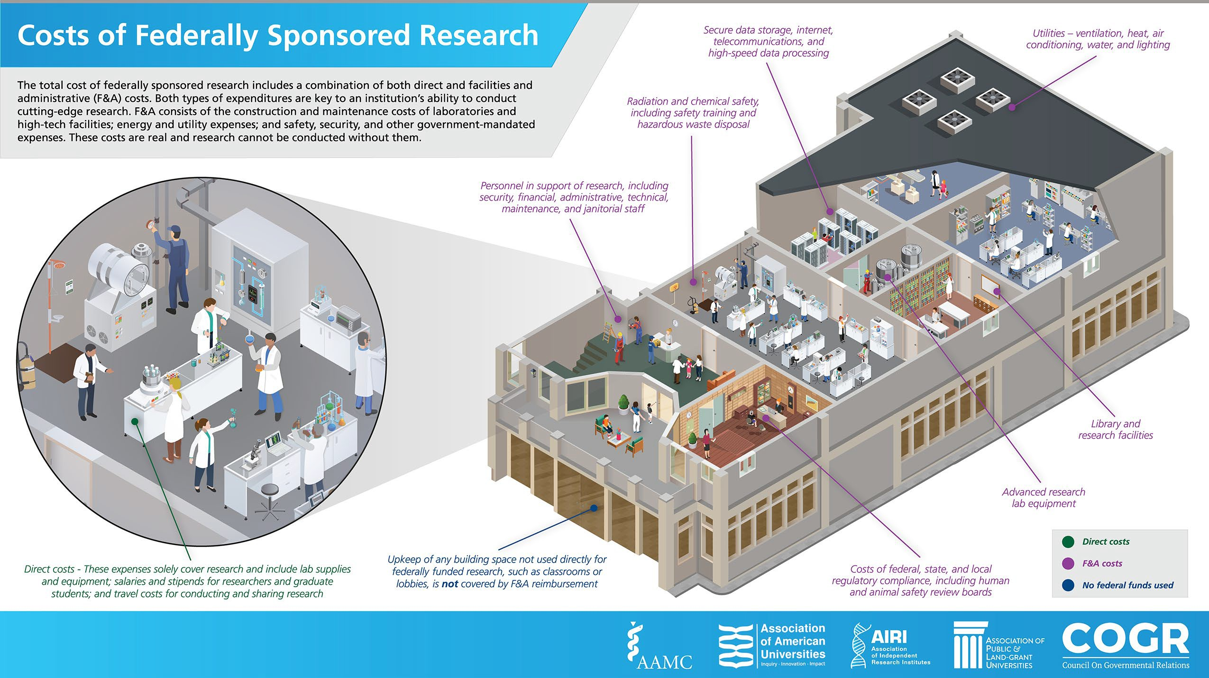

Costs of Federally Sponsored Research

Slide 4

How are Indirect Costs Rates Established?

Slide 5
Indirect Cost Basics
Indirect cost rates are based on NIU’s federally negotiated indirect cost rate agreement (NICRA) with the Federal Government. Rates as of July 1, 2024
RATE | PROJECT TYPE
52% | On Campus - Research
52% | On Campus - Instruction
37% | On Campus – Other sponsored activity (service projects, technical testing)
26% | All Off Campus Projects
15% De Minimis Rate -Grantees with out a federally negotiated indirect costs rate
Rates are typically negotiated every 4 years. Rates can be extended up to 4yrs if no significant changes occur in the intuitions cost structure
Notes:
Harvard 69%

Slide 6

F&A/Indirect Costs
Not all cost categories are eligible for indirect cost recovery.
Budget Categories Without IDC
Equipment over $5,000
Capital expenditures
Charge for patient care
Rental Costs –off site facilities
Scholarships
Fellowships
Tuition Remission
Participant Support Costs
Subaward Costs >25k

Slide 7
Modified Total Direct Costs
MTDC base refers to the total direct costs that are eligible for indirect cost recovery, excluding specific category.
MTDC Example: A budget broken down as follows for a one-year project. What is the MTDC Base? Costs are; personnel ($37,000), travel ($3,000), equipment ($10,000), research subject compensation($750), materials/supplies ($5,000) and tuition ($8,500) for a total of $64,250. Subtract equipment and tuition costs and the MTDC is $45,750.
MTDC Base

Slide 8
Examples of Program/Sponsor Restrictions
Sponsors may disallow indirect costs or set a lower rate
Federal Training Grants
  8% Modified Total Direct Costs
U.S. Department of Agriculture National Institutes of Food and Agriculture (NIFA)
  30% Total Project Costs
Robert Wood Johnson Foundation
  12% Total Direct Costs

Slide 9

Indirect Calcuations
The Post Award Team in SPA calculates and distributes indirects monthly.
  Calculations are based on allowable grant expenses posted to the grant
  Proper direct charging is essential
  Cost transfers or adjustments may impact indirects
  Indirects are earned as expenses are incurred.
    No expenditure = No Indirects
Indirect costs for departments and centers are typically distributed to the college, which then allocates them to local accounts.
Notes:
Calculations are based allowable expenses posted to the grant account
Cost transfers and adjustments may require adjustments to indirects
Indirect revenue is only earned as expenses are incurred

Slide 10
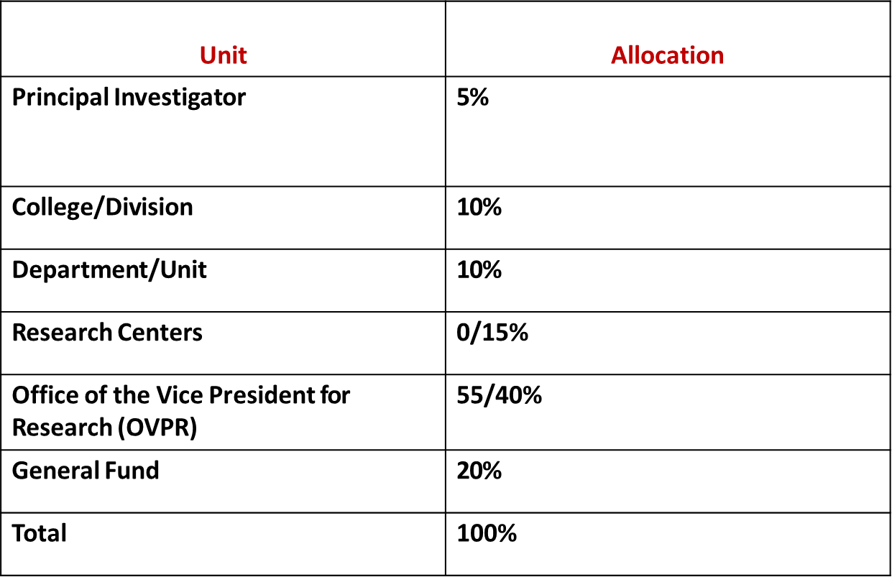
NIU Indirect Cost Allocation

Slide 11


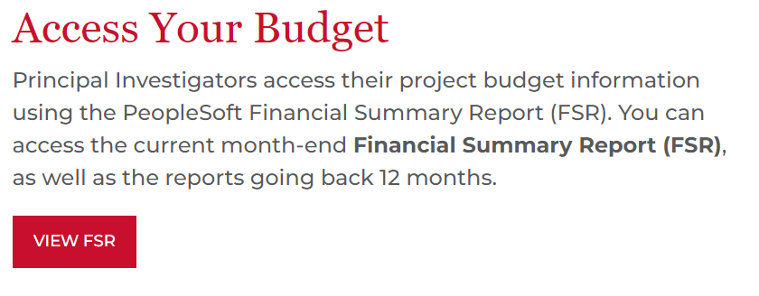
Indirects on Financial Reports
https://www.niu.edu/spa/awards/post-award-financial/budget.shtml

Slide 12
Resources
Budgeting Indirect Costs Policy
Indirect Cost Distribution Policy
SPA Budgeting F&A Guidance
NIU Negotiated Indirect Cost Rate Agreement

Slide 13

Questions?

