Slide 1
Monday Money Matters & More
Tuition and Cost Share

Slide 2
Graduate Assistant Tuition
Department hired GAs vs. Grant hired GAs
Department hired GA
Tuition absorbed by NIU.
Grant hired GA
Tuition paid for by the grant (Tuition Remission).
Participant Training Grant
Not hired as a GA, they are paid with a stipend.
Tuition absorbed by NIU.
Unless permission is received to waive (Tuition Remission Waiver).
Notes:
*Today I am going to be discussing tuition waivers and tuition remission. I will give an overview of what each are, how they differ, and how they work. Tuition remission for graduate assistants is a vital component of sponsored award budgets, it reflects the educational benefits associated with their research activities. Federal regulations governing sponsored programs acknowledge tuition remission as part of a student’s overall compensation package and sponsors expect budgets to include these costs. Tuition remission helps the university recoup waived tuition costs and invest in future research and education programs.
-Whenever a Graduate Assistant is hired they receive a tuition waiver from the university that is associated with that Assistantship. If a department hires a Graduate Assistant the tuition is waived and the university absorbs or covers those costs. When a grant hires a GA the grant covers the cost of the tuition, therefore helping the university recoup money. There are instances when permission may be received to waive this – a tuition remission waiver which I will discuss. There are also instances, mainly with training grants, where a student is not hired as a GA – they are a participant and are paid a stipend and receive a tuition waiver – again the university absorbs these costs.

Slide 3
Tuition Waiver vs. Tuition Remission vs. Tuition Remission Waiver
Tuition Waiver
Approved during proposal stage of the grant.
Tuition Remission
Choose the correct Job Code.
Tuition Remission Waiver
Approved during proposal stage of a grant.
Scenarios where a Tuition Remission Waiver on a grant may be approved…
Tuition Waiver form completed & sent to GCA to process.
GCA submits for tuition to be charged to the grant.
Does not incur indirect costs.
Coded to 860235 on Financial Summary Report (FSR).
Tuition cost absorbed by NIU.
Fall & Spring up to 9 credit hours.
  Sponsor does not allow Tuition Remission
  Small award amounts
  Projects lasting less than a full semester
Summer up to 3 credit hours.
Notes:
*Now we will go over how tuition waivers, tuition remission, and tuition remission waivers work and how they differ
*Tuition waiver – again this would be mostly for a training grant and would be when a student is participating in a project – not employed. This would be approved during the proposal stage. The PI completes the Grant-Participant Tuition Waiver Scholarship form and submits it to the Grants and Contracts Associate that manages the award who will then process it. Again this means that NIU is not collecting tuition for that student. Tuition Waivers can sometimes be used as Cost Share when Cost Share is required, which we will hear more about next.
*Tuition Remission – this is when a student is hired as a Graduate Assistant and the grant pays for the students tuition. When you submit paperwork to hire a student please be sure you choose the correct job code, tuition remission is only processed for Research Assistants – not for Teaching or Staff assistants at this time. Your GCA checks to see who is hired as Graduate Assistants on the grant each semester and submits a form to charge the grant for the GA’s tuition. This can be up to 9 credit hours for fall and spring and up to 6 for summer. Some things to note are that tuition remission does not incur indirects. Also when looking at your Financial Summary Report (FSR) you will see the budgeted and expensed tuition remission under code 860235 labeled Institutional Support.
*Tuition Remission Waiver – This would be when you have Graduate Assistants budgeted on the project but do not budget tuition remission. This would need to be approved at the proposal stage and requires some extra approvals. Some instances when this would be approved would be – sponsor does not allow TR, the award is for a very small amount, or the project lasts for less than a full semester. Again, the university would then be absorbing or covering these costs unless they are used as cost share.

Slide 4
Rebudgeting Tuition Remission
Keep in mind:
Approval always required from SPA, formal rebudget may be required by Sponsor.
If a GA works on the grant during that semester, Tuition Remission needs to be charged to the grant.
If rebudgeting Tuition Remission is approved, it impacts the indirect budget and will decrease the amount you can spend on direct costs.
Tuition Remission Policy
Notes:
*We understand that projects don’t always go as planned and budgets can change. If you find yourself needing to rebudget tuition remission keep in mind that SPA approval is always required for this. We may also need to do a formal rebudget with the sponsor. If a GA works on the grant during that semester their tuition needs to be charged to the grant. The only reason the position exists is because of the grant, so the grant should also cover the tuition. If you do end up rebudgeting tuition remission you have to keep in mind that because tuition remission does not incur indirects it impacts that budget and will decrease the amount you can spend on direct costs. If you had $1000 in tuition remission you have to take into account the indirects that would now need to be taken and do not get to spend that full amount.

Slide 5

Cost Share
  A portion of the total project costs that is not covered by the sponsor. These costs are covered by the university or a third party.
  Direct Costs
  Salaries
  Supplies
  Travel
  Indirect Costs
  Unrecovered
  Federal Funds - cannot be used for
  cost share
  View the Cost Sharing Policy

Slide 6
Types of Cost Share
Mandatory Cost Share
Required by the sponsor as a condition of the award. Must be tracked and documented.
Voluntary Committed Cost Share
Not required by the sponsor but included in the proposal. Once committed, it must be tracked and reported.
Voluntary Uncommitted Cost Share
Additional effort or expenses beyond what was proposed. Not required to be tracked.
In-Kind Contributions
Non-cash contributions such as donated services, equipment, or facilities that support the project.
Third-Party Cost Share
Contributions from external partners that support the project, which may require documentation for compliance.

Slide 7
Budgeting Cost Share
Only include cost share when required to avoid unnecessary financial commitments.
Unmet cost share can lead to a reduction in the total award amount or returning of funds
Budget $100,000
Cost Share 100% $100,000
Cost Share Met: 80%
$80,000
Unmet Cost Share reduces award to $80,000
  If the full $100,000 is spent NIU may be required to return $20,000 to the sponsor

Slide 8
Cost Share Changes and Tracking
  Changes that can impact cost share
    Reduction in effort
    PI changes
    Change in Scope
    Rebudgeting
  Cost Share Tracking
    Personnel Cost Share - Calculated by GCA
    Non-Payroll Cost Share - requires receipts submitted to GCA
    Certification – Completed quarterly unless specified otherwise
    Third Party/Gift in Kind – requires reports and receipts submitted to GCA

Slide 9
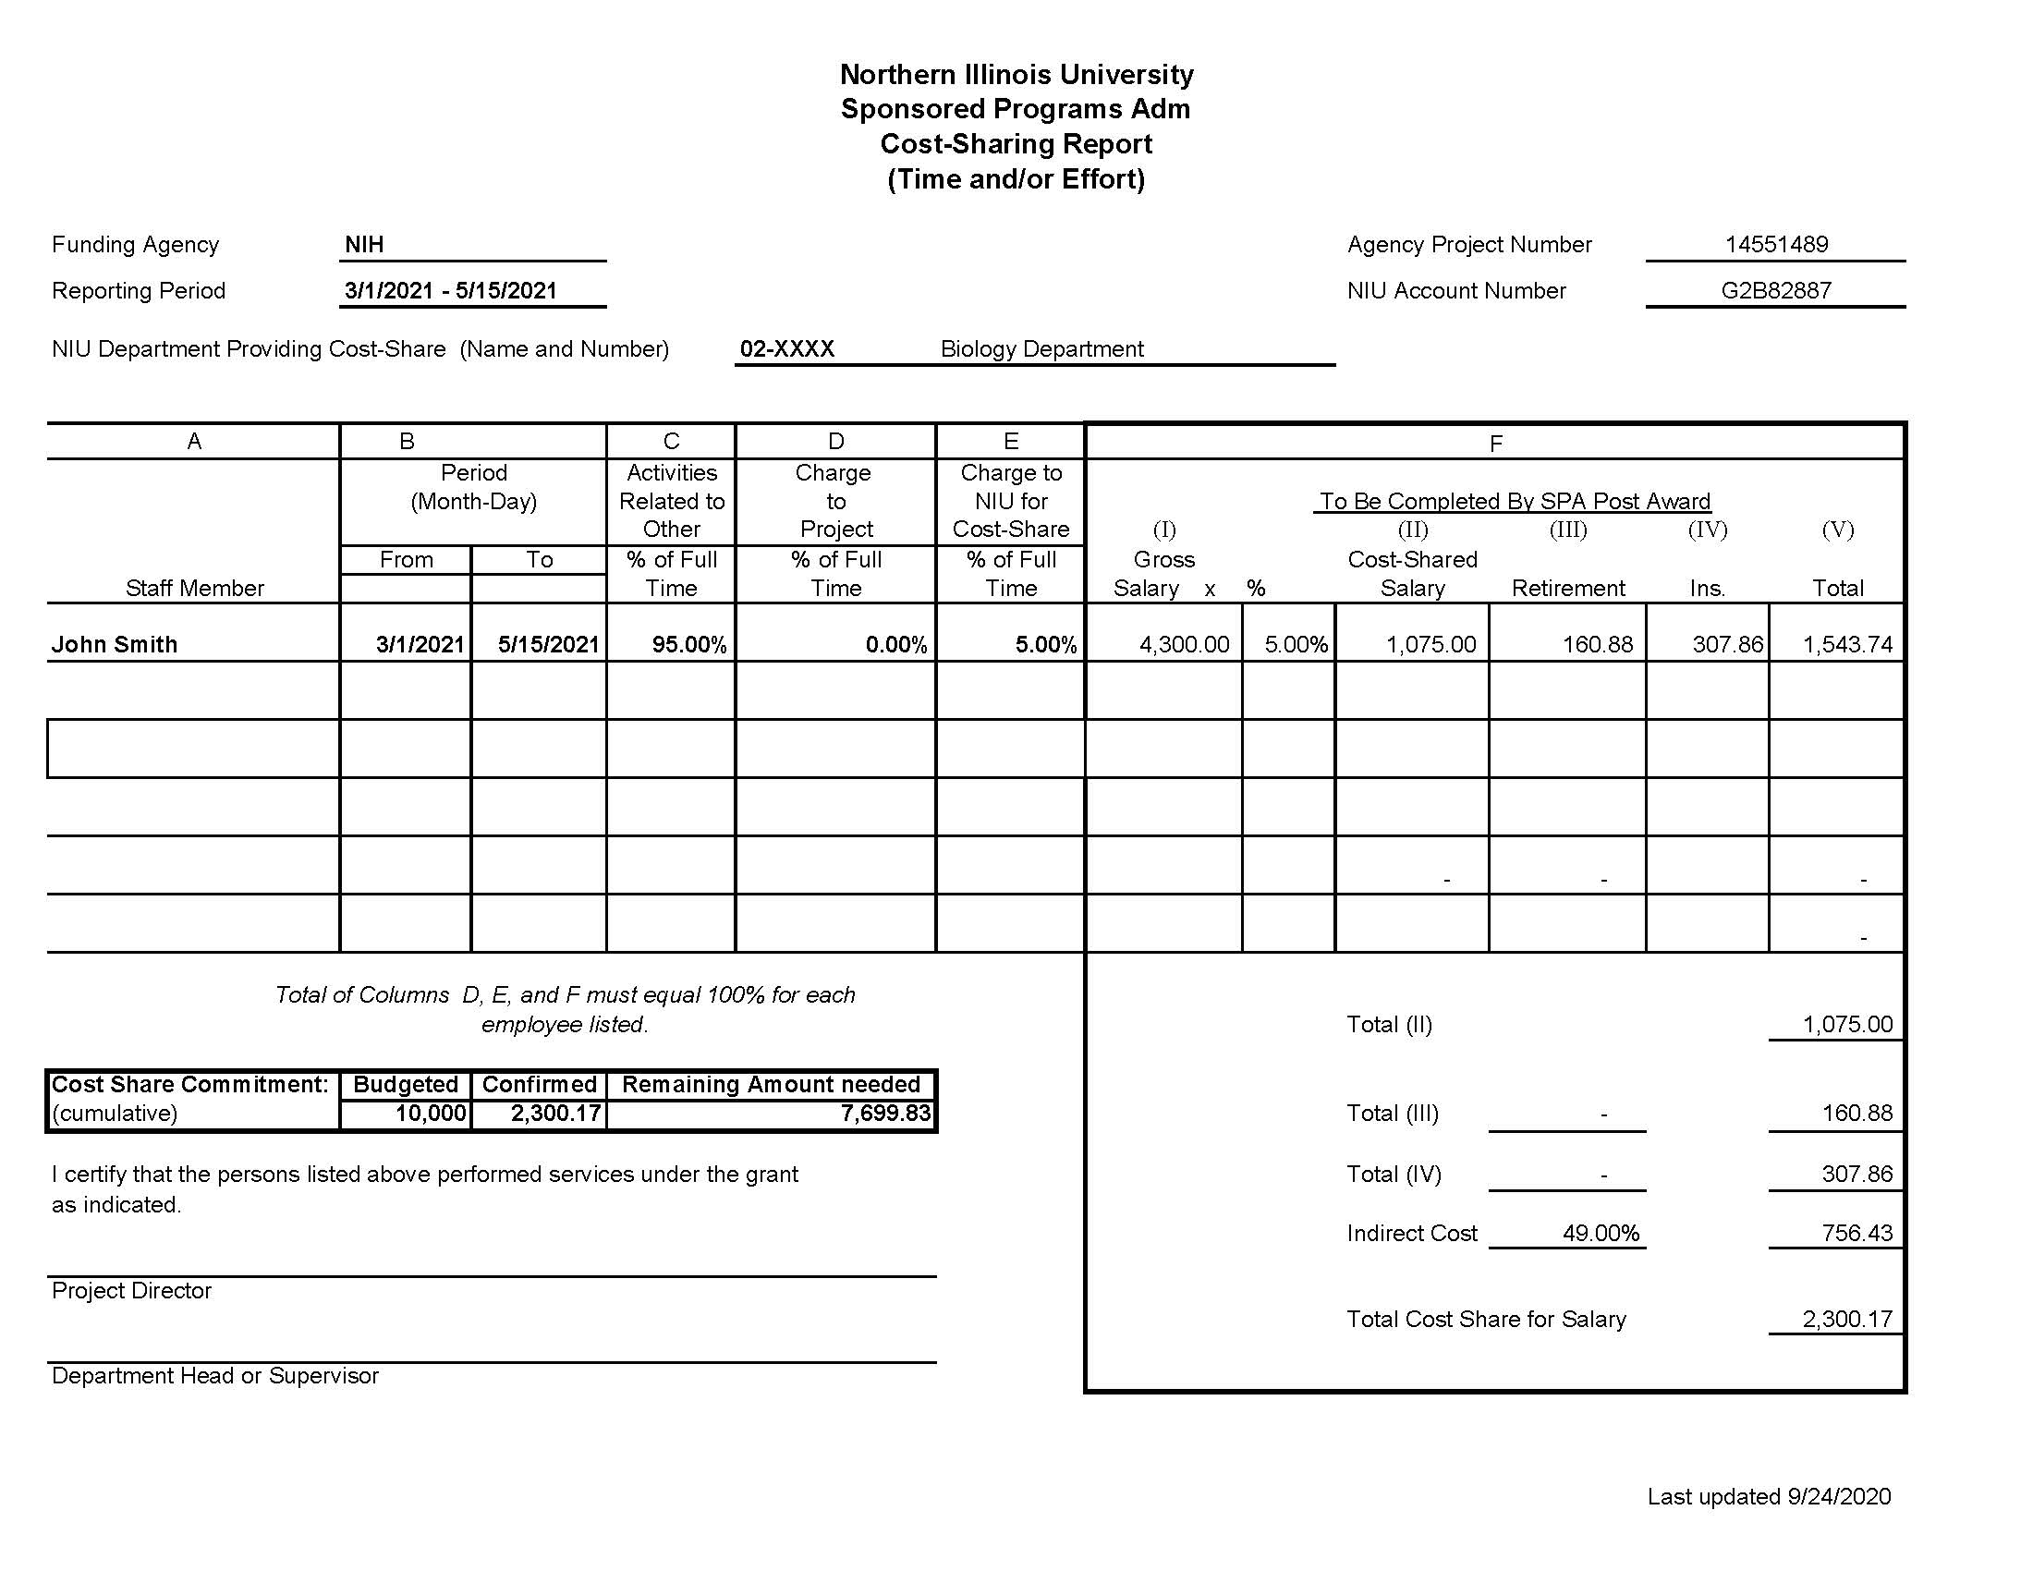
Capturing Cost Share

Slide 10
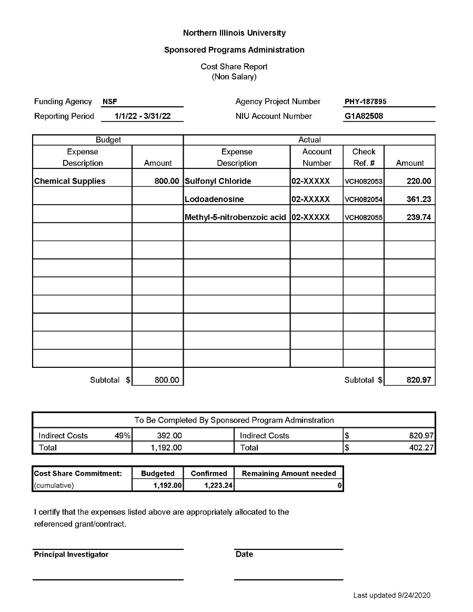
Capturing Cost Share Continued

Slide 11

Questions?

