Slide 1
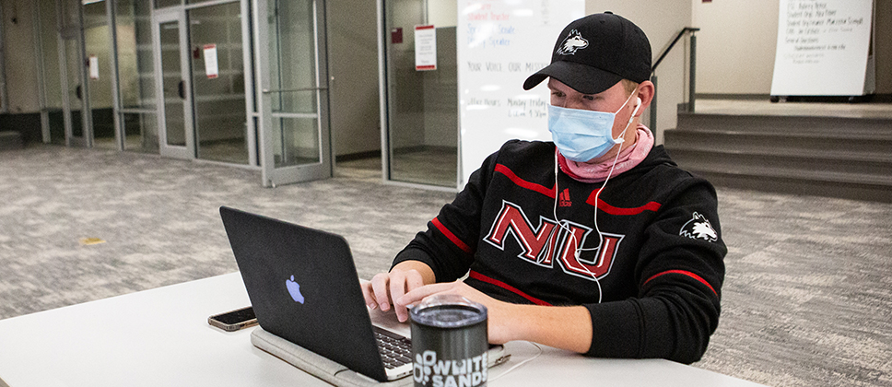

Slide 2
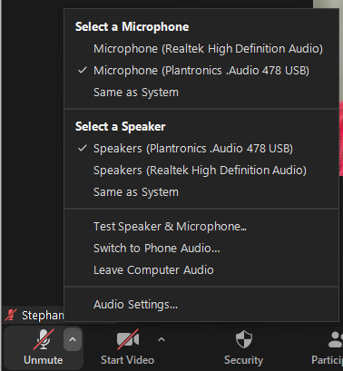
Can You Hear the Presenter?
Check your computer audio
Or Use a Phone to Dial-In
Check what you are using as a speaker
Check whether your system volume is muted or needs to be increased
Click arrow to open audio menu

Slide 3
Zoom Tools
View participants
Turn off captions
Turn on your microphone
Text chat
Turn on your camera
Quick reactions & raise hand

