Slide 1
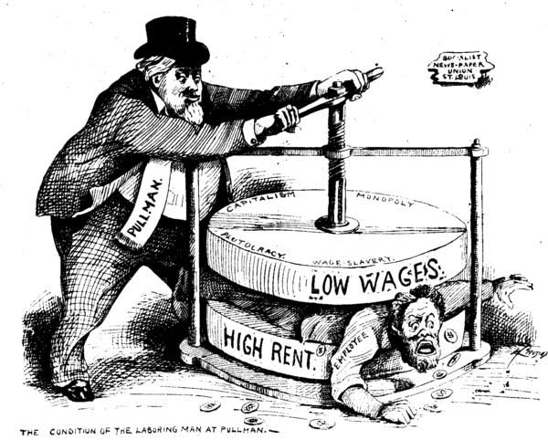
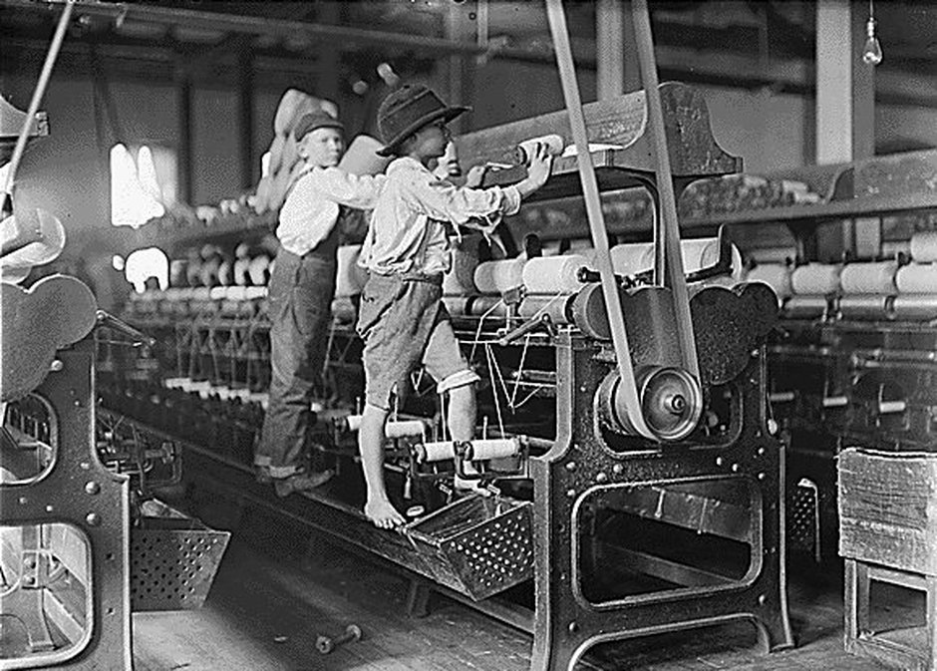
Workers in the Gilded Age
Artemus Ward
Dept. of Political Science
Northern Illinois University
aeward@niu.edu
Bill of Rights Institute
Kansas City, KS June 5-6, 2017

Slide 2

Introduction
Compared to today, workers were extremely vulnerable during the Gilded Age.
As workers moved away from farm work to factories, mines and other hard labor, they faced harsh working conditions such as long hours, low pay and health risks. Children and women worked in factories and generally received lower pay than men.
Labor movements in the industrialized world developed and they lobbied for better rights and safer conditions.
Initially, the government did little to limit these conditions. But eventually, progressives began passing laws to protect workers.
Yet business interests pushed back, convincing the U.S. Supreme Court to adopt a substantive notion of “due process” that protected the “liberty” of workers to contract with their employers for the conditions of their employment (wages, hours, etc.) without government interference.
The Court’s pro-business, Gilded-Age rulings would stifle both the ability of workers to organize and governments to regulate business. The Court would not repudiate these laissez-faire arguments until 1937—many years into the Great Depression.

Slide 3
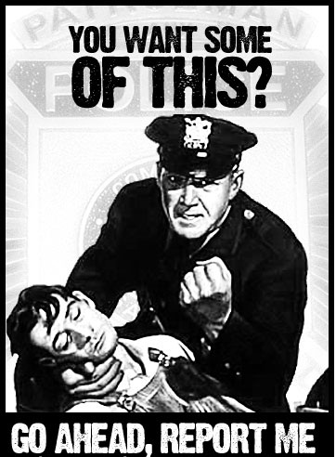
Police Power
What is the “police power”?
The inherent authority of the state to act to protect the health, safety, morals, and general welfare of the people.
Examples of the police power are best seen in criminal law which is enacted by states to protect its people: murder, motor vehicle regulation, alcohol and drug laws, etc.
While the federal government may limit certain forms of state police power under the U.S. Constitution, the federal government does not possess a general police power the way that states do.
The federal government’s powers are limited and defined by the Constitution
One of the ways that state police power is limited is through the Constitution’s guarantee of due process.

Slide 4
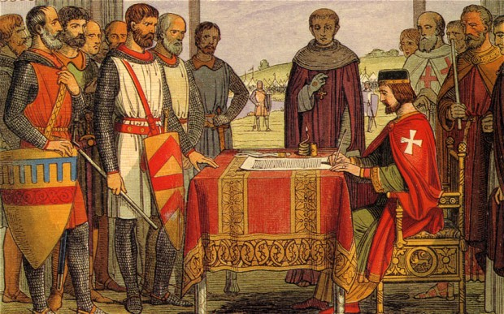
Magna Carta (1215)
What is due process?
The concept emanates from the Magna Carta (1215) where the Lords sought formal legal protection from arbitrary treatment by the King:
“No free man shall be seized or imprisoned, or stripped of his rights or possessions, or outlawed or exiled, or deprived of his standing in any other way, nor will we proceed with force against him, or send others to do so, except by the lawful judgment of his equals or by the law of the land.”
The phrase due process of law first appeared in a statutory rendition of Magna Carta in 1354 during the reign of Edward III of England, as follows: “No man of what state or condition he be, shall be put out of his lands or tenements nor taken, nor disinherited, nor put to death, without he be brought to answer by due process of law.”

Slide 5
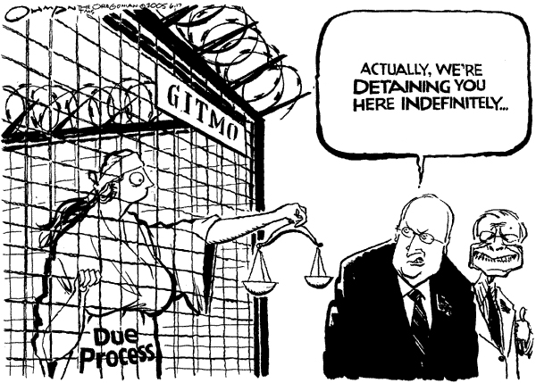
Procedural v. Substantive
Due Process
Both the 5th and the 14th Amendments to the U.S. Constitution contain a Due Process Clause:
5th: “nor shall any person…be deprived of life, liberty, or property, without due process of law.”
14th: “nor shall any state deprive any person of life, liberty, or property, without due process of law.”
What does this mean?
Procedural Due Process – guarantees individuals a fair and impartial legal process in criminal and civil matters (e.g., the right to sufficient notice, the right to an impartial arbiter, the right to give testimony and admit relevant evidence at hearings, etc.).
Substantive Due Process – protects individuals against majoritarian policy enactments which exceed the limits of governmental authority (i.e., a majority’s enactment is not law, and cannot be enforced regardless of how fair the process of enforcement actually is).

Slide 6
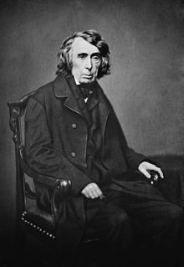
Substantive Due Process Origins
Though courts had discussed the substantive component of due process (without using the phrase) prior to the Civil War, it was Chief Justice Roger Taney’s opinion in Dred Scott v. Sanford (1857) that most point to as originating the concept in American constitutional law.
He declared the Missouri Compromise (1820) unconstitutional because “An act of Congress which deprives a citizen of the United States of his liberty or property [a slave], merely because he came himself or brought his property into a particular Territory…could hardly be dignified with the name of due process of law.”

Slide 7
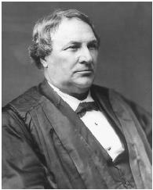
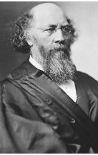
The Slaughter-House Cases (1873)
Following the passage of the 14th Amendment (1868), the Court decided the Slaughter-House Cases (1873). New Orleans butchers were dumping animal waste in the city’s water supply and the state passed a law regulating slaughtering – forcing butchers to slaughter their animals at a central location away from water supplies. The butchers argued that the newly enacted 14th Amendment protected their “liberty” to conduct their business affairs without state encroachment.
Writing for the 5-4 majority, Justice Samuel Miller took a narrow view of the 14th Amendment and ruled that it did not restrict the police powers of the state. With regard to the Due Process Clause, the Court held: “Under no construction of that provision that we have ever seen, or any that we deem admissible, can the restraint imposed by the state of Louisiana upon the exercise of their trade by butchers of New Orleans be held to be a deprivation of property within the meaning of that provision.”
Yet the dissenters, led by Justice Stephen J. Field, said that the 14th Amendment protected individual rights such as the “liberty” or freedom to pursue an economic occupation. Field’s dissent would become influential over time.

Slide 8
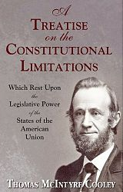
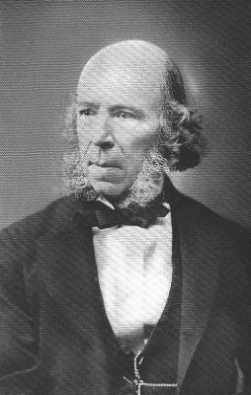
The Rise of Substantive Due Process
The theory of substantive due process slowly gained traction.
Thomas M. Cooley published his influential treatise Constitutional Limitations (1868), which elevated the word “liberty” within the due process clause to the status of an important constitutional right that would serve as a mechanism for protecting property rights and for restricting government regulation. By 1890 it was in its 6th edition.
Herbert Spencer was an influential theorist who promoted Social Darwinism—the idea that government should merely maintain order and property rights and the “fittest” would survive and succeed. His book Social Statics (1851) and other works would prove influential at the end of the 19th and early 20th centuries.

Slide 9
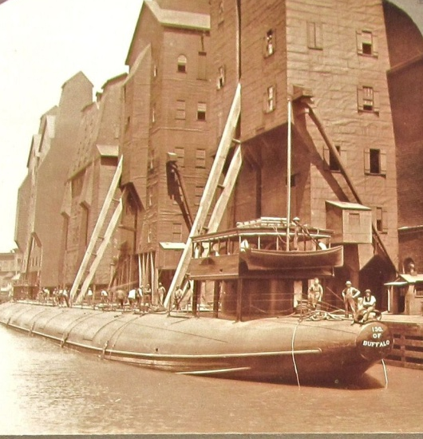
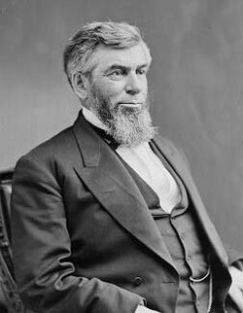
Munn v. Illinois (1877)
In Munn, the Court began encouraging substantive due process arguments. The Court upheld the state regulation—in this case a state regulatory board to fix maximum rates grain elevators could charge farmers and merchants—but instead of foreclosing any substantive due process claims the way the Court had done in Slaughter-House, the Court said that in some cases such regulations could be struck down.
Specifically, in his majority opinion Chief Justice Morrison Waite said it depended on the nature of the regulation: “We find that when private property is ‘affected with a public interest it ceases to be [of private right] only.’”
This doctrine came to be known as the business-affected-with-a-public-interest doctrine (BAPI). The Court used it in Munn to reason that the grain elevator business played a crucial role in the distribution of food stuffs to the nation and was therefore an industry that was affected with the public interest and subject to regulation.
In dissent, Justice Stephen J. Field railed against the test: “There is hardly an enterprise or business engaging the attention and labor of any considerable portion of the community, in which the public has not an interest in the sense in which that term is used by the court.”

Slide 10
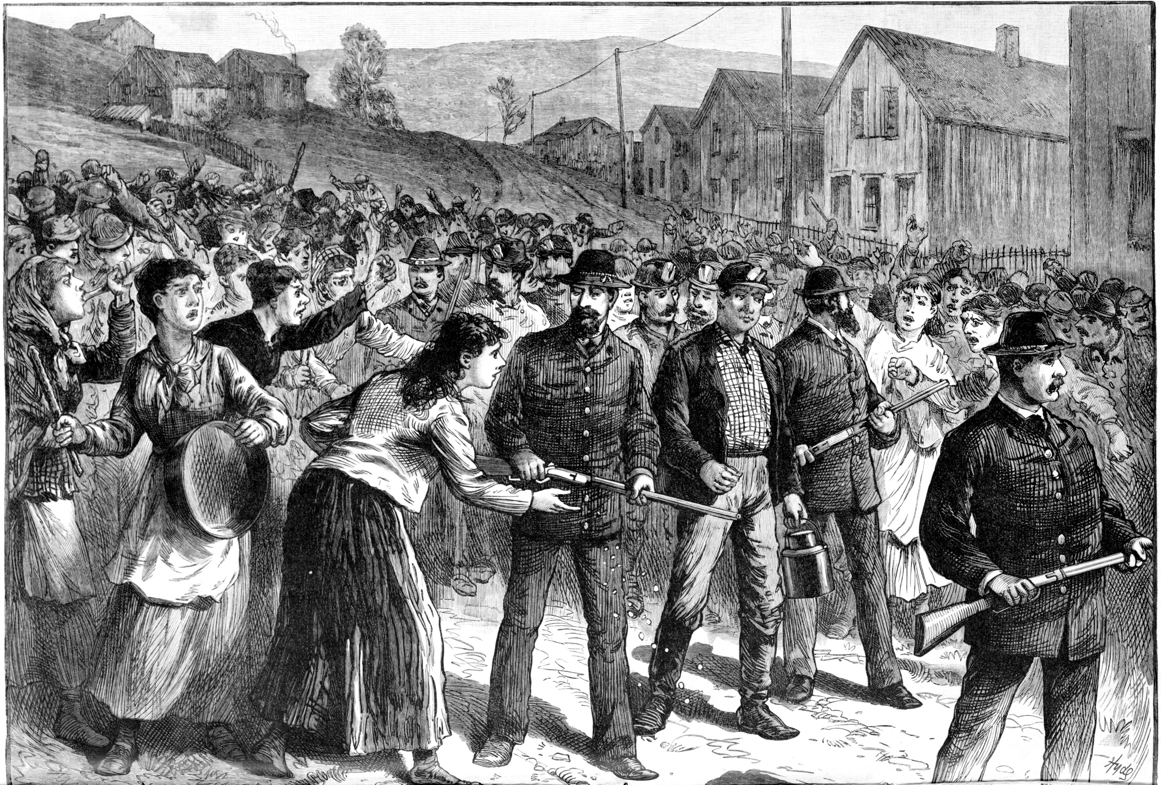
Ohio - the mining troubles in Hocking Valley - scene in the town of Buchtel - the striking miners' reception of "Blackleg" workmen when returning from their work escorted by a detachment of armed Pinkerton's detectives.
From a sketch by Joseph Becker, 1884.

Slide 11
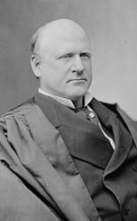
Mugler v. Kansas (1887)
The Court considered a state law that prohibited the manufacture and sale of liquor. Although the majority upheld the regulation against a substantive due process challenge, the Court’s opinion, written by Justice John Marshall Harlan I represented something of a break with Munn.
First, it articulated a view that not “every statute enacted ostensibly for the promotion of [the public interest] is to be accepted as a legitimate exertion of police powers of the state.”
Second, the Court suggested it would carefully scrutinize state action: “There are…limits beyond which legislation cannot rightfully go…. If, therefore, a statute purporting to have been enacted to protect the public health, the public morals, or the public safety, has no real or substantial relation to those objects, or is a palpable invasion of rights secured by the fundamental law, it is the duty of the courts to so adjudge, and thereby give effect to the Constitution.”

Slide 12
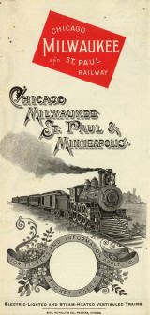
Chicago, Milwaukee & St. Paul Railway v. Minnesota (1890)
For the first time, the justices struck down a state regulation on the ground that it interfered with due process guarantees.
The state established a commission to set railroad rates for transportation of goods and for warehouse storage. The railroad argued that the commission had interfered with “its property” without providing due process of law.
Writing for the majority, Justice Samuel Blatchford held for the railroad on both procedural and substantive due process grounds. He examined the law in terms of the reasonableness standard set forth in Mugler: “The question of the reasonableness of a rate of charge for transportation by a railroad company…is eminently a question for judicial investigation, requiring due process of law for its determination.”
He found that the law deprived the company of its property in an unfair way: “If the company is deprived of the power of charging reasonable rates…and such deprivation takes place in the absence of an investigation by judicial machinery, it is deprived of the lawful use of its property, and thus, in substance and effect, of the property itself, without due process of law.”
In the 14 years since Slaughter-House, the Court had moved from a refusal to inject substance into due process to a near affirmation of the doctrine of substantive due process.

Slide 13
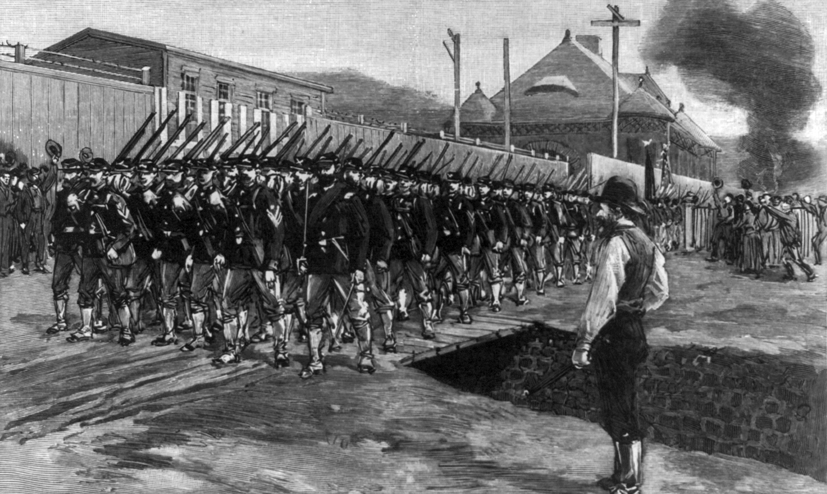
Labor Battles in the
Gilded Age
Harper's Weekly illustration of the Pennsylvania state militia marching on the Homestead Steelworks, 1892
The Gilded Age industrial workforce was easy to vilify as it was composed of African Americans and immigrants.
From 1865-1918, 27.5 million immigrants poured into the United States, many aspiring to the opportunities afforded by the nation’s economic successes.
The late 19th Century was a time when industrial capitalism was new, raw, and sometimes brutal.
Between 1881-1900, 35,000 workers per year lost their lives in industrial and other accidents at work.
Strikes were commonplace: no fewer than 100,000 workers went on strike each year. In 1892, for example, 1,298 strikes involving some 164,000 workers took place across the nation.
Unions—which function to protect workers’ wages, hours of labor, and working conditions—were on the rise.

Slide 14
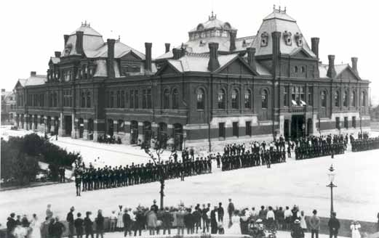
Labor Battles in the Gilded Age
Pullman strikers outside Arcade Building in Pullman, Chicago. The Illinois National Guard can be seen guarding the building during the Pullman Railroad Strike in 1894.
As the United States’ industrial economy grew in the late 1800s, conflict between workers and factory owners became increasingly frequent and sometimes led to violence.
The Homestead Strike occurred at the Carnegie Steel Company’s Homestead Steel Works in 1892. The strike culminated in a gun battle between unionized steelworkers and a group of men hired by the company to break the strike. The steelworkers ultimately lost the strike.
The Pullman Strike of 1894 started outside Chicago at the Pullman sleeping car manufacturing company and quickly grew into a national railroad strike involving the American Railway Union, the Pullman Company, railroads across the nation, and the federal government who used the Army to end the strike. One of its organizers, Eugene V. Debs, was imprisoned.

Slide 15
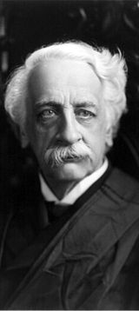
Allgeyer v. Louisiana (1897)
With the alleged purpose of preventing fraud, the state enacted a law that barred its citizens and corporations from doing business with out-of-state insurance companies, unless they complied with a specified set of requirements. Among those requirements were stipulations that the out-of-state company must establish as place of business in the state and must have an authorized agent inside the state.
Justice Rufus Peckham, writing for a unanimous Court, held the state law unconstitutional on substantive due process grounds:
"The 'liberty' mentioned in [the Fourteenth] amendment means not only the right of the citizen to be free from the mere physical restraint of his person, as by incarceration, but the term is deemed to embrace the right of the citizen to be free in the enjoyment of all his faculties, to be free to use them in all lawful ways, to live and work where he will, to earn his livelihood by any lawful calling, to pursue any livelihood or avocation, and for that purpose to enter into all contracts which may be proper, necessary, and essential to his carrying out to a successful conclusion the purposes above mentioned.“
In just under 25 years, business interests had pushed the Court from rejecting substantive due process to accepting it and equating it with a fundamental right to liberty of contract.

Slide 16
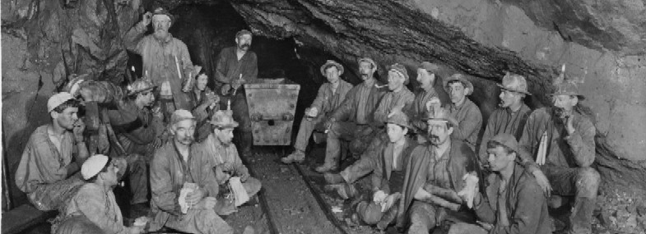
Holden v. Hardy (1898)
The Court examined a Utah law prohibiting mining companies from working their employees more than 8 hours in a day, except in emergency situations.
Attorneys challenging the law claimed: “It is…not within the power of the legislature to prevent persons who are…perfectly competent to contract, from entering into employment and voluntarily making contracts in relation thereto merely because the employment…may be considered by the legislature to be dangerous or injurious to the health of the employee; and if such right to contract cannot be prevented, it certainly cannot be restricted by the legislature to suit its own ideas of the ability of the employee to stand the physical and mental strain incident to the work.”
The state asserted that the challenged statute was a “health regulation” and within the state’s power because it was aimed at “preserving to a citizen his ability to work and support himself.”
The Supreme Court, in an opinion by Justice Henry Brown (fresh from his decision the previous term in Plessy), reiterated its Mugler position: “The question in each case is whether the legislature has adopted the statute in exercise of a reasonable discretion or whether its actions be a mere excuse for an unjust discrimination.” The Court deemed the regulation “reasonable”; that is, it did not impinge on the liberty of contract because the state had well justified its interest in protecting miners from their jobs’ unique health problems and dangerous conditions. It appeared that liberty of contract was not absolute and that some state regulation would be allowed.

Slide 17
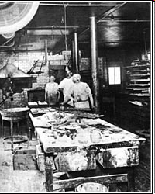
Lochner v. New York (1905)
In New York in the late 1800s, bakers were paid by the day, not by the hour. $2 per day was a typical wage.
Unsurprisingly, bakers favored shorter work days, as they assumed that they would continue to receive their current pay levels whether they worked 10 hours or they worked 14 hours. They also believed that long work hours increased their risk of developing various lung diseases.
A bill, supported by bakers, to reduce the workday for bakers to 10 hours was narrowly defeated in the New York Assembly in 1887.
By the mid-1890s, larger bakeries in New York were unionized and generally adopted 60-hour work weeks.
The large bakeries, however, faced competition from smaller bakeries which demanded longer hours from their employees (the employees often were required to sleep in or near the bakeries).
Lochner’s Home Bakery
Utica, New York

Slide 18
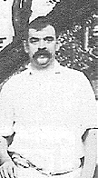
Lochner v. New York (1905)
While unionized bakers continued to lobby for a ten-hour law, a muckraking New York Press reporter published stories about unsanitary conditions in smaller bakeries, including accounts of finding open sewers and cockroaches on baking utensils.
A state factory inspector's report confirmed that conditions were unsanitary and led to growing public support for a law regulating bakeries.
The state legislature passed the Bakeshop Act of 1897. It included sections regulating sanitary conditions (e.g., no sleeping in a bake room) and a section strongly supported by the baker's union, establishing the 60-hour maximum hour, maximum work week for bakers.
Utica bakery owner Joseph Lochner had a longstanding dispute with the baker's union. Union officials persuaded state factory inspectors to file a complaint against Lochner for employing a baker named Aman Schmitter for more than sixty hours in one week.
In February 1903, Lochner was tried but offered no defense. He was found guilty of violating the Bakeshop Act and sentenced to pay a fine of $50.
Joseph Lochner

Slide 19
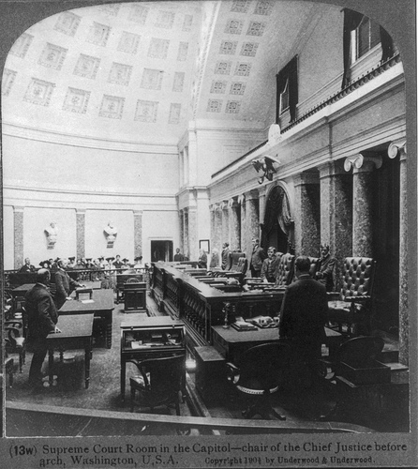
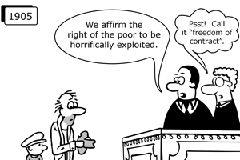
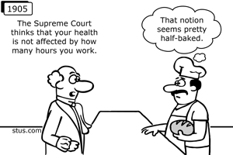
The original U.S. Senate Chamber in the Capitol became available when the Senate moved into its current chamber in 1861. When the Senators moved out, the U.S. Supreme Court moved in.
The Court met in the old Senate Chamber from 1861 until they received their own building in 1935.
This photo shows the old Senate Chamber converted for the Supreme Court. Notice the ladies wearing hats in the gallery as staff prepare for the justices, who decided Lochner, to take the bench.

Slide 20

Lochner v. New York (1905)
Justice Rufus Peckham delivered the 5-4 majority opinion.
“The statute necessarily interferes with the right of contract between the employer and employees, concerning the number of hours in which the latter may labor in the bakery of the employer. The general right to make a contract in relation to his business is part of the liberty of the individual protected by the 14th Amendment of the Federal Constitution. Under that provision no state can deprive any person of life, liberty, or property without due process of law. The right to purchase or to sell labor is part of the liberty protected by this amendment, unless there are circumstances which exclude the right.”
“To the common understanding, the trade of a baker has never been regarded as an unhealthy one….. “Clean and wholesome bread does not depend upon whether the baker works but ten hours per day or only sixty hours a week.”
Peckham explained that under a broad understanding of the police powers of the state (to protect the health, safety, welfare, and morals of the people) anything could be regulated: “Not only the hours of employees, but the hours of employers, could be regulated, and doctors, lawyers, scientists, all professional men, as well as athletes and artisans, could be forbidden to fatigue their brains and bodies by prolonged hours of exercise, lest the fighting strength of the state be impaired.”

Slide 21
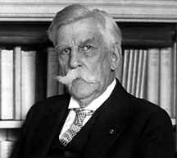
Lochner v. New York (1905)
Justice Oliver Wendell Holmes, Jr. Dissenting:
“This case is decided upon an economic theory which a large part of the country does not entertain. If it were a question whether I agreed with that theory, I should desire to study it further and long before making up my mind. But I do not conceive that to be my duty, because I strongly believe that my agreement or disagreement has nothing to do with the right of a majority to embody their opinions in law. It is settled by various decisions of this court that state constitutions and state laws may regulate life in many ways which we as legislators might think as injudicious, or if you like as tyrannical, as this, and which, equally with this, interfere with the liberty to contract.”
“The 14th Amendment does not enact Mr. Herbert Spencer's Social Statics.”
“Some of these laws embody convictions or prejudices which judges are likely to share. Some may not. But a Constitution is not intended to embody a particular economic theory, whether of paternalism and the organic relation of the citizen to the state or of laissez faire. It is made for people of fundamentally differing views, and the accident of our finding certain opinions natural and familiar, or novel, and even shocking, ought not to conclude our judgment upon the question whether statutes embodying them conflict with the Constitution of the United States.”

Slide 22
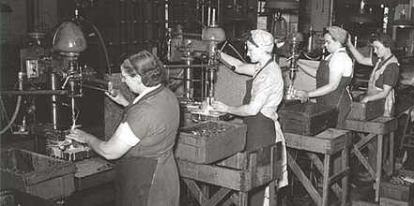
The Demise of Liberty of Contract
In the decades that followed, the Supreme Court struggled to apply liberty of contract principles to cases involving government regulation of workers and working conditions.
Liberal groups engaged in a piecemeal strategy of chipping away at the liberty of contract doctrine by winning exceptions to the rule. Weakened with numerous exceptions, ultimately—they hoped—the doctrine would be discarded and lost cases would be overturned.
Their initial approach was to convince an all-male Court to uphold so-called “protective legislation” for women with a new kind of legal brief providing not just legal arguments but scientific studies, government reports, and other data—the so-called “Brandeis Brief” named after the attorney who argued the case and who would soon be appointed to the Court, Louis Brandeis.
In Muller v. Oregon (1908) the Court agreed, invalidating a state maximum-hour statute limiting women to no more than 10 hours per day. The Court’s sexist opinion explained that women were the weaker sex and needed special protection from the state to protect their unique roles as child-bearers.
In Bunting v. Oregon (1917) the Court upheld a broader state maximum-hour statute that limited all workers in mills, factories, or manufacturing establishments to no more than 10 hours per day.
In Adkins v. Children’s Hospital (1923) the Court struck down on liberty of contract grounds a Washington, D.C. minimum wage law for women. Women had won the vote three years earlier and the Court reasoned that women were just as free as men to contract for wages with employers.
In Morehead v. New York ex rel. Tipaldo (1936) the Court struck down a state minimum wage law for women explaining that liberty of contract was the rule not the exception.
In West Coast Hotel v. Parrish (1937) the Court finally abandoned the liberty of contract doctrine, explicitly overruled Adkins, and upheld a minimum-wage law for women. The Court explained that a fresh approach to the law was required because of the Great Depression. The Court never again invoked liberty of contract to strike down a government regulation.

Slide 23
Liberal Revival: From Privacy to Liberty
The same Supreme Court that said the liberty provision of the 14th Amendment’s Due Process Clause included “freedom of contract” also said it included other freedoms.
In Meyer v. Nebraska (1923) the Court struck down a state law prohibiting teaching German below 8th grade. In Pierce v. Society of Sisters (1925) they struck down a state law that mandated public education for children, including those who had been attending religious schools.
In Meyer, the Court explained that “liberty” covers “the right of the individual…to engage in any of the common occupations of life, to acquire useful knowledge, to marry, establish a home and bring up children, to worship God according to the dictates of his own conscience, and generally to enjoy those privileges long recognized at common law as essential to the orderly pursuit of happiness by free men.” According to the Meyer Court, government cannot interfere with these liberties, “under the guise of protecting the public interest, by legislative action which is arbitrary or without reasonable relation to some purpose within the competency of the State to that effect.”
By the 1960s, the liberal justices who had agreed that economic substantive due process (liberty of contract) was no longer good law divided over another aspect of substantive due process: personal privacy.
In Griswold v. Connecticut (1965) the Court struck down, on right to privacy grounds, a state law that banned the distribution of contraceptives. But the justices did not agree on which section of the Constitution required that conclusion. Writing for the majority, Justice William O. Douglas said that various specific provisions gave rise to zones of privacy, including the marital bedroom. Some justices argued that privacy rights are embedded in the Due Process Clause of the 14th Amendment. Justice John Marshall Harlan II asserted this substantive due process approach to privacy in his concurring opinion: “In my view, the proper constitutional inquiry in this case is whether this Connecticut statute infringes the Due Process Clause of the Fourteenth Amendment because the enactment violates basic values ‘implicit in the concept of ordered liberty.’…The Due Process Clause of the Fourteenth Amendment stands, in my opinion, on its own bottom.”

Slide 24
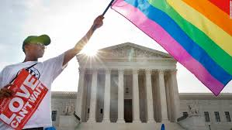
Liberal Revival:
From Privacy to Liberty
In the years after Griswold, the Court used the due process approach to privacy to expand a number of liberties. Most notable was Roe v. Wade (1973) that established the right to abortion. Writing for the majority, Justice Harry Blackmun said: “[The] right of privacy, whether it be founded in the Fourteenth Amendment’s concept of personal liberty and restrictions upon state action, as we feel it is, or [another clause]…is broad enough to encompass a woman’s decision whether or not to terminate her pregnancy.”
The Court has reached similar conclusions in other areas of privacy but has dropped using the controversial “right to privacy” language in favor of the phrase “liberty interest”:
In Cruzan v. Dir. Missouri Dept. of Health (1990) the justices held that “the principle that a competent person has a constitutionally protected liberty interest in refusing unwanted medical treatment may be inferred from our prior decisions.”
In Lawrence v. Texas (2003) the Court concluded that laws criminalizing consensual sodomy were barred by the “liberty” provision of the 14th Amendment’s Due Process Clause.
In Obergefell v. Hodges (2015) the Court held that the fundamental right to marry is guaranteed to same-sex couples by both the “liberty” provision of the Due Process Clause and the Equal Protection Clause. The Court said: “The Constitution promises liberty to all within its reach, a liberty that includes certain specific rights that allow persons, within a lawful realm, to define and express their identity.”

Slide 25
The Essential Fairness of the Judicial System
Beyond privacy, the Court has also used substantive due process for the issues of excessive monetary damages awarded by juries in BMW v. Gore (1996) and for problems associated with judicial conflicts of interest in Caperton v. Massey (2009).
Can jury awards for litigants who have been unlawfully harmed become so large as to constitute an unreasonable denial of essential fairness and a deprivation of property without due process of law?
In BMW v. Gore (1996) the purchaser of a new automobile found out that the car he bought as new had been slightly damaged and repainted during transport to the dealership. BMW policy allowed new cars with very minor damage to be fixed and sold as new without disclosure to the dealer or purchaser. The purchaser sued and was awarded $4,000 in compensatory damages and $4 million in punitive damages. The state supreme court reduced it to $2 million and the U.S. Supreme Court said 5-4 that even that was “grossly excessive.” The Court has reduced jury awards in subsequent cases.
In Caperton v. A.T. Massey Coal Co. (2009) the justices considered whether judges who are elected could be so beholden to the interests of campaign contributors that they may not be able to fair to litigants when a conflict of interest may be present. The Court ruled 5-4 that the Due Process clause of the 14th Amendment requires a judge to recuse himself not only when actual bias has been demonstrated or when the judge has an economic interest in the outcome of the case, but also when "extreme facts" create a "probability of bias."

Slide 26
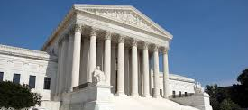
Conclusion
During a time of progressive legislation intended to protect workers, the Supreme Court agreed with arguments from conservative attorneys that workers had the liberty or right to contract with their employers, free from government intervention, under the Due Process Clause.
It was not until well into the Great Depression that the Court abandoned liberty of contract. Yet decades later a new generation of liberal justices would use the Due Process Clause for privacy rights.
Thus, historically, the Supreme Court has on occasion relied on the Due Process Clause to protect rights not explicitly mentioned in the Constitution—both rights favored by conservatives (liberty of contract) and rights favored by liberals (privacy, abortion, gay rights).
Critics suggest that substantive due process allows judges to act as legislators – to decide on their own what laws are so unreasonable as to violate due process.
They suggest that the people should make those decisions rather than unelected, unaccountable Supreme Court justices.
Are they right?

