Slide 1
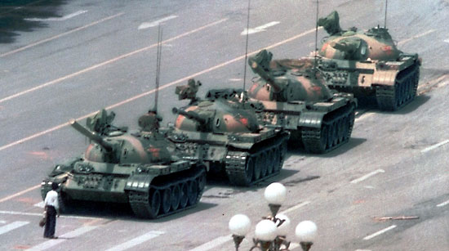
The Unknown Rebel of Tiananmen Square (1989)
Artemus Ward
Dept. of Political Science
Northern Illinois University
Bill of Rights Institute
Webinar
April 27, 2017

Slide 2
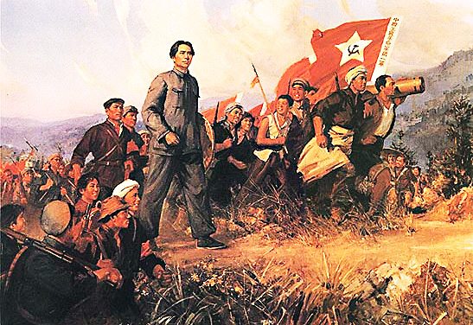
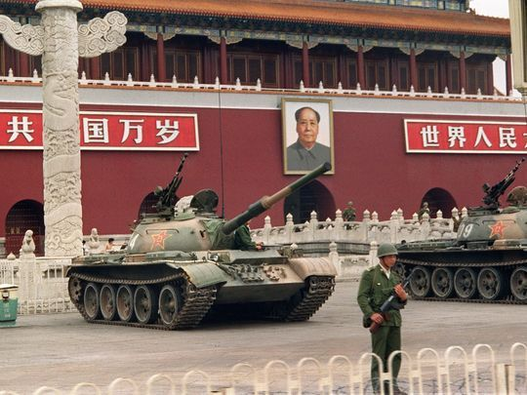
Introduction
While the “unknown rebel” or “tank man” of the Tiananmen Square Protests (1989) is an iconic image, it is important to understand the historical and political context of the protest.
China’s communist revolution led to an authoritarian government whose policies led to tens of millions of deaths.
Reformers in the 1970s-80s deemphasized ideological purity and transformed the nation into a state-capitalist system, albeit still an authoritarian one.
Increased economic freedom led to protests for political freedom.
Sensing the gravity of the moment, hardliners in the government suppressed the protesters through military power.
The relatively tolerant environment that led to the protests has never returned.

Slide 3
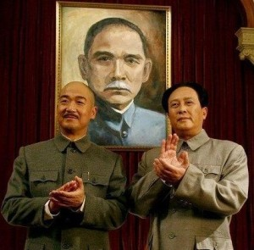
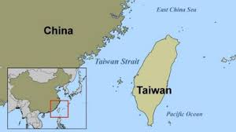
Chinese Communist Revolution (1946-1950)
The Chinese Communist Party was founded in 1921. The governing Chinese Nationalist Party, led by Chiang Kai-shek, sought to undermine and quash the communists.
Yet the two sides formed an uneasy alliance during WWII to oppose Japanese imperialism. After the war, the U.S. tried to broker a coalition -government but failed and the two factions fell into civil war with the U.S. supporting Chiang and the Soviet Union supporting Mao Zedong and the communists.
In 1949, the communists had taken control of the mainland with Chiang and the nationalists fleeing to Taiwan. The war effectively ended when the U.S. entered the theater during the Korean War in 1950.
Chiang Kai-shek (l) and Mao Zedong in front
of a portrait of Sun Yat-sen, the founder of
the post-imperial Republic of China.

Slide 4
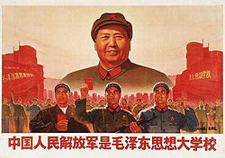
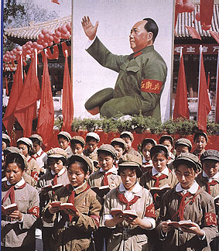
Mao’s Reign
As with the communists in the Soviet Union, Mao the Chinese communists implemented an authoritarian government with Mao wielding dictatorial powers.
During the “Great Leap Forward” (1958-1962) Mao sought to transform the largely agrarian economy into a socialist one through rapid industrialization and collectivization. Mao used coercion, terror, and systematic violence to implement his policies which failed and tens of millions died in the resulting famine.
Weakened, Mao sought to consolidate his power. During the “Cultural Revolution” (1966-1976) Mao sought to purge the nation of the last remnants of capitalism and traditional Chinese society. Violence ensured and millions were persecuted through public humiliation, arbitrary imprisonment, torture, hard labor, sustained harassment, seizure of property and sometimes execution. A large segment of the population was forcibly displaced, historical relics and artifacts were destroyed, and cultural and religious sites were ransacked.

Slide 5
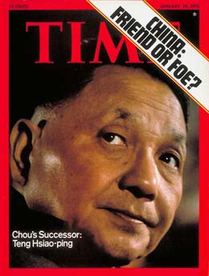
Modern China’s State Capitalism
After Mao’s death in 1976, reformers led by Deng Xiaoping gradually began
to dismantle the Maoist policies associated with the Cultural Revolution,
yet they still governed through authoritarianism.
The U.S. and China established full diplomatic relations in 1979 and the U.S.
recognized Deng’s government (and not Taiwan) as the legitimate government of China.
Deng steered China toward a new era of practical economic development known as “state capitalism” where the government, through state-owned companies, manages the exploitation of resources to create and maintain large numbers of jobs. The goal is not economic (maximizing growth) but political (maximizing the state’s power and the leadership’s chances of survival). This is a form of capitalism but one in which the state acts as the dominant economic player and uses markets primarily for political gain.
Ideology was deemphasized, numerous statues of Mao were removed, and portraits of Marx, Engels, Lenin, and Stalin were taken down from Tiananmen Square.
By the 1980s, many Chinese were speaking out about their nation’s problems and pressed for economic and democratic reforms as inflation, political corruption, and massive urban migration emerged. 20 million Chinese were unemployed and 100 million did not have enough food.

Slide 6
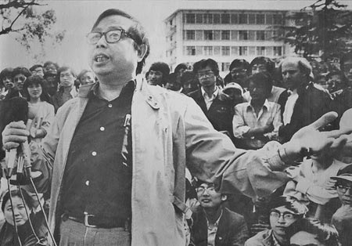
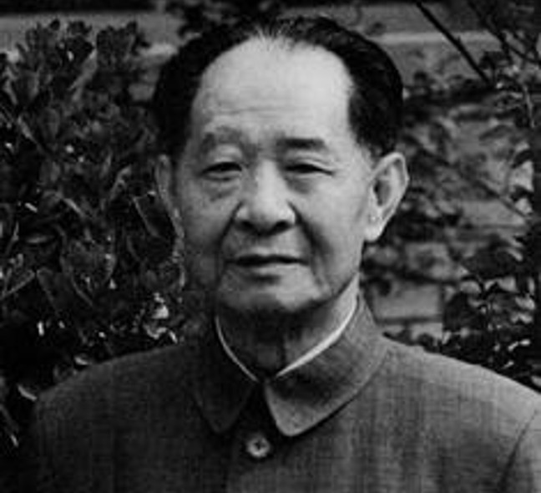
1986 Chinese Student Demonstrations
In mid-1986, astrophysics professor Fang Lizhi (top), who had returned from teaching at Princeton University, began a personal tour around universities in China, speaking about liberty, human rights, and separation of powers.
Students responded and protests began in a number of cities.
Hu Yaobang (bottom) had been an ally of Deng in the political and economic reforms but was blamed by hardliners for a tolerant attitude toward the growing social unrest.
Hardliners fired Hu, who was then General Secretary of the Communist Party of China, and cracked-down on the protests in early 1987.
Many of Fang’s students would lead the Tiananmen Square protests two years later.

Slide 7
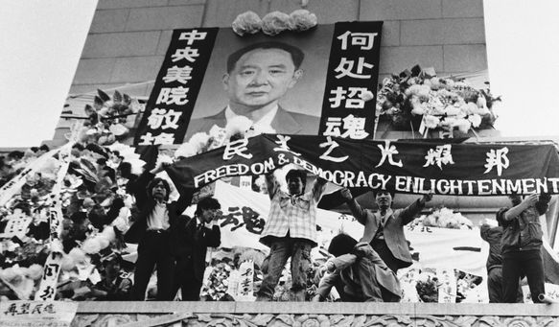
‘89 Democracy Movement
Hu’s death on April 15, 1989, however, was the catalyst for widespread protests. A day after Hu’s death, a small-scale demonstration commemorated him and demanded that the government reassess his legacy.
A week later, the day before Hu’s funeral, 100,000 students marched on Tiananmen Square, leading to a large-scale protest movement by students, intellectuals, and other parts of a disaffected urban population, not only in Beijing, but also in Shanghai, Guangzhou, and Chengdu among 400 other cities.
University students and other citizens in Beijing camped out at Tiananmen Square to mourn Hu’s death and to protest against those who would slow reform. A student-led hunger strike demonstrated the lengths to which the protesters were willing to go to achieve their aims.
Their protests, which grew over a month-and-a-half despite government efforts to contain them, called for an end to official corruption, democracy, and freedom of speech and press.

Slide 8
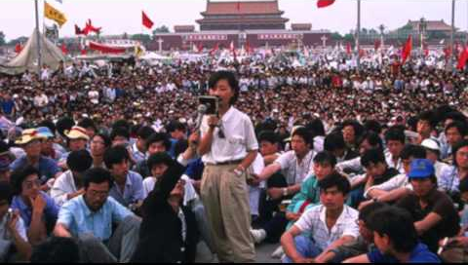
Tiananmen Square Protests (1989)
At its height, one million people filled the square and American and other foreign media covered the movement live on television. There was widespread speculation that China was in a revolutionary moment.
The implications of the protests were not lost on hardline government officials. They battled with reformers inside the government but ultimately Deng and his allies declared martial law on May 20th and sent in 300,000 troops with tanks and assault rifles.
It is important to understand that the Chinese Army was composed of poor, uneducated young people from remote, rural areas of China. The demonstrators they were sent to suppress were the educated, urban future leaders of the nation’s capital who were engaged in peaceful protest.

Slide 9
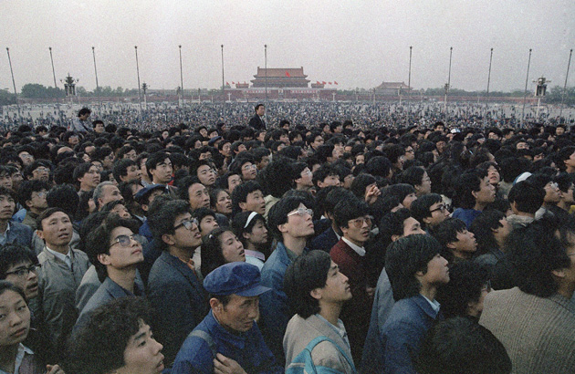
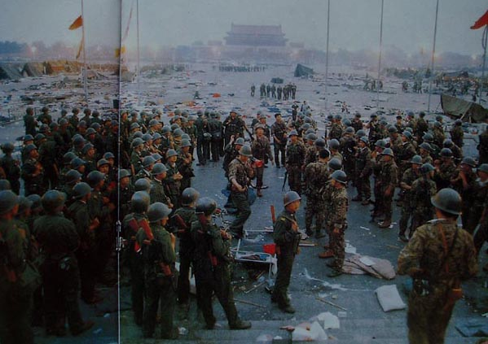
The massacre began the night of the 3rd and continued through the next day. Though relatively few were killed on the square itself as authorities cleared it, as many as 1,000 were killed throughout Beijing including university professors, technical people, officials, workers, owners of small private enterprises, retired workers, high school students and grade school students—the youngest was age 9.
Fang Lizhi was “wanted” by the government even though he did not take part in the protests. He sought asylum at the U.S. Embassy and was ultimately allowed to leave the country in exile one year later and returned to the U.S.

Slide 10
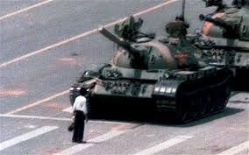
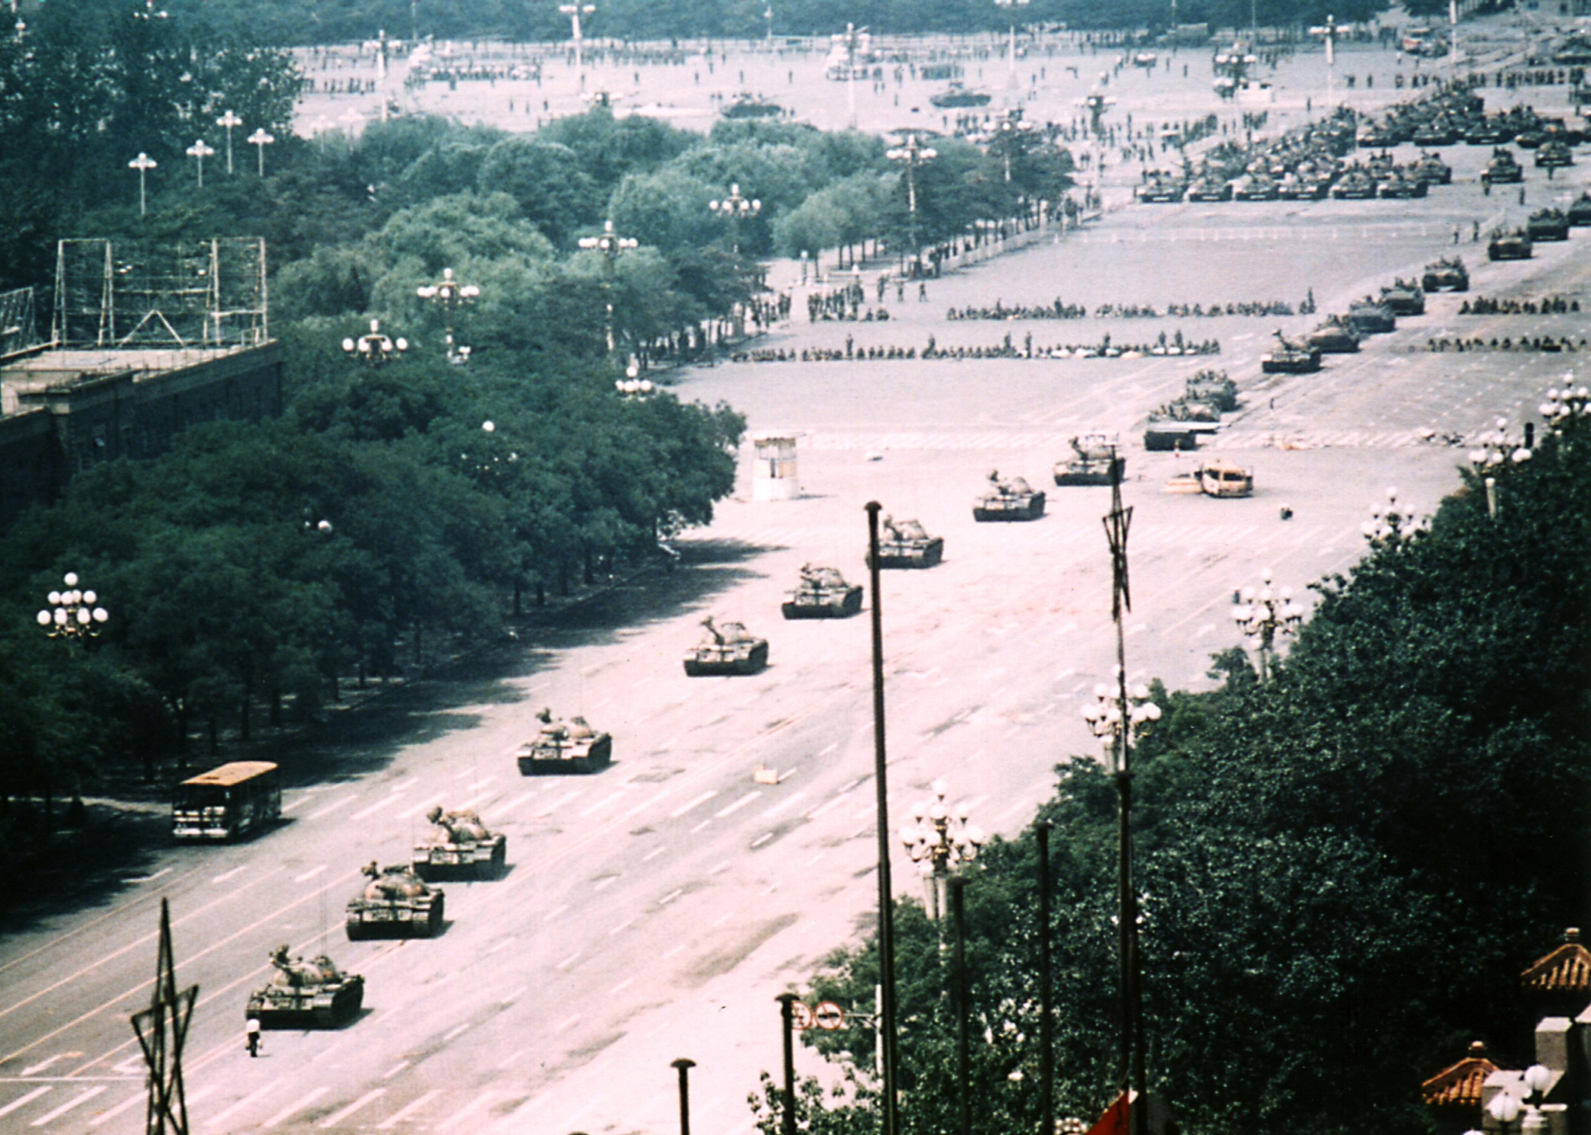
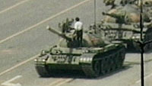
Tank Man
On June 5, suppression of the protest was immortalized in Western media by the famous video footage and photographs of a lone man standing in front of a column of tanks driving out of Tiananmen Square.
The iconic photo that would eventually make its way around the world was taken on June 5 on Chang’an Ave. As the tank driver attempted to go around him, the “Tank Man” moved into the tank’s path. He continued to stand defiantly in front of the tanks for some time, then climbed up onto the turret of the lead tank to speak to the soldiers inside. After returning to his position in front of the tanks, the man was pulled aside by a some plain-clothes people—it is unclear whether they were police or protesters.

Slide 11
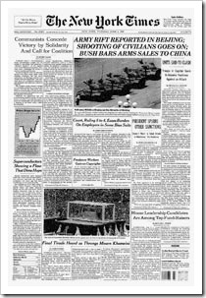
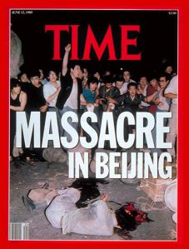
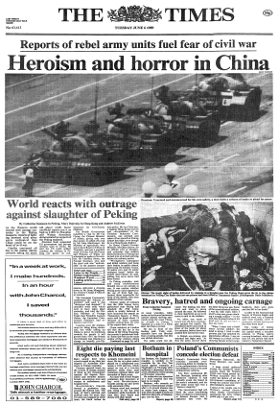
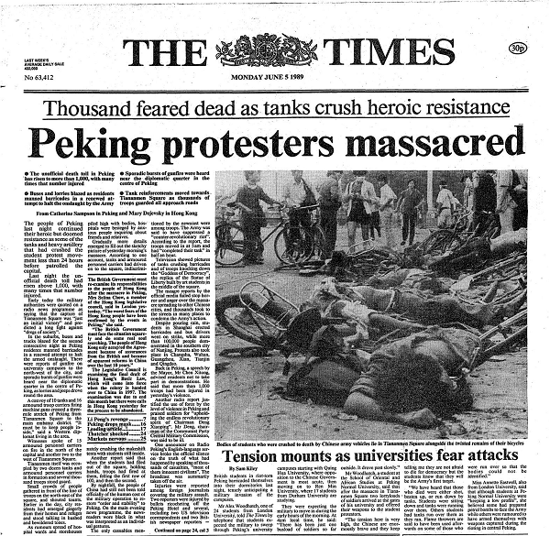
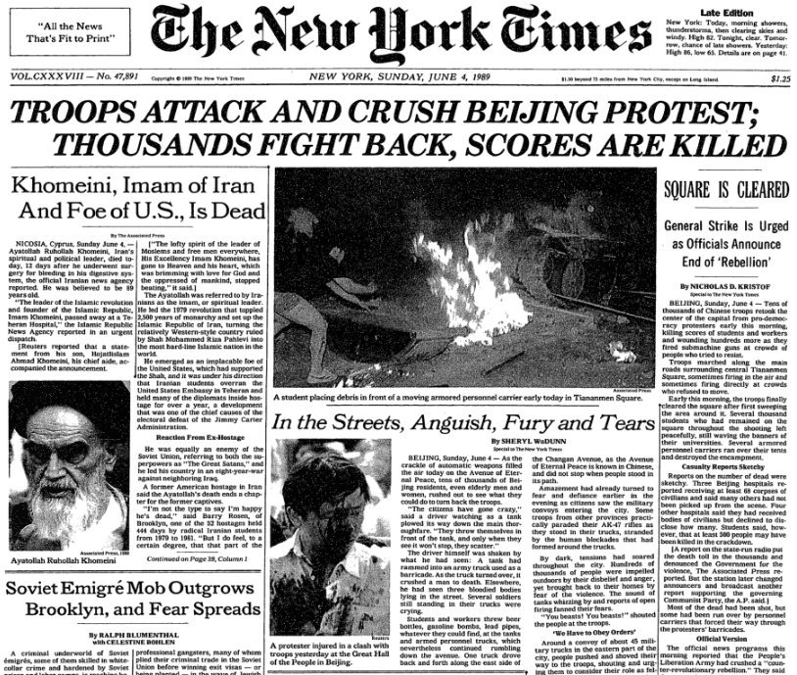

Slide 12
Aftermath & Implications
The international community widely condemned the use of force and
Western countries imposed economic sanctions and arms embargoes.
In the aftermath of the crackdown, the government:
conducted widespread arrests of protesters and their supporters,
suppressed other protests around China,
expelled foreign journalists,
strictly controlled coverage of the events in the domestic press,
strengthened police and internal security forces were strengthened,
demoted or purged officials deemed sympathetic to the protests,
temporarily halted the policies of liberalization.
Considered a watershed event, the protests also set the limits on political expression in China well into the 21st century. Its memory is widely associated with questioning the legitimacy of Communist Party rule, and remains one of the most sensitive and most widely censored political topics on mainland China.
The Chinese government censored the details of Hu's life inside mainland China for the next 15 years. But, on what would have been Hu’s 90th birthday in 2005, it officially rehabilitated his image and lifted its censorship restrictions.
The Tiananmen Square Massacre was remarkable considering that only months later the Berlin Wall would be dismantled and two years later the Soviet Union would collapse.

Slide 13
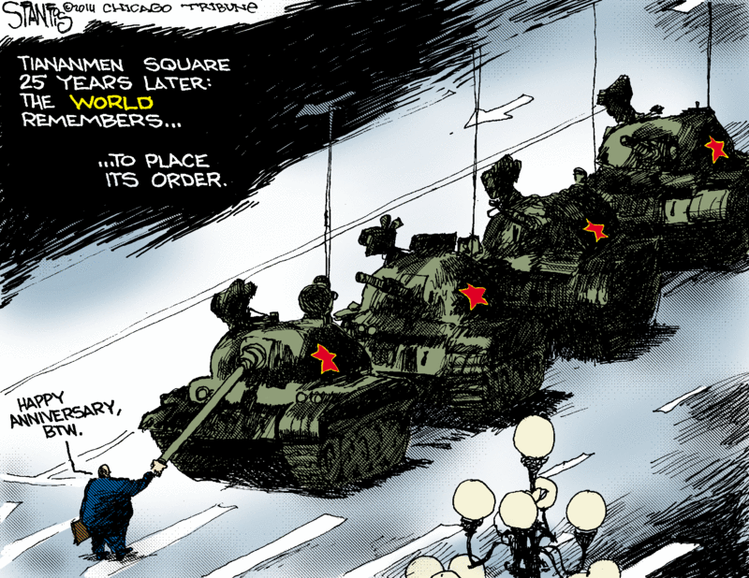
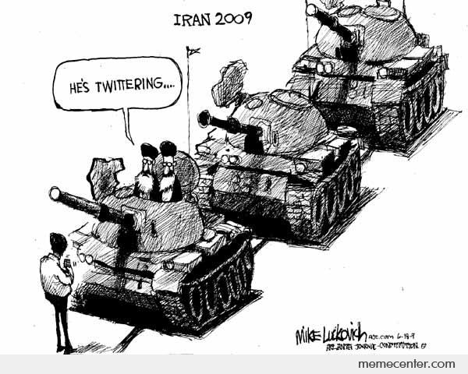
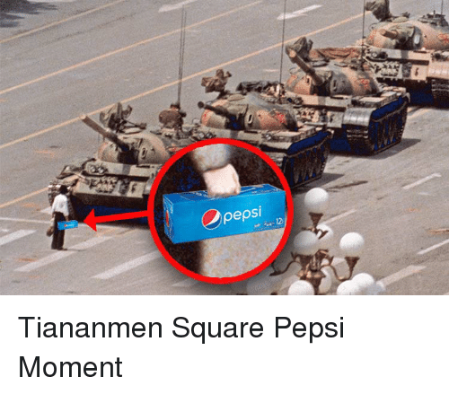
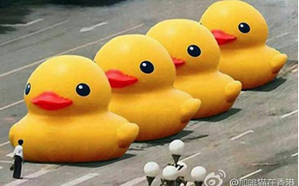
The iconic protest image has lived on in political cartoons and as internet memes.
One wonders how many of our students who laugh at the latest tanks meme understand the significance of the original episode.

