Slide 1
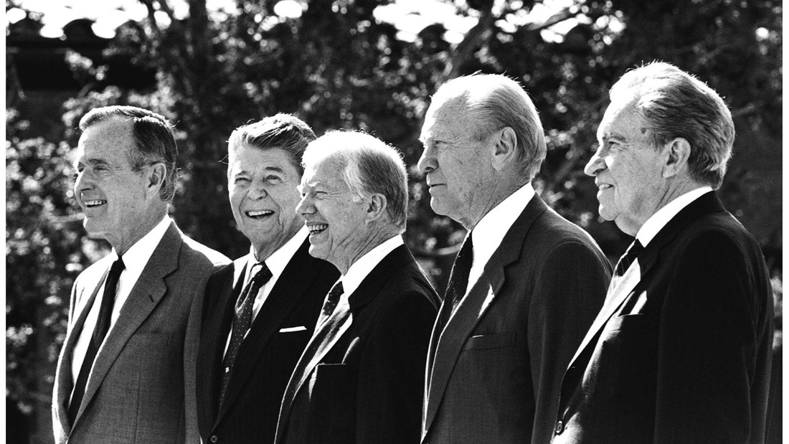
Patterns of Presidential Influence
Artemus Ward
Dept. of Political Science
Northern Illinois University
aeward@niu.edu
http://www.niu.edu/polisci/about/faculty-staff/full-time-faculty/ward-site/
Bill of Rights Institute
Kansas City, Kansas
June 6, 2017

Slide 2
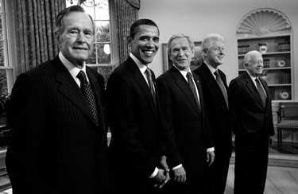
American Political Time
There is a recurring pattern in presidential history, which starts when a transformative presidency creates a new political order out of the ashes of an older one (think the transition from Hoover to FDR).
This transformative president is typically followed by a loyal disciple (Harry Truman, for example), and then by a president of the opposite party who has little choice but to operate within the existing political order (Dwight Eisenhower).
As long as a given political order persists, power rotates between presidents who are devoted to the reigning political orthodoxy (John F. Kennedy and Lyndon Johnson) and those who resist that orthodoxy but can’t quite dislodge it (Richard Nixon).
The cycle ends with a president who seeks to uphold a political order that is on the verge of collapse due to internal conflicts and contradictions that grow ever more difficult to reconcile.

Slide 3
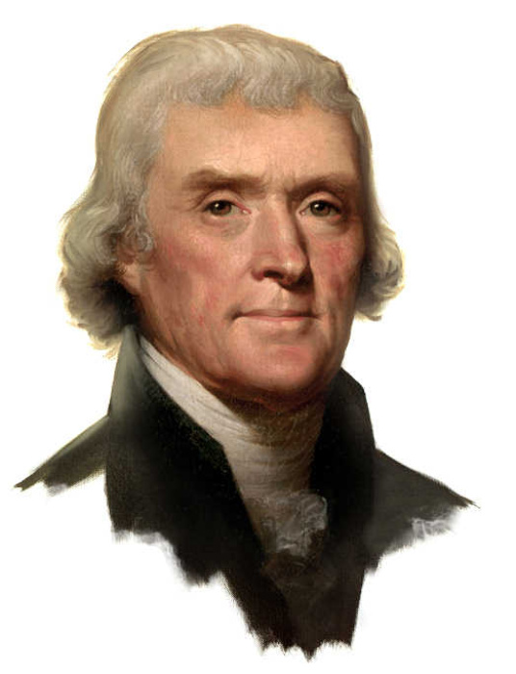
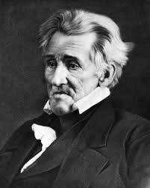
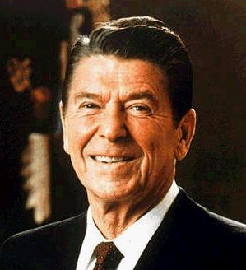
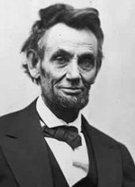
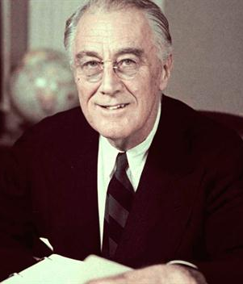
American Political Regimes: Reconstruction
A regime begins with a reconstruction. A president, and other office holders, are elected with expansive warrants to repudiate the politics of those who came before.
These presidents transform the ideological commitments of the nation and fashion a coalition of various interests in order to gain and wield power.
These presidents are generally thought of as the most successful presidents in American history: Jefferson, Jackson, Lincoln, FDR, and Reagan.

Slide 4
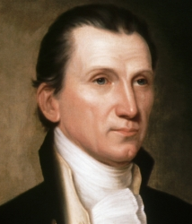
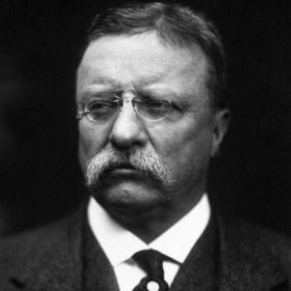
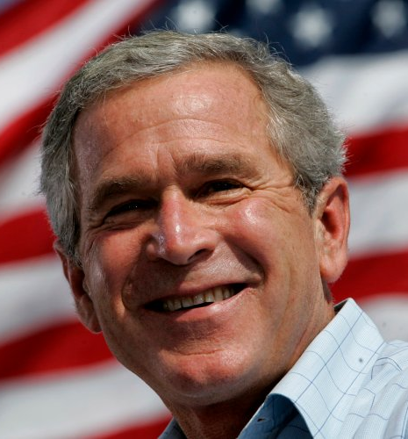
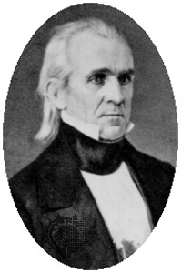
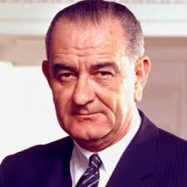
American Political Regimes: Articulation
Reconstructive presidents are followed by presidents from the same party who articulate the regime’s commitments.
These are the “heir apparents” and “faithful sons” who apply the orthodoxy of the regime to new issues that arise.
But in doing so, the coalition of interests that held together during the reconstruction begins to fray and these presidents often abdicate or otherwise depart the office under heavy criticism: Monroe, Polk, Theodore Roosevelt, LBJ, and Bush II.

Slide 5
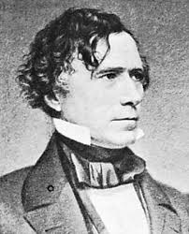
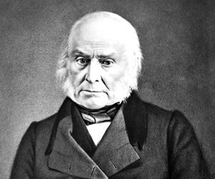
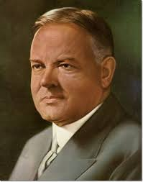
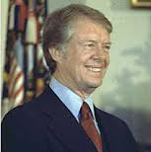
American Political Regimes: Disjunction
Elected toward the end of a political regime, disjunctive presidents are nominally affiliated with the regime (and the reconstructive and articulative presidents who came before them) and preside over the regime’s downfall as the ideological commitments of the regime are called into question and the coalition of interests that held the regime together becomes untenable.
Disjunctive presidents are generally considered among the worst in American history: John Quincy Adams, Pierce, Hoover, and Carter.

Slide 6
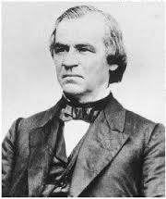
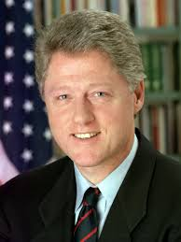
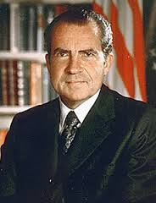
American Political Regimes: Preemption
In between the presidencies held by those affiliated with the political regime are presidents from the opposition party who temporarily preempt the regime.
These are the wild cards of American politics with some preemptive presidents able to achieve success (e.g. Cleveland, Eisenhower) by moderating their party’s positions on issues and working with the party that transformed the regime.
However, because they are opposition presidents, they have critics on all sides who attempt to delegitimize them and destroy their presidencies.
Thus, preemptive presidents are often delegitimized and/or impeached: Andrew Johnson, Nixon, Clinton.

Slide 7
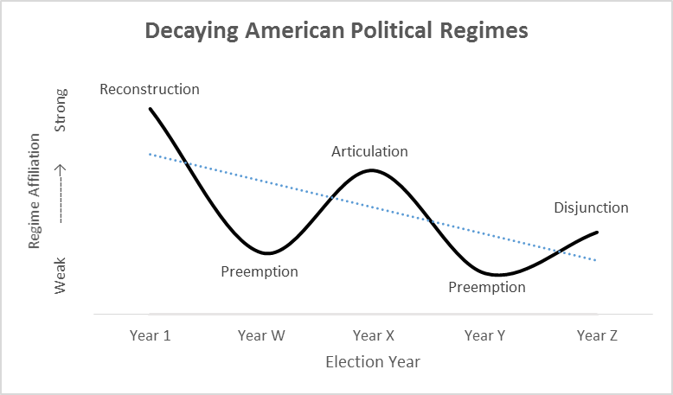

Slide 8
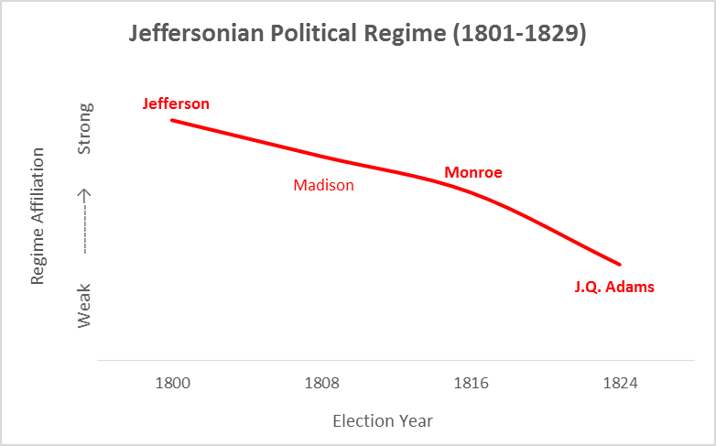

Slide 9
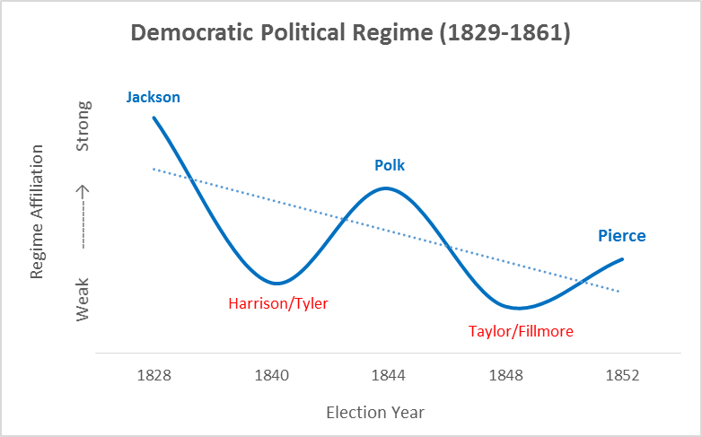

Slide 10
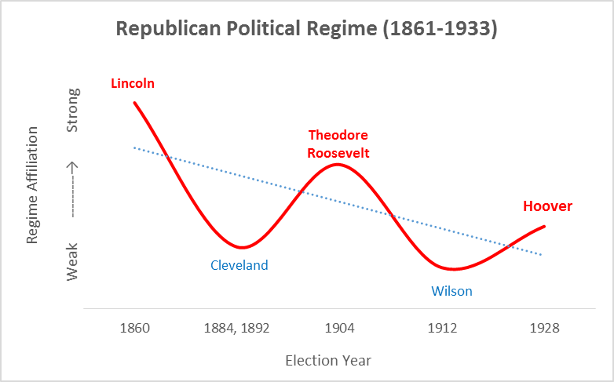

Slide 11
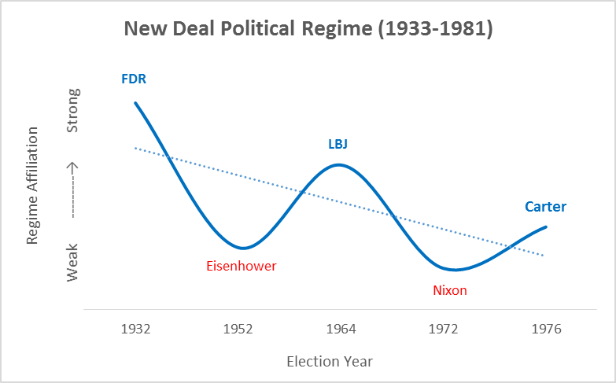

Slide 12
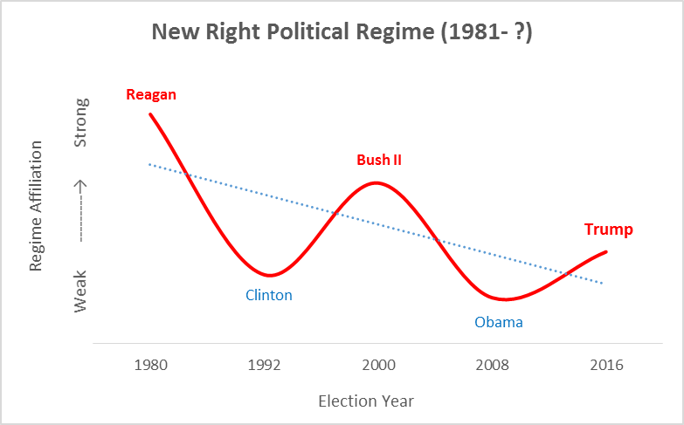

Slide 13
The Politics of Articulation
They come to power as representatives of the dominant political alliance.
The goal is to complete the work of the reconstruction, to maintain and vindicate the governing commitments of the dominant coalition, to serve the interests of the faithful (service delivery).
The trick is adapting the agenda of the reconstruction to new issues and events that have arisen—to keep the agenda timely and responsive to changing demands.
Conflicts among interests in the dominant coalition begin to cause political disaffection and weaken regime support.
Articulating presidents work to ameliorate factional divisions in the ranks (conflict control). They practice the art of aggressive maintenance to keep the whole from falling apart—which nearly works.
They are regime managers who avoid debates about ideology and interests.

Slide 14
Articulating Elections
As candidates, articulating presidents generally have 2nd-rank status in the party. They work their way up through the party ranks.
As candidates, they are not tied to a major party faction.
They engage in careful posturing to cultivate all regime interests.
They accept an especially controversial commitment that has long threatened to split the party apart but still holds majority support.
The elections are astonishingly close, which gives the opposition strong claims to the presidency and highlights the importance of the articulating president’s ability to service (as well as their dependence on) all regime factions.
Pledging to serve only one term is a way to garner all factional support as party giants aren’t foreclosed from running in the next election. Although it’s a bid for party unity, the party is likely to chew itself up under a passive, caretaker, one-term presidency.

Slide 15
Relationship to the Regime
Commitments of ideology and interests are all too clear and the fusion of national political legitimacy with established power relationships argues against any attempts to tinker with the basics of government and politics.
These presidents are partners to a highly structured regime. To make it work, they must anticipate and control impending disruptions.
If they take office after preemption (as is almost always the case), they promise to revise the commitments and revitalize the vision of the regime founder.

Slide 16
Governing
Cabinet appointments (patronage) is a way to appease all factions in the party.
The difficulty is that any action taken will evoke charges of favoritism.
Factional paranoia and ideological heresies have to be held in constant check. Mutual self-interest has to remain at the forefront so that reciprocal party obligations can be reinforced.
Articulating presidents engage in a constant struggle to mute the passions that divide their supporters and stem the tide of coalition disaffection.
They hold out their support to all interests and demand in return that each agree to allow the executive to determine the range, substance, and timing of policy initiatives.

Slide 17
Foreign Wars
Articulating presidents are most effective in marshaling the regime in international affairs.
Thus, they cannot resist the temptation to engage in small foreign wars of dubious provocation.
Muscle-flexing adventures driven more by ideology and political management than by necessity. It is not that these presidents want to go to war, they have no choice because the war-hawk faction of their party/regime demands it.

Slide 18
Theodore Roosevelt’s Articulation
Had he not been assassinated, President William McKinley would have been the articulator of the Republican regime that began under Lincoln. Instead, it was TR who served for 7 years (the remaining 3 years of McKinley’s term and one term of his own).
TR had to adapt the regime’s commitments to a new development: the shift from an agrarian economy to an industrial one.
The major schism in the Republican regime was between the “standpatters” who were satisfied with the status quo (laissez-faire, industrial capitalism) and the “progressives” who wanted change (a more active role for government and government officials).
The protective tariff was the cornerstone of the Republican regime. TR split the difference between the party factions by keeping the tariff but making special trade agreements when necessary. By keeping the tariff he was able to get congress to pass his railroad regulation bill.
To deal with growing corporate power he spoke directly to the American people (“bully pulpit”), built a federal government bureaucracy (e.g. Bureau of Corporations with investigative power), and engaged directly with business and labor leaders (e.g. Coal Strike of 1902).
Despite his efforts, the factions in the party continued to war. Standpatters were against government regulation and progressives felt TR did not go far enough.

Slide 19
Theodore Roosevelt’s Articulation
TR flexed his muscles in foreign policy settling border dispute with Britain, expanded Monroe Doctrine of U.S. hegemony over Latin America via Panama Canal, and dramatically strengthened the Navy—tying each of these to the Republican regime’s commercial interests.
In the end, the fraying Republican coalition made governing difficult for TR and he was only able to accomplish moderate reforms. Indeed, the Republican-controlled House of Representatives even censured him!
TR failed in his attempt to return to the presidency by running against his hand-picked successor (President William Howard Taft). Political time constrained his attempts to become a reconstructive president and transform the regime, despite the fact that he was the most popular articulating president in history.
Ultimately, TR’s political career demonstrates not only the difficulty Republicans faced in governing during the Gilded Age, but also how presidents are constrained by their place political time.

Slide 20
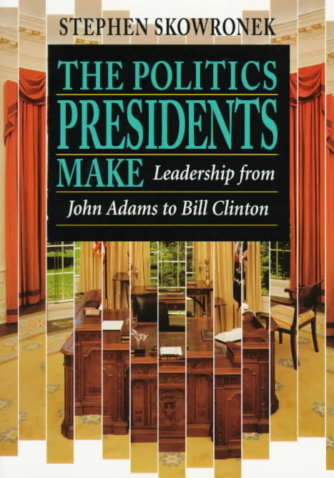
Further Reading
To learn more about the rise and fall of American political regimes and presidential leadership in political time, see:
Skowronek, Stephen, The Politics Presidents Make: Leadership from John Adams to Bill Clinton, revised ed. (New York: Belknap Press, 1997).
Skowronek, Stephen, Presidential Leadership in Political Time: Reprise and Reappraisal, 2nd ed. (Lawrence: University Press of Kansas, 2011).
For a brief history of each American presidential election, see:
Boller, Paul F. Jr., Presidential Campaigns: From George Washington to George W. Bush (New York: Oxford University Press, 2004).

