Slide 1
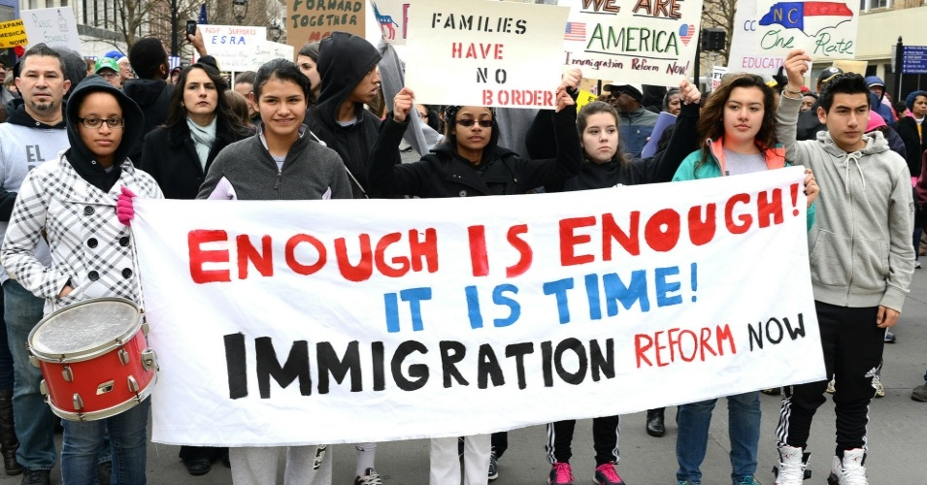
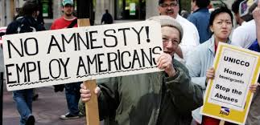
Modern Debate on Immigration: Liberal Era (1943-2016?)
Artemus Ward
Dept. of Political Science
Northern Illinois University
aeward@niu.edu
Bill of Rights Institute

Slide 2

Liberal Era (1943-2016?)
Immigration restrictions were progressively relaxed from 1943 on as the Cold War caused America to rethink its immigration stance in the face of criticism from its adversaries.
The Magnuson Act (1943) allowed Chinese immigration for the first time since the Chinese Exclusion Act of 1882, and permitted some Chinese immigrants already residing in the country to become naturalized citizens.
The Immigration and Nationality Act of 1952 (also known as the McCarran–Walter Act) prohibited racial and gender discrimination in naturalization. However, it retained a quota system for nationalities and regions. Eventually, the Act established a preference system which determined which ethnic groups were desirable immigrants and placed great importance on labor qualifications.
The Act defined three types of immigrants: immigrants with special skills or relatives of U.S. citizens who were exempt from quotas and who were to be admitted without restrictions; average immigrants whose numbers were not supposed to exceed 270,000 per year; and refugees.
President Harry Truman vetoed the bill because he felt it was not liberal enough and continued what he saw the nation’s “un-American” and discriminatory immigration policy.
Ironically, the liberalizing trend that struck ethnic discrimination from immigration law occurred at a time when American-born blacks were still struggling to achieve their full rights.

Slide 3
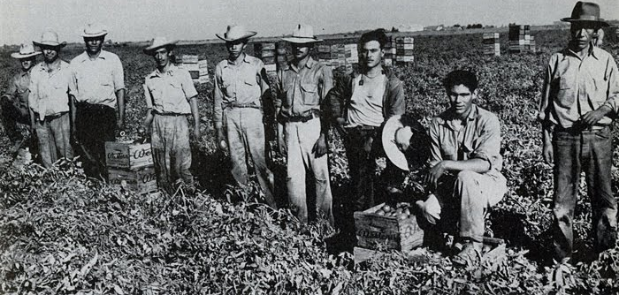
Mexicans and
Central Americans
Undocumented (“unauthorized” or “illegal”) immigrants, mainly from Mexico and Central America, began entering the United States in the 1910s, with over a million Mexican people seeking to escape the Mexican Revolution. The majority of these immigrants were of indigenous descent and from poor and working class backgrounds. Their numbers increased during the 1920s.
During the economic depression of the 1930s, undocumented immigration declined as economic opportunities in the U.S. became scarce. The federal government also became more active in enforcing immigration law.
Facing labor shortages during World War II, the U.S. and Mexico formed an agreement known as the Bracero Program, in which Mexicans were permitted into the U.S. to work on farms. This allowed several hundred thousand migrant workers to work in the U.S. during the 1940s, and many more continued to participate in the 1950s.
Though the Bracero Program was designed to meet labor shortages and discourage illegal immigration, undocumented immigrants continued to come to America.

Slide 4
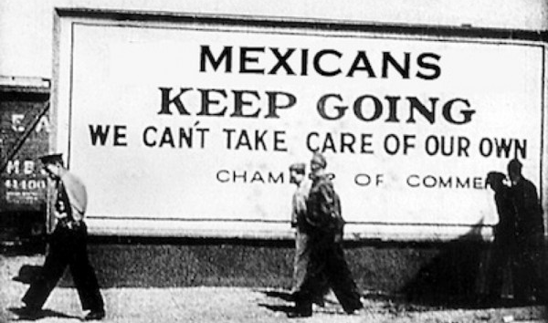
Backlash: Deportation
Finding and possibly deporting undocumented immigrants was the sole responsibility of the federal government and it was up to the executive branch to determine whether to expend resources to achieve this.
Concerned about disregard for the law and mounting competition against American agricultural workers, in 1954 the Eisenhower administration chose to begin systematic deportations of illegal immigrants.
Within a few years, more than a million people were apprehended.
Over time, Congressional opposition to the Bracero Program continued to grow, and in 1964 it was abolished.

Slide 5
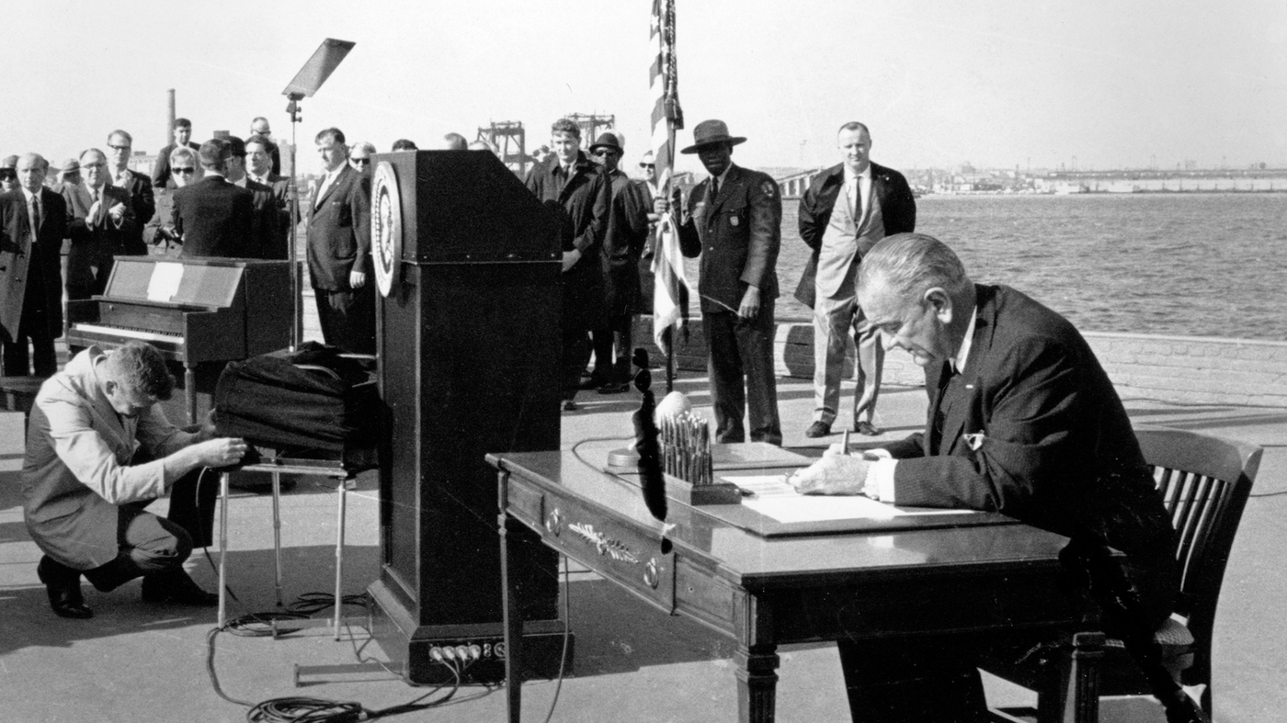
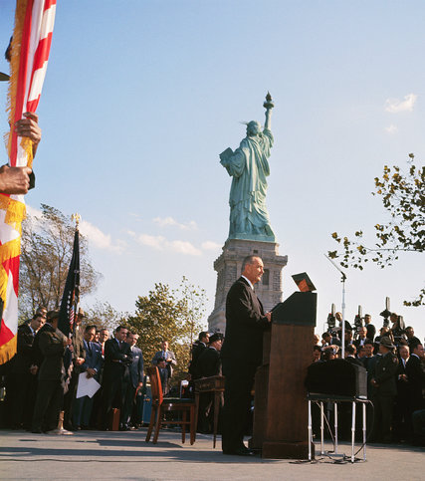
Immigration and Nationality Act (1965)
The 1924 quotas had essentially remained in place with minor alterations until the Immigration and Nationality Act of 1965 (aka Hart–Celler Act) was passed and signed by President Lyndon Johnson.
It ended the National Origins Formula, allowed 120,000 immigrants be admitted annually from Western Hemisphere nations in Latin and South America, 170,000 people per year would be admitted from Asia, Africa, and Europe combined.
The reforms of 1965 initiated a substantial change in the ethnic and national origin of immigrants and this accounts for the rapid growth of the non-European population seen today. Instead of a movement of people almost solely from Europe, immigration today is dominated by non-European peoples from all parts of the world.
Further, the 1965 reform provided an avenue for immigrants’ families to come to the United States after them, as family immigration is usually not counted in the overall quota. With minor revisions, the standards set forth in the Immigration and Nationality Act of 1965 remain in effect today and still determines from which countries the United States draws its new citizens.
The architects of the law believed it would favor Europeans but it actually opened doors for Asians and Latinos who became the next big immigrant groups to feel the nativist backlash.

Slide 6
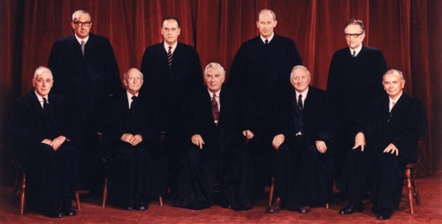
Resident Immigrants
In Graham v. Richardson (1971) the U.S. Supreme Court considered a challenge to the denial of public assistance to legally resident non-citizens (aliens). The Court held that noncitizens were a “suspect class” and therefore accorded special constitutional protections, historically reserved for racial minorities such as African Americans.
In the wake of Graham, the Court nullified a number of laws that prohibit resident aliens from:
  obtaining civil service employment (Sugarman v. Dougall, 1973),
  becoming a member of the bar (In re Griffiths, 1973),
  receiving financial aid for college (Nyquist v. Mauclet, 1977).
However, in Foley v. Connelie (1978) a divided Supreme Court concluded that the Constitution was not violated when a state denies an alien a job in law enforcement. The justices held that it is not necessary to apply strict scrutiny when a government can demonstrate that citizenship bears a rational relationship to the job.

Slide 7

Undocumented Immigrants
Unlike the previous line of cases that involve immigrants who legally reside in the U.S., illegal or undocumented aliens present an entirely different issue.
Should undocumented immigrants be entitled to the same benefits and social services as enjoyed by citizens and resident aliens?
To what extent does the Constitution protect undocumented aliens from discriminatory treatment?
In Plyler v. Doe (1982) the Supreme Court struck down 5-4 a 1975 Texas law that withheld from local school districts any state funds for the education of children who were not legal U.S. residents. The law also allowed local school districts to deny enrollment to any student who was an undocumented immigrant under the Texas education code. Thus, under the 14th Amendment’s Equal Protection Clause (which protects “persons”), undocumented children cannot be denied a public education.

Slide 8
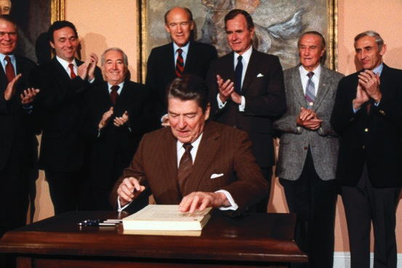
Immigration Reform and Control Act (1986)
In 1986, President Ronald Reagan supported and signed into law the Immigration Reform and Control Act (IRCA), providing amnesty to millions of undocumented immigrants already living in the U.S., while also promising enhanced border security. Simultaneously, IRCA created penalties for employers who knowingly hired undocumented immigrants, while mandating increased border security.
Following IRCA, the rate of illegal immigration increased rather than decreased. Before the law, the undocumented population mainly consisted of transients, who entered and left the U.S. as agricultural seasons changed and work became available.
After the law was passed, illegal immigrants increasingly took up permanent residence in the U.S. and joined family members who had been granted amnesty.

Slide 9
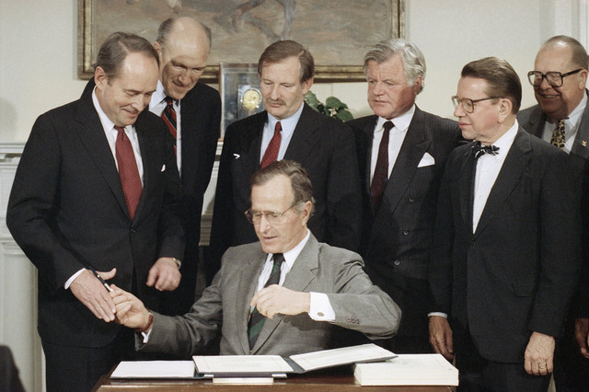
Immigration Act (1990)
Sen. Ted Kennedy (D-MA) introduced the Immigration Act of 1990 to update entry quotas and Republican President George H.W. Bush signed it into law. It:
  increased total, overall immigration to allow 700,000 immigrants to come to the U.S. per year for the fiscal years '92–'94, and 675,000 per year after that.
  allowed the number of family-based immigrants to increase from 216,000 per year to 480,000 (family-based immigration occurs when an immigrant settles in the United States and is joined in later years by other family members).
  increased the total number of employment-based visas by nearly 100,000, and established a lottery for 55,000 more people to enter annually.
  provided another round of amnesty for family members of those who were granted legal status under the 1986 Immigration Reform and Control Act.
  lifted the English testing process for naturalization which had been in effect since 1906.
  Eliminated the exclusion of homosexuals under the medically unsound classification of "sexual deviant" that was present in the passage of the 1965 Act.
Bush said: "I am also pleased to note that this Act facilitates immigration not just in numerical terms, but also in terms of basic entry rights of those beyond our borders."

Slide 10
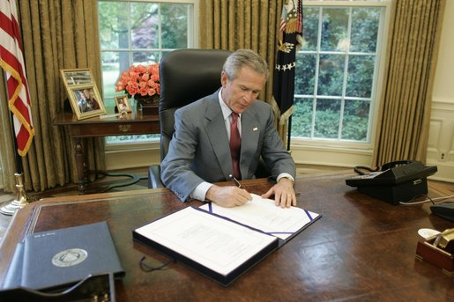
REAL ID Act (2005)
In 2005, Congress passed and President George W. Bush signed this law which prevents undocumented immigrants from obtaining a driver’s license without presenting proof of identity or without having a U.S. Social Security number.
The law was intended to make it difficult for undocumented workers to obtain a driver’s license, which would in turn impede their ability to obtain and hold jobs and access other services lawful immigrants and citizens would otherwise enjoy.
This law has not, however, altered the flow of undocumented immigrants into the country, however.

Slide 11
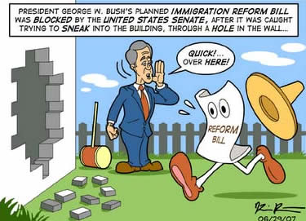
Amnesty Attempt Fails (2006-2007)
In 2006 and 2007, Congress debated a new set of major immigration reforms.
Under the proposed legislation undocumented immigrants would have been granted legal residency similar to the amnesty bestowed in the Immigration Reform and Control Act of 1986.
The federal government would have also increased border security and increased the number of available guest worker visas for lawful immigrants.
The bill faced enormous public opposition (a June 2007 Gallup poll found 60% of Americans opposed the law), and in both years the Comprehensive Immigration Reform Act failed to become law.

Slide 12
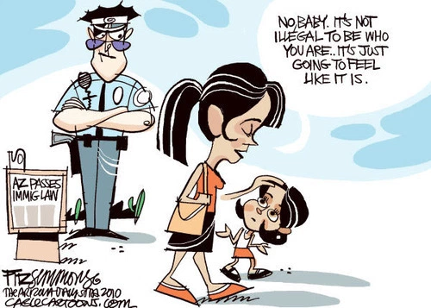
Arizona’s SB 1070 (2010)
In 2010, the state of Arizona enacted SB 1070, a law designed to curb illegal immigration through heightened enforcement of state and federal law.
The most important section of the law requires police officers, when in the process of a stop, arrest, or detention, to check a suspect’s immigration status, if the officer has reasonable suspicion to believe the person is an illegal immigrant.
This mandate sparked widespread protests and was challenged in the U.S. Supreme Court. In Arizona v. U.S. (2012), the Supreme Court upheld the constitutionality of this provision.

Slide 13
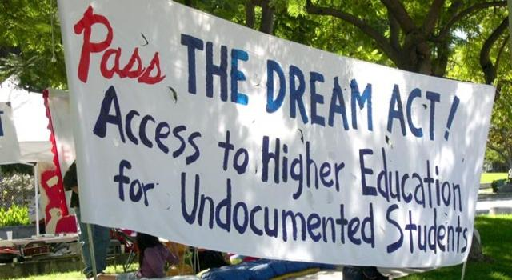
DREAM Act
In 2001, Sen. Dick Durbin (D-IL) and Sen. Orrin Hatch (R-UT) introduced the Development, Relief, and Education for Alien Minors Act, more commonly known as the DREAM Act.
Because many undocumented immigrants enter the U.S. with their children, these children also become undocumented immigrants. Since children have no control over the decisions and actions of their parents, supporters of the DREAM Act believe it is unfair to punish children because they entered the country with their parents.
The DREAM Act would provide a path to lawful residency for those individuals who came to the U.S. before they turned 16, provided they lived in the U.S. for the last five years and have graduated high school or passed the General Educational Development (GED) test.
Permanent residency may be granted if the individual attends college or enlists in the military and passes background checks.
It failed to pass, was reintroduced numerous times, and has never been enacted by congress.

Slide 14
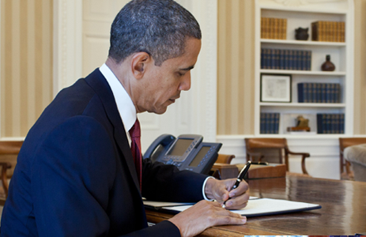
Obama Executive Orders: DACA and DAPA (2012-2014)
In 2012, President Barack Obama issued an executive order: “Deferred Action for Childhood Arrivals” (DACA).
It allowed some individuals who entered the country as minors, and had either entered or remained in the country illegally, to receive a renewable two-year period of deferred action from deportation and to be eligible for a work permit.
In 2014, Obama issued another executive order: “Deferred Action for Parents of Americans and Lawful Permanent Residents” (DAPA).
It granted deferred action status to certain undocumented immigrants who have lived in the U.S. since 2010 and have children who are either American citizens or lawful permanent residents. Deferred action is not full legal status but would come with a three-year, renewable work permit and exemption from deportation.
Obama also increased resources for border enforcement, implemented new procedures for high-skilled immigrants, and expanded the existing DACA program. As of 2017, approximately 800,000 individuals—referred to as Dreamers after the DREAM Act bill—were enrolled in the DACA program created by DACA.
Several states filed lawsuits against DAPA and a temporary injunction was issued in February 2015, blocking the program from going into effect while the lawsuit proceeds. The U.S. Supreme Court split 4-4 in U.S. v. Texas (2016) effectively leaving the block in place.

Slide 15
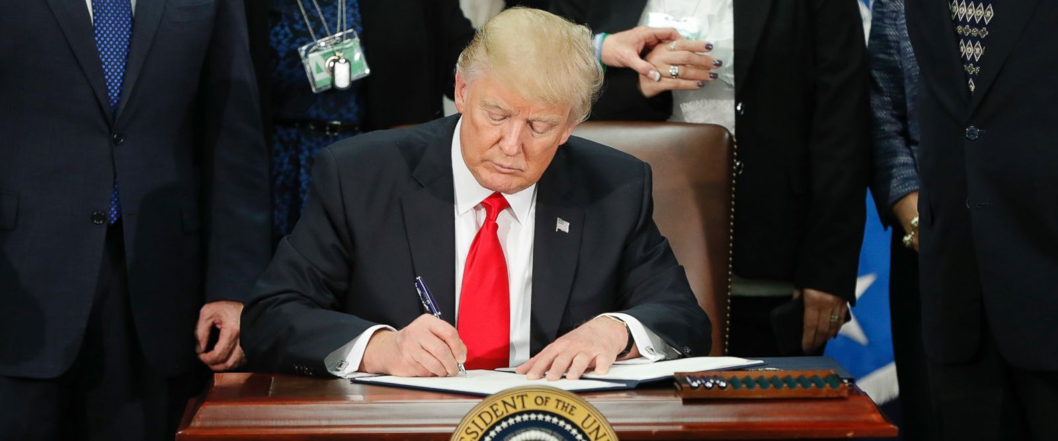
Trump Rescinds DAPA and DACA (2017)
In June 2017, the Trump Administration announced that it was rescinding DAPA.
It followed by rescinding DACA three months later, leaving the approximately 800,000 individuals enrolled in the program—referred to as Dreamers after the DREAM Act bill—in limbo and subject to deportation.

Slide 16
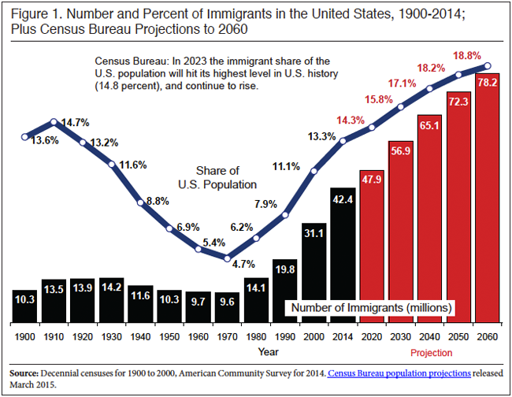
The clearest way to demonstrate the apparent continuity of immigration patterns in modern American history is to examine the percentage of foreign-born residents in the country, whom the census began to count only in 1850 vis-à-vis the gross number of immigrants admitted.
Between 1860-1920, a period when almost every aspect of American life was transformed, the incidence of immigrants in the American population was remarkably stable: in 7 successive censuses, about 1 American in 7 was foreign-born, the actual percentages varying only between 13.2 and 14.7%... (cont.)

Slide 17
Statistical Trends
The total number of resident immigrants grew steadily from 1850-1930, but their incidence in the population began to decline in 1910 and hit a low of 4.7%--less than one American in 20--in 1970.
This was well after immigration had begun to grow again, but the drop in incidence continued due to the high mortality among foreign-born because so many were old and so few immigrants had arrived in the previous four decades.
Because of depression, war, and immigration policy, fewer immigrants came to the United States between 1931 and 1971--7.3 million--than had arrived in the single decade 1901-10, even though the population in 1970 was more than twice as large as that in 1910.
Since 1970 the number and incidence of immigrants have risen, but that incidence is still well below traditional levels. The commonly held perception that America is receiving an unprecedented proportion of immigrants is false.
What has changed, however, have been American attitudes toward immigration and immigrants. One issue is the dualistic attitude that most Americans have developed toward immigration and immigrants, on the one hand reveling in the nation's immigrant past and on the other rejecting much of its immigrant present.

Slide 18
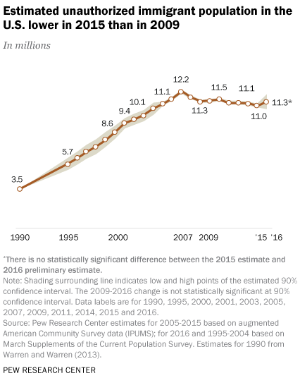
Unauthorized Immigrants: The Numbers
There are 11 million unauthorized immigrants in the U.S.
Unauthorized immigrants represent about 3% of the total U.S. population.
The number of unauthorized immigrants peaked in 2007 at 12.2 million, when this group was 4% of the U.S. population.
Why the decline since then?

Slide 19
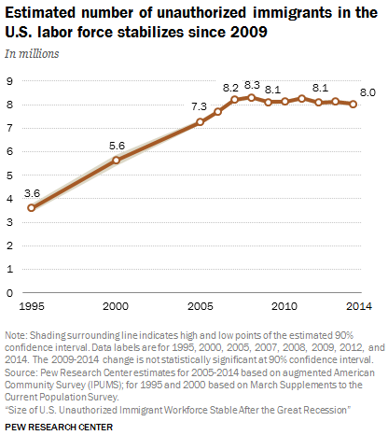
Unauthorized Immigrants in the Labor Force
The U.S. civilian workforce includes 8 million unauthorized immigrants, accounting for 5% of those who were working or were unemployed and looking for work.
Compared with their 5% share of the civilian workforce overall, unauthorized immigrants are overrepresented in farming and construction occupations (26% and 15%, respectively). In all industries and occupations, though, they are outnumbered by U.S.-born workers.

Slide 20
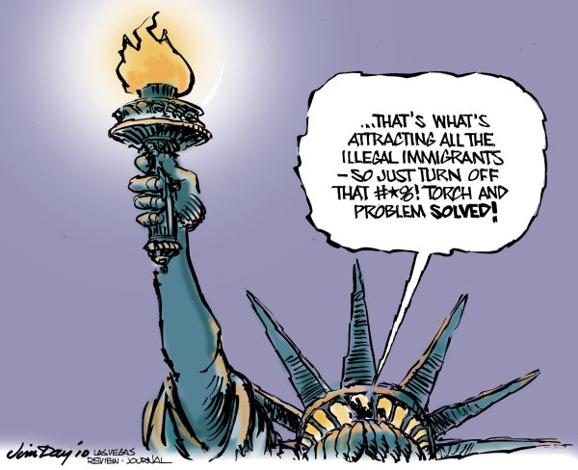
Conclusion
American immigration policy has shifted from essentially open borders to a restrictive era followed by a liberalizing era that has run through at least 2016.
Has the liberalizing era of immigration policy ended with the election of President Trump and his rescinding DAPA and DACA?
Is America returning to the pre-1943 restrictive era?
Will America ever return to essentially open borders?

