Slide 1
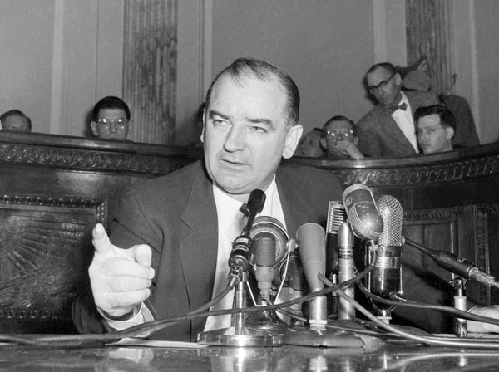
Joseph McCarthy and Demagoguery
Artemus Ward
Dept. of Political Science
Northern Illinois University
Bill of Rights Institute
Webinar
April 25, 2017

Slide 2
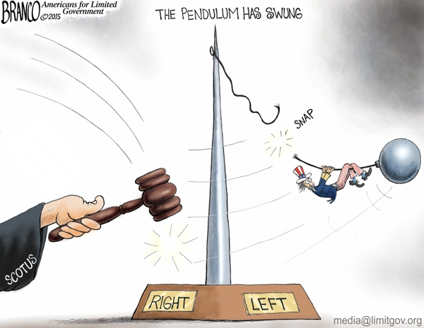
Introduction: McCarthyism in Context
Sen. Joseph McCarthy (R-WI) held office from 1947-1957.
During the Cold War, he used his position on a Senate sub-committee to accuse large numbers of Americans of being Communists and Soviet spies and sympathizers.
The term “McCarthyism,” coined in 1950 in reference to McCarthy’s practices, was soon applied to similar anti-communist activities. Today, the term is used in reference to what are considered demagogic, reckless, and unsubstantiated accusations, as well as public attacks on the character or patriotism of political opponents.
It is important to understand that McCarthy was not acting in isolation.
Both Democrats and Republicans were cold warriors and many were committed to rooting out communist infiltration of America, even decades before McCarthy came on the scene.
Through a review of the key Supreme Court cases of the era, we will see how the Court mirrored American society in the back-and-forth swing of the pendulum between conservative government authority and liberal civil liberties.

Slide 3
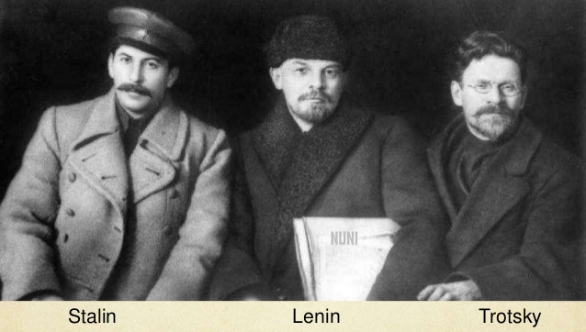
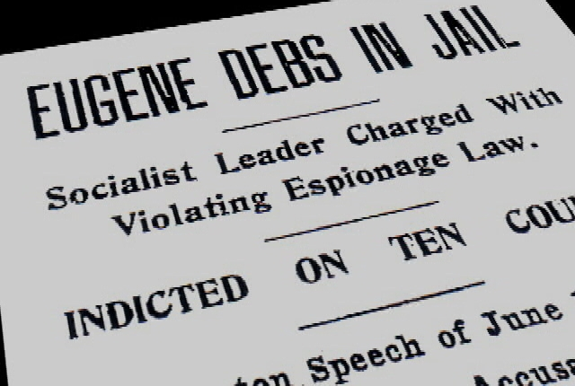
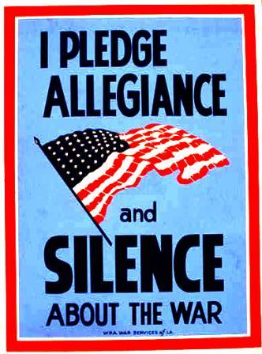
The First Red Scare
Following the Russian Revolution (1917), and a growing socialist movement in the U.S., fears over a similar communist takeover led to the passage of a number of federal and state laws targeting communist activity.
The Espionage Act (1917), amended by the Sedition Act (1918), prohibited interference with military operations or recruitment, to prevent insubordination in the military, and to prevent the support of United States enemies during wartime—notably by prohibition speech and the expression of opinion that cast the government or the war effort in a negative light.
In Schenck v. U.S. (1919), Debs v. U.S. (1919), and Abrams v. U.S. (1919) the Court upheld the laws and the thousands of convictions that resulted from it. The backlash against the laws and the decisions, however, led to congressional repeal of the Sedition Act in 1920 and President Woodrow Wilson pardoned or commuted the sentences of hundreds of people convicted under it.
An example of a similar state-level law was the New York Criminal Anarchy Law (1902) that prohibited advocating the violent overthrow of the government. In Gitlow v. New York (1925) the Court upheld the law and the conviction of a socialist who called for strikes and class action.
Similarly, California’s Criminal Syndicalism Act (1919) that prohibited the advocacy, teaching, or aiding the commission of a crime including terrorism as a means of accomplishing industrial or political change. The Court unanimously upheld the law in Whitney v. California (1927).
Despite each of these favorable legal precedents, peacetime and the Great Depression moved the nation and the Court in a more liberal direction and the justices began protecting suspected communists and/or labor organizers.

Slide 4
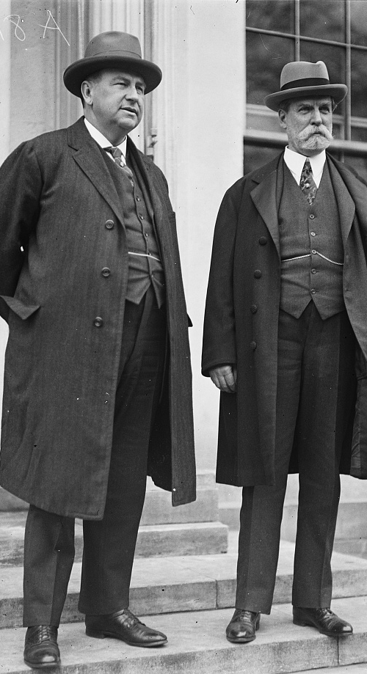
The Liberal Decisions of the Hughes and Stone Courts (1930-1946)
Charles Evans Hughes served on the Court from 1910-1916 and was later Chief Justice from 1930-1941. Harlan Fiske Stone served on the Court from 1925-1946 and was Chief Justice for the last five years.
In Stromberg v. California (1931), the Court struck down a state law that prohibiting the use or display of red fabric as impermissibly vague under the First Amendment’s freedom of expression.
In DeJonge v. Oregon (1937), the Court overturned the conviction the organizer of a Communist Party meeting as a violation of the First Amendment’s right to freedom of speech and association.
In Hague v. CIO (1939), struck down a local ordinance that prevented meetings of labor groups as a violation of the First Amendment’s right to freedom of assembly.
In U.S. v. Lovett (1946), the Court unanimously struck down a congressional statute denying salaries to three named federal government employees suspected of having communist sympathies as an impermissible bill of attainder.

Slide 5
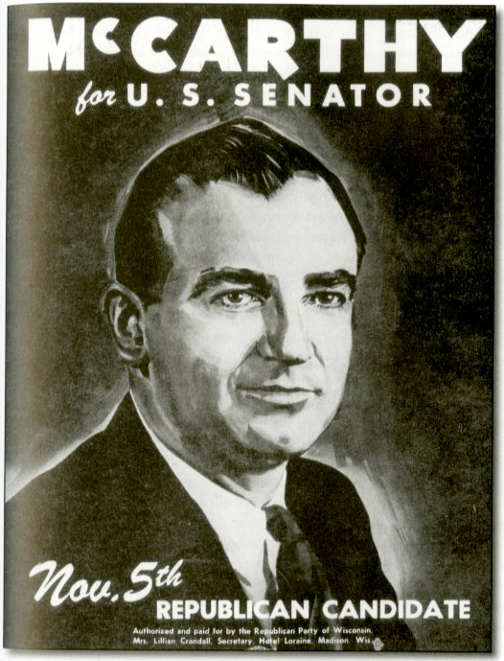
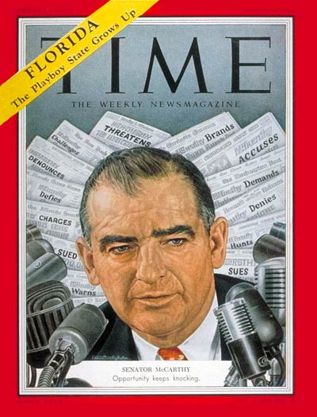
The Second Red Scare and the Rise of Joseph McCarthy
Soon after the end of World War II, the U.S. found itself in the midst of a second anti-Communist crusade.
While McCarthy was only one of many officials and institutions who propagated the Second Red Scare, his was highly visible and sought to use the issue for political and personal gain.
His chief tactic was using his power as a U.S. Senator to conduct committee hearings on potential communist infiltration of American government and society.
While congressional hearings are not courts of law, many felt that questioning witnesses about whether they were communists or whether they knew any communists was tantamount to a public trial for the “crime” of believing in socialism.
Coupled with McCarthy’s penchant for sensationalism, braggadocio, and even falsehoods, it became plain that he was using the charge of communism against his political enemies and to gain attention and popularity.
As a result, many people were “blacklisted” and lost careers because of the hearings and accusations made by McCarthy and others.

Slide 6
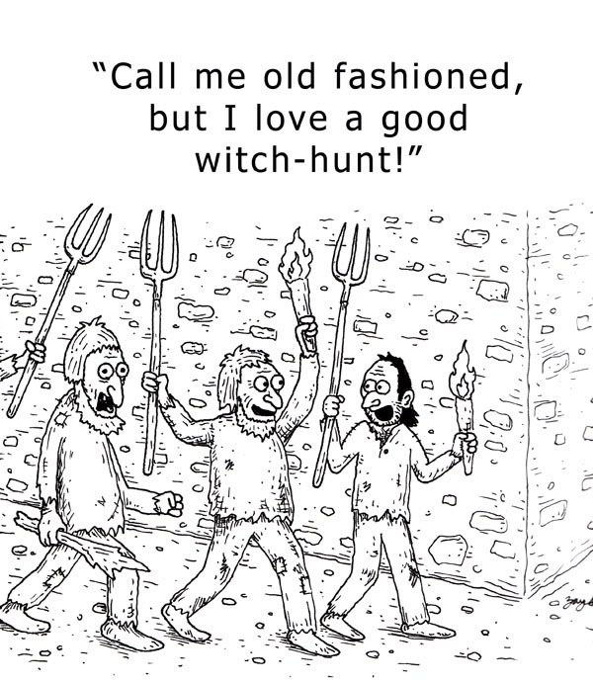
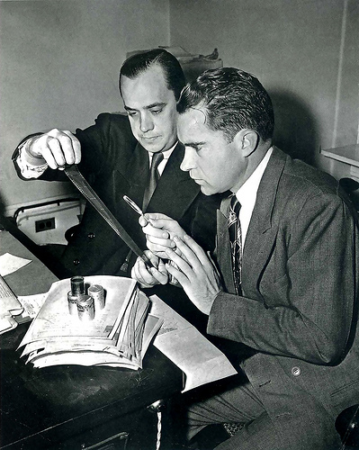
McCarthyism
Ultimately, McCarthy was censured by his Senate colleagues and died in office in 1957. But his tactics lived on.
The word “McCarthyism” has become synonymous with “witch hunt”—the idea of using power to demonize innocent individuals simply because of their supposed beliefs.
But it is crucial to understand that McCarthy was certainly not alone. The climate of fear caused by the Cold War, and the resulting political opportunities that it presented for politicians, resulted in widespread “McCarthyism” – something akin to what happened during the First Red Scare.
For example, a young Congressman from Southern California became a national figure by leading the House investigation of alleged Soviet spy Alger hiss.
His name? Richard Nixon—soon to be U.S. Vice President and, of course, ultimately President.

Slide 7
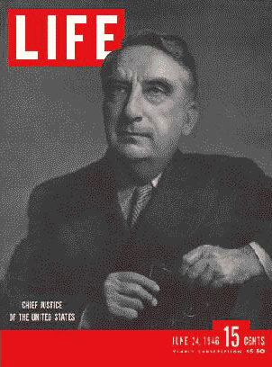
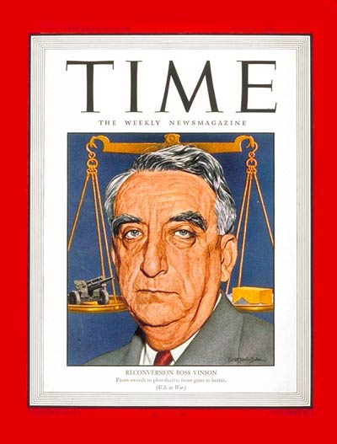
Conservative Decisions of the Vinson Court (1946-1953)
The tenure of Chief Justice Fed Vinson coincided with the Second Red Scare and resulted in generally conservative rulings upholding government action.
In American Communications Association v. Douds (1950), the Court upheld (5-1) a provision of the Taft-Hartley Act requiring union leaders to pledge that they were not communists and did not desire the overthrow of the government.
In 1947 President Truman issued an executive order charging Attorney General James McGrath with compiling a list of organizations thought to be subversive. McGrath listed 78 organizations including the Joint Anti-Fascist Refugee Committee, the National Council of American-Soviet Friendship, and the International Workers Order. These groups sued the Attorney General claiming that their ability to raise donations had suffered as a result of being placed on the list. The question that the Supreme Court considered was whether the Attorney General violated the organizations’ right to due process.
In Joint Anti-Fascist Refuge Committee v. McGrath (1951), the Court ruled 5-3 that the executive branch could not place organizations on a list of allegedly subversive organizations without conducting a hearing.

Slide 8
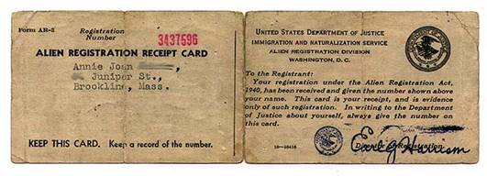
Conservative Decisions of the Vinson Court (1946-1953)
The Alien Registration Act (1940), aka the Smith Act, prohibited membership in organizations advocating the violent or forceful overthrow of the U.S. Government.
In Dennis v. U.S. (1951), the Court upheld (6-2) the convictions of 11 leaders of the Communist Party under the Smith Act, despite evidence that their trial was tainted by anti-communist bias.
But in Stack v. Boyle (1951), the Court ruled 6-2 that 12 members of the U.S. Communist Party who were arrested on charges of conspiring to overthrow the government could not have their bail set an excessively high amount compared to bail for other crimes.
In Adler v. Board of Education of City of New York (1952) the Court upheld 6-3 a law allowing the administration of government loyalty tests to ban communist teachers from New York public schools.

Slide 9
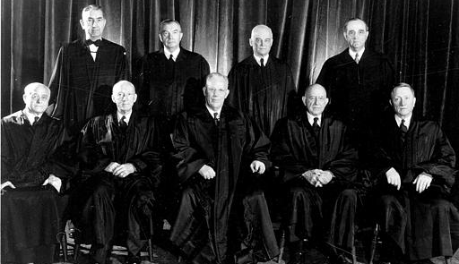
Liberal Decisions of the Warren Court (1953-1969)
Earl Warren’s tenure as Chief Justice saw the Court move back in the liberal the direction with often-time unpopular rulings against the government and in favor of the individual.
In Slochower v. Board of Education (1956), the Court struck down (5-4) a city ordinance that allowed tenured professors to be fired if they failed to answer questions related to their official conduct.
In Yates v. U.S. (1957), the Court ruled 6-1 that the Smith Act did not prohibit the advocacy or teaching of overthrowing the government as an abstract principle, when such advocacy is not connected to direct efforts to incite violent overthrow.
In Kent v. Dulles (1958), the Court ruled 5-4 on Fifth Amendment Due Process grounds that the Smith Act did not give the Secretary of State the ability to withhold passports without proof that those seeking to travel were engaged in illegal activities.

Slide 10
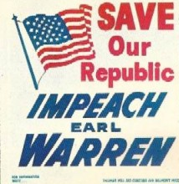
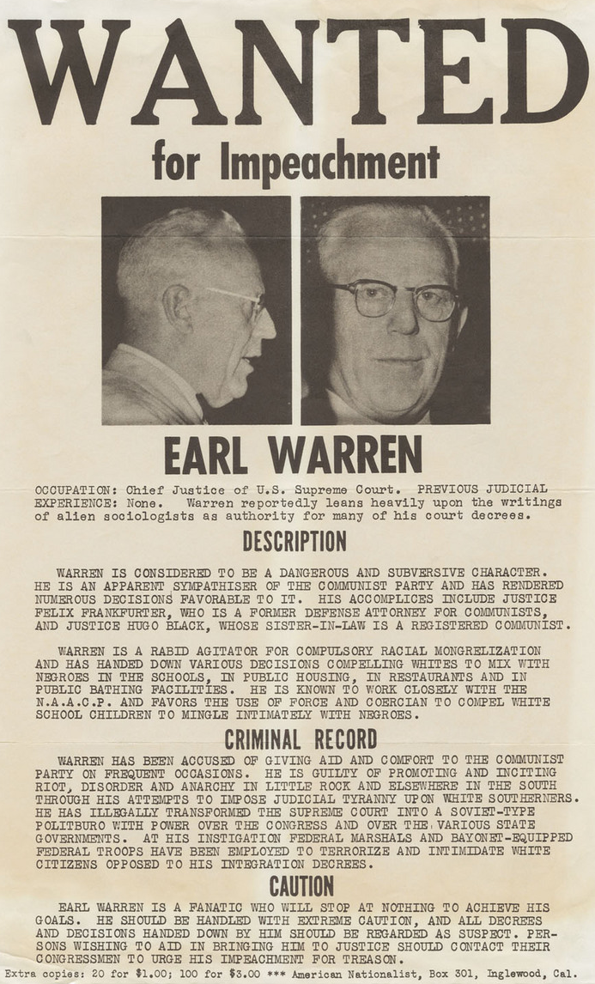
The Warren Court and Congressional Power to Investigate
In Watkins v. U.S. (1957), the Court ruled 6-1 that congressional powers to investigate are not unlimited, that congress had no power to expose the private affairs of individuals unless plainly necessary to a legitimate legislative end, and that it could not exercise executive functions such as enforcing the law or judicial functions such as conducting trials.
Congress was furious with Watkins and the other liberal Warren Court rulings supporting communists and the Civil Rights Movement.
Congressional leaders and others attacked the Court and in the face of pressure from a co-equal branch of government, the justices chose to revisit the issue.
In Barenblatt v. U.S. (1959), the Court held 5-4 that congress has the authority to question witnesses about their involvement with communist ideas and groups. The Court reasoned that the government’s interest of national self-preservation outweighed any First Amendment concerns.
The majority explained that, unlike in Watkins, the committee had made plain the authority for their questions and the consequences for not answering them, thus allowing Justices Felix Frankfurter and John Marshall Harlan II to switch sides from the liberal majority in Watkins to form a conservative majority in Barenblatt.

Slide 11
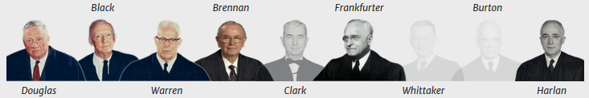
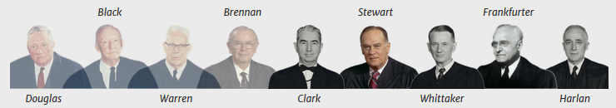
From Watkins to Barenblatt
Watkins liberal 6-1 majority
Barenblatt 5-4 conservative majority

Slide 12
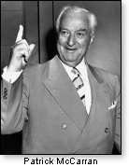
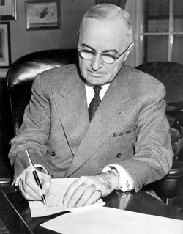
The McCarran Act (1950)
The Internal Security Act (1950), aka the Subversive Activities Control Act commonly known as the McCarran Act, was passed by congress over Pres. Harry Truman’s veto at the height of the Second Red Scare.
Its goal was to expose communists by requiring compulsory government registration of members of the Communist Party in the U.S. Truman called it “the greatest danger to freedom of speech, press, and assembly since the Alien and Sedition Laws of 1798,” a “mockery of the Bill of Rights” and a “long step toward totalitarianism.”
The Subversive Activities Control Board (SACB) was created to administer the registration process. The Board ordered the American Communist Party to register and disclose the names of officers and sources of funding. The party officers refused to register and were charged with federal crimes for failing to do so.
After more than a decade of litigation, in Communist Party v. SACB (1961), the Court upheld the registration requirement by a vote of 5-4.
The Court did not, however, rule on the constitutionality of the penalties contained in the Act until subsequent cases challenged the enforcement of its provisions—and a more liberal Court could rule on them.
In the meantime, in Scales v. U.S. and Noto v. U.S. (1961), the Court upheld (5-4) the conviction of Junius Scales for being a member of the Communist Party of the U.S. in violation of the Smith Act.
But the slight tick back to conservatism would not last as more liberals joined the Warren Court.
Harry S. Truman

Slide 13
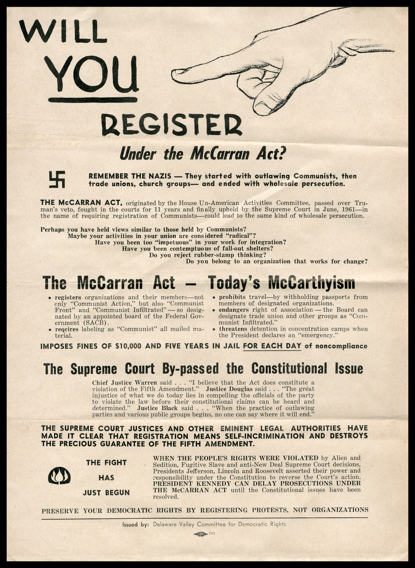
The McCarran Act: The Warren Court Pushes Back
In Aptheker v. Secretary of State (1964), the Court struck down 6-3 on Fifth Amendment due process and First Amendment free speech, association, and assembly grounds the Act’s provision allowing the secretary of state to deny passports to those who had membership in the Communist Party.
In Albertson v. Subversive Activities Control Board (1965), the Court unanimously invalidated, on 5th Amendment self-incrimination grounds, a provision of the Subversive Activities Control Act (1950)—aka the McCarran Act—that required members of the Communist Party to register with the government.
In U.S. v. Robel (1967), the Court struck down (6-2), on First Amendment freedom of association grounds, the Act’s prohibition on communists from working for the federal government or at defense facilities.
The McCarran Act expired in 1973 and the Nixon administration and congress decided not to renew the law.

Slide 14
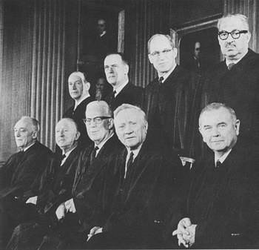
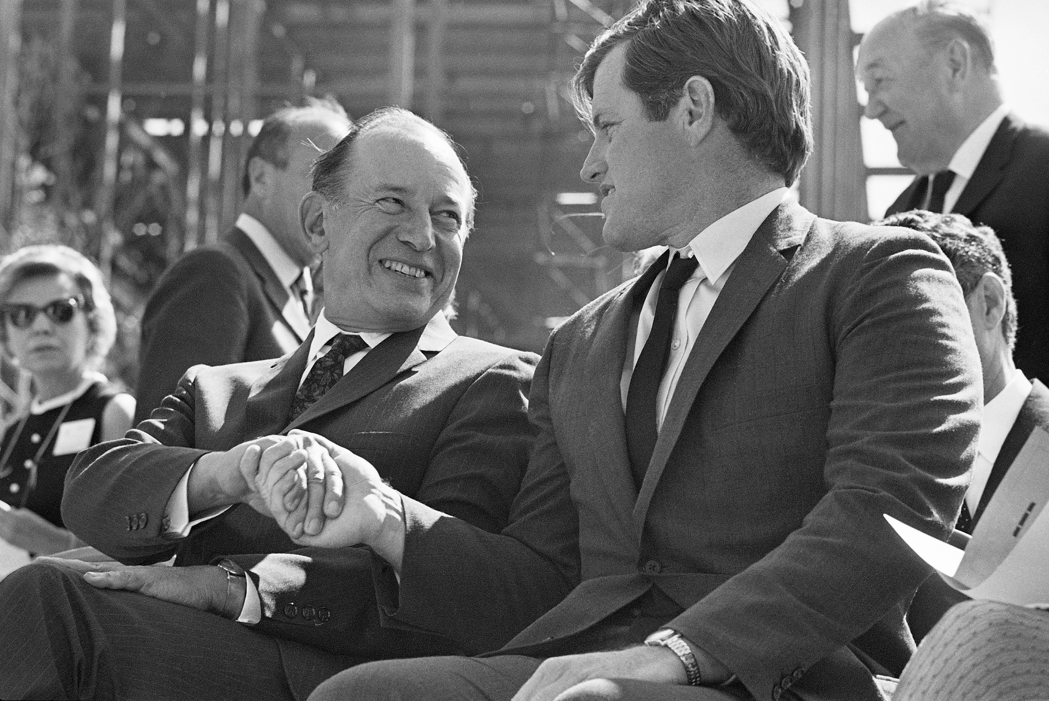
Additional Warren Court Checks on Red Scare Laws
By the end of the 1960s, the Warren Court mirrored American society broadly by reaching the most liberal political and legal point in American history.
In Dombrowski v. Pfister (1965), the Court held 7-2 that Louisiana’s Subversive Activities and Communist Control Law and Communist Propaganda Control Law violated the right to free expression under the First Amendment.
In Elfbrandt v. Russell (1966), the Court struck down 5-4 on First Amendment Freedom of Association grounds a loyalty oath required for state employees.
In Keyishian v. Board of Regents (1967), the Court struck down on First Amendment grounds, 5-4, a state rule that allowed dismissal and denial of unemployment benefits for educators thought to be “subversive.”
The backlash against liberalism was swift. During the 1968 election, Republican Senators were able to filibuster LBJ’s nominee to replace Warren as Chief Justice—liberal Abe Fortas (at right with Teddy Kennedy)—and Nixon’s election began moving both the Court and the nation back to conservatism—a movement that would be fully realized with Ronald Reagan’s election in 1980.

Slide 15
Demagoguery Cuts Both Ways: Connection to Bobby Kennedy and Donald Trump
McCarthy was a Republican and identified as a Catholic. However, most Catholics were Democrats including the Kennedy family.
McCarthy and the Kennedys became fast friends. The patriarch, Joseph P. Kennedy, Sr. saw McCarthy (then growing in popularity for his anti-communism) as someone who could pave the way for acceptance of Catholicism nationwide and his son Jack’s path to the presidency.
McCarthy dated two of the Kennedy sisters and hired Bobby Kennedy to be counsel for his sub-committee. But Bobby resigned after only six months due to disagreements with McCarthy and another committee lawyer Roy Cohn.
Cohn went on to become an infamous New York attorney and mentored a young Donald Trump in the ways of lawsuits, media manipulation, and demagoguery.
For his part, Bobby ran for president in 1968 and was accused of liberal, idealist demagoguery. In his biography of Bobby, historian Arthur Schlesinger wrote: “Some saw him as a compassionate savior, some as ruthless opportunist, some as irresponsible demagogue plucking at the exposed nerves of the American polity – race, poverty, the war. Few were neutral, very few indifferent.”

Slide 16
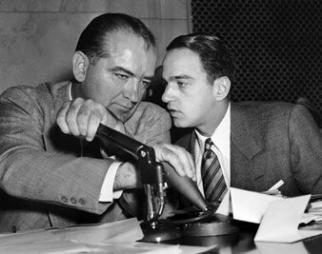
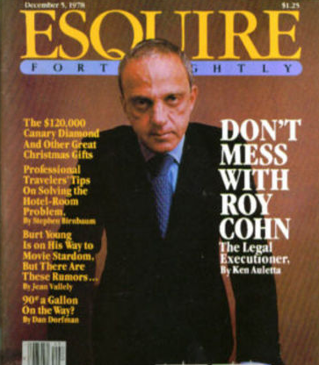
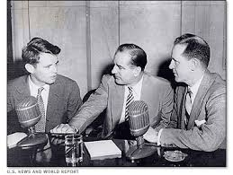
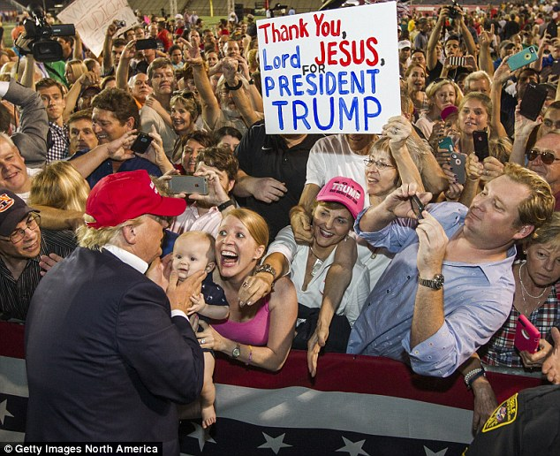
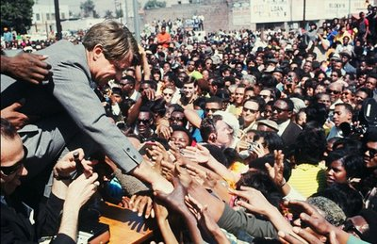
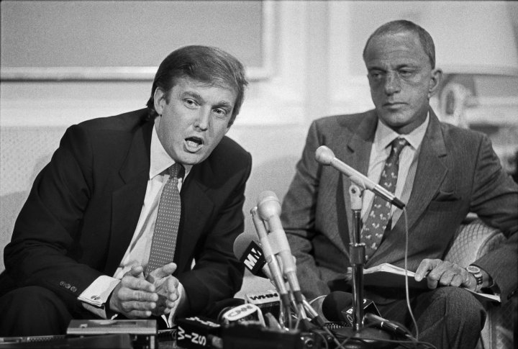
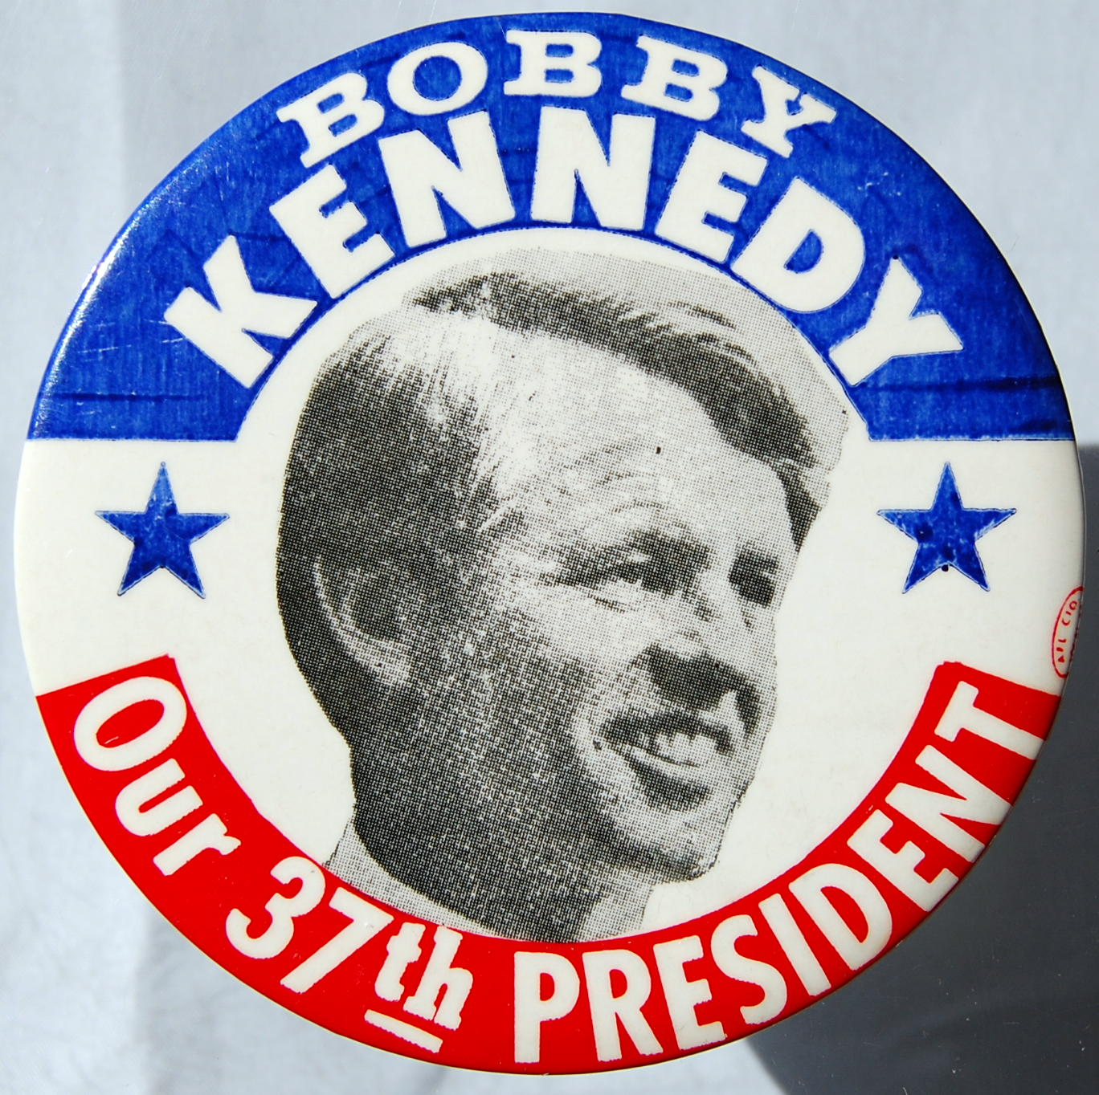
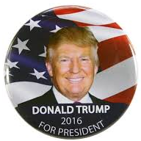

Slide 17
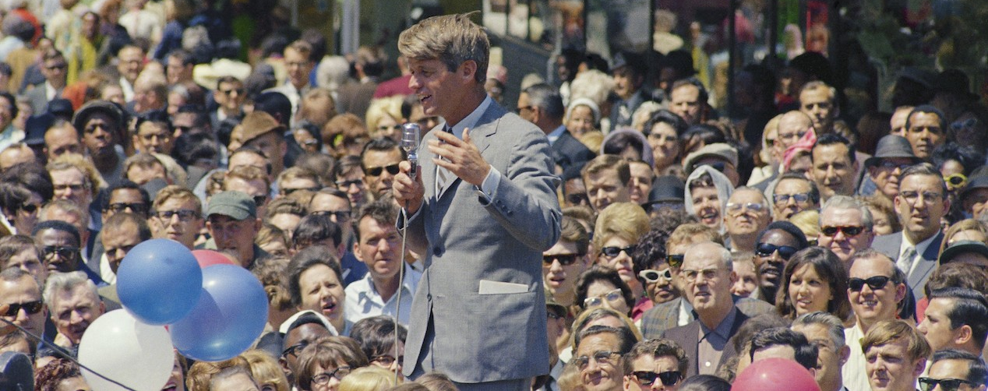
Demagoguery Cuts Both Ways: From Bobby Kennedy to Donald Trump
Bobby’s demagoguery was most visible when he challenged white audiences on the issues of racial equality and war.
No politician in 1968 spoke more eloquently and forcefully about race in America than Bobby, upsetting working-class white Democrats and fueling demagogic criticism.
During the Indiana primary in 1968, he was heckled by white medical students, who demanded to know how he would find the money for new healthcare programs for the poor. “From you,” Bobby said, lecturing the group in moral, occasionally pedantic, terms:
“I look around this room and I don’t see many black faces who will become doctors … I don't see many people coming here from slums, or off the Indian reservations. You are the privileged ones here … You sit here as a white medical student, while black people carry the burden of the fighting in Vietnam.”
Can you imagine a white politician saying this today? Any politician?
In what ways has Donald Trump practiced demagoguery?

