Slide 1
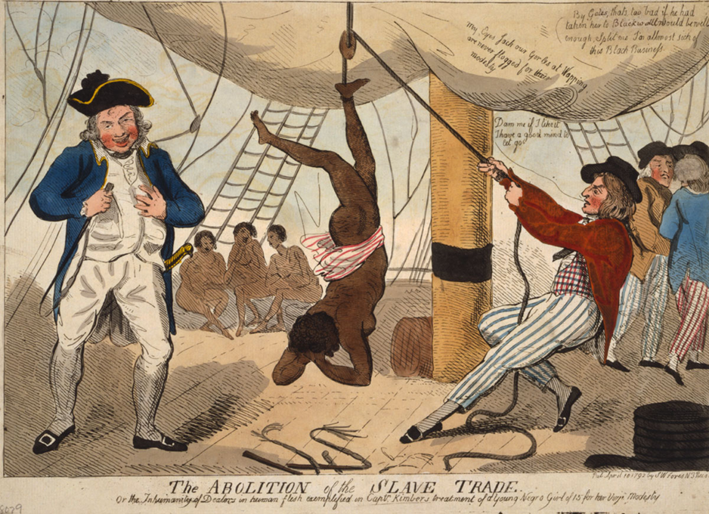
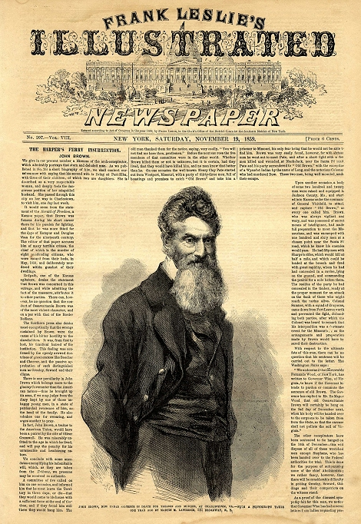
John Brown and Self-Deception
Artemus Ward Bill of Rights Institute
Dept. of Political Science Webinar
Northern Illinois University April 29, 2017

Slide 2
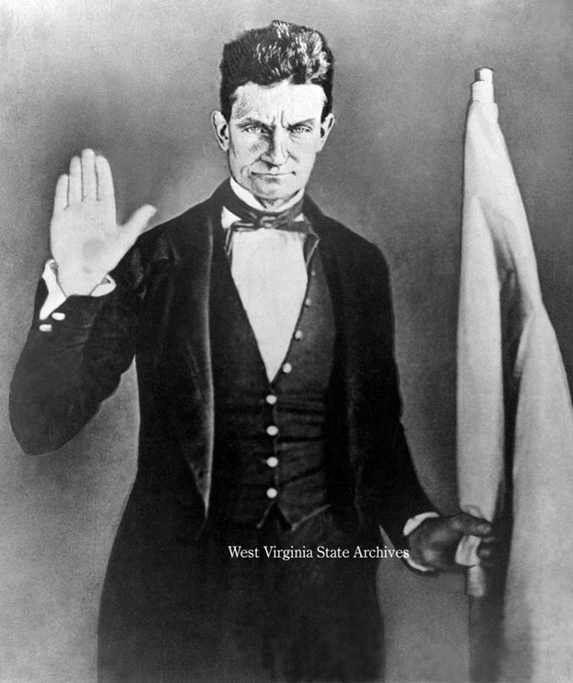
Introduction
John Brown was a radical abolitionist who believed that armed insurrection was the only way to abolish slavery in the United States.
The question is whether Brown was a self-righteous, fundamentalist terrorist or a crusading abolitionist for freedom.
Deception - To lie to yourself and others either to deceive purposefully or because you are deluded into thinking that something is right when it is wrong and unjust.
Did Brown practice self-deception?
To answer this question, we will review the practice of slavery in America juxtaposed against the ideal of America’s founding documents and principles.

Slide 3
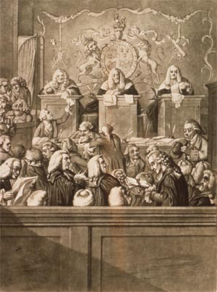
Slavery and the Revolution
People of African ancestry have been considered an inferior race in America since the first slaves were brought to Jamestown in 1619. They could be bought, sold, and used as personal property.
In 1772, a British court decision in Somerset v. Stewart, referred to slavery as “odious” and called for the release of James Somerset, an American slave traveling in Britain with his American owner.
This decision served as a catalyst among southern aristocrats to unite with the northern colonies to eventually call for independence.
Southerners felt that a new confederation of states would have much less authority to abolish slavery than would the British government.
The Revolution, in effect, strengthened slavery in America.

Slide 4
The Right of Rebellion
Given that southerners were afraid that they might lose the institution of slavery under British rule, it is perhaps surprising that they supported the Declaration of Independence (1776) which would not only seem to be at odds with slavery but would also allow a justification for a slave rebellion.
The Declaration famously states the natural rights principles that “all men are created equal” and are entitled to “life, liberty, and the pursuit of happiness.”
It goes on to explain the right of rebellion in the face of a government that denies these natural rights: “when a long train of abuses and usurpations… evinces a design to reduce [the people] under absolute Despotism, it is their right, it is their duty, to throw off such Government, and to provide new Guards for their future security.”
The American colonists believed in this principle and used it to justify armed, violent rebellion against their government. In short, they were terrorists—certainly from the British perspective.
Could a slave rebellion be similarly justified?

Slide 5
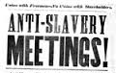
Northern Racism and Indifference
Northern racism and indifference were as important to slavery’s protection as was southern power.
While the Articles of Confederation did not mention “slavery” it did deny fugitives equal protection of the law and provided for criminal extradition among the states.
When northern states abolished slavery within their own borders they did so largely to rid their states of blacks rather than because of a moral position on slavery.
Northern states made major concessions to slaveholders within and outside their jurisdictions:
  they compensated slaveholders through gradual emancipation schemes;
  they created loopholes that allowed masters to sell slave property southwards rather than emancipate;
  they were slow to protect free blacks from kidnapping;
  and they were eager to protect southern slaveholder property rights, making allowances for recapturing fugitive slaves and for slaveholders to “sojourn” with their slave property for extended periods of time in the northern states.

Slide 6
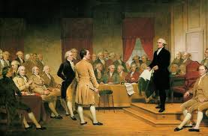
Political Security for Southern States under the U.S. Constitution
Although some states extended various civil and political rights to emancipated slaves and their descendants, the U.S. Constitution did not recognize black Americans as full citizens.
Because representation in the House and voting power for the presidency was based on population, southern states sought to ensure their political security by maximizing their numbers.
Thus, various slave clauses were inserted into the new Constitution. And although the Constitution never mentions the word “slave,” it is not the vague, ambiguous, compromise document that some historians have painted it to be. The slave clauses were precise in their effect and understood by all involved.

Slide 7
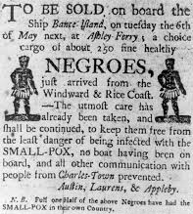
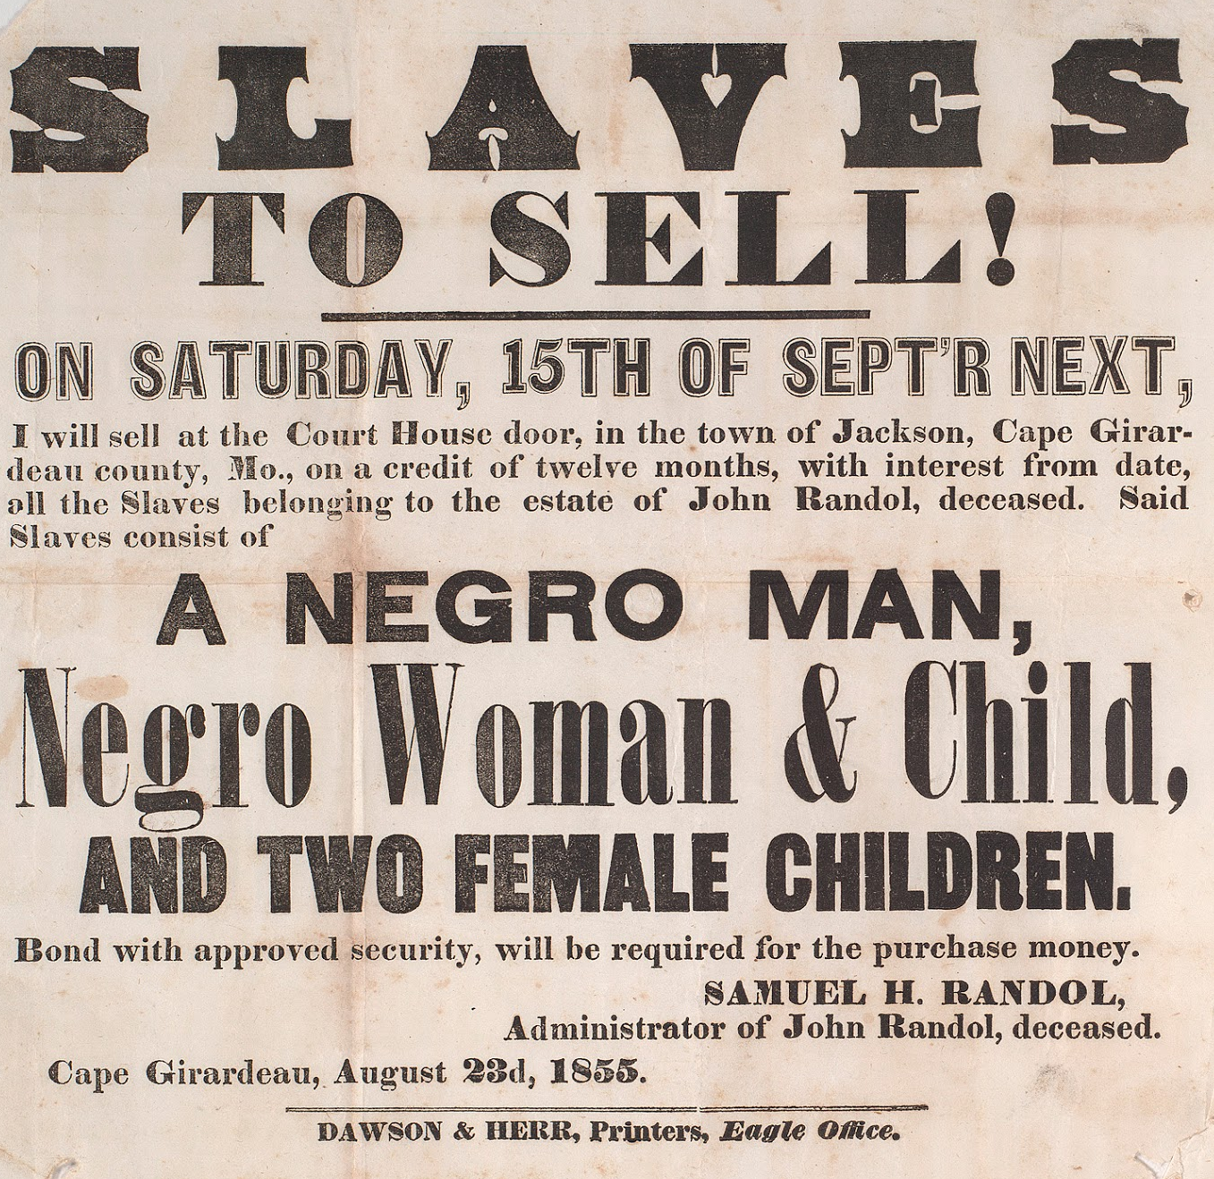
Three-Fifths Clause
  Article I, § 2: “Representatives and direct taxes shall be apportioned among the several states which may be included within this union, according to their respective numbers, which shall be determined by adding to the whole number of free persons, including those bound to service for a term of years, and excluding Indians not taxed, three fifths of all other Persons.”
  This Clause, regulating congressional apportionment, gave states perverse incentives to maintain and even expand slavery.
  If a state freed its slaves and the freedmen then moved away, the state might actually lose House seats.
  Conversely, if it imported or bred more slaves, it could increase its congressional clout.

Slide 8
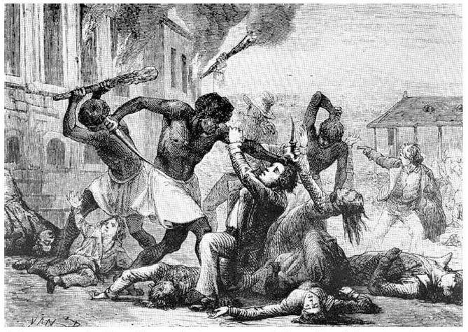
Habeas Corpus: Imprisoning Rebels
Article 1, Sec. 9: “The Privilege of the Writ of Habeas Corpus shall not be suspended, unless when in Cases of Rebellion or Invasion the public Safety may require it.”
Habeas Corpus is a right that allows individuals held by the government to petition a judge for release. Yet this provision can be suspended in cases of “Rebellion.” What kind of “Rebellion” do you think the framers were fearful of? A slave rebellion where free blacks and sympathetic whites would attempt to overthrow the government.
While there were countless small slave rebellions, there were two major uprisings during the colonial period:
Stono Rebellion (1739) - The largest slave revolt ever staged in the 13 colonies where over 100 slaves in South Carolina raided a warehouse-like store, Hutchenson’s, executing the white owners and placing their victims’ heads on the store’s front steps for all to see. They moved on to other houses in the area, killing the occupants and burning the structures, marching through the colony toward St. Augustine, Fla., where under Spanish law, they would be free. Most of them were ultimately stopped and killed. The next year another rebellion occurred in the same area and 50 slaves were executed.
The New York City Conspiracy (1741) – New York was a northern city that was always cruel to slaves, free blacks, and their white supporters. At the time, 7,000 whites lives alongside nearly 2,000 blacks. In early 1741, Fort George in New York burned to the ground. Fires erupted elsewhere in the city — four in one day — and in New Jersey and on Long Island. A number of whites said they heard slaves bragging about starting the fires and planning worse. Whites concluded a slave rebellion was coming. 17 black men were hanged, 13 were burned at the stake, two white men and two white women were executed, and 70 blacks were exiled to far-flung places like Newfoundland, Madeira (off the coast of Portugal, Haiti, and Curaçao.

Slide 9
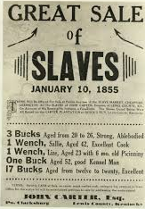
Slave Trade Clause
  Article I, § 9: “The migration or importation of such persons as any of the states now existing shall think proper to admit, shall not be prohibited by the Congress prior to the year 1808, but a tax or duty may be imposed on such importation, not exceeding ten dollars for each person.”
The slave trade clause temporarily barred Congress from using its otherwise plenary power over immigration and international trade to end the importation of African and Caribbean slaves.
Not until 1808 would Congress be permitted to stop the inflow of slave ships.
Even then, Congress would be under no obligation to act. Yet it did. On January 1, 1808, the first day it was permitted to do so, Congress approved legislation prohibiting the importation of slaves into the country.
Of courses this neither ended slavery nor ended its expansion in the south as slave owners simply bred more slaves to more than make up for the difference.

Slide 10
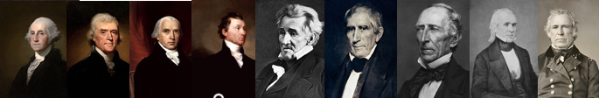
Electoral College
Article II, § 1, Cl. 2 – “Each State shall appoint, in such Manner as the Legislature thereof may direct, a Number of Electors, equal to the whole Number of Senators and Representatives to which the State may be entitled in the Congress…”
Article II handed slave states extra seats in the electoral college, giving the south a sizeable head start in presidential elections.
Southerners won the first 13 of 18 presidential elections before Lincoln’s narrow win in 1860.
The following pre-Civil War presidents were slave-owners: Washington, Jefferson, Madison, Monroe, Jackson, Harrison, Tyler, Polk, and Taylor.
Indeed, one wonders what radical abolitionists would have thought of the monuments erected to these men, their appearance on our currency and stamps, and the celebration of their birthdays among other things. What must slaves have thought? What about their descendants?
In addition, presidents inclined toward slavery could in turn be expected to nominate proslavery federal judges.
America was, in effect, governed by the south prior to the Civil War.

Slide 11
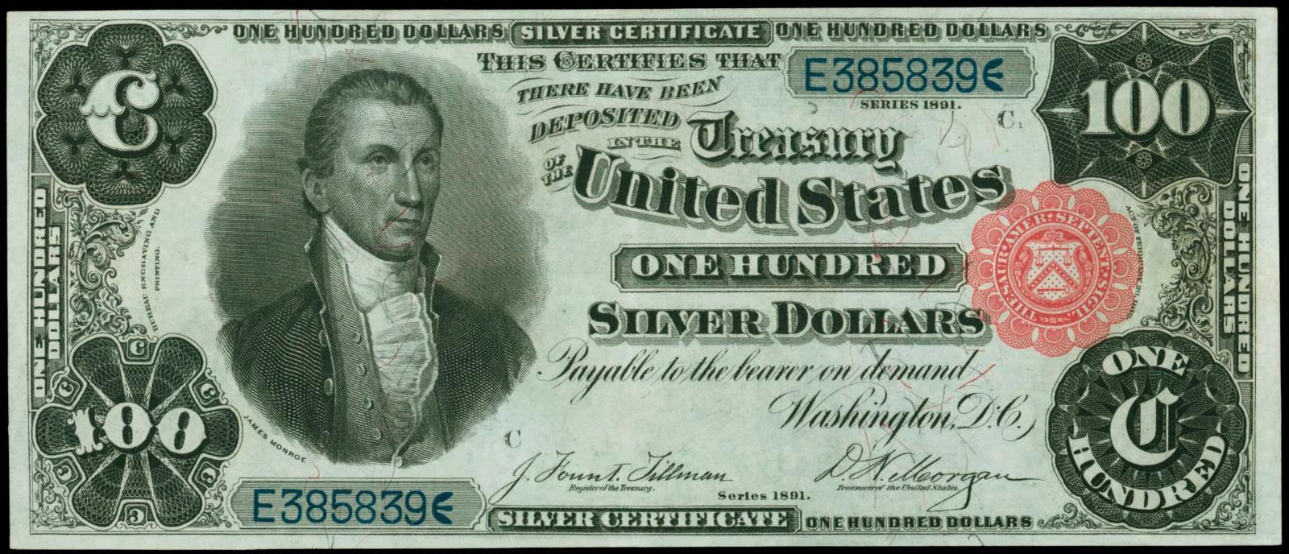
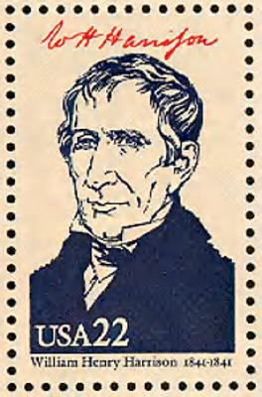
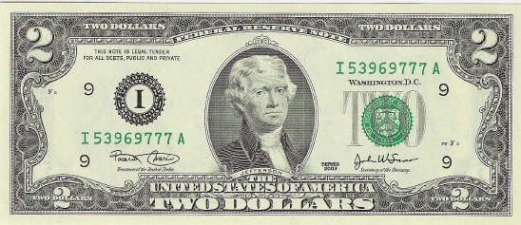
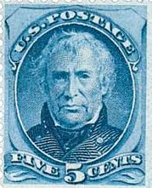
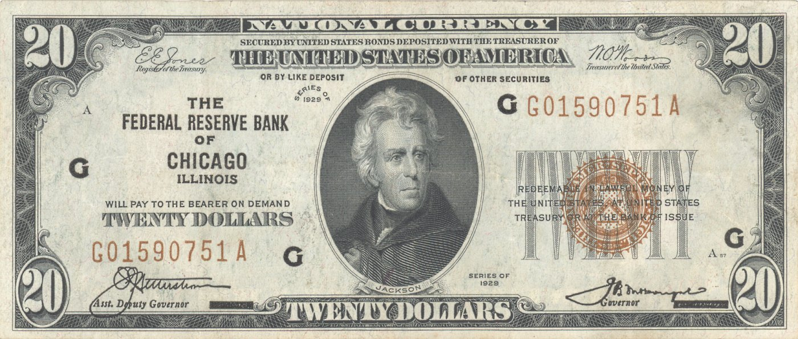
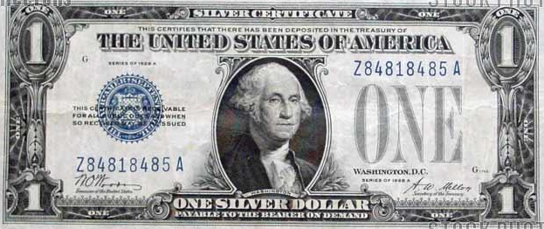
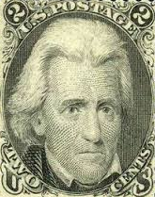
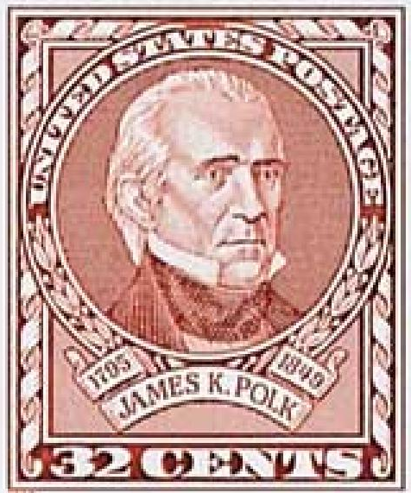
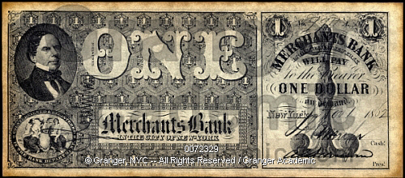
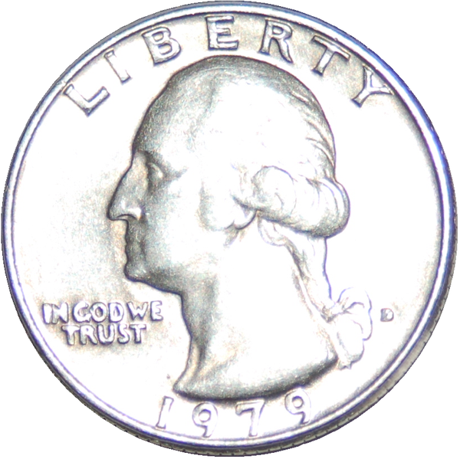
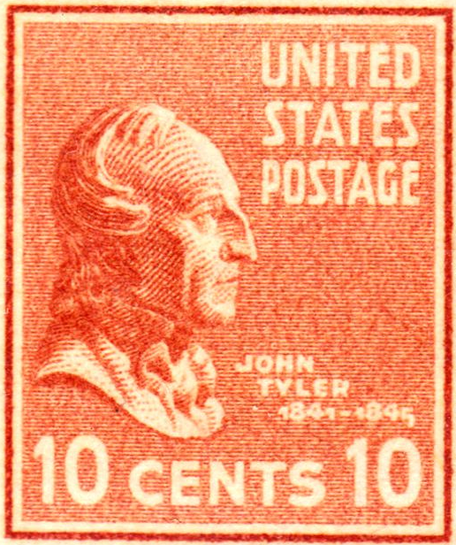
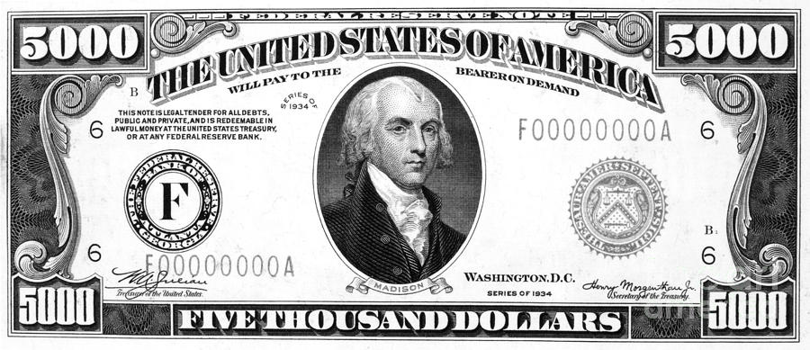
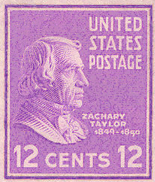
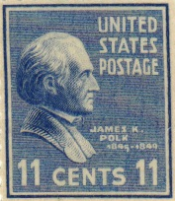
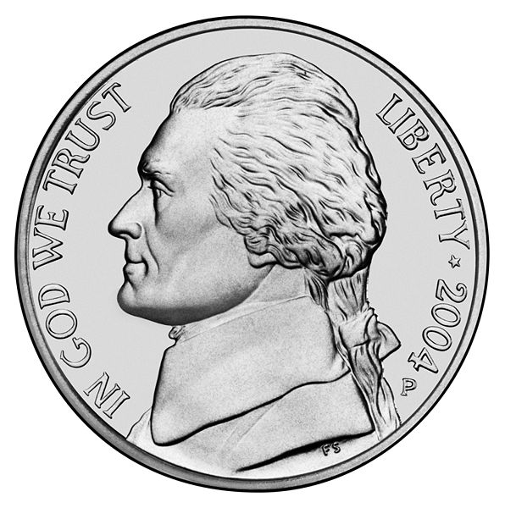

Slide 12
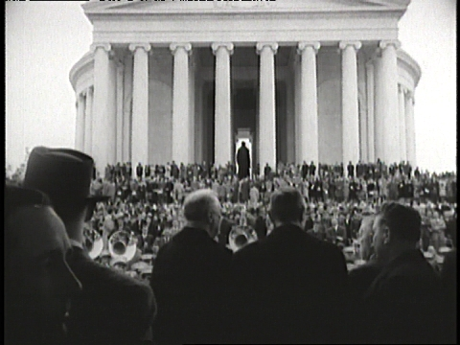
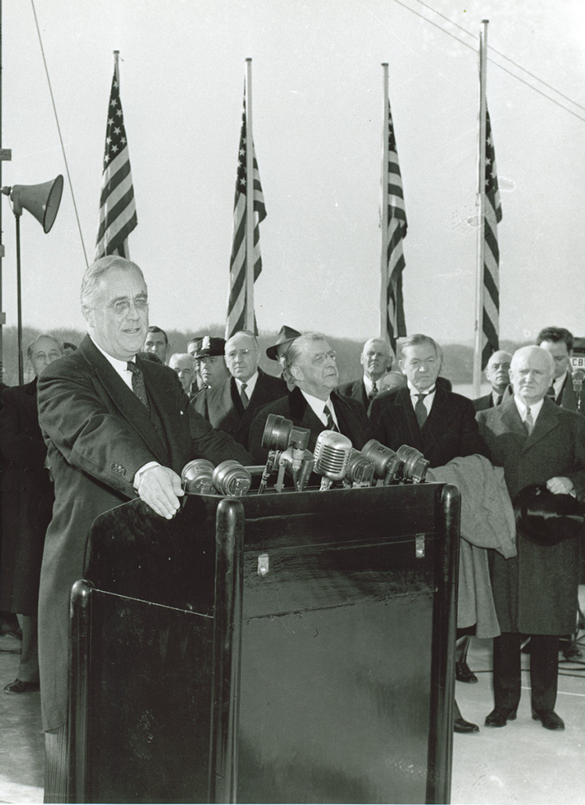
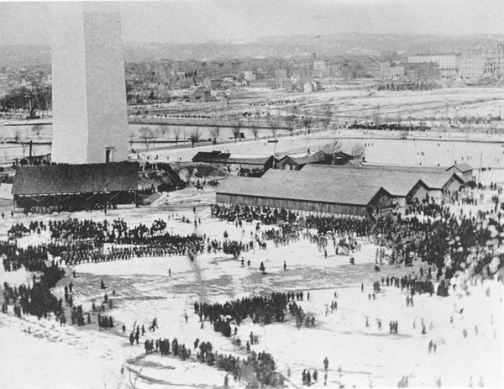
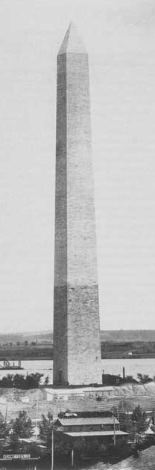
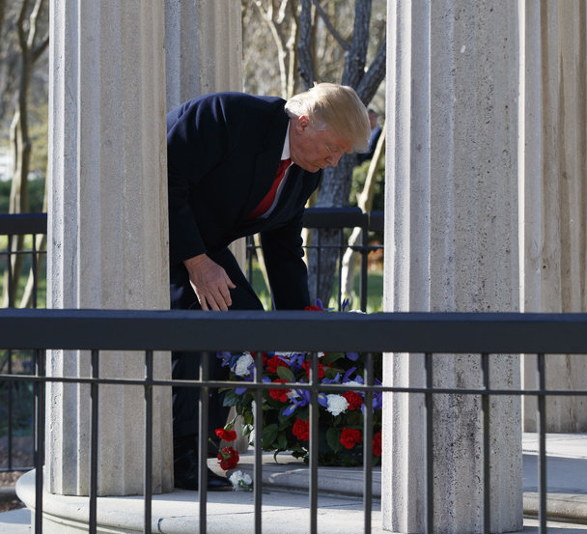
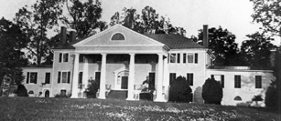
Examples of Presidential Tributes to Slaveholding Presidents
President Chester Arthur spoke at the opening of the Washington Monument in 1880: “It is a fit memorial for the greatest character in human history.”
The Jefferson Memorial was officially dedicated by President Franklin Roosevelt on April 13, 1943, the 200th anniversary of Jefferson's birthday. Roosevelt said: “Today, in the midst of a great war for freedom, we dedicate a shrine to freedom. To Thomas Jefferson, Apostle of Freedom, we are paying a debt long overdue.”
President Rutherford Hayes spoke at Madison’s home Montpelier in 1878, calling him: “a man whose name will be held in the grateful remembrance by the lovers of liberty and stable government as long as liberty and constitutional government exists on earth.”
President Donald Trump lays a wreath
at the grave of Andrew Jackson at the Hermitage: Jackson’s slave plantation in Tennessee, 2017. Trump said: “Inspirational visit, I have to tell you. I’m a fan,

Slide 13
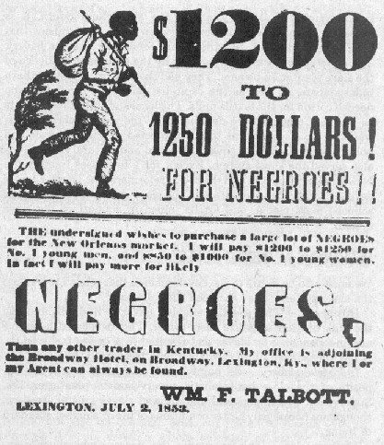
Fugitive Slave Clause
  Article IV, § 2: “No person held to service or labor in one state, under the laws thereof, escaping into another, shall, in consequence of any law or regulation therein, be discharged from such service or labor, but shall be delivered up on claim of the party to whom such service or labor may be due.
  This Clause obliged free states to send fugitive slaves back to slavery.
  It also imposed no immediate or long-run constitutional restriction on slaveholding in federal territory.
  Thus, it was meant to prevent a Sommerset-like American court decision on slavery.
  The Fugitive Slave Act (1793) was passed to give force to this clause. A similar Fugitive Slave Act was passed in 1850.

Slide 14
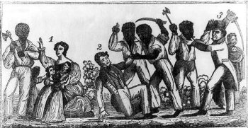
Federal Protection Against Slave Rebellion
Article I, § 8: “The Congress shall have power… To provide for calling forth the militia to execute the laws of the union, suppress insurrections and repel invasions…”
Because the U.S. did not originally have a standing Army, this provision was crucial for allowing the federal government to act with force to preserve slavery.

Slide 15
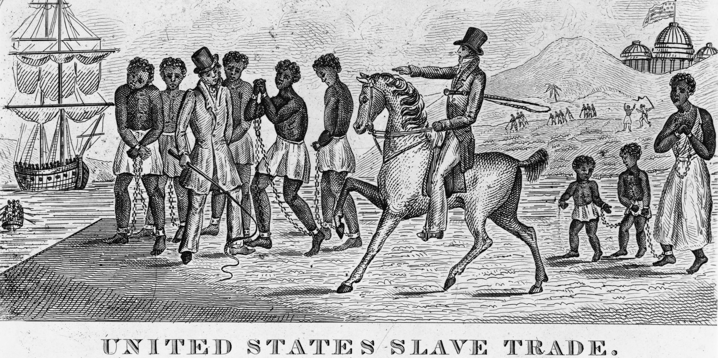
Shielding Slave Clauses from Amendment
Article V – “…no Amendment which may be made prior to the Year One thousand eight hundred and eight shall in any Manner affect the first and fourth Clauses in the Ninth Section of the first Article; and that no State, without its Consent, shall be deprived of its equal Suffrage in the Senate.”
This clause gave the international slave trade temporary immunity from constitutional amendment, in seeming violation of the people’s inalienable right to amend at any time, let alone cast off oppressive government.
It also came close to handing slave states an absolute veto over all future constitutional modifications under that Article as constitutional amendment required supermajorities in congress and the states.

Slide 16
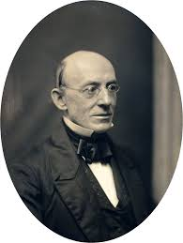
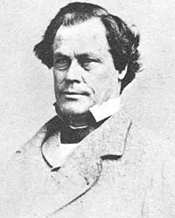
The Radicalization of John Brown
Like William Lloyd Garrison and many other prominent abolitionists, Brown’s anti-slavery beliefs were rooted in religious teachings.
His activism, like so many, was prompted by an act of violence and perhaps a desire for revenge: abolitionist preacher and journalist Elijah Lovejoy, was assassinated by a pro-slavery mob in Alton, Illinois in 1837. Brown said: “Here before God, in the presence of these witnesses, from this time, I consecrate my life to the destruction of slavery.”
Brown moved near Lake Placid, New York to manage a colony of free blacks and organized a secret society to prevent slavecatchers from catching their quarry of runaway slaves in the North.
However, Brown began to deceive himself into thinking that he could and must act violently to end the immoral slave system.
William Lloyd Garrison
Elijah Lovejoy

Slide 17
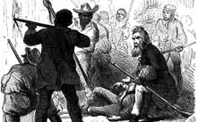
Bleeding Kansas
The Kansas–Nebraska Act (1854) created the Kansas and Nebraska territories and allowed each to decide for themselves (popular sovereignty) whether to be slave or free. Both pro and anti-slavery settlers streamed in setting off Bleeding Kansas (1854-1861) a period of violent battles that served as a precursor to the Civil War.
When Brown heard from his son, who had settled in Kansas, that pro-slavery forces were winning the political battle, Brown went to Kansas to join the fight.
Although there had only been a handful of killings prior to Brown’s arrival, In May 1854 he and small group of others kidnapped and murdered a handful of pro-slavery white men in what became known as the Pottawatomie Massacre. Brown denied the act: “I did not do it, but I approved of it.” In terms of the overall violent struggle against pro-slavery forces he felt his cause was righteous: “God is my judge. We were justified under the circumstances.”
The massacre set off a period of intense violence. For example, in June, Brown was among 30 men battling a group of pro-slavery forces in the Battle of Black Jack (1854) in Palmyra. The pro-slavery group had destroyed the Free State town of Lawrence, destroyed the Brown homestead, and taken two of Brown’s sons hostage. Brown’s group won the battle, captured two dozen men, and agreed to release them on the release of his sons.
In August, Brown and about 40 followers failed in their attempt to defend a Free State settlement against 400 pro-slavery soldiers in the Battle of Osawatomie. But they killed 20 and wounded 40 pro-slavery troops, making Brown a hero among Northern abolitionists.

Slide 18
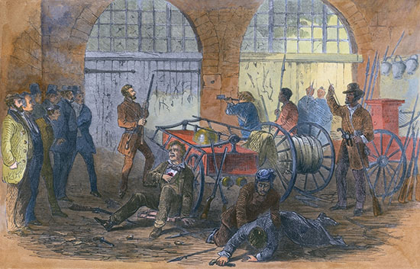
Harpers Ferry (1859)
Brown returned to East and planned to lead an army on a raid of the federal arsenal at Harper’s Ferry in Virginia. He planned to seize the weapons, distribute them to former slaves, and commence a violent race war to end slavery.
He emulated the American founders by writing a new declaration and constitution guaranteeing equality. He was only able to recruit 21 men but he pressed on.
The raid failed when the townspeople, assisted by U.S. Marines led by Robert E. Lee and Jeb Stuart killed or captured the band.
Brown was quickly tried and convicted of murder, inciting slave insurrection, and treason against the state of Virginia.

Slide 19
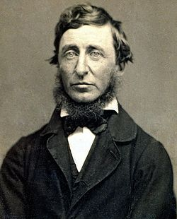
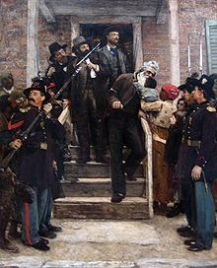
Was Brown Justified?
Philosopher Henry David Thoreau (right), delivered an oration praising Brown: “Are laws to be enforced simply because they are made?”
At his sentencing, Brown said: “If it is deemed necessary that I should forfeit my life for the furtherance of the ends of justice, and mingle my blood further with the blood of my children and with the blood of millions in this slave country, whose rights are disregarded by wicked, cruel, and unjust enactments, I submit. So let it be done!”
The morning of his hanging in December 1859, he wrote a final note: “I John Brown am now quite certain that the crimes of this guilty, land: will never be purged away; but with Blood.”
Did Brown deceive himself into thinking that killing was acceptable in order to end slavery? Was he simply an early casualty in Civil War?
Abraham Lincoln was elected the following year, southern states seceded, and the Civil War claimed over 600,000 American lives.

Slide 20
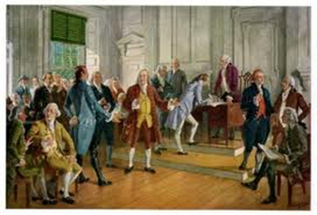
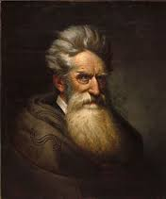
Conclusion
The enduring power of antigovernment rhetoric in the U.S. stems from the nation’s history of slavery rather than its history of liberty.
The Constitution, like the Articles of Confederation before it, preserved and protected slavery and therefore the economic and political power of slave states.
John Brown’s actions were controversial in his time and remain so today. Was he a heroic martyr and visionary or a self-deluded madman and terrorist?

Slide 21
Further Reading
Amar, Akhil, America’s Constitution: A Biography (Random House, 2005).
Einhorn, Robin L., American Taxation, American Slavery (University of Chicago Press, 2008).
Finkelman, Paul, Slavery and the Founders: Race and Liberty in the Age of Jefferson (M.E. Sharpe, 1996).
Graber, Mark, Dred Scott and the Problem of Constitutional Evil (Cambridge University Press, 2008)
Richards, Leonard, L., The Slave Power: The Free North and Southern Domination, 1780-1860 (Louisiana State University Press, 2000).
Van Cleve, George William, A Slaveholders’ Union: Slavery, Politics, and the Constitution in the Early American Republic (University of Chicago Press, 2010).
Waldstreicher, David, Slavery’s Constitution: From Revolution to Ratification (Hill and Wang, 2009).

