Slide 1
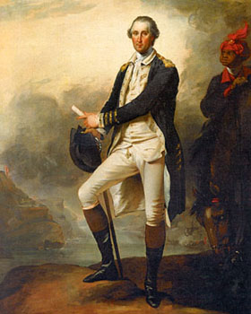
George Washington and Self-Governance
The Bill of Rights Institute
April 25, 2017
Artemus Ward
Department of Political Science
Northern Illinois University
aeward@niu.edu

Slide 2
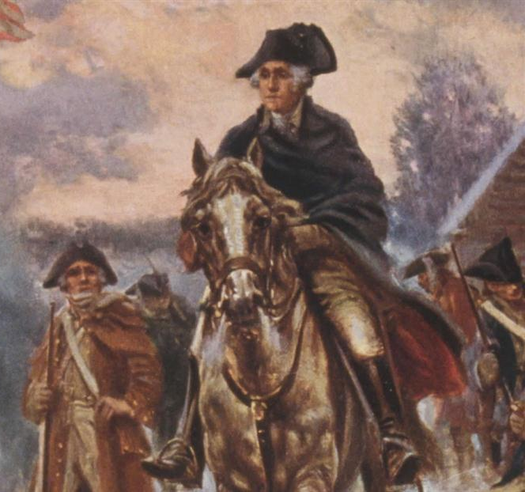
Self-Governance
To be self-controlled
Avoiding extremes
To not be excessively influenced or controlled by others.
How does George Washington exemplify allegiance to the principle of self-governance?

Slide 3
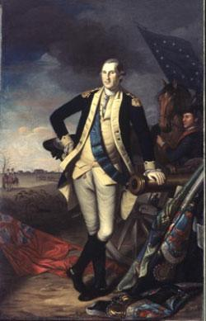
Thomas Jefferson on George Washington
. . . His integrity was pure, his justice the most inflexible I have ever known, no motives of interest or consanguinity [having a close relationship], of friendship or hatred, being able to bias his decision. . . . The whole, his character was, in its mass, perfect, in nothing bad, in a few points indifferent. —Thomas Jefferson on George Washington

Slide 4
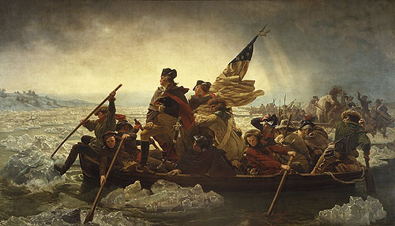
George Washington: A Case Study in Self-Governance
1783 resignation as Commander of the Continental Army.
1796 presidential farewell address.

Slide 5
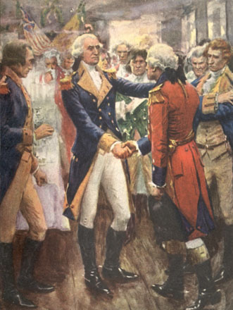
Resignation as Commander of the Continental Army (1783)
Following the American victory during the revolutionary war, the military officers (unpaid and disgruntled) met in New York to discuss insurrection by marching on Congress and seizing land for themselves in the West, presumably with Washington as their leader.
He rejected their offer and denounced the scheme as treason. He then reached into his pocket and put on a pair of glasses: “Gentlemen, you will permit me to put on my spectacles for I have not only grown gray but almost blind in service to my country.”
After hearing of Washington’s refusal to seize power, England’s King George III said: “If he does that, he will be the greatest man in the world.”
He then traveled to surrender his commission to Congress at Annapolis: “Having now finished the work assigned me, I now retire from the great theater of action.”

Slide 6
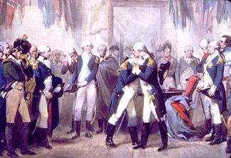
Washington Bids Farewell to His Officers
Long Room, Fraunces Tavern, December 4, 1783

Slide 7
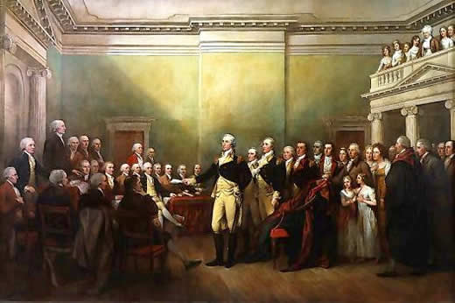
Washington Resigns His Commission
Annapolis, Maryland, December 23, 1783

Slide 8
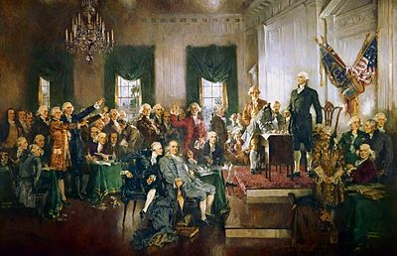
Implications for Self-Governance
By quashing the treasonous plot and choosing instead to work through the proper democratic channels to air grievances—namely the democratically elected continental congress—Washington provided an early example of the American value of self-governance.
By resigning his commission at the end of the revolutionary war, Washington again showed restraint and deference to the democratic process.
Ultimately, he was rewarded as both Federalists and anti-federalists saw him as an honest broker who could chair the constitutional convention and serve as the first President of the United States.

Slide 9
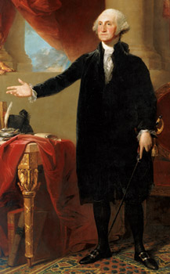
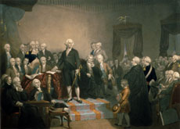
Washington’s Farewell Address (1796)
Henrietta Liston, wife of the British minister, described seeing him deliver his last annual presidential address before Congress on December 9, 1796: “The Hall was crowded and a prodigious Mob at the Door, about twelve oClock Washington entered in full dress, as He always is on publick occasion, black velvet, sword, etc.”

Slide 10
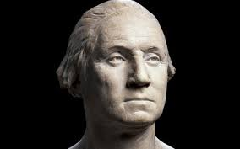
Washington’s Farewell Address (1796)
The speech is widely known for its warnings against political division at home and diplomatic involvement abroad.
Its greatest significance, however, is in demonstrating once again how Washington chose to relinquish power when faced with an opportunity to keep if not expand it.

Slide 11
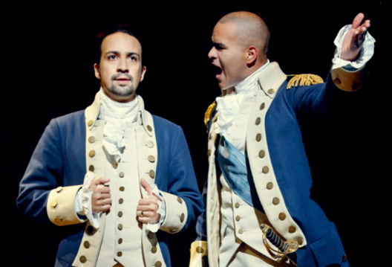
Washington’s Farewell Address (1796)
“I did not seek the office with which you have honored me… [and now possess] the grey hairs of a man who has, excepting the interval between the close of the Revolutionary War, and the organization of the new government—either in a civil, or military character, spent five and forty years—All the prime of his life—in serving his country; [may he] be suffered to pass quietly to the grave—and that his errors, however, numerous; if they are not criminal, may be consigned to the Tomb of oblivion, as he himself will soon be to the Mansion of Retirement.”
Note: Washington wrote this passage and wanted it to be near the beginning of his speech. Alexander Hamilton eliminated the references to “grey hairs,” “prime of his life,” and “errors, however numerous.” Hamilton also moved it to the end of the speech. Washington was pleased with the changes and praised his old friend for rendering him “with less egotism.”

Slide 12
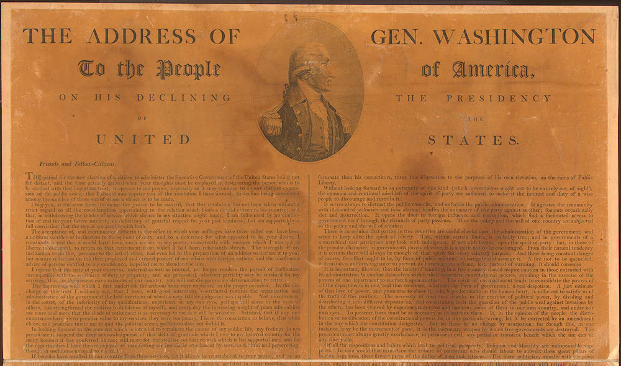

Slide 13
Conclusion
George Washington’s actions provide an instructive case study in how individual actions can promote the democratic ideal of self-governance.
Instead of seizing power by force at the end of the Revolution, he quashed a treasonous plot by his officers and ultimately resigned his commission as head of the Continental Army.
After two terms as President he voluntarily left public life and turned over the executive branch to others.

Slide 14
References
Chernow, Ron, Alexander Hamilton (New York: Penguin, 2004).
Ellis, Joseph J., Founding Brothers: The Revolutionary Generation (New York: Knopf, 2000).
Ellis, Joseph J., His Excellency: George Washington (New York: Knopf, 2004).
Wood, Gordon, Revolutionary Characters: What Made the Founders Different (New York: Penguin, 2006).

