Slide 1
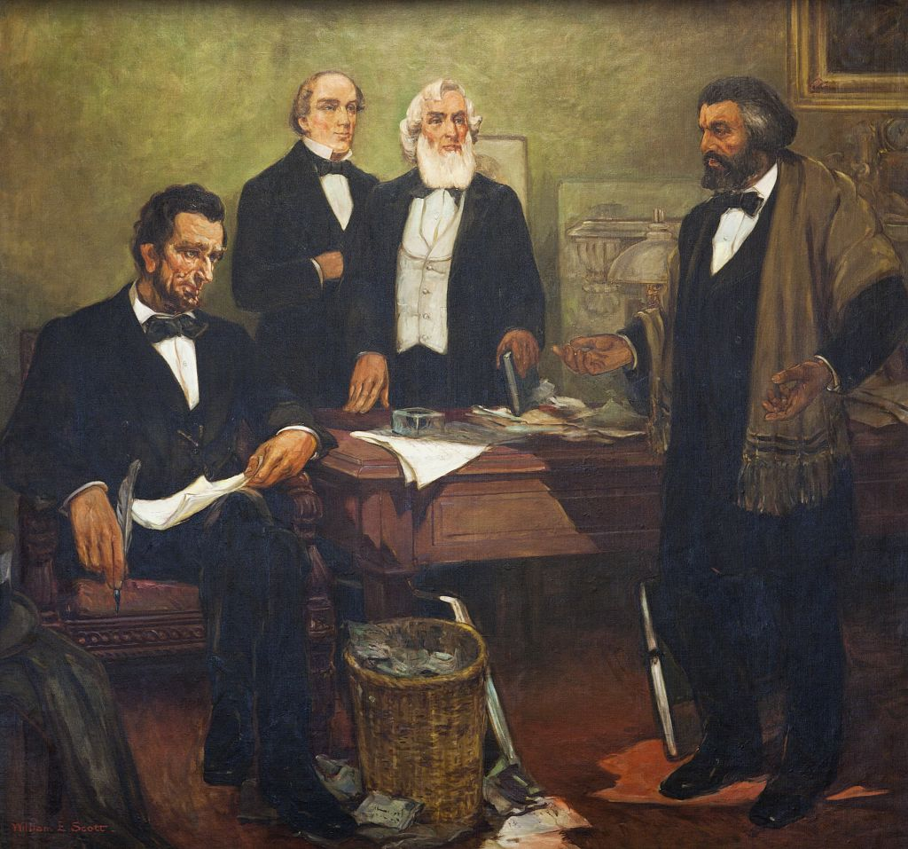
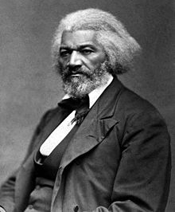
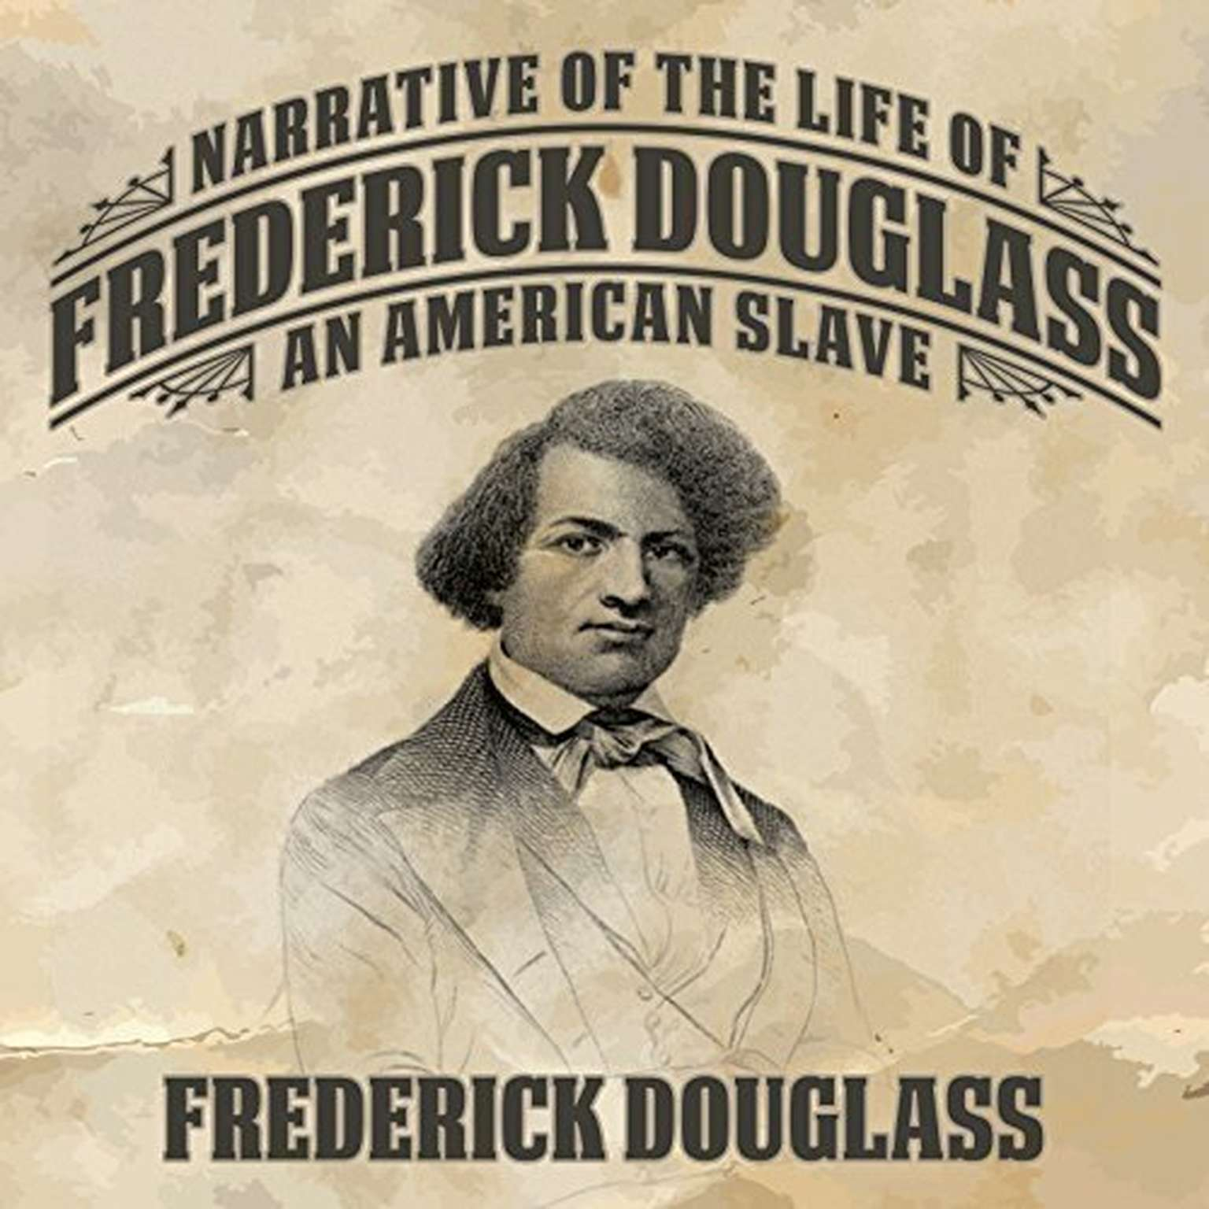
Frederick Douglass and Responsibility
Frederick Douglass was the most
photographed American of the 19th
Century. He never smiled and almost
always looked directly into the camera
in order to counteract the racist
caricature of the “happy slave.”
Artemus Ward, Dept. of Political Science, Northern Illinois University
Bill of Rights Institute Webinar for Teachers, April 29, 2017
Frederick Douglass appealing to President Lincoln and his cabinet for better treatment
of African American soldiers (1863). Mural by William Edouard Scott at the Recorder
of Deeds building, built in 1943. 515 D St., NW, Washington, D.C.

Slide 2
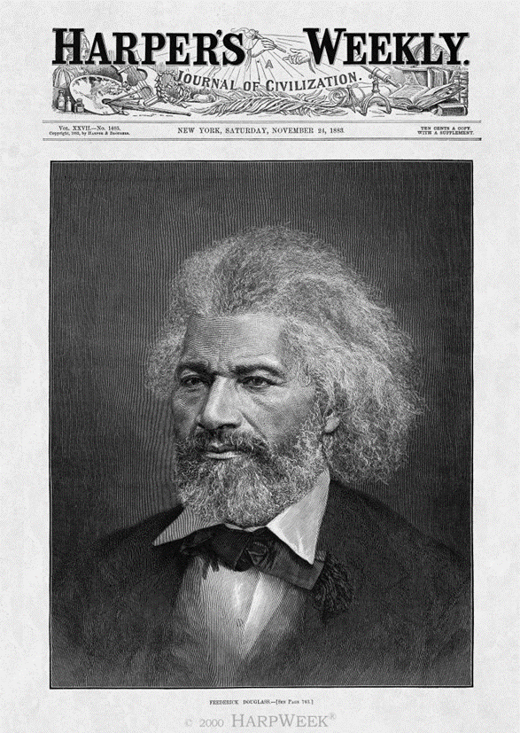
Introduction
Frederick Douglass’s life is instructive for a number of reasons.
Education was the most decisive factor in his journey from slavery to statesman.
Douglass exhibited extraordinary responsibility throughout his life as he chose to work for common causes and the greater good rather than personal fame or fortune.
Douglass had integrity in that he did not always do what was popular and was often criticized for his choices.
Ultimately, Douglass was one of the greatest Americans in history as he not only inspired his contemporaries but continued to inspire new generations of people who strive to live responsible lives.

Slide 3
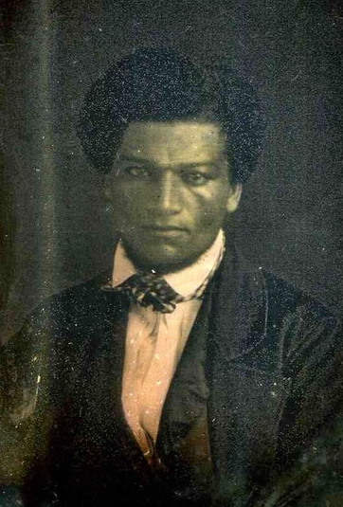
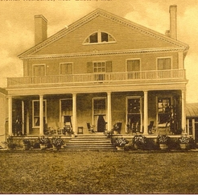
Slavery, Education, and Escape
In 1818, Douglass was born Frederick Augustus Washington Bailey, a slave on a plantation in Maryland. He was of Native American, African, and European ancestry. His father was likely his white master who raped his mother, a slave on the plantation.
Douglass was separated from his mother at a very early age and he was raised by his maternal grandmother until age 7 when he was separated from her.
At age 12, the wife of his then-master began teaching him the alphabet until her husband forced her to stop. But Douglass secretly persisted with the help of white children in the neighborhood.
He continued to teach himself to read and write and secretly educated other slaves.
Found out, he was sent to work for Edward Covey, a poor farmer who had a reputation as a “slave-breaker.” He whipped Douglass regularly, and nearly broke him psychologically. Now 16, Douglass finally fought back and Covey never tried to beat him again. It was at this moment, Douglass later recalled that he truly felt free.
After a few failed attempts to escape, Douglass finally succeeded in 1838 by boarding a train in Baltimore and heading north.
(Above) Douglass, age 23 (1841).
(Below) Wye House – a Maryland plantation where Douglass was enslaved beginning at age 7.

Slide 4
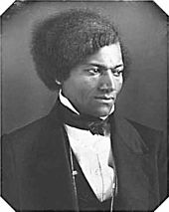
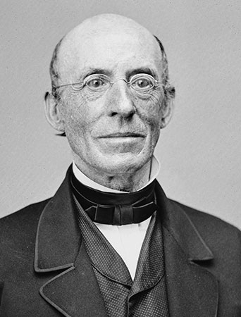
Abolitionist Leader
Douglass married, changed his last name from Bailey to Douglass, and settled in New Bedford, Massachusetts.
He became a licensed preacher in 1839 and, inspired by William Lloyd Garrison, became active in the abolitionist movement. He spoke around the country, was often accosted by slavery supporters, and was chased and beaten by an angry mob in Pendleton, IN.
Douglass published his first autobiography, Narrative of the Life of Frederick Douglass, an American Slave (1845) which was a bestseller despite skepticism on the part of some that a slave could have produced such an impressive work. He continued to write and publish books throughout his life.
He traveled to Britain in Ireland (1845-1847) and was surprised at how he was treated equally to whites. He spoke widely and was a sensation wherever he went. Admirers purchased his legal freedom and implored him to stay.
However, he returned to Rochester, NY and published his first abolitionist newspaper: The North Star.
He broke with Garrison who felt the Constitution was a document that protected slavery. Instead, Douglass sided with those who saw the document as forbidding it.
(Above) Douglass at age 30 (1848) and in his 30s
(Below) William Lloyd Garrison.

Slide 5
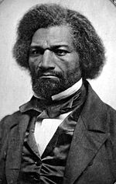
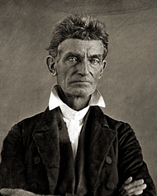
Abolitionist Leader
Douglass was the only African American to attend the Seneca Fall Convention (1848)—the first woman’s rights conference—and spoke in favor of women’s suffrage. Later, he supported the 15th Amendment (1870) granting suffrage to African American men believing that including women would cause it to fail. He reasoned, that with African American men voting, women’s suffrage would be easier to achieve.
Douglass felt that education was the key for African Americans to improve their lives. Given the inferiority of schools for African American children, in the 1850s he argued for school desegregation, called for court action, and argued that full inclusion in education was a more important civil rights issue than even voting and political participation.
Douglass met with radical abolitionist John Brown but opposed his plan to start an armed slave rebellion in the South.
(Above) Douglass at age 38, ca. 1856. (Below) Radical abolitionist John Brown.

Slide 6
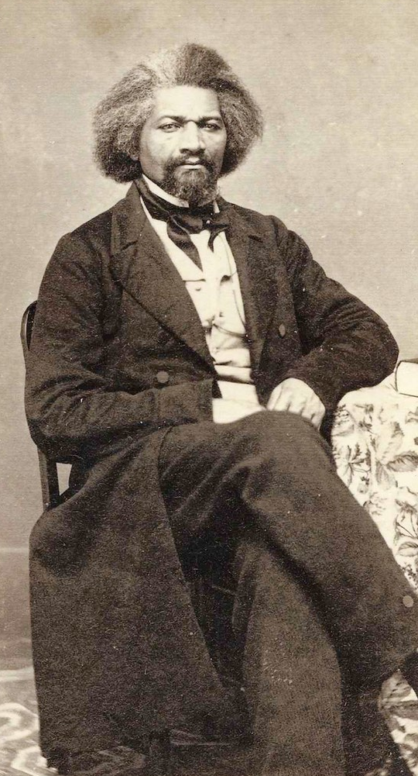
Civil War Years (1861-1865)
For Douglass, the Civil War was about slavery and he argued that African Americans should be allowed to fight for their freedom.
He was a critic of President Abraham Lincoln and regularly spoke out against Lincoln’s relatively moderate position on slavery.
Nearly two years after the outbreak of war, Lincoln finally issued the Emancipation Proclamation (1863) which enabled African-Americans, both free blacks and escaped slaves, to join the Union Army. Nearly 200,000 volunteered, furthering the Union’s advantage in troop strength.
Douglass met with Lincoln at the White House in 1863 to press for better treatment of African American soldiers. Among other things: black soldiers were not being paid as much as whites, were being sent on menial or dangerous missions without adequate support, were not promoted when deserving, and they were either executed or sold into slavery when captured by Confederates.
Lincoln treated Douglass with respect but did little to meet his demands. For example, it was not until June 15, 1864 that legislation was passed to equalize pay and make it retroactive to January 1. It also enabled black troops to collect back pay for 1862 and 1863, but imposed a number of conditions not resolved until the war’s end.
Douglass at age 45, Jan. 1863.

Slide 7
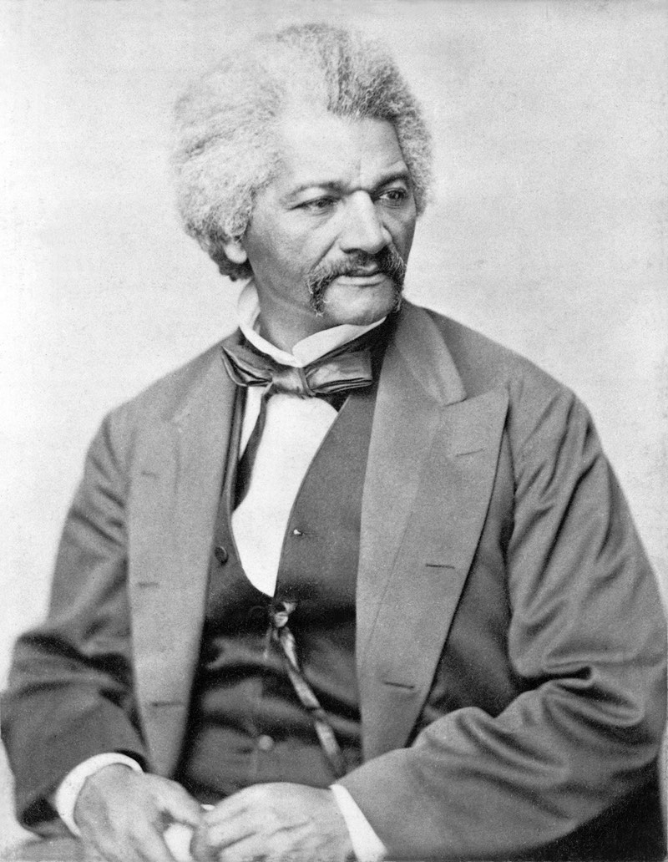
Reconstruction (1865-1876)
Douglass served as president of the government-created, Reconstruction-era Freedman’s Savings Bank toward the end of its tenure. It was designed to help former slaves economically so that they would not be subject to sharecropping and forced labor in the South.
It helped African Americans build savings, enabled community organizations (churches, charities, etc.) to increase their financial strength and expand, and helped create hospitals, schools, and aid societies
Similarly, the Freedman’s Bureau distributed clothing, food, and fuel to former slaves and white refugees; protected the civil rights of former slaves by offering them legal counsel; and helped to establish many of the first public schools in the South.
Douglass was appointed by President Ulysses Grant as the chargé d'affaires (the official U.S. diplomat) for the Dominican Republic. Douglass and Grant favored annexation with the idea that it might become a U.S. state for African Americans. But congress opposed annexation and Douglass resigned.
n 1872, Douglass became the first African American nominated for Vice President of the United States, as Victoria Woodhull’s running mate on the Equal Rights Party ticket.
Douglass at age 52, Apr. 1870.

Slide 8
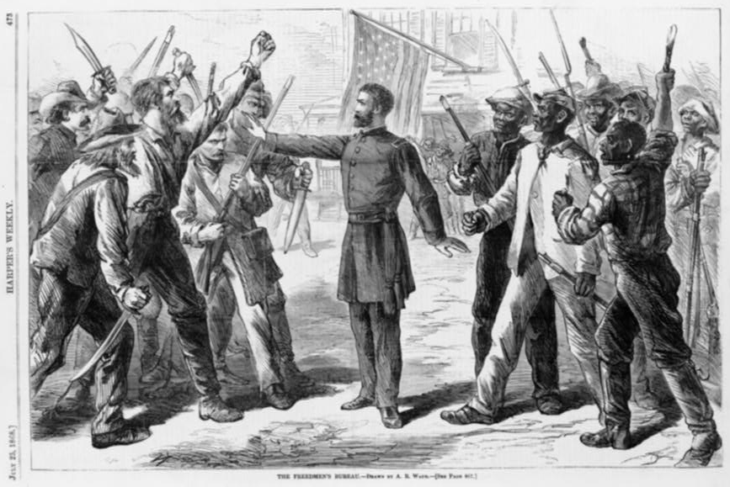
A man representing the Freedman’s Bureau stands between armed groups of whites and African Americans. Wood engraving by Alfred R. Waud, 1868. Published in Harper’s Weekly.

Slide 9
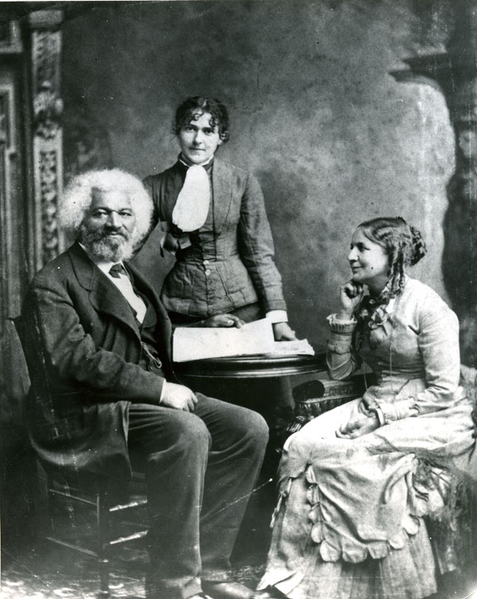
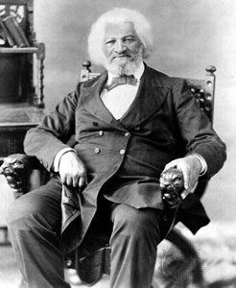
Later Years (1877-1895)
After the Freedman’s Savings Bank folded at the end of Reconstruction, Douglass accepted appointment from President Rutherford B. Hayes as U.S. Marshall for the District of Columbia, his new home.
In 1877 he visited his former master Thomas Auld, at the request of Auld’s daughter, on his deathbed and the two reconciled.
In 1881 he was named Recorder of Deeds for D.C.
After the death of his first wife, Douglass married a white woman (seated at right), Helen Pitts a feminist from New York who was 20 years younger. Amid criticism, he explained that his first wife was the color of his mother and his second wife was the color of his father.
Douglass traveled and spoke around the world and at the 1888 Republican National Convention, Douglass became the first African American to receive a vote for President of the United States in a major party's roll call vote.
In 1889, President Benjamin Harrison appointed Douglass U.S. minister resident and consul-general to Haiti and chargé d'affaires for the Dominican Republic.
In 1892, Douglass constructed rental housing for African Americans, now known as Douglass Place, in Baltimore. The complex still exists, and in 2003 was listed on the National Register of Historic Places.
In 1893, Haiti named Douglass co-commissioner of its pavilion at the World’s Columbian Exposition in Chicago.
In 1895, Douglass died of a massive heart attack at age 77 and was buried in Rochester, New York (his longest home) in the same cemetery as Susan B. Anthony who died in 1906.

Slide 10
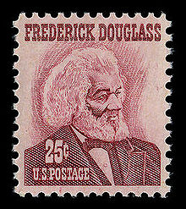
Conclusion
Frederick Douglass personifies the American ideal of responsibility.
Through education, advocacy, and public service, Douglass demonstrates how anyone can overcome their circumstances, no matter how bleak, and become an accomplished leader, inspiring others to live responsible lives.

