Slide 1
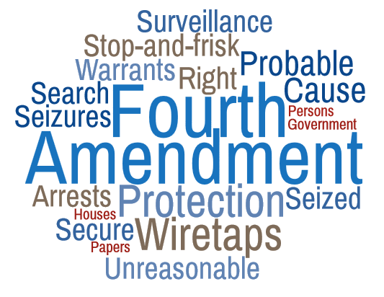

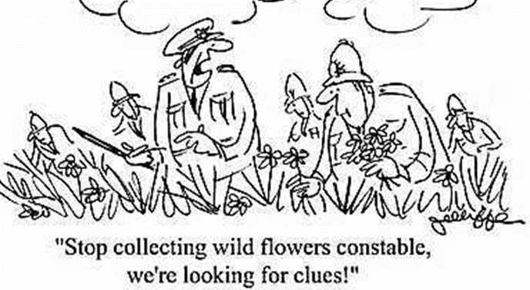
Artemus Ward
Dept. of Political Science
Northern Illinois University
Bill of Rights Institute Webinar
April 19, 2017

Slide 2
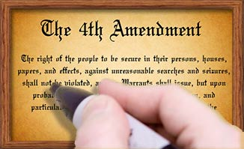
Introduction
The Fourth Amendment consists of two clauses dealing with criminal procedure:
Prohibition against unreasonable searches and seizures – “The right of the people to be secure in their persons, houses, papers, and effects, against unreasonable searches and seizures shall not be violated…”
Procedural details for issuing search warrants – “…no Warrants shall issue, but upon probable cause, supported by Oath or affirmation, and particularly describing the place to be searched or the person or things to be seized.”

Slide 3
Introduction
Historians agree that the Framers were particularly concerned about general warrants that lacked specificity for the persons or places to be searched or the items to be seized. Still, the Fourth Amendment caused little public or political controversy during the founding.
The Supreme Court did not begin to delve into the Fourth Amendment until Boyd v. U.S. (1886) where the justices held that a requirement to turn over personal papers for a customs investigation constituted an impermissible search and seizure.
One of the most litigated areas of constitutional law has to do with the question of when a warrant is necessary for a valid search and when evidence obtained without a warrant can be used in court.
Over time, the justices have attempted to strike a balance between protecting the rights of individuals against illegal searches and seizures and protecting the community from possible danger. The Court has generally required specific warrants based on probable cause.

Slide 4
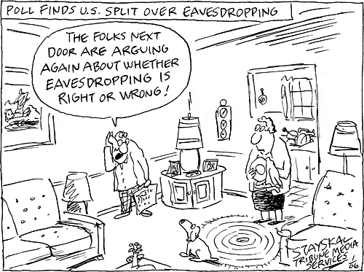
The “Physical Penetration” Rule
The Supreme Court generally adhered to the “physical penetration” rule for the first 150 years of its history.
The prevailing view was that the 4th Amendment did not restrict police searches and seizures unless law enforcement physically intruded on a person’s property—for example, physically searching through a person’s belongings or trespassing on private property.
The Court articulated this position best in Olmstead v. United States (1928) where the Supreme Court upheld government use of warrantless wiretaps on telephone lines because they were located outside the home.
The Court ultimately overturned this decision in Katz v. U.S. (1967) by requiring all state and federal law enforcement agencies obtain warrants prior to wiretapping. The Court explained that search and seizure protections applied to people, not places.

Slide 5
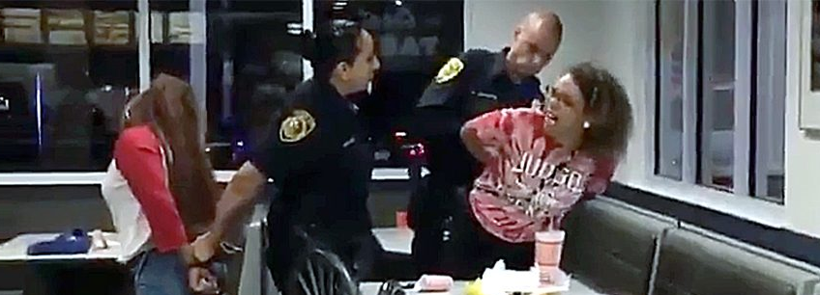
Post-Katz Exceptions
The Supreme Court has recognized that the requirement that police seek out and convince a judge that probable cause exists to justify search and seizure is, at times, just not practical.
As a result, the Court has carved out numerous exceptions to the general principle that police should obtain warrants to conduct searches. At the same time, the Court has also placed limits on those exceptions and all searches, whether under warrant or not, must be based on probable cause or reasonable suspicion.
There are seven common exceptions:
Searches Incident to a Valid Arrest – The Court has allowed such searches for three reasons: to protect the safety of the police officer in case the suspect is armed, to remove any means of escape, and to prevent the suspect of disposing of evidence. The Court has also imposed two limits: temporal (search only during time of arrest) and spatial (search only the suspect and area under his immediate control).
Loss of Evidence Searches – In situations where they must act quickly, police can search in order to preserve evidence before it is lost. But, the search and seizure may extend no further than necessary to preserve the evidence from loss or destruction. If the evidence is inside the human body, induced vomiting or forced surgery is not allowed but blood tests are.

Slide 6
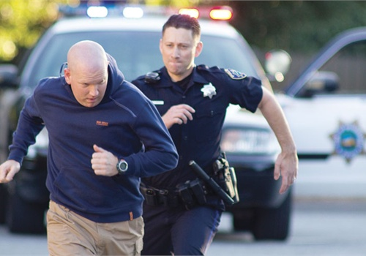
Post-Katz Exceptions
Consent Searches – Police can search if given consent. But two criteria must be met: permission must be freely and voluntarily granted and the individual granting consent must have the authority to do so. Police cannot coerce, lie, or use trickery.
Safety Searches – Police may pat down a suspect believed to pose a danger in order to find and remove any weapons or other threatening objects. Police must have a reason to believe that the suspect poses a threat to safety and the search may be only for the purposes of removing the danger.
Hot Pursuit – Police can pursue fleeing suspects into areas where they would otherwise need a warrant. The suspect must be evading arrest, evidence would be lost, and the fleeing suspect poses a threat to innocent people. The search must only focus on the apprehension of the fleeing suspect.

Slide 7
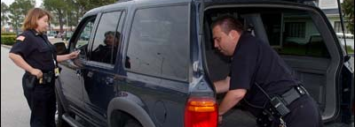
Post-Katz Exceptions
Plain View Doctrine – This controversial rule holds that if police officers are lawfully present and items subject to seizure are openly visible, the officers may seize those articles without any additional authorization.
Place Searches – In general the home is the most protected place. Other places have less protection such as “open fields” of land even if privately owned; prisoners and their cells; inspections by customs, border, and airport officials; and students in public elementary and secondary schools.
Automobiles are another area with lower levels of protection. The Court has given police broad latitude in searching cars because:
they are mobile and can quickly leave the jurisdiction of police;
car windows allow others to look in and drivers have a lower expectation of privacy than in the home; and
the government has a pervasive interest in regulating cars.
Therefore, there are many automobile exceptions to the Fourth Amendment. For example, routine traffic stops do not justify a search of the automobile but if police have probable cause to believe a crime has been committed than they may search the car. In another example, police may stop cars at checkpoints, even if those checkpoints are merely informational – police seeking information.

Slide 8
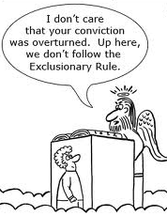
The Exclusionary Rule
The 4th Amendment is enforced through the application of the exclusionary rule, a judicially created principle that reduces the incentive police might otherwise have for violating search and seizure rights.
It holds that evidence gathered illegally may not be admitted into court.
The rationale behind the rule is straightforward: if police know that evidence produced by an illegal search will be of no use, they have no motive for violating the Constitution.
Yet until the rule’s development in the 20th century, law enforcement officials faced no federal punitive measures for conducting illegal searches and seizures. Unless individual states imposed some form of redress, the police were not held liable for their activities and unconstitutionally obtained evidence was not excluded from trials.

Slide 9
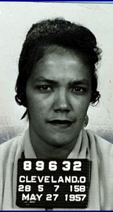
The Exclusionary Rule
The Court established the federal exclusionary rule in Weeks v. U.S. (1914) when it excluded evidence illegally obtained by federal agents after they entered Weeks’ house twice in one day to seize his property.
Yet when the Court incorporated the Fourth Amendment to the states via the due process clause of the Fourteenth Amendment in Wolf v. Colorado (1949) it failed to incorporate the exclusionary rule. As a result, evidence illegally obtained by state and local law enforcement could be turned over to federal officials for use in their prosecutions.
This so-called “silver platter doctrine” was overturned in Elkins v. U.S. (1960).
In Mapp v. Ohio (1961) police conducted a warrantless search of Dollree Mapp’s home and she was arrested and charged for possessing obscene materials. The Court applied the exclusionary rule to the states, calling it a “deterrent safeguard,” and explaining that without it, Fourth Amendment protections would be reduced.

Slide 10
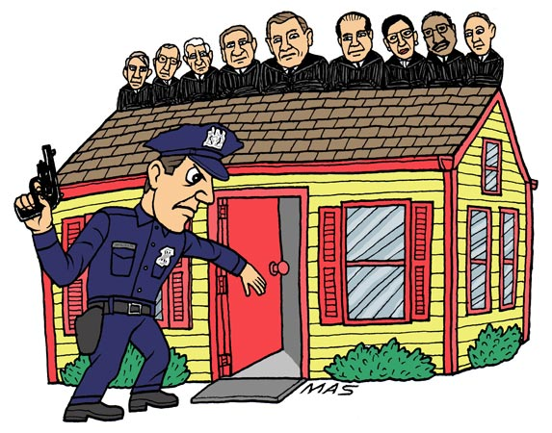
Exclusionary Rule Exceptions
When Chief Justice Earl Warren and other liberal justices left the bench and were replaced by the law-and-order minded Chief Warren Burger and other more conservative jurists, legal scholars predicted that the Court might well overrule Mapp.
But so far, the Court has only been able to scale back the exclusionary rule.
In U.S. v. Calandra (1974) the justices said that the exclusionary rule did not apply to grand jury hearings.
In U.S. v. Leon (1984) the Court ruled that evidence seized by police acting in “good faith” with a warrant is admissible even if the magistrate erred in issuing the warrant in the first place: “In absence of an allegation that the magistrate abandoned his detached and neutral role, suppression is appropriate only if the officers were dishonest or reckless in preparing their affidavit or could not have harbored an objectively reasonable belief in the existence of probable cause.” White reasoned that when police act in good faith, as they did in this case, the punitive aspect of the exclusionary rule becomes irrelevant.
In U.S. v. Nix (1984) the Court established the inevitable discovery exception: evidence discovered as the result of an illegal search an still be introduced in court if it can be shown that the evidence would have been found anyway.
In Illinois v. Krull (1987), the Court allowed evidence seized by police who conducted a search pursuant to an unconstitutional statute.

Slide 11
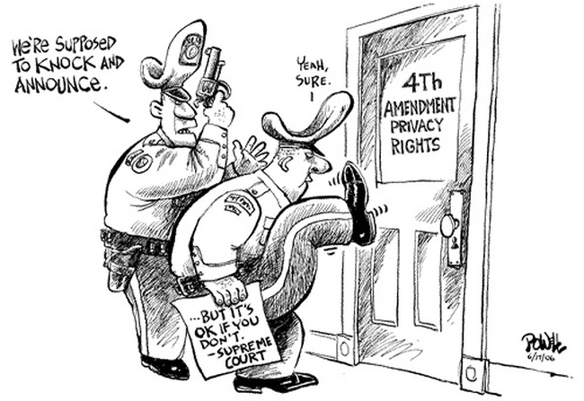
Exclusionary Rule Exceptions
In Hudson v. Michigan (2006) the Court considered the traditional “knock-and-announce” rule which requires police with a warrant to wait a reasonable amount of time for the occupant to respond to a knock before entering a home.
The Court ruled 5-4 (with new justices Roberts and Alito in the majority) that evidence found after entry with a valid search warrant need not be excluded if police violate the knock-and-announce rule.

Slide 12
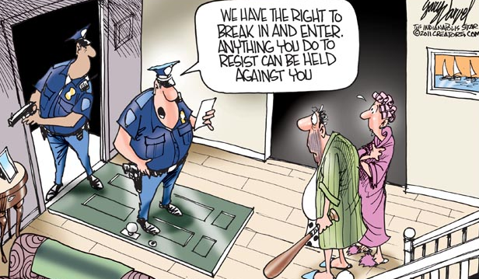
Conclusion
The debate over the Fourth Amendment and the exclusionary rule illustrates the highly politicized nature of judicial decision making generally and of criminal law specifically.
The Court’s search and seizure standards have evolved from the conservative “physical penetration” rule to the liberal “expectation of privacy” standard.
Opponents of the exclusionary rule argue that letting a guilty person go free is too great a price for society to pay just because a police officer violated search and seizure guidelines.
Supporters fear that if the exclusionary rule is eliminated, police will have no incentive to respect the law.
A 1983 study that was discussed by the Court in Leon estimated that between 1%-2% of all felony arrests are “lost” at any stage in the arrest disposition process (including trials and appeals) because of the exclusionary rule. The rate of lost arrests is somewhat higher in drug and other possessory offenses, but much lower in violent crimes.

Slide 13
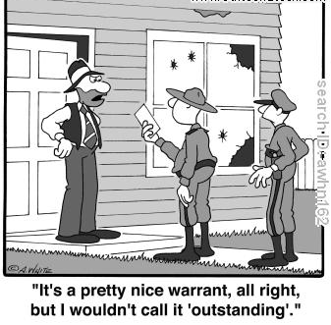
Bonus Slides

Slide 14
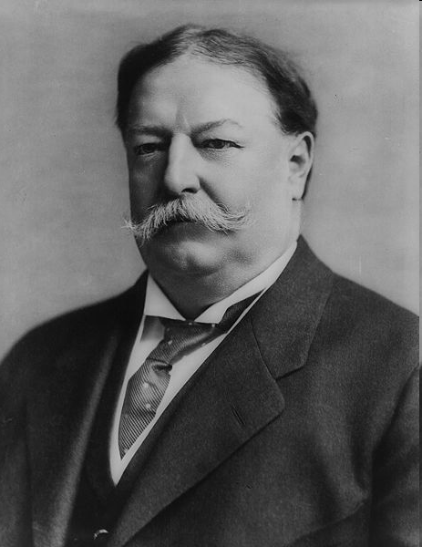
Olmstead v. United States (1928)
Federal agents had reason to believe that Roy Olmstead was importing and selling alcohol in violation of the National Prohibition Act. To collect evidence against him, the agents, without first obtaining a search warrant, placed wiretaps on Olmstead’s telephone lines. They did so without setting foot on Olmstead’s property. Once tap was applied in the basement of a large office building in which Olmstead rented space and the other on a telephone line on the street outside Olmstead’s home. These taps allowed the agents to overhear conversations involving illegal activities.
The Supreme Court ruled 5-4 in favor of the government. In the majority opinion written by Chief Justice William Howard Taft, the justices concluded that the 4th Amendment did not protect Olmstead’s conversations because it covers only searches of “material things—the person, the house, his papers or his effects.” Therefore, “the Amendment does not forbid what was done here. There was no searching. There was no seizure. The evidence was secured by the use of the sense of hearing and that only. There was no entry of the houses or offices of the defendants.”
William Howard Taft

Slide 15
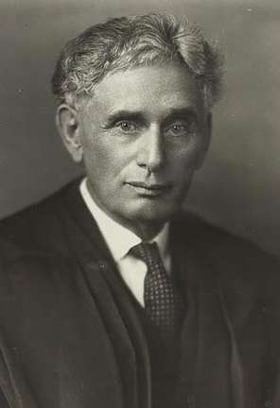
Olmstead v. United States (1928) Justice Louis D. Brandeis Dissenting
Of the four dissenters, Justice Brandeis’ is best remembered. He wrote:
“The makers of our Constitution undertook to secure conditions favorable to the pursuit of happiness…. They conferred, as against the Government, the right to be let alone—the most comprehensive of rights and the right most valued by civilized men. To protect that right, every unjustifiable intrusion by the Government upon the privacy of the individual, whatever the means employed, must be deemed a violation of the Fourth Amendment.”
To Brandeis, it was immaterial that agents had not needed to enter Olmstead’s home or office to place the wiretaps; it was equally unimportant that “the intrusion was in aid of law enforcement.” He declared, “The greatest dangers to liberty lurk in insidious encroachment by men of zeal, well-meaning but without understanding.”
Though Brandeis’ view lost out, over the next four decades, criticism of the “physical penetration” rule grew. In response, the justice decided to reconsider their traditional approach…

Slide 16
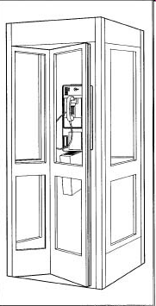
Katz v. United States (1967) The Facts
FBI agents suspected Charles Katz of engaging in illegal bookmaking activity; in particular, they thought he was placing bets and transmitting other wagering information by telephone from Los Angeles to Miami and Boston.
To gather evidence, they placed listening and recording devices outside the telephone booth Katz used to make his calls.
Even though law enforcement officials had listened in on Katz’s conversations without a warrant, federal attorneys used the transcripts of those conversations to obtain an eight-count indictment.
In Griswold v. Connecticut (1965), the Court held that there was a right to privacy that included the use of marital contraception. But the Court also said that the specific guarantees in the Bill of Rights created various “zones of privacy.”
Katz argued that the glass-enclosed telephone booth was a “constitutionally protected area.” The government argued that in previous cases the justices permitted the warrantless use of bugs if agents did not “physically penetrate” an individual’s space. Here, the FBI attached the bug to the outside of the booth; it never invaded Katz’s space.

Slide 17
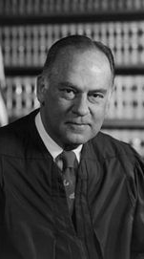
Katz v. United States (1967) Justice Potter Stewart Delivered the Opinion of the Court
Writing for the 7-1 majority, Stewart rejected the “physical penetration” rule: “the Fourth Amendment protects people, not places. What a person knowingly exposes to the public, even in his own home or office, is not a subject of Fourth Amendment protection. But what he seeks to preserve as private, even in an area accessible to the public, may be constitutionally protected.
“No less than an individual in a business office, in a friend’s apartment, or in a taxicab, a person in a telephone booth may rely upon the protection of the Fourth Amendment. One who occupies it, shuts the door behind him, and pays the toll that permits him to place a call is surely entitled to assume that the words he utters into the mouthpiece will no be broadcast to the world. To read the Constitution more narrowly is to ignore the vital role that the public telephone has come to play in private communication.”
“We conclude that the underpinnings of Olmstead … have been so eroded…[that they] can no longer be regarded as controlling.”
Stewart went on to explain that all the government needed to do was obtain a search warrant and they could have lawfully conducted the wiretapping.

Slide 18
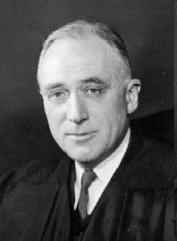
Katz v. United States (1967) Justice John Marshall Harlan II Concurring
While Harlan agreed with the majority, he sought to make plain his understanding of proper search and seizure test: “My understanding of the rule that has emerged from prior decisions is that there is a twofold requirement, first that a person have exhibited an actual (subjective) expectation of privacy and, second, that the expectation be one that society is prepared to recognize as ‘reasonable.’”
“Thus a man’s home is, for most purposes, a place where he expects privacy, but objects, activities, or statements that he exposes to the ‘plain view’ of outsiders are not ‘protected’ because no intention to keep them to himself has been exhibited. On the other hand, conversations in the open would not be protected against being overheard, for the expectation of privacy under the circumstances would be unreasonable.”
This new “expectation of privacy” approach is still used to this day.

Slide 19
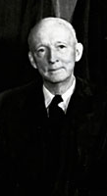
Katz v. United States (1967) Justice Hugo Black Dissenting
The words [of the 4th Amendment] protect ‘persons, houses, papers, and effects against unreasonable searches and seizures....’ These words connote the idea of tangible things with size, form, and weight, things capable of being searched, seized, or both. The second clause of the Amendment still further establishes its Framers’ purpose to limit its protection to tangible things by providing that no warrants shall issue but those ‘particularly describing the place to be searched, and the persons or things to be seized.’ A conversation overheard by eavesdropping, whether by plain snooping or wiretapping, is not tangible and, under the normally accepted meanings of the words, can neither be searched nor seized.”
Black explained that while wiretapping was not known to the framers, eavesdropping was: “There can be no doubt that the Framers were aware of this practice, and, if they had desired to outlaw or restrict the use of evidence obtained by eavesdropping, I believe that they would have used the appropriate language to do so in the Fourth Amendment.”

Slide 20
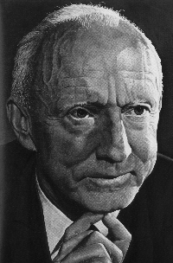
Katz v. United States (1967) Justice Hugo Black Dissenting
“In interpreting the Bill of Bill of Rights, I willingly go as far as a liberal construction of the language takes me, but I simply cannot in good conscience give a meaning to words which they have never before been thought to have and which they certainly do not have in ordinary usage. I will not distort the words of the Amendment in order to ‘keep the Constitution up to date’ or ‘to bring it into harmony with the times.’ It was never meant that this Court have such power, which, in effect, would make us a continuously functioning constitutional convention.”
Finally, Black criticized the Court for continuing the broad construction of privacy, which it had recently announced in the marital contraception case Griswold v. Connecticut (1965): “No general right is created by the Amendment so as to give this Court the unlimited power to hold unconstitutional everything which affects privacy. Certainly the Framers, well acquainted as they were with the excesses of governmental power, did not intend to grant this Court such omnipotent lawmaking authority as that. The history of governments proves that it is dangerous to freedom to repose such powers in courts.”

Slide 21
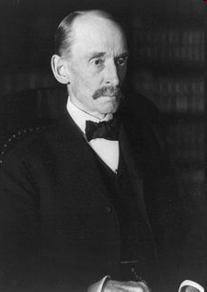
Weeks v. United States (1914)
The law began to change with Weeks v. United States (1914). In that case, federal law enforcement went to Weeks’ house and, without a warrant, carried off boxes of his papers, documents, and other possessions. The Court excluded the evidence, Justice William R. Day held: “If letters and private documents can thus be seized and held and used as evidence against a citizen accused of an offense, the protection of the Fourth Amendment declaring his right to be secure against such searches and seizures is of no value, and, so far as those thus placed are concerned, might as well be stricken from the Constitution.”
With this conclusion, the Court created the exclusionary rule. But Weeks was a federal case. What about the state and local level, where nearly all of criminal activity takes place?
This issue first reached the Court in Wolf v. Colorado (1949)…

Slide 22
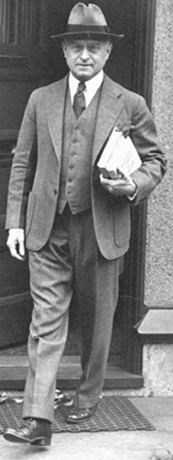
Wolf v. Colorado (1949)
This case involved a Colorado physician who was suspected of performing illegal abortions. Because the police were unable to obtain any solid evidence against him, a deputy sheriff surreptitiously took Julius Wolf’s appointment book and followed up on the names in it. The police gathered enough evidence to convict him. Wolf’s attorney argued that because the case against his client rested on illegally obtained evidence, the Court should dismiss it. To implement his arguments, however, the justices would have to apply or incorporate the Fourth Amendment and impose the exclusionary rule on the states.
Writing for the Court, Justice Felix Frankfurter agreed to incorporate the Fourth Amendment. To be secure against unreasonable searches and seizures was deemed a fundamental right, “basic to a free society,” and the provisions of the amendment applied to the states through the due process clause of the Fourteenth Amendment.
The Court, however, refused to hold that the exclusionary rule was a necessary part of the Fourth Amendment and upheld Wolf’s conviction. The rule was one method of enforcing search and seizure rights, but it was not the only one. In other words, although state law enforcement officials must abide by the guarantees contained in the Fourth Amendment, judges need not use a particular mechanism, such as the exclusionary rule, to ensure compliance. Indeed, 2/3 of the states do not use the exclusionary rule.
Frankfurter noted that the law in England, where there was no exclusionary rule, and in the states, the majority of which rejected the rule, proved that justice could be served without this check on police behavior. States were left free to adopt whatever procedures they wished to enforce search and seizure rights. The exclusionary rule was not mandatory.
Felix Frankfurter

Slide 23
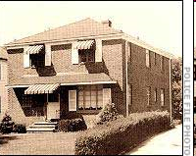
Mapp v. Ohio (1961)

Slide 24
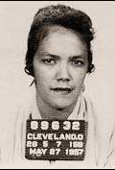
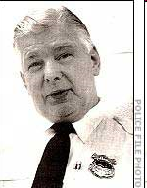
Mapp v. Ohio (1961): The Facts
Dollree Mapp, a woman in her early twenties, carried on a number of illegal activities in her Cleveland home. For several months the police had attempted to shut down her operations, but apparently Mapp was tipped off because each time police planned a raid, she managed to elude them.
One day, plainclothes police Sgt. Carl Delau tried to enter Mapp’s house, this time on the ground that she was harboring a fugitive from justice (the fugitive was suspected of bombing the house of an alleged Cleveland numbers racketeer, Don King, who later became a boxing promoter). When Delau arrived, Mapp refused to let him in because he did not have a search warrant.
Delau returned to his car, radioed for backup and a warrant, and kept the house under surveillance for three hours.
Meanwhile, Mapp called her attorney and he showed up just as the police again knocked on the door. Mapp was upstairs and did not answer and the police forced the door open. Mapp’s attorney was not allowed to enter the house. Hearing the police break in, Mapp came downstairs and began arguing with them. Delau held up a piece of paper which he claimed was a search warrant. Mapp grabbed it and stuffed it down her blouse. A fight broke out, during which police handcuffed Mapp, retrieved the paper, and searched the house. The did not find the fugitive but did seize some allegedly obscene pictures, which were illegal to posses under Ohio law.
At trial, the prosecution did not produce the search warrant and no explanation was offered the failure to do so. Mapp was found guilty of possession of obscene materials and sentenced to prison.
Mapp appealed to the Supreme Court on 1st Amendment grounds, but the justices were more interested in exploring the search and seizure issue.
Dolly Mapp
Sgt. Carl Delau

Slide 25
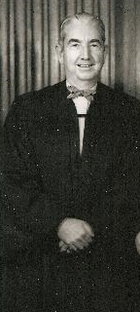
Mapp v. Ohio (1961) Justice Tom Clark Delivered the Opinion of the Court
Clark explained that the facts that supported the Wolf Court’s decision not to incorporate the exclusionary rule, were no longer controlling: more than half of the states have adopted the exclusionary rule, in adopting it California explained that other means of protection don’t work and other Supreme Court decisions since Wolf confirm this.
“Since the Fourth Amendment’s right of privacy has been declared enforceable against the States through the Due Process Clause of the Fourteenth, it is enforceable against them by the same sanction of exclusion as is used against the Federal Government. Were it otherwise, then just as without the Weeks rule the assurance against unreasonable federal searches and seizures would be ‘a form of words,’ valueless and undeserving of mention in a perpetual charter of inestimable human liberties, so too, without that rule the freedom from state invasions of privacy would be so ephemeral and so neatly severed from its conceptual nexus with the freedom from all brutish means of coercing evidence as not to merit this Court’s high regard as a freedom ‘implicit in the concept of ordered liberty.’”
“This Court has not hesitated to enforce as strictly against the States as it does against the Federal Government the rights of free speech and of a free press, the rights to notice and to a fair, public trial, including, as it does, the right not to be convicted by use of a coerced confession…. And nothing could be more certain than that when a coerced confession is involved, ‘the relevant ruled of evidence’ are overridden without regard to ‘the incidence of such conduct by the police,’ slight or frequent. Why should not the same rule apply to what is tantamount to coerced testimony by way of unconstitutional seizure of goods, papers, effects, documents, etc.?”

Slide 26
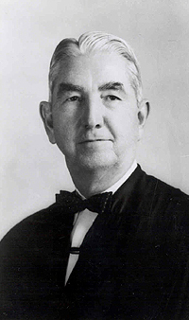
Mapp v. Ohio (1961) Justice Clark’s Opinion continued…
“Moreover, our holding that the exclusionary rule is an essential part of both the Fourth and Fourteenth Amendments is not only the logical dictate of prior cases, but t also makes very good sense. There is no war between the Constitution and common sense. Presently, a federal prosecutor may make no use of evidence illegally seized, but a State’s attorney across the street may, although he supposedly is operating under the enforceable prohibitions of the same Amendment. Thus the State, by admitting evidence unlawfully seized, serves to encourage disobedience to the Federal Constitution which it is bound to uphold.”
“There are those who say, as did Justice (then Judge) Cardozo, that under our constitutional exclusionary doctrine ‘the criminal is to go free because the constable has blundered.’ In some cases this will undoubtedly be the result. But…’there is another consideration—the imperative of judicial integrity.’ The criminal goes free, if he must, but it is the law that sets him free. Nothing can destroy a government more quickly than its failure to observe its own laws, or worse, its disregard of the character of its own existence.”

Slide 27
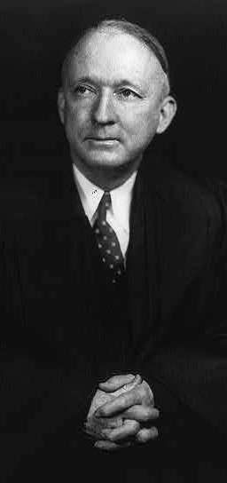
Mapp v. Ohio (1961) Justice Hugo Black Concurring
“I am still not persuaded that the Fourth Amendment, standing alone, would be enough to bar the introduction into evidence against an accused of papers and effects seized from him in violation of its commands. For the Fourth Amendment does not itself contain any provision expressly precluding the use of such evidence, and I am extremely doubtful that such a provision could properly be inferred from nothing more than the basic command against unreasonable searches and seizure.
Reflection on the problem, however, in the light of cases coming before the Court since Wolf, has led me to conclude that when the Fourth Amendment’s ban against unreasonable searches and seizures is considered together with the Fifth Amendment’s ban against compelled self-incrimination, a constitutional basis emerges which not only justifies but actually requires the exclusionary rule.”
Black went on to explain that he agreed with the Court’s holding in Boyd v. United States (1866) where the justices declared that they were “unable to perceive that the seizure of a man’s private books and papers to be used in evidence against him is substantially different from compelling him to be a witness against himself.” Black concluded: “Although I rejected the argument at that time [when Wolf was decided], its force has, for me at least, become compelling with the more thorough understanding of the problem brought on by recent cases.”

Slide 28
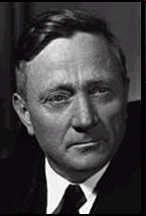
Mapp v. Ohio (1961) Justice William O. Douglas Concurring
“We held in Wolf that the Fourth Amendment was applicable to the states by reason of the due process clause of the Fourteenth Amendment. But a majority held that the exclusionary rule of the Weeks case was not required of the states, that they could apply such sanctions as they chose. That position had the necessary votes to carry the day. But with all respect it was not the voice of reason or principle.
As stated in the Weeks case, if evidence seized in violation of the Fourth Amendment can be used against an accused, ‘his right to be secure against such searches and seizures is of no value, and…might as well be stricken from the Constitution.’
When we allowed the States to give constitutional sanction to the ‘shabby business’ of unlawful entry into a home (to use an expression of Mr. Justice Murphy), we did indeed rob the Fourth Amendment of much meaningful force.”

Slide 29

Mapp v. Ohio (1961) Justices John Marshall Harlan II, Felix Frankfurter, and Charles Whittaker Dissenting
Harlan explained that while fewer states adhere to the common-law non-exclusionary rule, half still do.
“For us the question remains, as it has always been, one of state power, not one of passing judgment on the wisdom of one state course or another. In my view this Court should continue to forbear from fettering the States with an adamant rule which may embarrass them in coping with their own peculiar problems in criminal law enforcement.”
There is a big difference between the Weeks rule and this case. “There, in implementing the Fourth Amendment, we occupied the position of a tribunal having the ultimate responsibility for developing the standards and procedures of judicial administration within the judicial system over which it presides. Here we review state procedures whose measure is to be taken not against the specific substantive commands of the Fourth Amendment but under the flexible contours of the Due Process Clause. I do not believe that the Fourteenth Amendment empowers this Court to mould state remedies effectuating the right to freedom from ‘arbitrary intrusion by the police’ to suit its own notions of how things should be done.”
“But in the last analysis I think this Court an increase respect for the Constitution only if it rigidly respects the limitations which the Constitution places upon it, and respects as well the principles inherent in its own processes. In the present case. I think we exceed both, and that our voice becomes only a voice of power, not of reason.”

