Slide 1
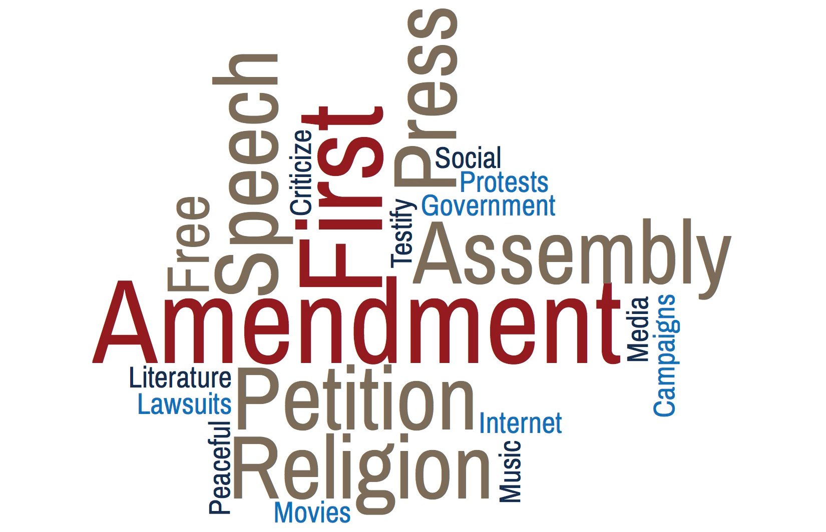
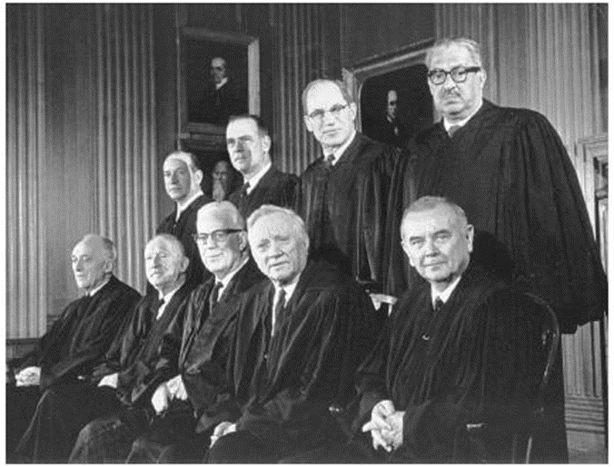
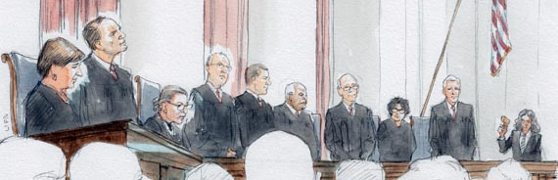
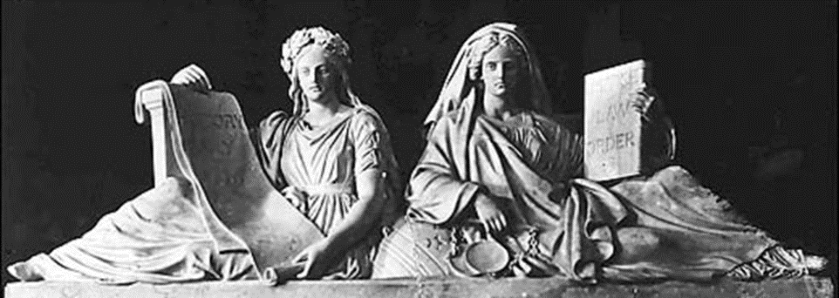
Artemus Ward
Dept. of Political Science
Northern Illinois University
aeward@niu.edu
Bill of Rights Institute
April 19, 2017
Justice and History is above the Senate doors on the east front of the Capitol. An unusual feature
of this sculpture and the panel in the old Supreme Court chamber is that Justice is not blindfolded.

Slide 2
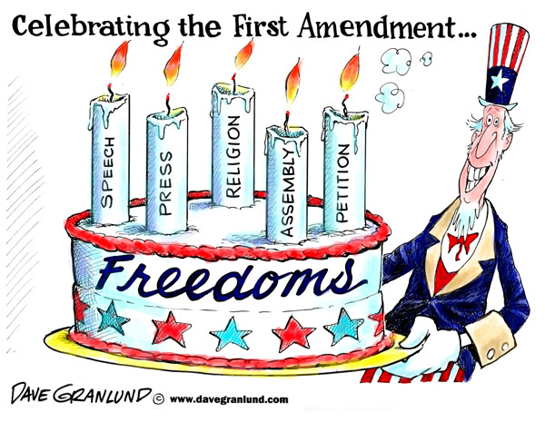
Introduction: The First Amendment (1791)
“Congress shall make no law respecting an establishment of religion, or prohibiting the free exercise thereof; or abridging the freedom of speech, or of the press; or the right of the people peaceably to assemble, and to petition the Government for a redress of grievances.”
Like all rights in the Constitution, 1st Amendment rights are not absolute and must be balanced against the inherent police power of the state to protect the health, safety, welfare, and morals of the people.
The U.S. Supreme Court has attempted to strike this balance in a series of landmark cases in each area: 1) religious establishment, 2) free exercise of religion, 3) speech, 4) press, 5) assembly and petition.

Slide 3
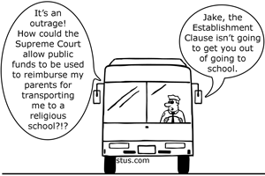
The Establishment Clause
1st Amendment: “Congress shall make no law . . . respecting an establishment of religion...”
The Supreme Court has been either separationist (liberal) or accommodationist (conservative) in its rulings.
There are three broad areas of Establishment Clause cases.
Aid to religious schools (accommodationist),
Religious access to public facilities (accommodationist).
Prayer and teaching religion in public schools (separationist)

Slide 4
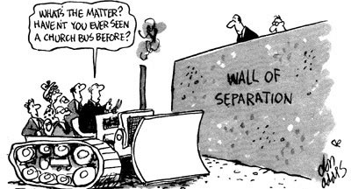
The Wall of Separation
In 1801, a group of Connecticut Baptists wrote a letter to President Thomas Jefferson expressing concern for a lack of protection for religious liberty in their state constitution. Jefferson said the Establishment Clause erected a “wall of separation” between church and state.
In In Everson v. Board of Education (1947) the Court upheld 5-4 a state’s reimbursement to parents of parochial school children for the cost of busing their kids to religious schools.
The Court reasoned that the taxpayer funds were permissible because they went to the children/parents and not the religious schools.
But the Court also said, “In the words of Jefferson, the clause against establishment of religion by law was intended to erect ‘a wall of separation between Church and State.’”
After Everson, liberal justices periodically invoked the phrase but ultimately conservative justices repudiated it arguing that its use was part of an attempt by liberal activist judges to keep religion out of public life—something they said the framers never intended.

Slide 5
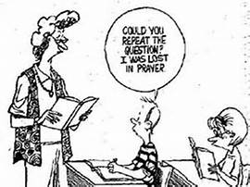
Lemon v. Kurtzman (1971)
In Lemon v. Kurtzman (1971) the Supreme Court articulated what became known as the “Lemon Test” to determine Establishment Clause violations.
Derived from past rulings, the test contained three parts, all of which had to be passed for a policy to be valid:
Does program at issue have a secular legislative PURPOSE?
Is the primary EFFECT to inhibit or advance religion?
Does the legislation foster an EXECESSIVE GOVERNMENT ENTAGLEMENT with religion?
This test became divisive in subsequent cases and though it has been slightly modified, and other justices have preferred different tests, the Lemon Test is essentially still in tact as good law today.

Slide 6

Applying the Lemon Test
In the years after Lemon, the justices’ record in applying the test in aid to religious school cases was mixed and some justices favored different tests. Yet, regardless of the test used, over time 5-4 and 6-3 accommodationist majorities became the norm.
For example, the Court has upheld:
textbook loans
diagnostic, health, therapeutic, and testing services
tax deductions for tuition, textbooks, and transportation
state-funded sign language interpreters
remedial instruction through payment for supplies, materials, and salaries for teachers and counselors
state-funded library services and materials, computer hardware and software, and other curricular materials
state-funded vouchers to pay for tuition at religious schools.

Slide 7
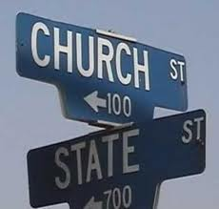
Religious Access to Public Facilities
Initially, the justices took a firm position against allowing religious teaching or other activities in public buildings.
In the mid-20th Century, the Court said that as long as religious instruction took place off school premises, it is constitutionally permissible.
But beginning in the 1980s, the Court handed down a series of decisions holding that public schools may not deny religious groups the use of their facilities for meetings or other programs, reasoning that if facilities were open to non-religious groups, religious groups could not be excluded.
The Court has upheld displays of religious symbols, such as a crèche or the Ten Commandments, if they are longstanding and placed with other secular symbols but disallowed them if they are placed alone or are relatively new.
In general, the Court has been largely accommodationist in allowing access to public facilities.

Slide 8
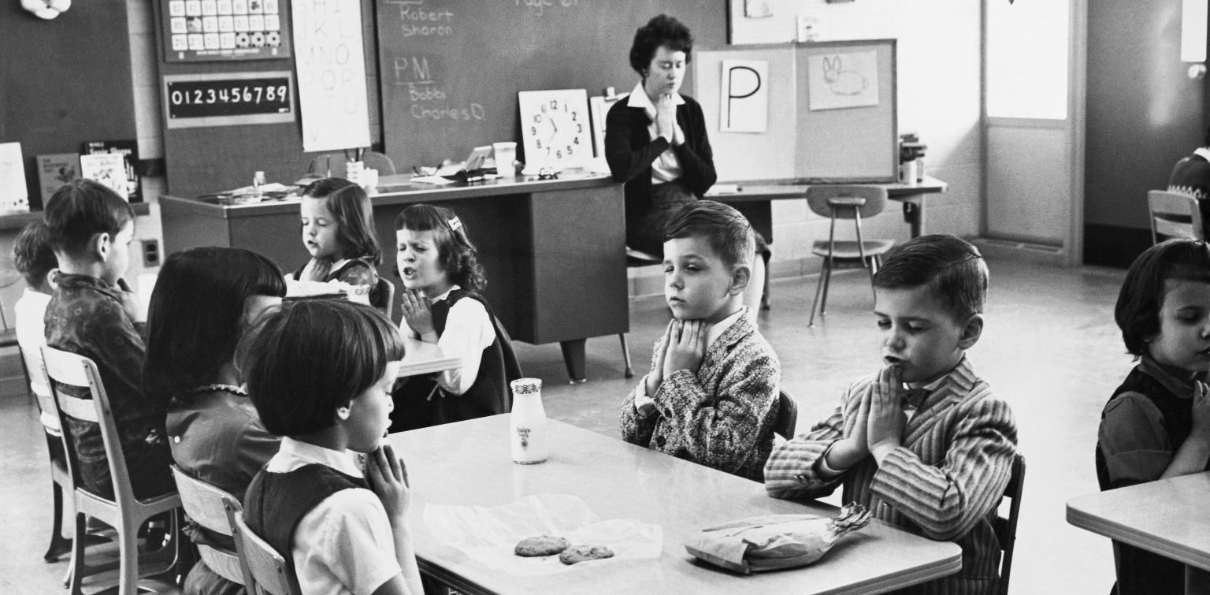
Prayer & Teaching Religion
The Court has been separationist in this area, disallowing state-mandated prayer and Bible reading since the early 1960s, despite the American people being overwhelmingly in favor of the practices.
The Court has also invalidated prayer before graduation and school sporting events.
They have allowed, however, prayer during legislative sessions because the practice has been occurring since the founding.
Moment of silence laws are allowed as long as prayer is not suggested by the state during that time.
The Court has also struck down laws requiring teaching religion in public schools or requiring that creationism (religion) be taught alongside evolution (science).

Slide 9

Free Exercise of Religion
Over time the Court has expanded the definition of religion from what was recognized as religion at the founding to a sincerely held belief.
Valid secular policies (such as time, manner, and place restrictions) are allowed even if they incidentally burden religious practices.
At the state level, neutrality is the standard while the Religious Freedom Restoration Act has made strict scrutiny the standard at the federal level, making it difficult for the federal government to burden religious practices.
Early cases were decided in a liberal direction in favor of religious minorities (Jehovah's Witnesses, the Amish) who were fired from their jobs and denied unemployment benefits (the former) or who were forced to attend high school (the latter).
Recent free exercise cases have been decided by the Roberts Court in a conservative direction in favor of groups (including businesses) who claim a religious reason for wishing to opt-out of federal laws (such as Obamacare’s contraception mandate).

Slide 10
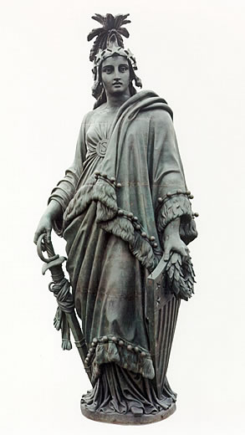
Political Speech
1st Amendment: “Congress shall make no law…abridging the freedom of speech...”
As distinguished from other types of speech (commercial speech, obscene speech, etc.) the Supreme Court has consistently held that political speech is the most protected form of expression.
The long-time standard was whether the speech created a “clear and present danger.” Since 1969, it is “incitement to imminent lawless action”—a more speech protective test.
The Statue of Freedom above the Capitol
dome wears a laurel of five pointed stars
and holds a sword and shield.

Slide 11
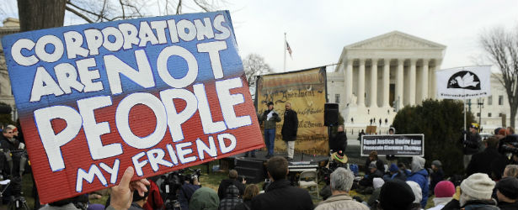
Other Forms of Speech
Symbolic Speech – Burning the American flag is allowed because it is political speech but burning a draft card is not because it is government property and interferes with congressional authority to raise armies.
Obscenity – The Court has adopted a generally speech protective test but there can different standards for different communities. The test is:
(a) whether “the average person, applying contemporary community standards” would find that the work, taken as whole, appeals to the prurient interest;
(b) whether the work depicts or describes, in a patently offensive way, sexual conduct specifically defined by the applicable state law; and
(c) whether the work, taken as a whole, lacks serious literary, artistic, political, or scientific value.
Student Speech – While students do have political speech rights on campus, that speech can be restricted if it is disruptive to the learning environment.
Campaign Finance – While the Court has allowed restrictions on direct campaign contributions to candidates due to “corruption or the appearance of corruption,” they have also allowed unlimited contributions to and spending by outside groups (corporations, labor unions, non-profit groups, etc.) who have free speech rights to engage in political speech, including supporting specific candidates through advertisements and other forms of communication.

Slide 12

Freedom of the Press
Freedom of the press is not absolute and must be balanced against the police power of the state.
Exceptions include obscenity, national security, incitement to violent action, and student publications.
Still, the Supreme Court has held that that publications cannot be censored or prohibited by the government prior to their publication (prior restraint).
But there is some uncertainty in this area of the law. Thus, the press and the government often attempt to work together to balance their interests.
While the press has the freedom to publish virtually anything about public figures, they may not publish information that they know is false. If they do, libel suits for monetary damages may result.
But the Court has articulated a press-protective test: a public official may not recover “damages for a defamatory falsehood relating to his official conduct unless he proves that the statement was made with ‘actual malice’—that is, with knowledge that it was false or with reckless disregard” for the truth.

Slide 13
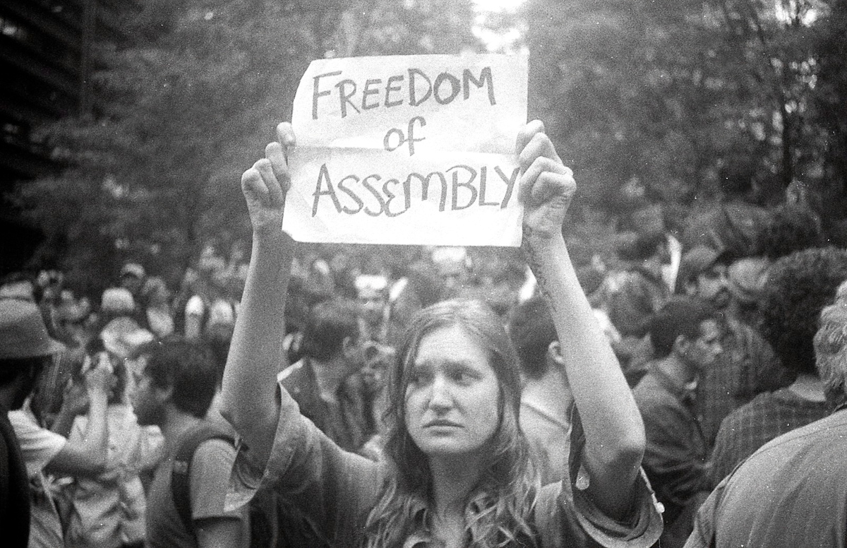
Assembly & Petition
“Congress shall make no law…abridging…the right of the people peaceably to assemble, and to petition the government for a redress of grievances.”
As with all constitutional rights and liberties the Court has sought to balance individual and group freedoms against the state’s power to preserve order.
In general the Supreme Court has been most protective of the freedom of assemble in open public forums such as public parks, streets and sidewalks, town squares, and the seats of government.
However, in more limited public forums (e.g. schools) and on private property the Court has been less willing to extend assembly rights.
The Court has struggled with balancing freedom of assembly against public order and safety—particularly where both protesters and audiences are large and communication is through expressive conduct addressing volatile issues.
Peaceful public assemblies at the seat of government have garnered the most protection as where demonstrations in and around less public forums and private property have been more likely to be restricted.

Slide 14
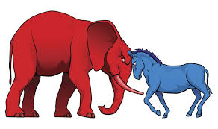
Conclusion
The First Amendment is a major point of contention in constitutional law because it contains numerous contested provisions.
The Court’s record in each area has been mixed and changes with the personnel changes on the bench.
Liberal justices from the 20th Century have, for the most part, been replaced by more conservative justices who have steered the law in a more conservative direction in recent years.
As we saw with the 2016 election, who wins the presidency is crucial for determining who sits on the Supreme Court and the future of First Amendment law.

Slide 15
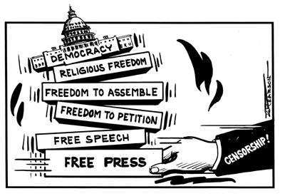
Bonus Slides

Slide 16
Establishment clause

Slide 17
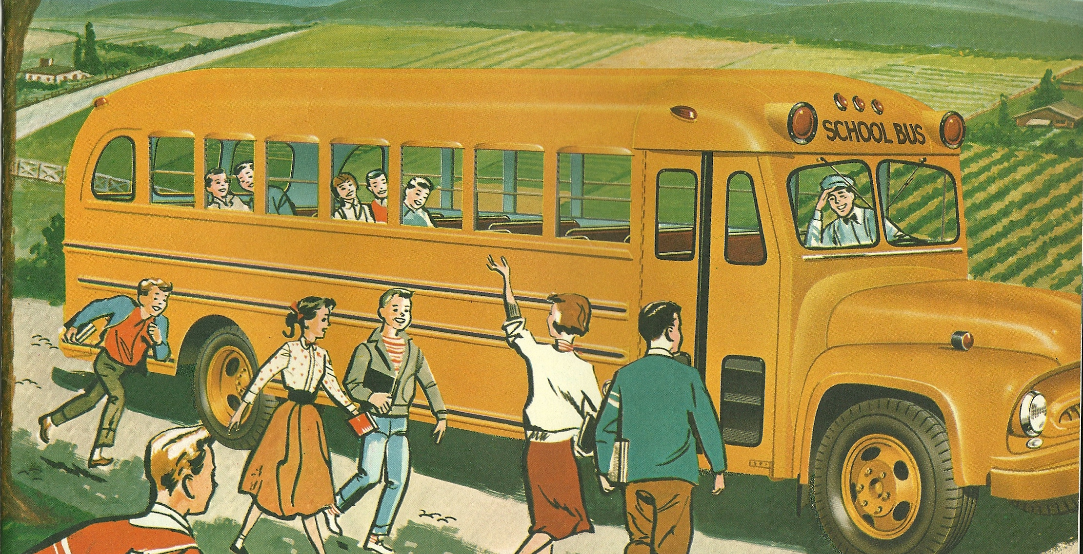
Aid to Religious Schools
In Bradfield v. Roberts (1899) the Supreme Court unanimously upheld a $30,000 grant from Congress to a Washington, DC hospital operated by Catholic nuns to construct facilities to treat indigent patients. The Court reasoned that purpose of the institution was secular – a hospital for the poor. This test became a core standard in establishment cases.
In Everson v. Board of Education (1947) the Court upheld 5-4 a state’s reimbursement to parents of parochial school children for the cost of busing their kids to religious schools. The Court reasoned that the taxpayer funds were permissible because they went to the children/parents and not the religious schools. But the Court also said, “In the words of Jefferson, the clause against establishment of religion by law was intended to erect ‘a wall of separation between Church and State.’”

Slide 18
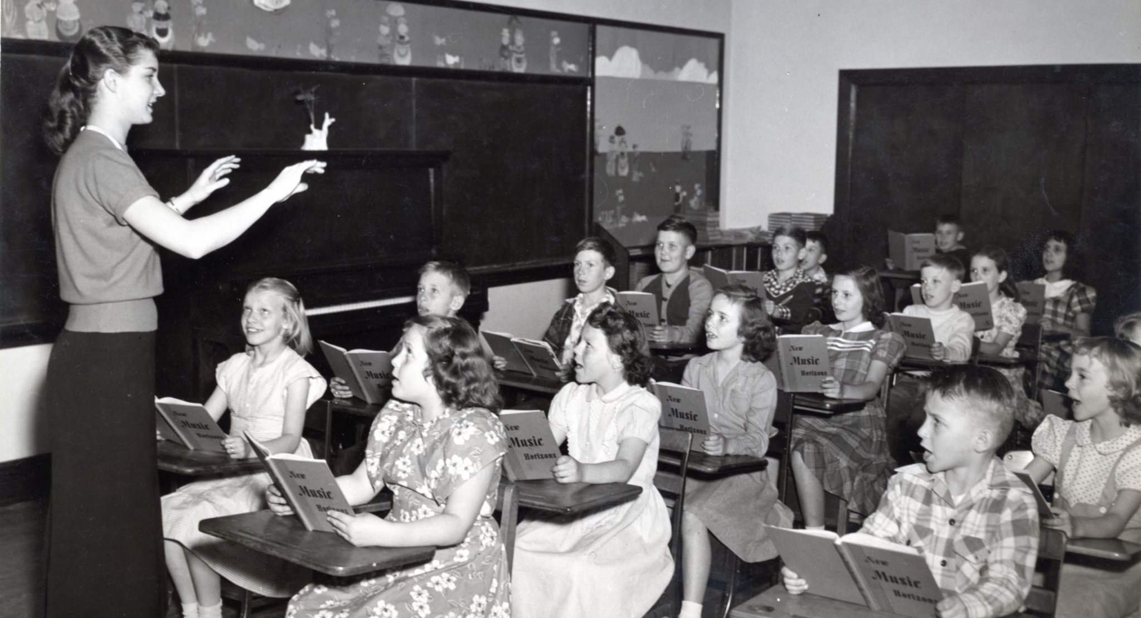
Aid to Religious Schools
Illinois ex rel. McCollum v. Board of Education (1948) the Court voted 8-1 to strike down a “release time” program in which religious instructors came to public schools weekly and provided religious training for students whose parents so desired. The Court said the close cooperation between churches and school officials, the use of school property, and the fact that religious students were released from their legal requirement to obtain a secular education constituted an establishment of religion.
In Zorach v. Clauson (1952) the Court ruled 6-3 that programs where students are released for an hour or so early one day each week to obtain religious instruction off campus was permissible. In one of the most often quoted passages in this area of the law, Douglas wrote: “We are a religious people whose institutions presuppose a Supreme Being.” The dissenters had been in the majority in McCollum and argued this was the same case.
In Board of Education v. Allen (1968) the Court upheld 6-3 a state program where public schools loaned secular textbooks to students attending private schools. The Court reasoned that the primary purpose of the law was to further education, not religion: “the financial benefit is to parents and children, not schools.”

Slide 19
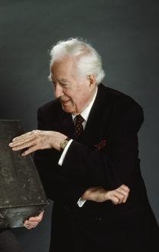
Lemon v. Kurtzman (1971)
The Court invalidated a state law reimbursing religious schools for non-religious textbooks and salaries for non-religious teachers.
Chief Justice Warren Burger reasoned that unlike textbooks, it was easy for teachers to inject religion into their teaching.
Though the aid only went to teachers of "secular" subjects, they were employed by and subject to supervision and disciplinary action by the church. Because most lay teachers were of the Catholic faith, there was potential for public funds to be used for religious instruction. Because of this potential danger, the state would have to continually monitor the school to make sure the money was being distributed correctly.
This would be excessive involvement.

Slide 20
Aguilar v. Felton (1985)
Aguilar v. Felton (1985) was the high watermark for the Supreme Court’s liberal, separationist rulings.
A 5-4 majority applied the Lemon test to strike down a New York program that allowed state-supported remedial instruction of students in religious schools through payment for supplies, materials, and salaries for teachers and counselors.
The Court said that Lemon’s 2nd prong was violated because the instruction happened in a religious setting and the effect of the law was to free up funds for religious instruction and Lemon’s 3rd prong was violated because of the “ongoing and pervasive” monitoring of classrooms and joint administration of the program by church and state.
Over time, however, the Court became increasingly conservative and began to revisit and overturn many of separationist decisions of the Burger and Warren Courts.
Aguilar was a prime target.

Slide 21
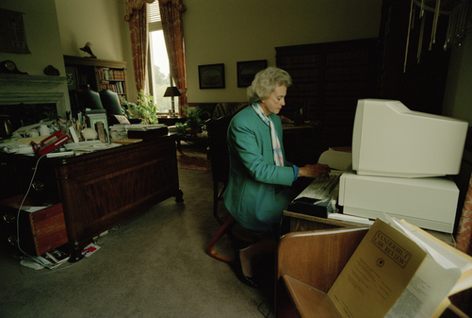
Agostini v. Felton (1997)
Following Aguilar, students at religious schools who needed remedial instruction began leaving campus to be taught in buses parked across the street.
The Court voted 5-4 to overturn Aguilar and allow the program to continue in sectarian classrooms as it had prior to Aguilar.
Justice Sandra Day O’Connor explained that establishment cases since Aguilar had been more accommodationist, thereby weakening its precedential value.
She said that there was little danger that the remedial instructors would attempt to inculcate religion into their teaching. There was not evidence that they did and they are professionals, trained to do a specific job.
As for entanglement, she explained that there would be cooperation between church and state to run this program no matter where it took place.

Slide 22
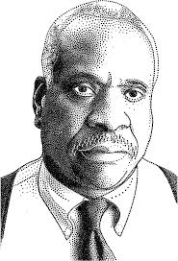
Mitchell v. Helms (2000)
The Court overturned some prior decisions and upheld 6-3 state aid to religious schools in the form of library services and materials, computer hardware and software, and other curricular materials.
Writing for the majority, Justice Clarence Thomas said: “The question of whether governmental aid to religious schools results in religious indoctrination ultimately depends on whether any indoctrination that occurs could reasonably be attributed to governmental action.”
To decide this, the Court found that the aid was available to everyone neutrally and that it was a matter of private choice for schools to participate in the program.

Slide 23
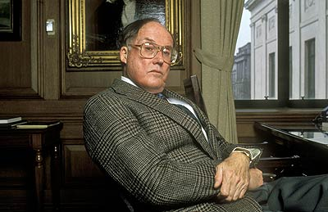
Zelman v. Simmons-Harris (2002)
For a 5-4 majority, Chief Justice Rehnquist upheld a government program providing tuition vouchers for Cleveland schoolchildren to attend private (including religious) schools.
He ignored the Lemon test, stressed the neutrality of the program, and reasoned that because the vouchers went to parents and they made a “private choice” the program was constitutional.
“No reasonable observer would think a neutral program of private choice, where state aid reaches religious schools solely as a result of the numerous independent decisions of private individuals, carries with it the imprimatur of government endorsement.”

Slide 24
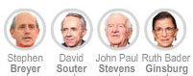
Zelman v. Simmons-Harris (2002)
The dissenters emphasized two key points:
Religious use of public funds will increase the risk of religious strife and religiously-based social conflict—the very thing the Establishment Clause was put in place to avoid
Public funds allow religious schools to divert money to religious instruction that would have been used for secular purposes: scholarships, busing, textbooks, etc.

Slide 25
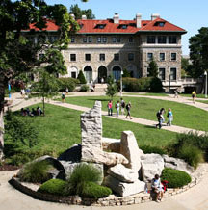
Widmar v. Vincent (1981)
In the early 1970s, a group of Christian evangelical students at the University of Missouri-Kansas City started Cornerstone—an organization whose purpose was to “promote a knowledge of Jesus Christ among students.”
Although affiliated with a local church , Cornerstone met on campus in university buildings just as the other one hundred student groups at UMKC did and told the school that its meetings addressed “various topics relating to Christianity and the Bible.” “We engaged in personal evangelism and open air preaching, but we also sought to give a reasoned presentation of the Christian faith in the academic environment,” said Jonathan Williams, then member of Cornerstone.
The “backbone” of Cornerstone was about 20 evangelical Christian students and leaders who ran the group, but its meetings (which included worship) were open to everyone and drew as many as 125.
In 1977 the school began enforcing an existing policy that denied student religious groups the use of its campus meeting rooms. The group claimed that they were told by the school that they were getting too influential on campus.
The school claimed that allowing the group to conduct their religious activities in campus rooms would cross the constitutional line between church and state.

Slide 26
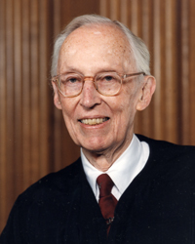
Widmar v. Vincent (1981)
Writing for an 8-1 majority, Justice Lewis Powell applied the Lemon test to find in favor of the students.
He said that equal access policies have the secular purpose of encouraging the exchange of ideas.
Further, he asserted that if the university retained its closed access policy, it would risk excessive entanglement with religion, as it would have to determine whether groups were engaging in religious speech or worship.
Finally, Powell claimed that equal access policies do not have the primary effect of advancing religion; rather they encourage “all forms of discourse.”

Slide 27
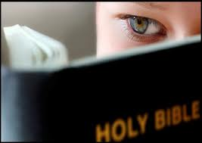
Westside Community School v. Mergens (1990) The Facts
In 1984, Congress passed the Equal Access Act requiring all public secondary schools with “limited open forum” polices to give equal access to “any students who wish to conduct a meeting within that limited open forum,” regardless of the “religious, political, philosophical, or content of the speech at such meetings.”
A limited open forum is in effect if a school permits “one or more noncurriculum related student groups to meet in school premises during noninstructional times.”
Westside High School in Omaha, Nebraska, refused to let a group of students form a Christian Bible Study Club. The school denied the request because school policy requires a staff member to sponsor any club that sought to meet on campus.
The students argued that the district's decision violated the Equal Access Act.

Slide 28
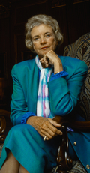
Westside Community School v. Mergens (1990) The Decision
A divided Court voted to uphold the Equal Access Act.
In a plurality opinion (fully endorsed by only four justices) Justice Sandra Day O’Connor held that private endorsements of religion, such as those that might occur during a group meeting, she asserted, were protected by the free speech and free exercise clauses of the First Amendment, but government endorsements would violate the establishment clause.

Slide 29
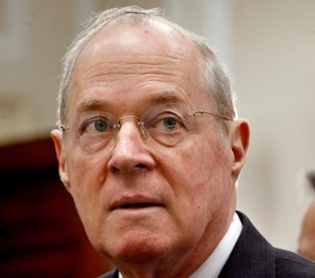
Westside Community School v. Mergens (1990) The Decision
Justices Anthony Kennedy and Antonin Scalia agreed that the act was constitutional, but they took issue with O’Connor’s endorsement approach. They advocated a standard emphasizing the relative “coercive” nature of government policies.
Kennedy wrote: “I should think it inevitable that a public school ‘endorses’ a religious club, in a commonsense use of the term, if the club happens to be one of many activities that the school permits students to choose in order to further the development of their intellect and character in an extracurricular setting.
But no constitutional violation occurs if the school’s action is based upon recognition of the fact that membership in a religious club is one of many permissible ways for a student to further his or her own personal enrichment.
The inquiry with respect to coercion must be whether the government imposes pressure upon a student to participate in a religious activity. This inquiry, of course, must be undertaken with sensitivity to the special circumstances that exist in a secondary school where the line between voluntary and coerced participation may be difficult to draw. No such coercion…has been shown to exist s a necessary result of this statute.”

Slide 30
Lamb’s Chapel v. Center Moriches Union Free School District (1993)
New York law prevented school boards from allowing schools to be used after hours for religious activities.
Lamb’s Chapel, an evangelical group, twice requested use of a public school’s facilities and were denied both times. They sought to use the school to show films from a religious-oriented series concerning family values and child rearing.
Both the district and appellate courts ruled in favor of the school district, calling the school a “limited public forum” that need not be available to everyone.

Slide 31
Lamb’s Chapel v. Center Moriches Union Free School District (1993)
The Court ruled unanimously to reject the school district’s decision to refuse to allow school property to be used for religious activities.
Writing for the Court, Justice Byron White explained that the critical point is whether the school’s decision to refuse the religious group’s request was neutral.
Because the topic of the films served a social or civic purpose and would be allowed to be shown by a non-religious group, the rejection of the Lamb’s Chapel request was not neutral.
To refuse the forum to the religious group favors some viewpoints at the disadvantage of others.
The Establishment Clause would not have been violated because the film would have been shown after school hours and would have been open to the public.
Even though the decision was unanimous, disagreements over the appropriate standard to use continued to divide the justices, and their rhetoric became more extreme.
Three justices (Scalia, Kennedy, and Thomas) harshly criticized the Court’s use of the Lemon test and the endorsement standard preferred by Justice O’Connor.

Slide 32
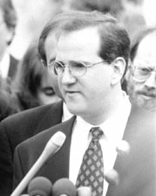
Rosenberger v. University of Virginia (1995)
Ronald Rosenberger, a member of a recognized organization of Christian students at the University of Virginia, objected to a denial of student activity funds to support the printing of the group’s newspaper, Wide Awake: A Christian Perspective at the University of Virginia.
Other student groups received funding to support their publications, but the university’s rules prohibited support for religious activities.

Slide 33
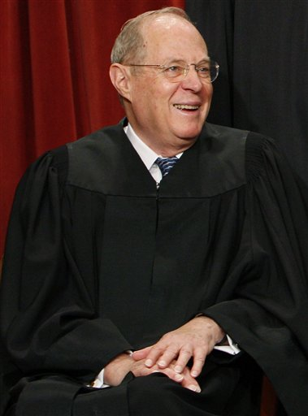
Rosenberger v. University of Virginia (1995)
The Court ruled 5-4 in favor of Rosenberger.
Relying on decisions such as Lamb’s Chapel, Justice Kennedy, writing for the Court, found the university’s policies to be an unconstitutional form of “viewpoint discrimination.”
He explained that “it does not violate the Establishment Clause for a public university to grant access to its facilities on a religion-neutral basis to a wide spectrum of student groups.”
Ruling otherwise, according to Kennedy, would require the university to scrutinize all student speech to ensure that it did not contain excessively religious content.
Four justices dissented, condemning the majority for approving for the first time direct government expenditures to support core religious activities.

Slide 34
Good News Club v. Milford Central School (2001)
This dispute began when a private Christian children’s organization requested the use of classrooms for weekly meetings.
The school allowed outside groups to use school facilities after hours but excluded those whose purpose was to conduct religious instruction or services.
Good News Club leaders acknowledged that the meetings were primarily for the singing of religious songs, Bible lessons, prayer, and Scripture recitations.
Consequently, the request for access was denied.

Slide 35
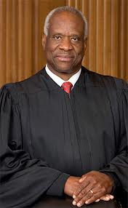
Good News Club v. Milford Central School (2001)
Writing for the 6-3 majority, Justice Clarence Thomas said that the denial violated the Good News Club’s First Amendment rights because school officials had engaged in impermissible viewpoint discrimination.
Upon creating a limited public forum, the school could deny access based on subject matter, but it could not discriminate on the basis of viewpoint.
Other groups interested in promoting good character and values had been granted access; the Good News Club was also involved in character and moral development but promoted it from a distinctly Christian perspective. Therefore, viewpoint, not subject matter, impermissibly dictated the school’s decision.
Once again, the Court emphasized that there was no realistic danger that members of the community would believe that the school was endorsing religion or any particular creed; nor was there any evidence that any child would feel coerced into attending a Good News Club meeting.

Slide 36
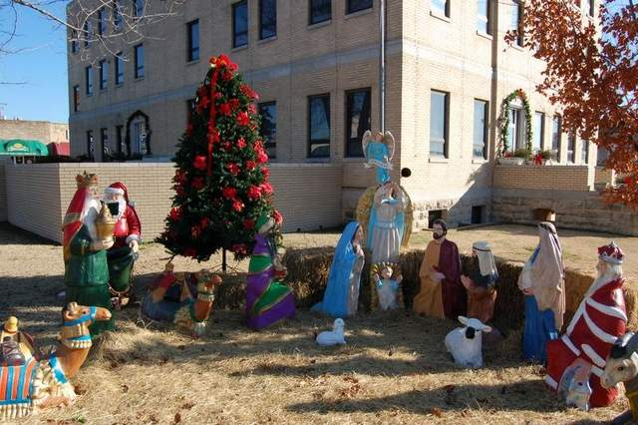
Public Display of Religious Symbols
In Lynch v. Donnelly (1984) the Court upheld the public display of a crèche because it was coupled with secular symbols: Santa, reindeer, and talking wishing wells.
In Allegheny County v. ACLU (1989) the Court struck down the public display of a stand-alone crèche on a courthouse staircase but allowed a menorah to be displayed outside the courthouse because it was coupled with a Christmas tree.

Slide 37
The Ten Commandment Cases (2005)
In two cases—McCreary County v. ACLU (2005) and Van Orden v. Perry (2005)—the Court held 5-4 that:
Two large, framed copies of the Ten Commandments could not be displayed in a courthouse building because they were placed there relatively recently and were displayed by themselves . . .
But, a six-foot monument displaying the Ten Commandments could be placed on public grounds because it was longstanding and was placed with other historical monuments.

Slide 38
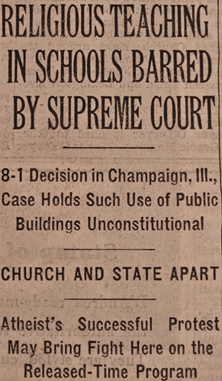
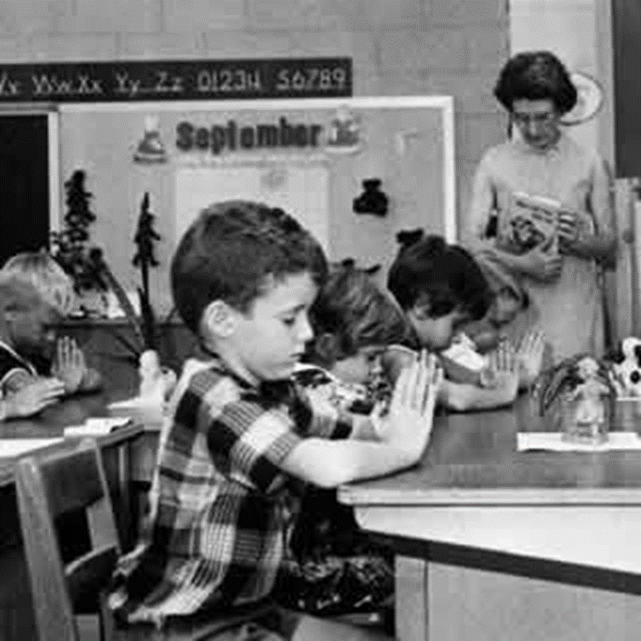
Prayer & Teaching Religion
In Engel v. Vitale (1962) the Supreme Court stuck down 6-1 state-imposed prayer in public schools.
In Abington School District v. Schempp (1963) the Court struck down 8-1 state-imposed Bible reading in public schools.
The justices reasoned that the intent of these laws was to promote religion and the effect was to coerce students to participate in religion.
A majority of Americans have never approved of the Court’s holdings in Engel and Schempp. Today only about 1/3 agree with them.
In Epperson v. Arkansas (1968) a unanimous Court struck down state laws prohibiting the teaching of evolution but allowed teaching creationism. The Court said the state may not favor religion over non-religion.

Slide 39

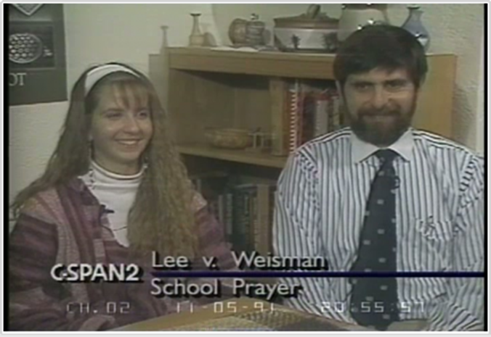
Prayer & Teaching Religion
In Marsh v. Chambers (1983), the Court voted 6-3 to uphold prayers before legislative sessions. Ignoring the Lemon test, the justices said that tradition and history were determinative. The Court reaffirmed 5-4 in Town of Greece v. Galloway (2014).
In Wallace v. Jaffree (1985) the Court struck down 6-3 a state law that mandated a moment of silence “for meditation or voluntary prayer” because the law’s purpose was not secular. (
In Edwards v. Aguillard (1987) the Court struck down 7-2 a state law that mandated that creationism be taught if evolution was taught. The Court found that the stated purpose of the law—to promote “academic freedom” was a sham and that it was instead an attempt to promote religion.
In Lee v. Weisman (1992) the Court struck down 5-4 a state-approved, clergy-led prayer at a public school graduation because “subtle coercive pressures exist and the student had no real alternative which would have allowed her to avoid the fact or appearance of participation.”
In Santa Fe Independent School District v. Doe (2000) the Court struck down 6-3 student-led invocations to be delivered on the public address system during school football pre-game ceremonies. The Court said the policy had a religious purpose, was a government endorsement of religion, and was coercive for students who were required to attend the event (cheerleaders, band members, players, etc.)

Slide 40
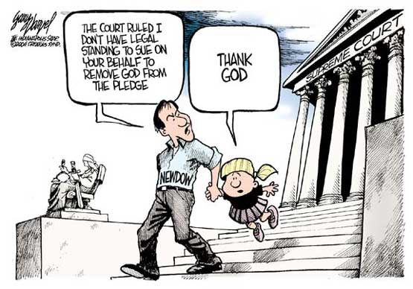
Elk Grove v. Newdow (2004)
The Pledge of Allegiance has included the phrase “under God” since 1954.
California requires public elementary school teachers to lead students in the Pledge.
Newdow, an atheist, challenged the Pledge that his daughter was required to recite.
The Court ducked the issue by holding that Newdow, as a divorced father who did not have legal custody of his daughter, did not have standing to bring the suit. In his opinion for the Court, liberal Justice John Paul Stevens added: “[The Pledge’s] recitation is a patriotic exercise designed to foster national unity and pride in those principles.”
Still, Rehnquist, O’Connor, and Thomas went to great lengths in separate opinions to explain why the Pledge was constitutional.

Slide 41
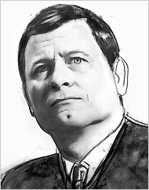
The Roberts Court and the Establishment Clause
The Roberts Court has been reluctant to wade into the controversy surrounding Lemon and has instead sought to decide the few establishment cases they have hear on narrower, alternate grounds.
For example, In Arizona Christian School Tuition Organization v. Winn (2011) the Court denied Arizona taxpayers the right to challenge, under the Establishment Clause, tax credits for tuition payments to a parochial school.
The decision was 5–4 along ideological lines with the liberals explaining that taxpayers have always had standing to sue the government on Establishment Clause grounds—e.g. Flast v. Cohen (1968)—and that the conservative justices were undermining the rule from that case by carving out an exception.

Slide 42
Hosanna-Tabor Evangelical Lutheran Church and School v. EEOC (2011)
Can teachers bring suits again religious schools for violating federal antidiscrimination laws such as the Americans with Disabilities Act or are the schools exempt under the First Amendment religion clauses?
The key issue was whether the teacher—who in this instance had narcolepsy, and who only taught religious material for 45 minutes and secular subjects the rest o the school day—fell under the “ministerial exception” to the employment discrimination laws, whereby those employees deemed clergy cannot sue their employers for violation of anti-discrimination laws.
The Court ruled 9-0 that the suit was invalid on both Establishment and Free Exercise grounds.
Chief Justice Roberts wrote:
“By imposing an unwanted minister, the state infringes the Free Exercise Clause, which protects a religious group’s right to shape its own faith and mission through its appointments. According the state the power to determine which individuals will minister to the faithful also violates the Establishment Clause, which prohibits government involvement in such ecclesiastical decisions.”
“The purpose of the [ministerial] exception is not to safeguard a church’s decision to fire a minister only when it is made for a religious reason. The exception instead assumes that the authority to select and control who will minister to the faithful—a matter “strictly ecclesiastical,”—is the church’s alone.”

Slide 43
Free exercise of religion

Slide 44
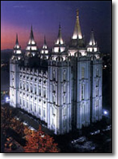
Reynolds v. United States (1879)
1830—Mormon church founded.
1874—U.S. Congress outlawed polygamy.
In Reynolds v. United States (1879) the Court held that the polygamy was not protected by the Free Exercise Clause because it was not practiced when the First Amendment was adopted, i.e. Mormonism was not a religion because it was not contemplated by the framers.
This ruling basically defined religion to a belief in God, in the Western sense.

Slide 45
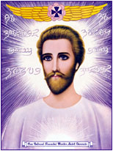
Defining Religion
Later cases expanded the Reynolds definition from a “belief in God” to:
“a sincerely held belief” in the case involving the “I AM” sect of Saint Germain in California: United States v. Ballard (1944),
“moral and ethical” sincerely held beliefs in the Vietnam draft objector cases: United States v. Seeger (1965) and Welsh v. United States (1970).
Saint Germain

Slide 46
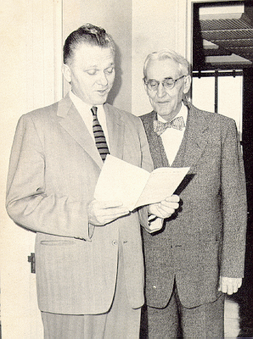
Cantwell v. Connecticut (1940)
Cantwell and his sons, Jehovah's Witnesses, were in the streets of New Haven, a heavily Catholic neighborhood, playing records and handing out literature attacking the Catholic Church. Two men complained and the next day Cantwell was arrested.
They were convicted of unauthorized solicitation (not petitioning a state official beforehand who had to determine whether “the cause was a religious one” or one of a “bona fide object or charity”; if the official found neither he could withhold the license).
Can the state require a license for religious solicitation in public?
Hayden C. Covington (left) worked as an attorney for the Jehovah’s Witnesses for many years and recorded a record 37 victories in the U.S. Supreme Court.

Slide 47
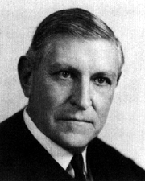
Cantwell v. Connecticut (1940)
Writing for a unanimous Court, Justice Owen J. Roberts struck down the law because the state official was determining what was and was not a religion.
The first Amendment “embraces two concepts - freedom to believe and freedom to act. The first is absolute but . . . conduct remains subject to regulation for the protection of society.“ For example, states can "regulate the times, the places, and the manner of soliciting upon its streets. . . and in other respects safeguard the peace, good order and comfort of the community."
This is called the “valid secular policy test" – if there is a legitimate state interest—a valid secular policy—then regulations are allowed, even if they conflict with religious practices.

Slide 48
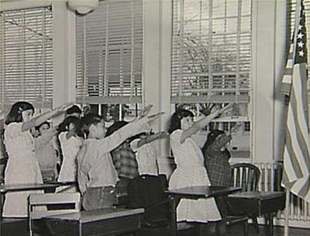
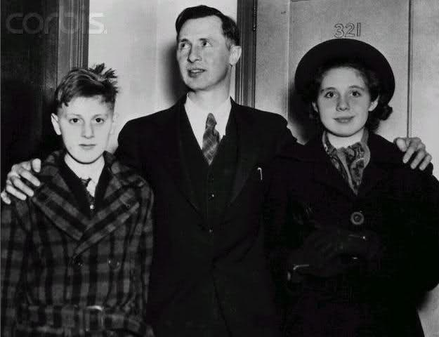
Minersville School Dist. v. Gobitis (1940)
Walter Gobitas and his children—12-year-old Lillian and her younger brother, Billy—attended a Pennsylvania public school with a mandatory flag salute policy. As Jehovah’s Witnesses they believed that the salute violated their religious teaching and refused to do it.
The children were expelled despite the fact that Billy sent school officials the following letter:

Slide 49
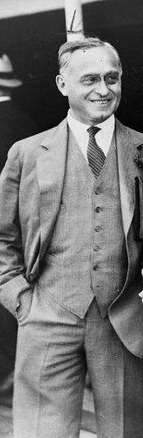
Minersville School Dist. v. Gobitis (1940)
By a vote of 8-1 the Court rejected their claim.
Justice Felix Frankfurter wrote: “The ultimate foundation of a free society is the binding tie of cohesive sentiment….The flag is the symbol of our national unity, transcending all internal differences…. To stigmatize legislative judgment in providing for this universal gesture of respect for the symbol of our national life…would amount to no less than the pronouncement of pedagogical and psychological dogma in a field where courts posses…no controlling competence.”
Put simply, the Court said that the state had a legitimate secular reason for requiring flag salutes: to foster patriotism.

Slide 50
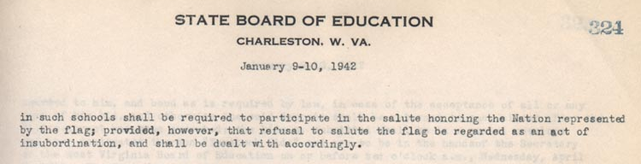
West Virginia Board of Education v. Barnette (1943)
The repercussions from Gobitis were extraordinary. Many states either retained or passed laws requiring flag salutes and pledges for all public school children or they would face expulsion.
“Within two weeks of the Court’s decision,” two federal officials later wrote, “hundreds of attacks upon the Witnesses were reported to the Department of Justice.”
Mobs throughout the country stoned, kidnapped, beat, and even castrated Jehovah’s Witnesses.
In the wake of these developments, many newspapers and major organizations, such as the American Bar Association, condemned the Court’s ruling.
In Barnette, the justices overruled Gobitis but primarily on free speech grounds rather than on religious exercise.

Slide 51
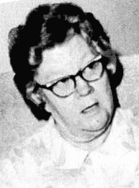
Sherbert v. Verner (1963)
Sherbert worked M-F in a textile mill for 35 years. Saturday work was optional and she always chose not to work because of her religious beliefs.
She was informed that Saturdays would now be mandatory, didn't show and got fired. Other mills had mandatory Saturday work and did not hire her.
She filed for unemployment and was denied because she was "able to work" as defined by the state unemployment statute.
Her attorneys argued that the denial of benefits due to the Saturday work requirement impinged on her religious belief -- the state was using economic coercion to force her to give up her religious belief.
Adele Sherbert

Slide 52
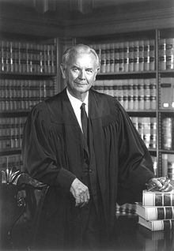
Sherbert v. Verner (1963)
Justice Brennan struck down the law, comparing it to a criminal statute:
“The ruling forces her to choose between following the precepts of her religion and forfeiting benefits, on the one hand, and abandoning one of the precepts of her religion in order to accept work, on the other hand. Governmental imposition of such a choice puts the same kind of burden upon the free exercise of religion as would a fine imposed against appellant for her Saturday worship.”
The Court applied strict scrutiny, i.e. “the compelling state interest” test: The burden of proof is on the state to prove that their interest in restricting religion is “compelling.” They cannot simply assert a reason, but must instead provide data, evidence, proof, etc.
The state said that its interest was curbing fraudulent benefits claims but the Court said that the state had not provided any evidence that fraudulent religious claims were a problem.

Slide 53
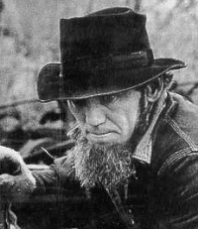
Wisconsin v. Yoder (1972)
State required compulsory education to age 16 (10th grade).
The Court said that “Amish objection to formal education beyond the eight grade is firmly grounded in . . . central religious concepts.”
The Court applied the compelling interest test: “Whatever their idiosyncrasies as seen by the majority, this record strongly shows that the Amish community has been a highly successful social unit within our society, even if apart from the conventional ‘mainstream.’ Its members are productive and very law-abiding members of society.”
Jonas Yoder

Slide 54

Employment Division of Oregon v. Smith “The Peyote Case” (1990)
Two Native Americans were fired from their jobs, as drug counselors at a private clinic, after ingesting peyote as part of tribal religious rituals. They were not charged with a crime. They were, however, denied unemployment benefits because of “work-related misconduct.”
While many states and the federal government do not criminalize peyote use for religious purposes, others, such as Oregon, do criminalize its general use. Oregon allows its use only on a prescription basis.

Slide 55
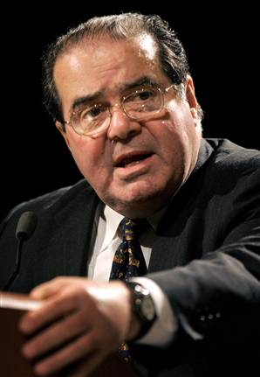
Employment Division of Oregon v. Smith “The Peyote Case” (1990)
The Court upheld the denial of benefits. Justice Scalia wrote, “We have never held that an individual’s religious beliefs excuse him from compliance with an otherwise valid law prohibiting conduct that the state is free to regulate.”
Scalia explained that the “compelling interest” test from Sherbert v. Verner does not apply to criminal statutes and that as long as the law was neutral—i.e. applicable to everyone—it was constitutional.
“Although we have sometimes used the Sherbert test to analyze free exercise challenges to such laws . . . we have never applied the test to invalidate one. We conclude today that the sounder approach in accord with the vast majority of our precedents, is to hold the test inapplicable to such challenges.”

Slide 56
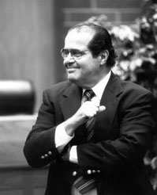
Employment Division of Oregon v. Smith “The Peyote Case” (1990)
Scalia explained that the kind of rule the "compelling interest" standard would give us would provide a religious exemption from almost anything:
compulsory military service, taxes, health and safety regulation such as manslaughter and child neglect laws, compulsory vaccination laws, drug laws, traffic laws, minimum wage laws, child labor laws, animal cruelty laws, environmental laws, laws providing for equality of opportunity for the races.
He wrote: “The first amendment's protection of religious liberty does not require this.”

Slide 57

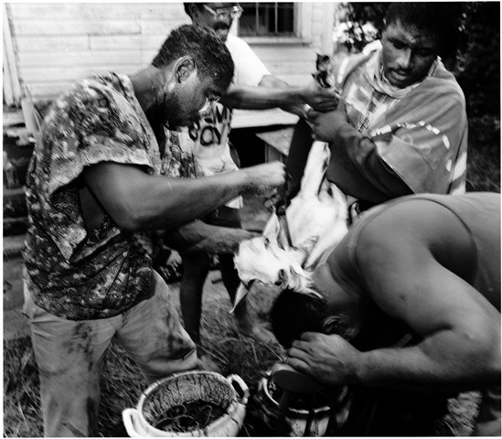
Church of the Lukumi v. Hialeah (1993)
Church members practice the Santeria religion, which originated in West Africa, came to Cuba, and then to the U.S. following the Cuban revolution. There are 50,000 practitioners in Florida and 100 million worldwide.
Central to the religion is animal sacrifice (chickens, goats, sheep, turtles, etc.) at weddings, births, deaths, etc. The animals' throats are cut and often they are eaten later.
The city of Hialeah, Florida enacted a series of ordinances limiting animal sacrifice, which it defined as "to unnecessarily kill, torment, or mutilate an animal in a public or private ritual or ceremony not for the primary purpose of food consumption."
The city argued there were significant health risks and problems of feeding, housing, and disposing of remains when slaughtering a large amount of animals (perhaps 10,000 a year) in places not properly zoned (like slaughterhouses) for the activity.
The city also expressed concern for inhumane treatment of animals.

Slide 58

Church of the Lukumi v. Hialeah (1993)
Justice Kennedy applied both the neutrality test from Smith and the compelling interest standard from Sherbert in striking down the law.
Kennedy said that if the law was not neutral, or generally applicable, the state must show a compelling interest.
“The record in this case compels the conclusion that suppression of the central element of the Santeria worship service was the object of the ordinances. . . . No one suggests, and on this record it cannot be maintained, that city officials had in mind a religion other than Santeria.”
In separate opinions, Justices Blackmun, O’Connor, and Souter explained that only the compelling interest test ought to be used.
Justice Scalia and Chief Justice Rehnquist explained that only neutrality was required.

Slide 59

City of Boerne v. Flores (1997)
In response to the Peyote case, Congress passed the Religious Freedom Restoration Act (RFRA) of 1993 which required that statutes "substantially burdening" a person's exercise of religion must further a compelling governmental interest, and use the least restrictive means of furthering that compelling governmental interest. In effect Congress sought a return from the more conservative “neutrality” test of Smith to the liberal “compelling interest” test of Sherbert/Yoder.
Congress cited its authority under the 14th Amendment’s section V enforcement power to make RFRA applicable to the states.
Flores, the Catholic Archbishop of San Antonio applied for a building permit to enlarge his 1923 mission-style St. Peter's Church in Boerne, Texas. Local zoning authorities denied the permit, relying on a local historical preservation ordinance. The Archbishop brought a lawsuit challenging the permit denial under RFRA. He argued that his congregation had outgrown the existing structure and claimed his ability to act on his beliefs was substantially burdened by the denial of his proposed addition.

Slide 60

City of Boerne v. Flores (1997)
The Court, in an opinion by Justice Anthony Kennedy struck down RFRA as an unconstitutional use of Congress's enforcement powers.
“Legislation which alters the meaning of the Free Exercise Clause cannot be said to be enforcing the Clause. While the line between measures that remedy or prevent unconstitutional actions and measures that make a substantive change in the governing law is not easy to discern, and Congress must have wide latitude in determining where it lies, the distinction exists and must be observed...Congress does not enforce a constitutional right by changing what the right is.”
Moreover, remedial or prophylactic legislation still had to show "congruence and proportionality" between the end it aimed to reach (that is, the violations it aimed to correct), and the means it chose to reach those ends—that is, the penalties or prohibitions it enacted to prevent or correct those violations. Because RFRA was not reasonably remedial or prophylactic, it was unconstitutional.

Slide 61

Gonzales v. O Centro Espirita Beneficente Uniao do Vegetal (2006)
In 1999, U. S. Customs agents seized over 30 gallons of hoasca tea which was shipped to the Santa Fe, New Mexico branch of the Brazil-based UDV; the tea contains a Schedule I drug, illegal under the federal Controlled Substances Act.
The U.S.-based UDV filed suit claiming that the seizure was an illegal violation of the church members' rights; they claimed their usage was permitted under the RFRA.
Chief Justice John Roberts wrote the opinion for a unanimous Court and found that the government was unable to detail the State's compelling interest in barring religious usage of Hoasca under the strict scrutiny that the RFRA demands of such regulations.
Because the government had failed to submit any evidence on the consequences of granting an exemption to CSA enforcement allowing UDV to practice its religion, the Court ruled that it had failed to meet its burden on this point.
States were not directly impacted by the Court's ruling under City of Boerne v. Flores (1997). Yet the decision made plain that RFRA was good law as applied to the federal government.

Slide 62
Recent Free Exercise Decisions of the Roberts Court
In Christian Legal Society v. Martinez (2010) the Court ruled 5-4 (with Justice Kennedy joining the liberals) that a student organization at a public university was not free to limit their members to those who shared their belief system (including religious beliefs) if that resulted in discrimination on the basis of sexual orientation.
Though there was a free exercise claim made in the case, the justices based their decision on free speech/association.
In Hosanna-Tabor Evangelical Lutheran Church and School v. EEOC (2011) the Court ruled 9-0 that there is a “ministerial exception” for religious organizations that allows them to fire religious teachers for any reason even if that reason would otherwise violate federal antidiscrimination law. While this case involved a free exercise claim, the Court also relied on the Establishment Clause for its holding.
In Burwell v. Hobby Lobby (2014) the Court ruled 5-4 to allow private corporations to opt out on religious grounds of a federal requirement under Obamacare to provide contraception to employees.

Slide 63
Free Exercise Standards
 | Liberal | Conservative
Test | Strict Scrutiny | Neutrality
Presumption For | Individual/Group | State
Standard | Compelling State Interest; Narrowly Tailored; Least Restrictive Means | Neutrality, General Applicability
Cases | Sherbert, Yoder, Gonzales, Hobby Lobby (conservative) | Smith, Hialeah, Boerne

Slide 64
Freedom of speech

Slide 65

Political Speech
In times of peace there is little reason to restrict expression.
In times of crisis (war, economic collapse, natural catastrophes, or internal rebellion) the government places a priority on national unity and takes firm action against subversive groups and opposition criticism—often restricting the right of the people to speak, publish, and organize.
Over time, the Supreme Court has shifted its standards for determining the limits of free speech from speech restrictive standards (bad tendency, clear and present danger) to the current, protective standard (incitement to imminent lawless action)

Slide 66
Political Speech Standards: What Can be Banned?
Speech Restrictive Tests
Speech Protective Tests
Bad Tendency – speech that has a tendency to incite or cause unlawful action.
Grave and Probable Danger – speech where the gravity of the “evil,” discounted by its improbability, justifies such invasion of free speech as is necessary to avoid the “danger.”
Clear and Present Danger – speech that creates such a clear and present danger that it will bring about the substantive evils that government has a right to prevent.
Incitement to Imminent Lawless Action – speech that is directed to inciting or producing imminent lawless action and is likely to incite or produce such action. This is the law today.
Absolutism – while actions may be prohibited, speech may never be.

Slide 67
Political Speech Standards
Speech Protective Speech Restrictive
Absolutism Black & Douglas in Dennis v. U.S. (1951) | Incitement to Imminent Lawless Action [Good Law] Brandenburg v. Ohio (1969) Hand in Masses v. Patten (1917) | Clear & Present Danger Holmes in Schenck v. U.S. (1919), Abrams v. U.S. (1919), Gitlow v. New York (1925) | Grave & Probable Danger Vinson in Dennis v. U.S. (1951) | Bad Tendency Majority in Abrams v. U.S. (1919) and Gitlow v. New York (1925)

Slide 68

Obscenity: From Hicklin to Roth
The U.S. indicted Samuel Roth for violating federal obscenity law, specifically for sending “obscene, indecent, and filthy matter” through the mail. Among those materials was an advertisement for Photo and Body, Good Times, and American Aphrodite Number Thirteen.
Regina v. Hicklin (1868) – British case held that expression could be deemed “obscene” and banned if “the tendency of the matter charged as obscenity is to deprave and corrupt those whose minds are open to such immoral influences and into whose hands a publication of this sort might fall.”
This rule is also known as the child test: if any part of a work (book, play, film, etc.) was something that should not be shown to a child, then the entire work could be banned for all.
The U.S. Supreme Court adopted this rule and did not overturn it for a more speech protective standard until 1957.
In Roth v. U.S. (1957) the Court ruled that the constitutional test is “whether the average person, applying contemporary community standards, the dominant theme of the material taken as a whole appeals to prurient interest.”
Over the next twelve years, the most liberal Supreme Court in history ruled in favor of free speech claims in nearly 90% of obscenity cases. Ultimately, however, the nation and the Court became more conservative and the justices settled on a new three-part test that they would use to find in favor of speech claims in obscenity cases about one-third of the time—a dramatic shift in favor of government regulation….

Slide 69

Obscenity: The Miller Test
In Miller v. California (1973) the Supreme Court
held that the basic guidelines for a trier of fact must be:
(a) whether “the average person, applying contemporary community standards” would find that the work, taken as whole, appeals to the prurient interest;
(b) whether the work depicts or describes, in a patently offensive way, sexual conduct specifically defined by the applicable state law; and
(c) whether the work, taken as a whole, lacks serious literary, artistic, political, or scientific value.
The Court said that the state can regulate:
“(a) patently offensive representations or descriptions of ultimate sexual acts, normal or perverted, actual or simulated;
(b) patently offensive representation or descriptions of masturbation, excretory functions, and lewd exhibition of the genitals. Sex and nudity may not be exploited without limit by films or pictures exhibited or sold in places of public accommodation any more than live sex and nudity can be exhibited or sold without limit in such public places.”
While the Miller test is still valid law today, the Court has made exceptions including allowing bans on child pornography in New York v. Ferber (1982) but not virtual child pornography (where adults pretend to be minors) in Ashcroft v. Free Speech Coalition (2002).

Slide 70

Symbolic Speech
In O’Brien v. U.S. (1969) the Court ruled 8-1 that burning a draft card is not protected expression.
In Cohen v. California (1971) the Court overturned 5-4 a man’s conviction for the crime of disturbing the peace for wearing a jacket in the public corridors of a courthouse that displayed the phrase, "Fuck the Draft."
In Texas v. Johnson (1989) Gregory Johnson burned an American flag outside the 1984 Republican National Convention to protest President Ronald Reagan. The Court ruled 5-4 that burning the American flag is protected political speech. Despite the unpopularity of the ruling it has never been overturned and constitutional amendments to ban the practice have not made it out of congress.

Slide 71


Student Speech
In Tinker v. Des Moines (1969) the Supreme Court ruled 7-2 that students could engage in symbolic speech--"closely akin to pure speech"—(in this case wearing arm bands to protest the Vietnam War) as long as it would not cause a substantial disruption of the school's educational mission. The Court famously held that students do not “shed their constitutional rights when they enter the schoolhouse door.”
In Morse v. Frederick the Supreme Court held 5-4 that schools can restrict student expression that they reasonably regard as promoting illegal drug use, in this case a “BONG HiTS 4 JESUS” banner displayed at a school-sanctioned and school-supervised event: the Olympic Torch relay.
Thus, both Tinker and Morse stand for the principle that while political speech is generally protected by the Constitution, there are restrictions, particularly in schools. Students cannot be disruptive and cannot promote messages that school officials may deem harmful to students.

Slide 72

Campaign Finance: Buckley v. Valeo (1976)
In Buckley the U.S. Supreme Court upheld limits on direct contributions to candidates and but struck down limits on how much candidates could spend.
The Court’s decision rested on an assumption that placing a ceiling on campaign expenditures was equivalent to restricting political speech.
Still, the Court did find that the government's compelling interest in preventing "corruption or its appearance" could justify restrictions that went beyond bribery. The Court ruled that because contributions involved the danger of "quid pro quo" exchanges, in which the candidate would agree, if elected, to take or not to take certain actions in exchange for the contribution, limitations on contributions could generally be justified.
The Court struck down limitations on spending by candidates and spending by others undertaken independently of candidates, on the grounds that spending money did not, by definition, involve such candidate/donor exchanges.
Thus the justices balanced the need to secure the integrity of federal elections against the right to political expression. The Court concluded that reducing electoral corruption was a sufficient interest to limit campaign contributions, but not to restrict campaign expenditures.

Slide 73


Citizens United v. FEC (2010)
The Court struck down 5-4 the provision of the Bipartisan Campaign Finance Reform Act (2002) that prohibited corporations (including non-profit issue organizations) from financing independent electioneering communications including negative, attack ads against political candidates.
Writing for the majority, Justice Anthony Kennedy said: “The Court has recognized that First Amendment protection extends to corporations. This protection has been extended…to the context of political speech…. political speech does not lose First Amendment protection simply because its source is a corporation.”
“If the First Amendment has any force, it prohibits Congress from fining or jailing citizens, or associations of citizens, for simply engaging in political speech.”
Citizens United has often been credited for the creation of Super PACs – political action committees which make no contributions to candidates or parties and so can accept unlimited contributions from individuals, corporations and unions.
Because individuals could make unlimited anonymous contributions to Super PACs that supported individual candidates, a new (old) phenomenon took hold in 2012: presidential campaigns that were essentially underwritten by single individuals or a small number of wealthy individuals.

Slide 74
Freedom of the press

Slide 75

Common Law
When printing began in England in the 1400s, Britain developed a licensing system under which nothing could be printed without prior approval of the government.
England controlled the press from the 15th through the 17th centuries.
When licensing law expired in 1695, the right to publish free from censorship became recognized under common law.
In his influential Commentaries on the Laws of England, English jurist Sir William Blackstone wrote: “The liberty of the press consists in laying no previous restraint upon publications and not in freedom from censure for criminal matter when published.”

Slide 76

Freedom of the Press
The 1st Amendment: “Congress shall make no law… abridging the freedom… of the press…”
The framers saw the right to publish freely as a significant protection against the government denying other political and personal liberties.
In 1800, James Madison wrote, “in the United States, the great and essential rights of the people are secured against legislative as well as against executive ambition. They are secured, not by law paramount to prerogative, but by constitutions paramount to laws. This security of the freedom of the press requires that it should be exempt not only from previous restraint by the Executive, as in Great Britain, but from legislative restraint also.”
In 1816, Thomas Jefferson said, “When the press is free, and every man is able to read, all is safe.”

Slide 77

Prior Restraint
Prior restraint occurs when the government reviews material to determine whether publication will be allowed.
Consider what would have happened in the Watergate situation if Washington Post reporters Bob Woodward and Carl Bernstein would have had to get their stories approved by an executive branch agency prior to publication?

Slide 78

Near v. Minnesota (1931)
A 1925 state “gag law” provided for the abatement, as a public nuisance, of a “malicious, scandalous, and defamatory newspaper, magazine, or other periodical.”
A local attorney asked a state judge to issue a restraining order banning publication of the Saturday Press, owned by Jay Near.
The Saturday Press committed itself to exposing corruption, bribery, gambling, and prostitution in Minneapolis. It attacked specific city officials for being in league with gangsters and chided the established press for refusing to uncover the corruption. However, these attacks were colored by Near’s racist, anti-Semitic attitudes.
For example, “I simply state a fact when I say that ninety percent of the crimes committed against society in this city are committed by Jew gangsters…. It is Jew, Jew, Jew, as long as one care to comb over the records. I am launching no attack against the Jewish people AS A RACE. I am merely calling attention to a FACT. And if people of that race and faith wish to rid themselves of the odium and stigma THE RODENTS OF THEIR OWN RACE HAVE BROUGHT UPON THEM, they need only to step to the front and help the decent citizens of Minneapolis rid the city of these criminal Jews.”
In a piece attacking establishment journalism, Near wrote: “Journalism today isn’t prostituted so much as it is disgustingly flabby. I’d rather be a louse in the cotton shirt of a nigger than be a journalistic prostitute.”
Based on the paper’s past record, the judge issued a temporary restraining order prohibiting the sale of printed and future editions. The ACLU was initially involved but was ultimately supplanted when Near’s cause was supported by conservative Chicago Tribune publisher Col. Robert R. McCormick, who put his legal staff on the case for its appeal to the Supreme Court.

Slide 79

Near v. Minnesota (1931)
Chief Justice Charles Evans Hughes wrote for the majority that regardless of the nature of the speech at issue, and with only limited exceptions, an injunction against publication constitutes an unconstitutional prior restraint: “The statute not only seeks to suppress the offending newspaper…but to put the publisher under an effective censorship.”
Echoing Blackstone, Hughes reasoned that prior restraint was far more dangerous than subsequent sanctions because censorship kept material out of “the marketplace of ideas” while criminal statutes, including those prohibiting libel and slander, would be available to harmed parties after the fact.
Hughes specified 3 vital interests that may justify government censorship:
The protection of national security;
The regulation of obscenity;
The prohibition of expression that would incite acts of violence.
Though Hughes did not mention is, later the Court added a fourth category: the authority of educators to control the content of student publications.

Slide 80

New York Times v. United States (1971)
In June 1971 the New York Times and the Washington Post began publishing articles based on defense department documents concerning the Viet Nam War, including the 1965 Gulf of Tonkin incident, and a 1968 history of U.S. involvement which totaled 47 volumes and 7,000 pages.
After the newspapers began publishing articles, the U.S. government asked a federal judge to order that the publications cease, citing national security. Nine days later, the Supreme Court decided the matter.
Relying on the rule against prior restraint, the Court refused (6-3) to permit the government to prevent publication of the Pentagon Papers.

Slide 81

New York Times v. Unites States (1971)
However, the six-justice majority was somewhat divided and each issued their own opinion on prior restraint and national security. Moderate justices such as Potter Stewart and Byron White suggested that congress could pass statutes clarifying the executive’s power in this area.
Liberal justices were more absolute. For example, Justice Hugo Black wrote: “The word ‘security’ is a broad, vague generality whose contours should not be invoked to abrogate the fundamental law embodied in the 1st Amendment. The guarding of military and diplomatic secrets at the expense of informed representative government provides no real security for our Republic. The Framers of the 1st Amendment, fully aware of both the need to defend a new nation and the abuses of the English and Colonial Governments, sought to give this new society strength and security by providing that freedom of speech, press, religion, and assembly should not be abridged.”
The dissenting justices suggested that the case was being too hastily decided and that the matter ought to be decided on the president’s foreign relations power, i.e. as long as the documents pertain to foreign affairs, it is not for the judiciary to insert itself into the matter.

Slide 82


Recent Examples
The U.S. government placed a number of constraints on the media’s coverage of the Iraq war. The Department of Defense, for example, requested that journalists refrain from publishing information that could harm national security and reserved the ability to review reports before they are published or aired. Still, 600 embedded journalists covered the invasion and were given greater freedom than in any other U.S. war.
The British press agreed not to publish information regarding Prince Harry’s service in Afghanistan in exchange for access to him during his service for future publication.
What about non-national security matters that could, nonetheless, affect domestic politics? The New York Times negotiated with Sen. John McCain (R-AZ) for months before running the story about his involvement with a lobbyist.

Slide 83

Prior Restraint and the Student Press: Hazelwood School Dist. v. Kuhlmeier (1988)
In May 1983 the editors of the Spectrum, Hazelwood East High School’s newspaper, planned to publish articles on divorce and teenage pregnancy.
The Principal pulled two pages of the article because, in his view: “The students and families in the articles were described in such a way that the readers could tell who they were. When it became clear that [they] were going to tread on the right to privacy of students and their parents, I stepped in to stop the process.”

Slide 84
Hazelwood School Dist. v. Kuhlmeier (1988) The Censored Stories
Divorce’s impact on kids may have lifelong effect
…One junior commented on how the divorce occurred, “My dad dian’t make any money, so my mother divorced him.”
“My father was an alcoholic and he always came home drunk, and my mom really couldn’t stand it any longer,” said another junior.
Diana Herbert, freshman, said “My dad wasn’t spending enough time with my mom, my sister and I. He was always out of town or out late playing cards with the guys. My parents always argued about everything.”
“In the beginning I thought I caused the problem, but now I realize it wasn’t me,” added Diana.
“I was only five when my parents got divorced,” said Susan Kiefer, junior. “I didn’t quite understand what the divorce really meant until about the age of seven. I understood that divorce meant my mother and father wouldn’t be together again.”
“It stinks!” exclaimed Jill Viola, junior. “They can, afterwards, remarry and start their lives over again, but their kids will always be caught in between.”…

Slide 85

Hazelwood School Dist. v. Kuhlmeier (1988)
Justice Byron White held for the conservative 5-3 majority that while students have rights, because of the school environment and their age, their rights are not coextensive with the rights of adults in other settings.
The school newspaper, while run by student reporters and editors, was “a supervised learning experience for journalism students. Accordingly, school officials were entitled to regulate the contents of Spectrum in any reasonable manner. It is this standard, rather than our decision in Tinker [v. Des Moines (1969)], that governs this case.”
In Tinker student expression was to be merely tolerated by the school as where in this case, student expression would appear under the name of and made with the resources of the school.
The principal “could reasonably have concluded that the students who had written and edited these articles had not sufficiently mastered those portions of the Journalism II curriculum that pertained to the treatment of controversial issues and personal attacks, the need to protect the privacy of individuals whose most intimate concerns are to be revealed in the newspaper, and ‘the legal, moral, and ethical restrictions imposed upon journalists within a school community’ that includes adolescent subjects and readers.”

Slide 86

Hazelwood School Dist. v. Kuhlmeier (1988)
Justice William Brennan wrote in dissent: “In my view the principal…. Violated the First Amendment’s prohibitions against censorship of any student expression that neither disrupts classwork nor invades the rights of others…”
“The Court opens its analysis in this case by purporting to reaffirm Tinker’s time-tested proposition that public school students ‘do not shed their constitutional rights to freedom of speech or expression at the schoolhouse gate.’ That is an ironic introduction to an opinion that denudes high school students of much of the First Amendment protection that Tinker itself prescribed.”
The young men and women of Hazelwood East expected a civics lesson, but not the one the Court teaches them today.”

Slide 87
Libel
The cases on prior restraint suggest that individuals or even governments generally cannot prohibit the media from disseminating information about public officials, well-known figures, or even private citizens who have made news for various reasons—regardless of whether the information is true or false.
But once a story is published or televised, do the subjects of the stories have any recourse?
Under U.S. law they do: they can bring a libel action against the offender.
If individuals believe that falsehoods in a published or televised story resulted in the defamation of their character, they can ask a court to hold the media responsible for their actions. They have this recourse because, like obscenity, libelous statements are outside the reach of the First Amendment.
Initially, the Supreme Court allowed states to determine their own standards for the most common form of libel: civil actions brought by individuals against other individuals—for example, those running a newspaper. Most states allowed defamed individuals to seek two kinds of damages: compensatory, which provide money for actual financial loss (losing a job because of the story), and punitive, which punish the offender. To collect, all the plaintiff had to demonstrate was that the story was false and damaging—truth is always a defense against claims of libel.
While these standards sound simple, many media outlets argued that they had a chilling effect on freedom of the press. They feared printing anything critical of government of public officials, in particular, because if the story contained even the smallest factual error, they could face a costly lawsuit.

Slide 88
New York Times v. Sullivan (1964) The Facts
The March 29, 1960, edition of the New York Times ran an advertisement to publicize the struggle for civil rights and to raise money for the cause.
L.B. Sullivan, an elected commissioner of the city of Montgomery, AL, took offense at the ad. It did not mention his name, but it gave an account of a racial incident that had occurred in Montgomery. The ad suggested that the police, of whom Sullivan was in charge, had participated in wrongdoing.
Sullivan brought a libel suit alleging that the ad contained falsehoods, which, in fact, it did.
For example, it claimed that demonstrating students sang “My Country, ‘Tis of Thee,” when they actually sang the “Star-Spangled Banner.”

Slide 89
New York Times v. Sullivan (1964) The Decision
Justice William Brennan delivered the opinion for a unanimous Court.
Allowing libel actions in cases like this one would tend to “chill” future criticism of government officials, even legitimate criticism, for a “pall or fear and timidity” would fall over speakers, leading to “self-censorship.”
Therefore, public officials may not recover “damages for a defamatory falsehood relating to his official conduct unless he proves that the statement was made with ‘actual malice’—that is, with knowledge that it was false or with reckless disregard” for the truth.
In Brennan’s view, such an exacting standard—now called the New York Times test—was necessary because of a “profound national commitment to the principle that debate on public issues should be uninhibited, robust, and wide-open.”
In a concurring opinion, Justice Hugo Black (joined by William O. Douglas) went even further: “‘Malice,’…is an elusive, abstract concept, hard to prove and hard to disprove. The requirement that malice be proved provides at best an evanescent protection for the right critically to discuss public affairs and certainly does not measure up to the sturdy safeguard embodied in the First Amendment. Unlike the Court, therefore, I vote to reverse exclusively on the ground that the Times and the individual defendants had an absolute, unconditional constitutional right to publish…their criticisms of the Montgomery agencies and officials.”

Slide 90
Freedom of association & petition

Slide 91
DeJonge v. Oregon (1937)
In 1934, as a member of the Communist Party in Portland, Oregon, Dirk DeJonge distributed handbills throughout the city, calling for a meeting of all members and other interested parties.
The purpose of the gathering was to protest police raids of members’ houses and between 160 and 200 people attended—only a small percentage of whom belonged to the party.
DeJonge spoke about striking workers and jail conditions and although some members tried to sell copies of the party’s newspaper, the Daily Worker, the agenda of the meeting was quite general, and it proceeded in an orderly fashion until the police raided it.
DeJonge was arrested and convicted for violating Oregon’s criminal syndicalism law, which prohibited the advocacy of “crime, physical violence, sabotage or any unlawful acts or methods as a means of accomplishing or effecting industrial or political change or revolution.”
The justices unanimously overturned DeJonge’s convition on this charge, holding that the state violated the First Amendment. The meeting had been peaceful and orderly, and DeJonge had not engaged in any “forcible subversion.”
According to the opinion by Chief Justice Charles Evans Hughes, written in language closely resembling the free-speech clear and present danger test, “peaceful assembly for lawful discussion cannot be made a crime.”
In short attending a meeting of the Communist Party and discussing current events was protected by the First Amendment.

Slide 92
Hague v. CIO (1939)
In Jersey City, NJ, the mayor, Frank Hague, denied the Congress of Industrial Organizations (CIO), then the nation’s second largest labor organization, use of public places for speeches and distribution of union materials because he believed the organization was controlled by Communists.
The Court upheld an injunction against Hague, Justice Owen Roberts observing that streets and parks have “immemorially been held in trust for the use of the public and time out of mind have been used for…assembly, communicating thoughts between citizens and discussing public questions.” Their use may be regulated but not arbitrarily denied by authorities because they do not like the ideas discussed.

Slide 93
Edwards v. South Carolina (1963)
The 1960s civil rights movement, which made effective use of demonstrations, marches, sit-ins, and other protests, produced several important speech and assembly cases.
In Edwards some 200 black college and high school students holding placards and singing patriotic songs walked peaceably through the grounds of the state capitol in Columbia to protest policies of racial discrimination.
After about 45 minutes during which there was no sign of disturbance from a large group of onlookers, the students were told to disperse by police and were arrested when they refused.
By a vote of 8-1 the Supreme Court held the law under which they were prosecuted to be impermissibly broad in permitting “a state to make criminal the peaceful expression of unpopular views.”
The convictions were based on evidence, Justice Potter Stewart observed, “which showed no more than that the opinions which they were peaceably expressing were sufficiently opposed to the views of the majority of the community to attract a crowd and necessitate police protection.”
He said that the marchers were exercising their First Amendment rights “in their most pristine and classic form.”
In dissent, Justice Tom Clark pointed to eye-witness testimony that “‘a dangerous situation was really building up’ which South Carolina’s courts expressly found had created ‘an actual interference with traffic and an imminently threatened disturbance of the peace of the community.’”

Slide 94
Cox v. Louisiana (1965)
Elton Cox led 2,000 students in an anti-discrimination march to the state courthouse. 100 to 300 whites gathered to watch. Protestors followed police directions and did not disturb traffic. Cox told protestors that they should demand service at nearby segregated restaurants which caused “mutterings” and “grumblings” in the in the white crowd. When they heard the protestors’ plans, police pushed them away with tear gas. Cox was arrested the next day for disturbing the peace.
The justices watched a film of the event which showed that the protest was peaceful until the police took action.
The Court ruled 8-1 that his arrest was unconstitutional because the demonstration did not result in a breech of the peace. Calling for actions that might result in violence (blacks asking to be served at whites-only lunch counters) was also not a breech of the peace. Freedom of assembly cannot be denied because the government disagrees with someone’s message.

Slide 95
Adderley v. Florida (1966)
Approximately 200 Florida A&M students marched form the university to the county jail to protest an earlier arrest of several schoolmates. The group assembled outside the jailhouse entrance and engaged in singing, clapping, and dancing to express their opposition to the county’s segregation policies. A deputy sheriff asked them to move back, claiming that they were blocking entry to the building. They partially complied by moving away from the door but not pulling back as far as the deputy requested. In their new location, the students blocked a driveway used for deliveries and the transportation of inmates. The sheriff then told the protesters that because they were trespassing on jail property, they would be arrested if they did not disperse within ten minutes. Some students left but some remained. After a second warning, the sheriff arrested 107 students for trespass and they were later convicted at trial.
Although no violence had occurred, the Court upheld the arrests by a vote of 5-4.
Unlike the state capitol grounds in Edwards, a jail is not an appropriate place for a mass public protest. A jail is a government facility dedicated to securing prisoners. Security interests must be given high priority, and these interests are incompatible with a gathering of protesters.
Justice Hugo Black explained: “The State, no less than a private owner of property, has power to preserve the property under its control for the use to which it is lawfully dedicated.” In addition, blocking the driveway and the jailhouse entry placed a burden on the execution of government business and restricted the access of people who had business at the jail.

Slide 96
Gregory v. Chicago (1969)
Demonstrations singling out a person’s home were at issue in this case where 100 black civil rights activists marched on the sidewalks outside the home of the city’s mayor to protest segregation in the public schools. Gregory addressed the marchers and said: “First we will go over to the snake pit [city hall]. When we leave there, we will go out to the snake’s house [the mayor’s home]. Then, we will continue to go out to Mayor Daley’s home until he [desegregates the schools].” The marchers sang into the evening but stopped at 8:30pm.
When a crowd of angry white neighbors grew, police arrested several marchers, who were later found guilty of disorderly conduct.
In reversing the convictions for lack of evidence, the Court unanimously affirmed that a peaceful and orderly march is protected by the First Amendment, even though it is a residential neighborhood.
Chief Justice Earl Warren wrote: “This is a simple case…. Petitioners’ march, if peaceful and orderly, falls well within the sphere of conduct protected by the First Amendment. There is no evidence in this record that petitioners’ conduct was disorderly.”
But in Frisby v. Schultz (1988), where it had to address the issue more directly, the Court upheld a local ordinance that specifically forbade picketing individual homes. The law was invoked after a group of antiabortion protesters, sometimes as many as 40, had several times picketed the home of a doctor who worked at an abortion clinic. The Court read the ordinance narrowly, to ban only demonstrations “focused” on a particular home and not those in residential neighborhoods generally.

Slide 97
Lloyd v. Tanner (1972)
By a vote of 5-4 the Court retreated from its earlier reasoning in Amalgamated Food Employees Union v. Logan Valley Plaza (1968) that a private mall might be the functional equivalent of a business district, to hold that the First Amendment did not protect distribution of handbills—in this instance protesting Vietnam War policies—on the property.
In inviting the public to do business with its tenants, the owners did not open the mall “for any and all purposes.”
Writing for the majority Justice Lewis F. Powell went on to explain that the First Amendment “safeguards the rights of free speech and assembly by limitations on state action, not on action by the owner of private property…” adding that it had never held that, “an uninvited guest may exercise general rights of free speech on property privately owned and used non-discriminantly for private purpose only.”

Slide 98
Modern Protesters: Abortion
Protests at abortion clinics by right-to-life groups have created public order problems where demonstrators block access to the buildings and the Court has weighed in on the issue in recent years.
In Madsen v. Women’s Health Center (1994) the Court sustained an injunction that set out a 36-foot buffer zone around a clinic in Florida, from which protesters were barred.
In Schenck v. Pro-Choice Network of Western New York (1997) the Court, though again upholding a fixed buffer zone around a clinic, vacated an injunction that required a 15-foot “floating” zone around persons or vehicles entering or leaving the clinic.
But in Hill v. Colorado (2000) the justices voted 6-3 to uphold a state law that required demonstrators within a fixed 100-foot buffer zone to remain outside a floating 8-foot buffer around anyone entering or leaving a health care facility unless that person gave their consent. The Court said that the state had the power to protect persons who are “often in particularly vulnerable physical and emotional conditions.”

