Slide 1
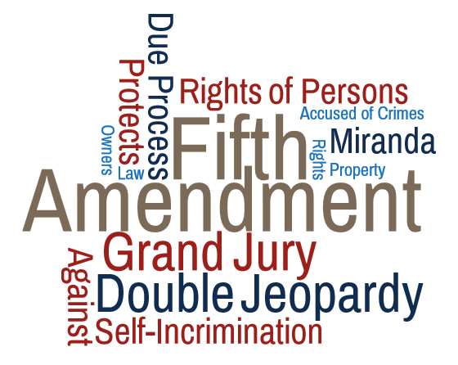
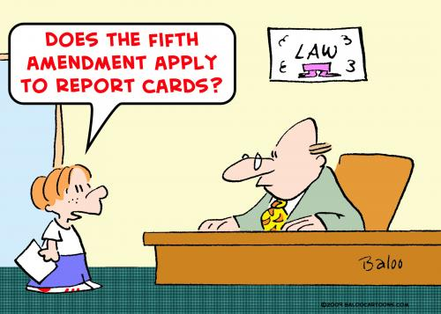
Artemus Ward
Dept. of Political Science
Northern Illinois University
Bill of Rights Institute Webinar
April 19, 2017

Slide 2
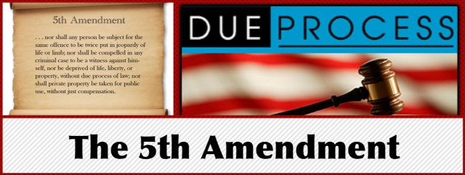
Ratified in 1791, the Fifth Amendment
contains a number of individual
protections against the government:
Grand Jury – Guarantees that individuals accused by the federal government of capital crimes be afforded a grand jury. This is one of the few protections in the Bill of Rights that has not been extended to state proceedings.
Double Jeopardy – Prohibits trying someone twice for the same crime.
Self-incrimination – Guarantees a person the right to remain silent and not be forced to give testimony against one’s self.
Due process – Protects against the deprivation of life, liberty or property without due process of law.
Takings clause – Protects private property from being taken by the government through their power of eminent domain unless it is for public use and just compensation is provided.

Slide 3
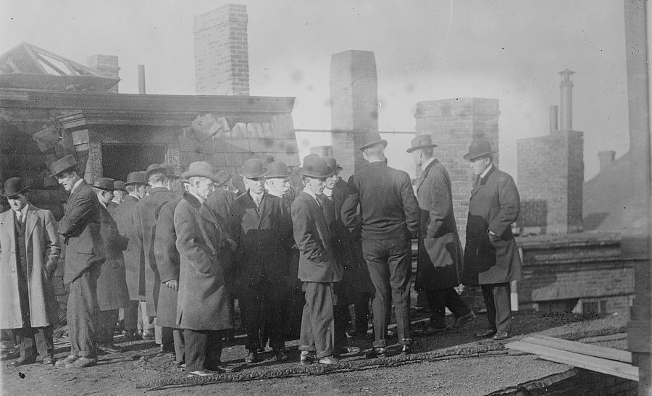
A grand jury investigating a fire that destroyed the Arcadia Hotel in Boston, MA (1913).

Slide 4
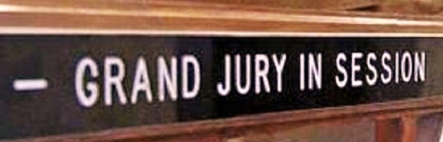
Grand Jury
Grand Jury – A panel of between 12 and 23 jurors empowered to evaluate and investigate crimes within a jurisdiction.
The Fifth Amendment guarantees a grand jury review to anyone accused in federal court of a felony (a serious crime) as a protection against overzealous or malicious prosecutions.
Unlike trial juries, grand juries have much greater leeway in terms of what they can consider such as rumor, hearsay, and speculation.
The proceedings are run by the prosecution. Witness testimony can be considered but there is no defense attorney.
Generally, at least 12 grand jurors must vote for an indictment for the case to move forward and the accused to be charged.
Indictments returned by grand jury panels whose selection has been tainted by racial or sexual discrimination will be dismissed.
Critics of the grand jury system argue that it is not really a check on prosecutors as they have little restriction on what they can say and provide to the jurors—making an indictment highly probable and more of a formality than anything.
As a result, the practice of grand juries has been diminishing in most states and in the federal courts, with more than half of states having abandoned grand juries altogether.
The Supreme Court ruled in Hurtado v. California (1884) that grand jury protections are not required in state proceedings—making this provision one of the few guarantees in the Bill of Rights that only apply to the federal government. Hurtado was reaffirmed in Maxwell v. Dow (1900).

Slide 5
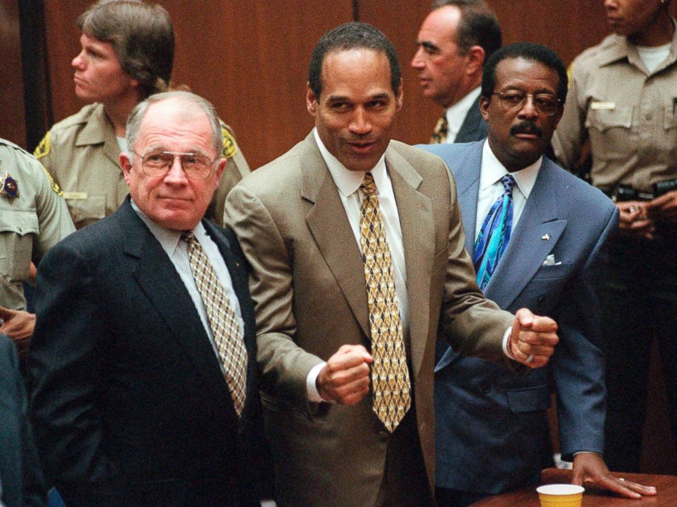
Double Jeopardy
Double jeopardy is the prosecution of a person for a criminal
offense for which the person has already been prosecuted.
The Fifth Amendment prohibits:
a second prosecution after acquittal of the same offense;
a second prosecution after conviction of the same offense;
punishment more than once for the same crime.
Although this seems simple and clear, there are countless complications in determining what constitutes the same crime or offense. For example:
A single criminal act may violate multiple statutes potentially allowing for multiple prosecutions.
Mistrials generally allow for another trial.
First convictions that are reversed on appeal allow for another trial.
Separate sovereignty prosecutions for the same offense are allowed, so federal prosecution may proceed after state prosecution for the same crime.
An acquittal in a criminal case does not provide immunity to civil action arising from the same crime, an example being the wrongful death civil liability judgment against O.J. Simpson after he was acquitted of the related murder charges.
Note: roughly 90% of criminal cases are plea bargained, which counts as a conviction. Therefore, double jeopardy rules apply just as they would for conviction by trial court.

Slide 6
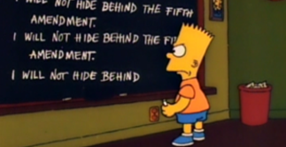
Self-Incrimination
The self-incrimination clause guarantees individuals the
right not to be compelled to testify against themselves in
criminal proceedings. The right does not extend to persons
have been granted immunity from prosecution.
In Miranda v. Arizona (1966) the Supreme Court ruled 5-4 that a confession is inadmissible as evidence unless the accused is verbally apprised of his or her constitutional rights.
Ernesto Miranda was not informed of his rights prior to signing a confession which was later used in his conviction for kidnapping and rape.
Writing for the majority, Chief Justice Earl Warren overturned his conviction explaining that the police must verbally apprise a suspect of his or her rights:
“The person in custody must, prior to interrogation, be clearly informed that he has the right to remain silent, and that anything he says will be used against him in court; he must be clearly informed that he has the right to consult with a lawyer and to have the lawyer with him during interrogation, and that, if he is indigent, a lawyer will be appointed to represent him.”
These Fifth and Sixth Amendment rights became known as “Miranda rights” and the process of verbally stating them to the accuses was called “Mirandizing.”
The ruling was controversial and had a marked impact on law enforcement procedures. Today, Americans routinely hear these warnings in popular culture portrayals of crime and policing.
Despite continuing criticism by conservatives, Miranda was upheld in Dickerson v. U.S. (2000).

Slide 7
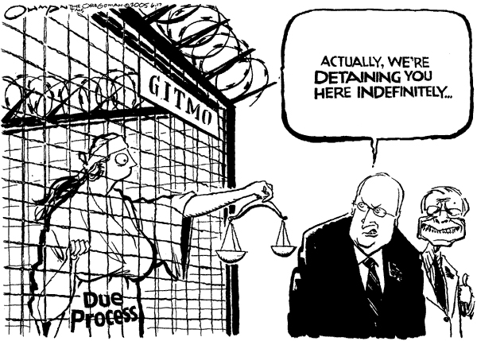
Due Process
DUE PROCESS - The administration of justice according to
established rules and principles.
The Fifth Amendment to the U.S. Constitution states that no
person shall be deprived of life, liberty or property without due
process of law. The Fourteenth Amendment applies the same
guarantee to the states.
The concept of due process is divided into two categories:
Procedural due process refers to the procedures of arresting and trying people for crimes and to any government action which may deprive people of life, liberty or property. Procedural due process limits the power of state and federal governments by adherence to specific procedures in civil and criminal matters. These procedures are familiar and are generally those listed in various provisions of the Bill of Rights: jury, attorney, silence, etc.
Substantive due process is a much more controversial concept and concerns the rights and behaviors of individuals which are or should be beyond the authority of the government such as exercise of religion or political beliefs. Substantive due process has been used as the basis for the protection of the property rights of business owners and the civil liberties of individuals.
Critics charge that judges who invoke the substantive element of the due process clause are activists—whether conservative justices of the early 20th Century who struck down government regulation of business, such as minimum wage and workplace safety laws, as a violation of “liberty of contract” between employer and employee, or liberal justices of the late 20th and early 21st Century who struck down restrictions on abortion or gays and lesbians as a violation of their “liberty interest.”

Slide 8

The Right to Privacy
The word privacy does not appear in the U.S. Constitution. A constitutional right to privacy, however, has been established by the Supreme Court through a series of cases broadly interpreting specific aspects of the Constitution that are suggestive of privacy, including parts of the Fifth Amendment.
In Olmstead v. U.S. (1928) Justice Louis Brandeis argued that the framers of the Constitution conferred the “right to be let alone” by the government in the Self-incrimination Clause of the Fifth Amendment and the Fourth Amendment’s protection against unreasonable search and seizures.
In Griswold v. Connecticut (1965) the Court overturned a law criminalizing the use of contraception as a violation of the right to privacy. Controversially, the Court said that “specific guarantees in the Bill of Rights have penumbras, formed by emanations from those guarantees that help give them life and substance.” One of those guarantees was protection from self-incrimination which suggests privacy of one’s own thoughts. Another was substantive liberty protected by the due process clause.
In Roe v. Wade (1973) laws against abortion were invalidated under the right to privacy. The concept has proved controversial and over time the Court has moved away from a broad categorization of privacy rights to a more narrow interpretation of the word “liberty” that arguably allows justices to more easily sustain government regulation.
In Lawrence v. Texas (2003) the Court struck down criminal sodomy laws holding that same-sex couples had a protected liberty interest to engage in private, intimate conduct.

Slide 9
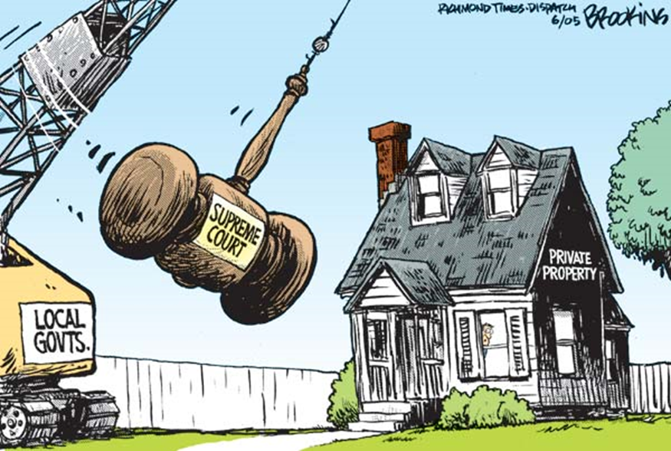
Takings Clause
EMINENT DOMAIN - The authority of the government to take
private property.
The Fifth Amendment’s Takings Clause requires that private property
not be taken by the government unless:
it is for public use and
there is just compensation.
Most state constitutions contain similar provisions and the states have extended these protections to local governments.
The procedure of acquisition of the property is called condemnation and the transfer may be to the government or to another private entity that provides some public service, such as a railroad.
What constitutes “public use” has proved controversial. Usually “public use” is obvious such as when a government wants to build a courthouse, road, school, or park.
In Berman v. Parker (1954) the Supreme Court held that aesthetics and beautification qualified.
In Hawaii Housing Authority v. Midkiff (1984) the Court upheld a state plan to redistribute land by forcing large landowners to sell their properties to the people who leased them.
In Kelo v. City of New London (2005) the Court allowed long-standing, well-maintained private homes to be taken for a city redevelopment plan that included a proposed Pfizer research facility, a hotel, conference center, museum, restaurants, shops, office space, marina, river walk, and new residential housing.

Slide 10
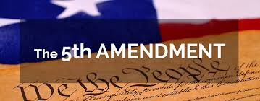
Conclusion
While the Grand Jury provision of the Fifth Amendment does not apply to state and local governments, the Double Jeopardy, Self-incrimination, and Takings clauses do.
Due process guarantees apply to both the federal government through the Fifth Amendment and to state and local governments via the Fourteenth Amendment which also contains a due process clause.
The right to privacy derives, in part, from the Fifth Amendment.
It is important to understand that each of the rights guaranteed by the Fifth Amendment are still contested in that liberal judges generally seek to expand protections for the accused while allowing more government leeway for takings. Conservative judges, on the other hand, generally seek to restrict protections for the accused while also making it more difficult for governments to take private property.
The makeup of the Supreme Court (currently five conservatives and four liberals) determines the development of Fifth Amendment law.

Slide 11
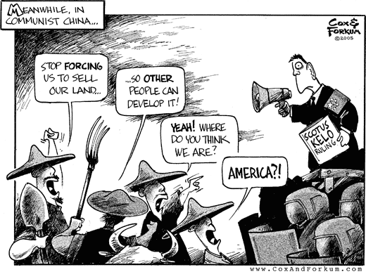
Bonus Slides: Key Cases

Slide 12
Grand Jury: Hurtado v. California (1884)
HURTADO V. CALIFORNIA, 110 U.S. 516 (1884). Incorporation case where the Supreme Court held that the Fifth Amendment’s provision requiring indictment by grand jury was not applicable to state governments via the Fourteenth Amendment’s Due Process Clause.
Justice Stanley Matthews wrote for the 8-1 majority that grand jury indictment was not required on the state level. Matthews reasoned that the Due Process Clause did not encompass the specific guarantees of the Fifth Amendment and that any legal proceeding could constitute due process.
Justice John Marshall Harlan I was the lone dissenter arguing that it was inconsistent with the due process of law to “require a person to answer for a capital offence except upon the presentment or indictment of a grand jury.” Harlan noted that when the Fourteenth Amendment was adopted, the Bill of Rights and the constitutions of 27 states “expressly forbade criminal prosecutions, by information, for capital cases.” Harlan’s driving concern was the safe-guarding of the personal liberties of defendants, vis-à-vis a grand jury system, against “official repression, cruelty of mobs, the machinations of falsehood, and the malevolence of private persons who would use the machinery of law to bring ruin upon their personal enemies.”
While the other guarantees of the Fifth Amendment were subsequently applied to the states, the grand jury provision remains unincorporated.

Slide 13
Grand Jury: Maxwell v. Dow (1900)
MAXWELL V. DOW, 176 U.S. 581 (1900). Incorporation case where the Supreme Court refused to apply various federal protections under the Fifth and Sixth Amendments to state governments. Charles Maxwell was convicted of robbery in state court. He appealed and argued that he was not afforded a grand jury for indictment and that he was tried by only eight jurors instead of 12 in violation of the Privileges and Immunities Clause and the Due Process Clause of the Fourteenth Amendment. The Supreme Court rejected Maxwell’s arguments.
Writing for the 8-1 majority, Justice Rufus Peckham said that due process did not require either indictment by grand jury or a 12-person jury at the state level even though those rights were protected against the federal government. Furthermore, as with the Slaughterhouse Cases (1873) the Court refused to articulate any substantive component to what the privileges or immunities of citizens were—which is essentially still the case to this day.
In dissent, Justice John Marshall Harlan I argued that the privileges and immunities enumerated in the Bill of Rights were meant to be protections extended to citizens from both the federal and state governments under the Fourteenth Amendment. Harlan’s dissent proved influential for later cases incorporating various provisions of the Bill of Rights to the states under the Due Process Clause—though not the grand jury provision which to this day remains only applicable to the federal government. See also HURTADO V. CALIFORNIA; PALKO V. CONNECTICUT; TWINING V. NEW JERSEY.

Slide 14
Grand Jury: Racial Discrimination
Norris v. Alabama (1935) was the second of the “Scottsboro Boys” cases where a group of young African American men were convicted in a sham trial and sentenced to death for allegedly raping two white women while riding on a freight train in Alabama. The Supreme Court reversed their convictions because African Americans were systematically excluded from both the grand jury that indicted them and the trial jury that convicted them.
In Vasquez v. Hillery (1986) an African American ranch hand was convicted of brutally murdering a 15-year-old girl. After serving over two decades in prison, the Court reversed 6-3 because African Americans had been systematically excluded from his grand jury in violation of the Equal Protection Clause of the Fourteenth Amendment.

Slide 15
Double Jeopardy: Palko v. Connecticut (1937)
Incorporation case where the Supreme Court refused to apply the double jeopardy provision of the Fifth Amendment to the states via the Due Process Clause of the Fourteenth Amendment. Palko was accused of killing two police officers while robbing a store and was tried for first degree murder. He was convicted of second degree murder and sentenced to life in prison. The prosecutors secured a new trial at which Palko was convicted of first degree murder and sentenced to death. He appealed to the Supreme Court claiming that the double jeopardy clause of the Fifth Amendment should be applied to the states through the Due Process Clause of the Fourteenth Amendment.
Justice Benjamin Cardozo delivered the 8-1 opinion upholding the conviction for first degree murder. Cardozo held that the Fourteenth Amendment only guarantees the application of the most fundamental rights to the states. The right to not be subjected to double jeopardy was not a fundamental right and was therefore a matter for states to determine for themselves. Cardozo said that fundamental rights represent “the very essence of a scheme of ordered liberty” and are “principles of justice so rooted in the traditions and conscience of our people as to be ranked as fundamental.”
The justices continued to struggle with the issue of incorporation in subsequent cases. The Court ultimately overturned Palko in Benton v. Maryland (1969).

Slide 16
Double Jeopardy: Louisiana ex rel. Francis v. Resweber (1947)
Capital punishment case where the Supreme Court ruled that scheduling a second execution by electric chair, after the first one malfunctioned, did not violate the Fifth and Eighth Amendments. Willie Francis, a 15-year-old African American, was convicted of murdering a white drug store worker in Louisiana and was sentenced to death by electrocution. On the chosen day, Francis was strapped in the chair and the executioner threw the switch. Electric current passed through Francis’s body but it was not enough to kill him. The malfunction required a repair of the chair. In the meantime Francis sought to prevent the second execution attempt by arguing it would constitute double jeopardy and cruel and unusual punishment as incorporated to the states via the Fourteenth Amendment’s Due Process Clause.
By a vote of 5-4 the U.S. Supreme Court refused to block a second execution attempt. Writing for four justices, Justice Stanley Reed said that double jeopardy only applies to trials and not simply carrying out a sentence, in this case a second time because of a malfunction does not constitute double jeopardy after a malfunction. Reed went on to explain that cruel and unusual punishment applies to the method of executing the convicted man, not the suffering involved in the enactment of the death penalty.
The fifth vote to allow the execution was Justice Felix Frankfurter who wrote a concurring opinion explaining how the Fourteenth Amendment guarantees due process and that Francis received all the fundamental due process guarantees in his case including a fair trial.
Justice Harold Burton wrote the dissent which argued that shocking a convicted criminal more than once is a cruel and unusual punishment. He compared it to shocking someone three, four, or five times and wondered when it became cruel and unusual. If five is cruel and unusual why is two not? Francis was scheduled for another execution and this time it worked.

Slide 17
Double Jeopardy: Benton v. Maryland (1969)
The Supreme Court ruled that the Due process clause of the Fourteenth Amendment incorporated the Fifth Amendment’s protection against double jeopardy making it applicable to the states.
In Palko v. Connecticut (1937) the Court held that double jeopardy was not “implicit in the concept of ordered liberty” and therefore not applicable to state governments. John Dalmer Benton was tried for larceny and burglary in the state of Maryland. Having been initially convicted of burglary, he was retried and convicted of both charges.
Justice Thurgood Marshall delivered the 7-2 opinion ruling that retrying Benton for the initial charge he was acquitted on constituted double jeopardy. Marshall reasoned that protections against double jeopardy were fundamental, dating back to English common law and present in either the common law or constitutions of the American states.

Slide 18
Double Jeopardy: U.S. v. Ursery (1996)
Supreme Court decision holding that the combination of a civil property forfeiture and criminal prosecution did not violate the Double Jeopardy Clause of the Fifth Amendment, which protects defendants from being punished twice for the same offense.
The U.S. government prosecuted Ursery for manufacturing marijuana on his property. They initiated two separate proceedings against him: one criminal and the other a civil forfeiture case for the property used in committing the crime.
Writing for the 8-1 majority, Chief Justice William Rehnquist held that the two proceedings did not constitute double jeopardy. He said that there was a clear distinction between the civil and criminal proceedings. He held that unlike criminal proceedings which result in punishment, civil forfeiture proceedings were remedial in nature and did not qualify as punishment. The main goal of the civil action, Rehnquist said, was to ensure that property is not used for illegal activities. He noted that while the forfeiture of property may have some punitive aspects, the mere existence of such characteristics did not serve as proof that the government intended for the sanctions to be criminal and for the forfeiture to be punitive.
In a separate concurrence, Justices Antonin Scalia and Clarence Thomas considered the Double Jeopardy Clause to protect against successive prosecution, not successive punishment.
In dissent, Justice John Paul Stevens said that while he agreed that the forfeiture of some property, namely monetary proceeds and contraband, did not qualify as punishment because it did not deprive anyone of liberty or lawfully obtained property, the government’s decision to seek the forfeiture of Ursery’s residence did constitute punishment because no evidence existed that suggested the house had been purchased using the proceeds from illegal activities and the house itself was not contraband. Stevens cited prior court decisions, which concluded that the purpose of forfeiture proceedings was intended to penalize criminal activities, therefore amounting to punitive action. He was also skeptical of the government’s claim of deterrence, noting that civil sanctions that could not be solely defined as remedial and possessed some retributive or deterrent characteristics had been traditionally classified as punishment.
Widely viewed as an about-face by the Court, this decision reestablished forfeitures as a less burdensome means of prosecuting federal crimes.

Slide 19
Double Jeopardy: Kansas v. Hendricks (1997)
Criminal procedure case where the Supreme Court upheld a state law that allowed indefinite involuntary confinement for those the state deems likely to engage in predatory acts of sexual violence.
Leroy Hendricks had an extensive history of sexually molesting children. After serving his prison sentence for a conviction the state sought to commit him and a civil trial was held to determine his eligibility under the state law which defined pedophilia as a “mental abnormality.” A jury decided that he qualified as a sexually violent predator and the court ordered that he be committed. Hendricks appealed claiming that his commitment violated the due process, ex post facto, and double jeopardy provisions of the Constitution.
Justice Clarence Thomas delivered the 5-4 majority opinion, holding that the states’ definition of “mental abnormality” satisfied “substantive” due process requirements. He said that the state law requires predetermination of dangerousness to ones’ self or to others and that the Court has consistently upheld the right of states to commit those who pose a danger to public health and safety. He also held that Hendricks’ commitment under the law was a civil, rather than criminal, matter and therefore did not violate double jeopardy or ex post facto principles.
Justice Stephen Breyer filed a dissenting opinion, arguing that the state had not funded, nor provided adequate treatment for Hendricks, until after he served his prison sentence. He reasoned, therefore, that the law and his commitment were intended to inflict further punishment and should be struck down as a violation of both double jeopardy and ex post facto lawmaking.

Slide 20
Self Incrimination: Boyd, Counselman, Twining
BOYD V. U.S., 116 U.S. 616 (1886). The Fourth and Fifth Amendments were at issue in this case when the government attempted to procure customs records from the petitioner under the Customs Act of 1874. Justice Joseph Bradley held for a unanimous Court that the protections of the Fourth Amendment against illegal search and seizure and the Fifth Amendment’s guarantee against self-incrimination extend beyond the physical intrusion of the home in criminal matters to the broad protection of an individual’s private affairs from government intrusion. The decision was an important precursor to the establishment of a right to privacy based, in part, on the Fourth and Fifth Amendments. See also GRISWOLD V. CONNECTICUT; OLMSTEAD V. U.S.; ROE V. WADE.
COUNSELMAN V. HITCHCOCK, 142 U.S. 547 (1892). Case extending self-incrimination protections to grand jury proceedings. Charles Counselman was called as a witness before a federal grand jury but refused to answer certain questions on the grounds that his answers might incriminate him, despite a federal statute granting witness immunity. Justice Samuel Blatchford wrote for a unanimous Court that the Fifth Amendment privilege against self-incrimination applied not only to the accused in criminal proceedings, but also to witnesses in any investigation including grand jury proceedings. Furthermore, the Court held that the federal immunity statute did not compel Counselman’s testimony because its protection was not as broad as that of the Fifth Amendment. Specifically, while the statute protected against prosecution for the testimony itself it did not prohibit the use of the testimony to search for other evidence against him.
TWINING V. NEW JERSEY, 211 U.S. 78 (1908). Incorporation case where the Supreme Court declined to apply the Fifth Amendment’s Self-Incrimination Clause to state and local governments. Albert Twining was accused of deceiving a state bank examiner and at trial refused to testify on his own behalf. The judge told the jury that Twining’s refusal to testify could be considered in determining his guilt. Justice William Moody delivered the 8-2 majority opinion holding that the protection against self-incrimination was not a fundamental right to be applied to the states through the Due process clause of the Fourteenth Amendment. John Marshall Harlan I dissented arguing the privilege against self-incrimination should be incorporated. Ultimately, the Court’s decision was overturned by Malloy v Hogan (1964) which applied self-incrimination protections to the states.

Slide 21
Self-Incrimination: Adamson, Rochin, Ullman
ADAMSON V. CALIFORNIA, 332 U.S. 46 (1947). Supreme Court decision holding that the Fifth Amendment’s protection against self-incrimination was not applicable to state and local governments. Dewey Adamson was convicted of first degree murder in California, but chose not to testify on his own behalf. The prosecution used his refusal as evidence against him in court. Writing for a 5-4 majority, Justice Stanley Reed ruled that the Due process clause of the Fourteenth Amendment did not incorporate all of the provisions of the Bill of Rights—including the Fifth Amendment’s self-incrimination clause—but only those that are “fundamental.” Therefore, while Adamson’s rights may have been violated had he been tried in a federal court, because the case took place in a state court his right against self-incrimination did not apply. In dissent, Justice Hugo Black argued for the total incorporation of the Bill of Rights to the states, saying that not doing so left too much discretion to the state courts. Black’s position has never been adopted by the Supreme Court. Instead they have selectively applied certain provisions of the Bill of Rights to the states, including the self-incrimination provision in Griffin v. California (1965).
ROCHIN V. CALIFORNIA, 342 U.S. 165 (1952). The Supreme Court invalidated the use of involuntary stomach-pumping to obtain evidence against the will of the accused as a violation of due process under the Fourteenth Amendment. Rochin was convicted in California for possession of illegal drugs after police ordered doctors to pump his stomach to extract the evidence against his will. Writing for the unanimous Court, Justice Felix Frankfurter overturned Rochin’s conviction likening the method use to obtain the evidence to an impermissible forced confession by physical abuse. He said that obtaining evidence through stomach-pumping “shocked the conscience” and constituted “methods too close to the rack and the screw to permit constitutional differentiation.” Justices William O. Douglas and Hugo Black wrote concurring opinions arguing that the method violated the right against self-incrimination protected by the Fifth Amendment.
ULLMAN V. U.S., 350 U.S. 422 (1955). The Supreme Court upheld a federal law that required individuals to testify in court when compelled to but granted them immunity from any criminal prosecution that could result from their testimony. The Immunity Act of 1954 required individuals to testify in court when so ordered but also protected them from federal or state prosecution for their testimony. Ullman was ordered by a federal district court to testify before a federal grand jury investigating a national security matter. Ullman refused to testify and was sentenced to six months in prison for contempt. Ullman argued that the Immunity Act did not give him total immunity because even though he was protected against prosecution for his testimony, he could still lose his job, be expelled from a labor union, and publicly condemned. Thus, he argued, the law violated the Fifth Amendment’s Self-Incrimination Clause. Writing for the 7-2 majority, Justice Felix Frankfurter rejected Ullman’s argument and upheld the statute. Frankfurter said that the Fifth Amendment only provided protection from criminal prosecution and not from the other possibilities listed by Ullman. In dissent, Justice William O. Douglas argued that the right to remain silent, guaranteed by the Fifth Amendment, is beyond the reach of congress. He said that any information given by an individual during a government proceeding must come willingly and cannot be compelled under threat of punishment.

Slide 22
Self Incrimination: Red Scare Cases
COMMUNIST PARTY V. SUBVERSIVE ACTIVITIES CONTROL BOARD, 367 U.S. 1 (1961). The Internal Security Act of 1950, commonly known as the McCarran Act was passed to require compulsory registration of members of the Communist Party in the U.S. The Subversive Activities Control Board was created to administer the registration process. The Board ordered the American Communist Party to register and disclose the names of officers and sources of funding. The party officers refused to register. After 10 years of litigation the court of appeals affirmed the order of the Board.
Justice Felix Frankfurter delivered the 5-4 opinion upholding the decision of the lower court with regard to registration. The Court did not, however, rule on the constitutionality of the penalties contained in the Act until subsequent cases challenged the enforcement of its provisions. Chief Justice Earl Warren was joined by Justices Hugo Black, William O. Douglas and William Brennan in dissent arguing that the majority ignored too many testimonial discrepancies and ignored the Fifth Amendment defense against self-incrimination which they felt should have been applied to this case. They also said that the Act was a violation of freedom of speech and freedom of assembly.
ALBERTSON V. SUBVERSIVE ACTIVITIES CONTROL BOARD, 382 U.S. 70 (1965). Criminal procedure case where the Supreme Court ruled that requiring communist organizations to register with the government violated the Self-Incrimination Clause of the Fifth Amendment. The Subversive Activities Control Board (SACB) was formed under the Internal Security Act of 1950 which was passed to expose members of the Communist Party. Albertson and other members refused to register and were charged. The justices had upheld the registration requirement in Communist Party v. SACB (1961) but waited to rule on the sanctions until they were enforced. Albertson provided just such a case. Writing for a unanimous Court, Justice William Brennan struck down the registration requirement reasoning that the information could be used as an admission of guilt, provide evidence to be used in court, or provide leads for investigations.
The Court later invalidated the SACB’s ban on defense plant employment in U.S. v. Robel (1967) and the Nixon Administration did not renew the law when it expired in 1973.

Slide 23
Self Incrimination: Malloy and Griffin
MALLOY V. HOGAN, 378 U.S. 1 (1964). The Court ruled that the Fourteenth Amendment incorporates the Fifth Amendment protection against self-incrimination; thereby makings it applicable to the states. The Court revoked the state’s ability to hold a witness in contempt because they would not testify in a trial for fear of self-incrimination. In the 5-4 majority opinion, Justice William Brennan stated that any confession obtained by the state must be “free and voluntary: that is, it must not be extracted by any sort of threats or violence, nor obtained by any direct or implied promises, however slight, nor by the exertion of any improper influence.” He also stated that governments, state and federal alike, are constitutionally required to prove ones guilt by evidence, not a coerced confession. Brennan finally noted that a defendant is able to invoke his Fifth Amendment rights if he is sure “that a responsive answer to the question or an explanation of why it cannot be answered might be dangerous because injurious disclosure could result” and a judge may only compel a witness to testify if he is certain that his testimony “cannot possibly” self-incriminate.
Justices John Harlan and Byron White dissented. Harlan believed that the reasoning behind the Court’s decision carries “extremely mischievous, if not dangerous, consequences for our federal system in the realm of criminal law enforcement.” He believed that the idea of incorporation of the Fifth Amendment had already been settled in Twining v. New Jersey (1908) and did not need to be revisited again because the Court clearly stated that the right against self-incrimination in state courts was not protected in any part by the Constitution. White, on the other hand, agreed with the majority in that the Fourteenth Amendment did in fact incorporate the Fifth Amendment’s guarantee against self-incrimination; however, he disagreed that the facts of the case warranted the application of the Fifth Amendment. He believed that the questions asked Malloy could, in no way, incriminate him of a crime.
GRIFFIN V. CALIFORNIA, 380 U.S. 609 (1965). The Supreme Court invalidated the practice by prosecutors of commenting on a defendant’s right to decline to testify in a court of law as inconsistent with the Fifth Amendment protection against self-incrimination. Previously, prosecutors often argued that a defendant who would not speak to defend himself shows evidence of guilt. Edward Dean Griffin was convicted of murder in the state of California. Griffin did not testify and the prosecutor said that Griffin refused to testify because he was guilty.
In a 7-2 opinion by Justice William O. Douglas, the Supreme Court held that allowing court officials to comment adversely on a defendant’s refusal to testify jeopardized the presumption of innocence that is the hallmark of the American adversarial system of justice. The Court overturned Adamson v. California (1947). Justices Potter Stewart and Byron White dissented arguing that California’s comment rule did not compel anyone to testify against himself and therefore did not implicate self-incrimination.

Slide 24
Self Incrimination: Limiting Miranda
HARRIS V. NEW YORK, 401 U.S. 222 (1971). First Supreme Court decision limiting the criminal procedure protections articulated in Miranda v. Arizona (1966). Harris was accused of selling a bag to an undercover officer that contained heroin. During his interrogation by police, Harris was not read his Miranda rights and answered police questions, implicating himself in the alleged crime. Yet at trial, Harris testified and denied that the bag contained heroin. The prosecution cross-examined him and used his answers during interrogation to impeach his credibility.
Writing for the 5-4 majority, Chief Justice Warren Burger declared that Miranda cannot be used as a “license to commit perjury” and held that statements made by Harris prior to receiving his Miranda warnings could be used in court. Burger distinguished the difference between the state obtaining evidence illegally, and Harris using the state’s method as a shield against his contradicting statements. Justices William Brennan, William O. Douglas, Thurgood Marshall, and Hugo Black dissented claiming that the distinction made by the majority ignores the improper police work used to impeach Harris, which should be disallowed under Miranda.
RHODE ISLAND V. INNIS, 446 U.S. 291 (1980). The Supreme Court ruled that general police discussion that induces the accused to speak does not constitute an impermissible interrogation under Miranda v. Arizona (1966). Thomas Innis was arrested and placed in a squad car with three police officers. The officers suspected that he had hidden a gun somewhere and began to talk about a nearby school for disabled children and what would happen if one of them found a firearm. Innis interrupted the conversation and told the officers to turn the car around so he could show them where the gun was. He then sued the state of Rhode Island charging the police with violating his Miranda rights. Justice Potter Stewart delivered the 6-3 majority opinion holding that the conversation by the officers did not qualify as words or actions to induce an answer from Innis.
Justice Thurgood Marshall, in dissent, agreed with the majority’s decision of what was considered interrogation under Miranda, but did not agree with how the facts of the case were applied. Justice John Paul Stevens joined Marshall and stated that he believed the police conversation did induce Innis to speak. Stevens said that if the police were to put their discussion into the form of a question, it would be considered an interrogation. With this thought process, he believed that police should not be able to avoid an individual’s Miranda rights by changing the form of the conduct of interrogation, which in this case would be the discussion the police had with Innis in the vehicle. While the Court’s decision helped to reaffirm Miranda rights, it did failed to broaden the type of police conduct that is prohibited under Miranda.

Slide 25
Self Incrimination: Limiting Miranda
NEW YORK V. QUARLES, 467 U.S. 649 (1984). Criminal procedure decision where the Supreme Court ruled that there is a public safety exception to Miranda warnings required under Miranda v. Arizona (1966). After being told by a woman that she had been raped, a New York police officer ran into a supermarket and found the suspect, who had an empty gun holster. The officer asked the suspect where the gun was and the suspect told the police officer where he put it. After being told where the gun was the officer then arrested the suspect and read him his Miranda Rights. The Supreme Court overturned lower court rulings which held that statements given to officers by suspects before they were read their Miranda rights must be suppressed. Justice William Rehnquist delivered the 5-4 majority opinion, holding that when there is a danger to public safety, police may ask questions to remove that danger prior to reading the Miranda warning, and answers to such questions may be used as evidence.
In his dissent, Justice Thurgood Marshall wrote that the majority’s entire argument was based on the assumption that the suspect was still a threat to public safety. Because the officer had the suspect reduced to a position of physical powerlessness, there was no threat to public safety and therefore should have been read his Miranda rights immediately. As a result, the statements made by the suspect before being read his warnings, as well as his gun, should not be allowed as evidence in court. Also writing a dissent, Justice Sandra Day O’Connor argued that the statements by the suspect should not be allowed in the courtroom because it was a clear violation of Miranda. On the other hand, O’Connor reasoned that the gun should be allowed as evidence because, “nothing in Miranda or the privilege itself requires exclusion of non-testimonial evidence derived from informal custodial interrogation.”

Slide 26
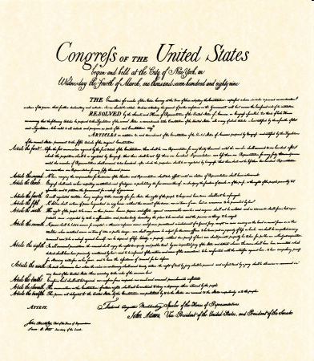
Privacy
Where does the right to privacy come from?
Some argue that the right to privacy emanates from various specific provisions of the Bill of Rights:
1st Amendment: freedom of association
3rd Amendment: prohibition against quartering soldiers
4th Amendment: prohibition against unlawful search and seizure
5th Amendment: guarantees against self-incrimination; liberty and due process guarantee (federal)
9th Amendment: unenumerated rights
14th Amendment: liberty and due process guarantee (states)

Slide 27
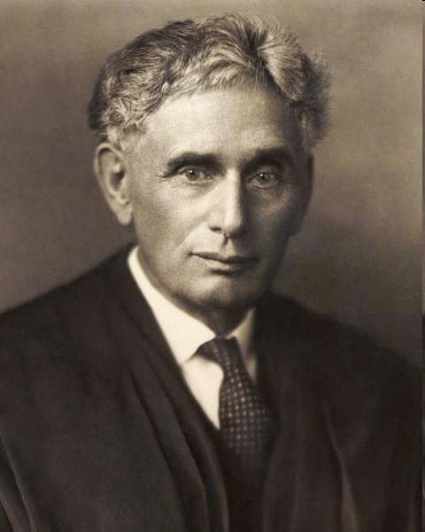
Olmstead v. United States (1928) Justice Louis Brandeis, Dissenting
Dissenting from a 5-4 decision upholding government wiretaps, Justice Brandeis wrote:
“The protection guaranteed by the amendments is much broader in scope. The makers of our Constitution undertook to secure conditions favorable to the pursuit of happiness. They recognized the significance of man’s spiritual nature, of his feelings and of his intellect. They knew that only a part of the pain, pleasure and satisfactions of life are to be found in material things. They sought to protect Americans in their beliefs, their thoughts, their emotions and their sensations. They conferred, as against the government, the right to be let alone--the most comprehensive of rights and the right most valued by civilized men. To protect, that right, every unjustifiable intrusion by the government upon the privacy of the individual, whatever the means employed, must be deemed a violation of the Fourth Amendment. And the use, as evidence in a criminal proceeding, of facts ascertained by such intrusion must be deemed a violation of the Fifth.”

Slide 28
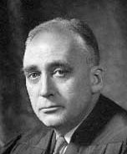
Poe v. Ullman (1961)
At issue was an 1879 Connecticut law prohibiting the aiding, abetting, counseling or use of birth control, even by married couples. A physician challenged the act on behalf of two women who wanted to use contraceptives for health reasons.
A Supreme Court majority voted to dismiss the case on procedural grounds. Several other justices disagreed with this holding, but Justice John Marshall Harlan II issued a dissent that was especially important.
Harlan wrote: “I consider that this Connecticut legislation…violates the Fourteenth Amendment. I believe that a statute making it a criminal offense for married couples to use contraceptives is an intolerable and unjustifiable invasion of privacy in the conduct of the most intimate concerns of an individual’s personal life.”
“I think the sweep of the Court’s decisions, under both the Fourth and Fourteenth Amendments, amply shows that the Constitution protects the privacy of the home against all unreasonable intrusion of whatever character…. If the physical curtilage of the home is protected, it is surely as a result of solicitude to protect the privacies of the life within. The home derives its preeminence as the seat of family life. And the integrity of that life is…fundamental…. Of this whole ‘private realm of family life’ it is difficult to imagine what is more private or more intimate than a husband and wife’s marital relations.”

Slide 29
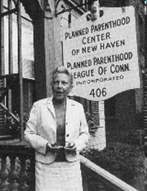
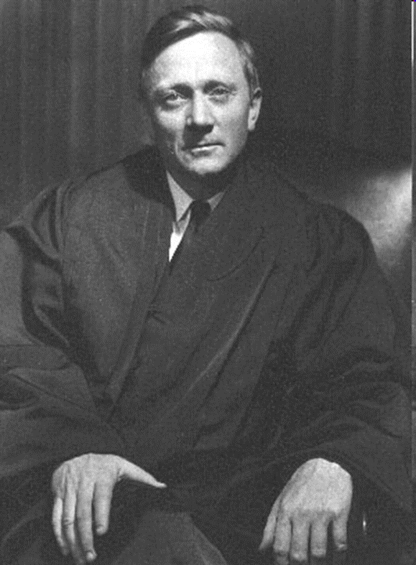
Griswold v. Connecticut (1965)
At issue was an 1879 Connecticut law prohibiting the aiding, abetting, counseling or use of birth control, even by married couples.
The Director of Planned Parenthood, Estelle Griswold who was also a physician, opened a clinic to purposely challenge the law. She was arrested, tried, and convicted of violating the law.
Justice William O. Douglas, for the 7-2 majority, began by listing individual rights that were recognized by courts but that were not specifically listed in the Constitution.
“The foregoing cases suggest that specific guarantees in the Bill of Rights have penumbras, formed by emanations from those guarantees that help give them life and substance. Various guarantees create zones of privacy.”
“The present case, then, concerns a relationship lying within the zone of privacy created by several fundamental constitutional guarantees.”
“Would we allow the police to search the sacred precincts of marital bedrooms for telltale signs of the use of contraceptives? The very idea is repulsive to the notions of privacy surrounding the marriage relationship.”

Slide 30
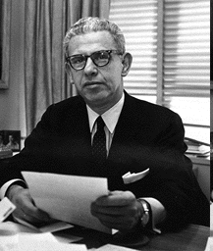
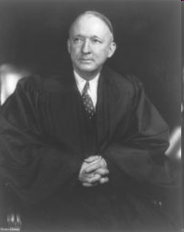
Griswold v. Connecticut (1965) The Other Justices Weigh In
Justice Arthur Goldberg, Chief Justice Earl Warren, and Justice William Brennan concurred and explained that the concept of liberty includes the marital right of privacy. They also cited the 9th Amendment, which they argued showed that the framers believed there were additional fundamental rights existing alongside those specifically listed in the Bill of Rights.
Justice John Marshall Harlan II concurred and explained that the 14th Amendment’s due process clause was the proper grounding for the issue. Justice White also wrote a separate concurring opinion also relying on the due process clause of the 14th Amendment.
Justices Hugo Black and Potter Stewart dissented and charged the majority of inventing a general right to privacy that encompasses whatever they choose to say it includes.
In his separate dissent, Justice Stewart noted that “this is an uncommonly silly law” but one which is not prohibited by the Constitution.
Griswold articulated a right to privacy, but how broad was this right? Certainly it protected “notions of privacy surrounding the marriage relationship” but what else? The next case helped answer that question.
Arthur Goldberg
Hugo Black

Slide 31
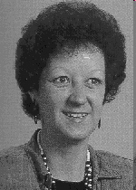
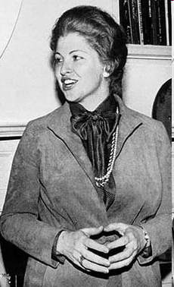
Roe v. Wade (1973)
An 1857 Texas law (revised in 1879) made it a crime to attempt to “procure an abortion” except for the purpose of saving the life of the mother. Similar statutes were in place in a majority of states.
Norma McCorvey (top left), 21, claimed to have been raped and became pregnant. Her doctor refused to perform the abortion citing the Texas law.
Her attorneys—including Sarah Weddington (bottom left)—argued that abortion was a fundamental right under the Griswold privacy doctrine
Texas countered that it had a compelling interest in protecting human life.

Slide 32
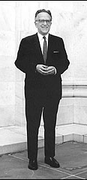
Roe v. Wade (1973)
The Court struck down the statute by a vote of 7-2. Writing for the majority, Justice Harry Blackmun began by noting that anti-abortion laws were a relatively recent phenomenon. They were enacted in the latter half of the 19th century and reached their apex in the late 1950s. There has been a slight trend toward liberalization since.
The "right of privacy, whether it be founded in the Fourteenth Amendment's concept of personal liberty and restrictions upon state action, as we feel it is, or, as the District Court determined, in the Ninth Amendment's reservation of rights to the people, is broad enough to encompass a woman's decision whether or not to terminate her pregnancy."
“A state criminal abortion statute of the current Texas type, that excepts from criminality only a life-saving procedure on behalf of the mother, without regard to pregnancy stage and without recognition of the other interests involved, is violative of the Due Process Clause of the Fourteenth Amendment.”
Blackmun explained that the fetus was not a person under the meaning of the 14th Amendment. "We need not resolve the difficult question of when life begins. When those trained in the respective disciplines of medicine, philosophy, and theology are unable to arrive at any consensus, the judiciary, at this point in the development of man's knowledge, is not in a position to speculate as to the answer."
"We, therefore, conclude that the right of personal privacy includes the abortion decision, but that this right is not unqualified and must be considered against important state interests in regulation.”

Slide 33
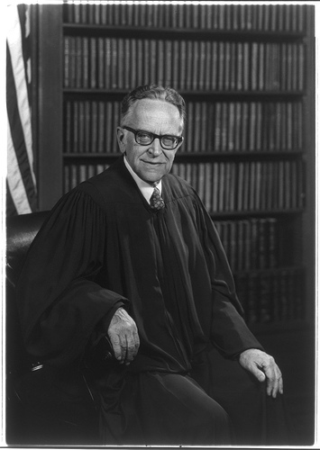
Roe v. Wade (1973)
Blackmun balanced the competing interests by drawing on the medical literature about the stages of pregnancy—The Trimester Framework:
“For the stage prior to approximately the end of the first trimester, the abortion decision and its effectuation must be left to the medical judgment of the pregnant woman’s attending physician.”
“For the stage subsequent to approximately the end of the first trimester, the State, in promoting its interest in the health of the mother, may, if it chooses, regulate the abortion procedure in ways that are reasonably related to maternal health.”
“For the stage subsequent to viability, the State in promoting its interest in the potentiality of human life may, if it chooses, regulate, and even proscribe, abortion except where it is necessary, in appropriate medical judgment, for the preservation of the life or health of the mother.”

Slide 34
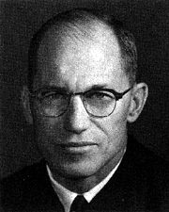
Roe v. Wade (1973)
Filing his dissent “with all due respect,” Justice Byron White found “nothing in the language
or history of the Constitution to support the Court’s judgments.”
“The Court simply fashions and announces a new constitutional right for pregnant women and, with scarcely any reason or authority for its action, invests that right with sufficient substance to override most existing state abortion statutes. The upshot is that the people and the legislatures of the 50 States are constitutionally disentitled to weigh the relative importance of the continued existence and development of the fetus, on the one hand, against a spectrum of possible impacts on the mother, on the other hand. As an exercise of raw judicial power, the Court perhaps has authority to do what it does today; but in my view its judgment is an improvident and extravagant exercise of the power of judicial review.”
White was particularly concerned that the Court, through the second trimester of a pregnancy, “values the convenience of the pregnant woman more that the continued existence and development of the life or potential life that she carries.”
“The common claim before us is that for any [reason]…, or for no reason at all, and without asserting or claiming any threat to life or health, any woman is entitled to an abortion at her request if she is able to find a medical adviser willing to undertake the procedure…. Whether or not I might agree with that marshaling of values, I can in no event join the Court’s opinion because I find no constitutional warrant for imposing such an order of priorities on the people and legislatures of the States. In a sensitive area such as this, involving as it does issues over which reasonable men may easily and heartedly differ, I cannot accept the Court’s exercise of its clear power of choice by interposing a constitutional barrier to state efforts to protect human life and by investing women and doctors with the constitutionally protected right to exterminate it. This issue, for the most part, should be left with the people and to the political processes the people have devised to govern their affairs.”

Slide 35
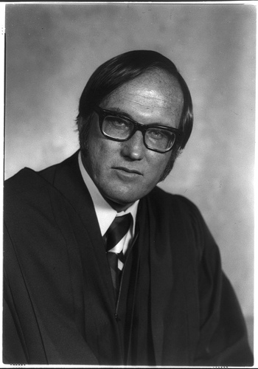
Roe v. Wade (1973)
Justice William H. Rehnquist dissenting: “To reach its result, the Court necessarily has had to find within the scope of the Fourteenth Amendment a right that was apparently completely unknown to the drafters of the Amendment. As early as 1821, the first state law dealing directly with abortion was enacted by the Connecticut Legislature. By the time of the adoption of the Fourteenth Amendment in 1868, there were at least 36 laws enacted by state or territorial legislatures limiting abortion. While many States have amended or updated their laws, 21 of the laws on the books in 1868 remain in effect today.”
From this historical record, Rehnquist concluded that, "There apparently was no question concerning the validity of this provision or of any of the other state statutes when the Fourteenth Amendment was adopted." Therefore, "the drafters did not intend to have the Fourteenth Amendment withdraw from the States the power to legislate with respect to this matter."

Slide 36
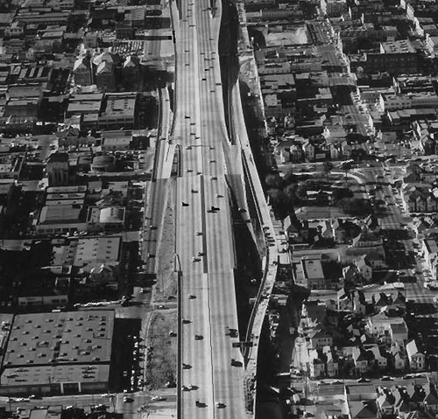
Eminent Domain
Imagine that one day you own your own home, your dream house in fact. It is in perfect condition. You have raised your kids there. It is the only home they know. They attend the excellent local school down the street. Your neighbors are your best friends and each day all of the neighborhood kids play to together.
One day you get a letter from the government explaining that they have “condemned” your house so that they can build a new superhighway. The letter further explains that they will pay you $100,000, what they consider “fair market value,” and that you have to vacate your home within 6 months.
Can the government do this?
Yes. Eminent Domain is the power of the government to take private real estate without the owner’s permission.

Slide 37
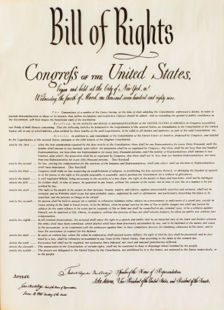
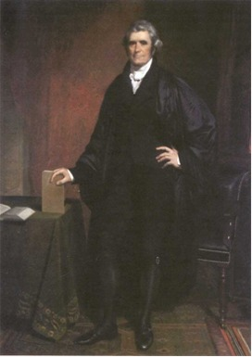
The Takings Clause
The 5th Amendment to the U.S. Constitution states: “nor shall private property be taken for public use, without just compensation.”
This provision assumes that the government has the power of eminent domain and imposes a limit on the government’s power: property must be taken for “public use” and “just compensation” must be provided.
At the founding, many states protected private property through similar laws and it was understood that the Takings Clause only applied to the federal government.
Chief Justice John Marshall affirmed this view in Barron v. Baltimore (1833) where the Supreme Court ruled that the Bill of Rights only applied to the federal government and not to state or local governments.

Slide 38
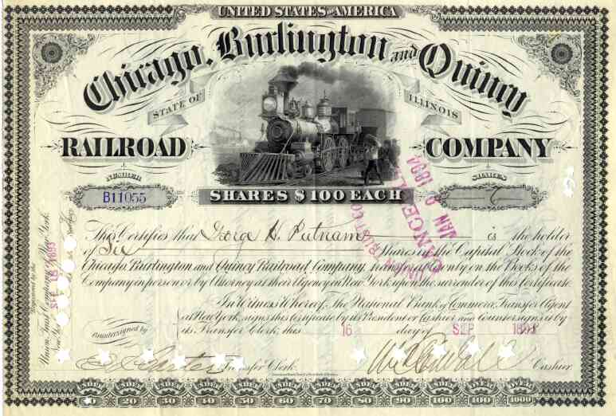
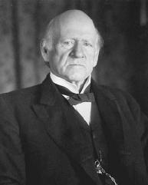
Incorporation
With the passage of the 14th Amendment after the Civil War, lawyers began arguing that the provisions of the Bill of Rights, including the 5th Amendment’s Takings Clause, now applied to the states.
Among other things, the 14th Amendment states: “nor shall any State deprive any person of life, liberty, or property, without due process of law.”
In Chicago, Burlington, and Quincy Railroad v. Chicago (1897) the Supreme Court held that this provision—the Due Process Clause—“incorporated” the 5th Amendment’s Takings Clause, making it applicable to state governments.
The Court reasoned that if the government was going to take private property, “due process” required that it be taken for “public use” and that “just compensation” was given.
Justice John Marshall Harlan wrote for the 7-1 majority: “The legislature may prescribe a form of procedure to be observed in the taking of private property for public use, but it is not due process of law if provision be not made for compensation. Notice to the owner to appear in some judicial tribunal and show cause why his property shall not be taken for public use without compensation would be a mockery of justice. Due process of law, as applied to judicial proceedings instituted for the taking of private property for public use means, therefore, such process as recognizes the right of the owner to be compensated if his property be wrested from him and transferred to the public.”

Slide 39
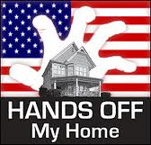
What Constitutes a “Public Use” Early Limits
Though there has been disagreement about exactly what constitutes a government “taking” and what is “just compensation,” it is the “public use” provision that we will focus on in this lecture.
Usually “public use” is obvious such as when a government wants to build a courthouse, road, school, or park.
Prior to the New Deal in the 1930s, the Supreme Court took a strict interpretation of “public use” and disallowed a number of government attempts to take private property.
For example, in Cole v. LaGrange (1884) the city of LaGrange, Missouri issued bonds to help finance the operation of a private iron and steel mill. The Supreme Court held that this was not a proper “public use.”
The Court invalidated other takings for failing to qualify as “public use” in Missouri Pacific Railway Company v. Nebraska (1896) and Cincinnati v. Vester (1930).

Slide 40
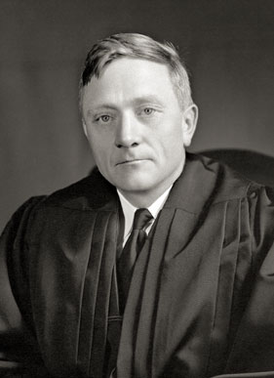
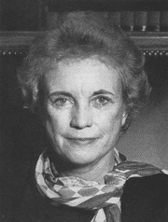
What Constitutes a “Public Use”: Modern Expansion
After the New Deal the Supreme Court’s position began to change. In a series of unanimous opinions the justices increasingly deferred to legislatures to determine what constituted “public use.”
In United States ex rel. Tennessee Valley Authority v. Welch (1946) the justices upheld the authority of the federal government to condemn private land that would be flooded as a result of the TVA’s flood control programs.
In Berman v. Parker (1954) the Court failed to provide relief to a landowner whose property, which was in a blighted area, was taken from him as part of an urban renewal project but later was transferred to another private party. Justice William O. Douglas reasoned that aesthetics and beautification qualified as a legitimate “public purpose.”
In Hawaii Housing Authority v. Midkiff (1984) the Court upheld a state plan to redistribute land by forcing large landowners to sell their properties to the people who leased them. Justice Sandra Day O’Connor reasoned that the “public use” requirement is satisfied as long as the taking is rationally related to some conceivable public purpose; it is the purpose of the taking, not the use of the property, that is important.

Slide 41

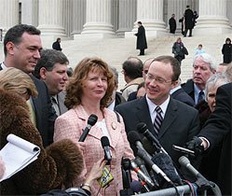
Kelo v. City of New London (2005)
For decades the city of New London, Connecticut suffered significant economic decline.
By 1998 the unemployment rate was double that of the state and the population had declined to 24,000, the same number of residents the city had in 1920.
In response, state and local officials created the New London Development Corp. (NLDC) to devise strategies for economic advancement.
The Pfizer drug company already had a research facility in New London but tentatively committed to build a new $300 million research facility in the city’s Fort Trumbull area.
Officials believed that the new development would not only bring jobs and tax revenues to the city but also would spur other economic revitalization efforts. The NLDC developed a master plan for the areas surrounding the proposed Pfizer operation calling for a hotel, conference center, museum, restaurants, shops, office space, marina, river walk, and new residential housing. In 2000 the city adopted the plan.
To begin the development, however, the city had to acquire 115 parcels of privately owned land. The city successfully negotiated with most of the owners to purchase their land but some refused to sell. The city responded by condemning their properties through their power of eminent domain.
Nine landowners, including Susette Kelo, filed suit. She had owned a waterview home since 1997 and has spent considerable funds to fix it up. Another owner, Wilhelmina Dery, was born in and had lived in her home since 1918. None of the homes were in poor condition and the area was not blighted.

Slide 42
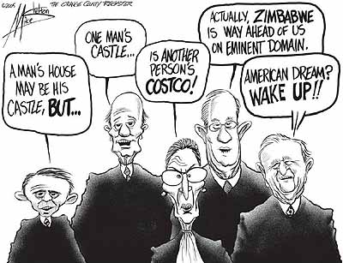
The court ruled 5-4 in favor of the government. The justices in the majority were (from right): John Paul Stevens, Anthony Kennedy, Ruth Bader Ginsburg, Stephen Breyer, and David Souter—the Court’s most liberal members.

Slide 43
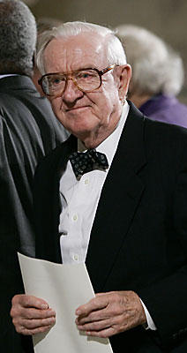
Justice John Paul Stevens Delivered the Opinion of the Court
In a 5-4 decision, the Court upheld the takings. Writing for the majority, Justice Stevens explained that simply taking A’s property and giving it to B is unconstitutional. Yet this taking was executed pursuant to a “carefully considered” development plan and therefore satisfies the public use requirement.
Stevens explained that the Court long ago rejected the 19^{th-}century “common carrier” idea – that “public use” means “used by the public.”
He cited Berman v. Parker and Midkiff to explain that legislatures are entitled to determine what “public use” entails: “For more than a century, our public use jurisprudence has wisely eschewed rigid formulas and intrusive scrutiny in favor of affording legislatures broad latitude in determining what public needs justify the use of the takings power.”
He recognized that while the properties and area were not blighted, the city determined “that the area was sufficiently distressed to justify a program of economic rejuvenation” and “promoting economic development is a traditional and long accepted function of government” which cannot be distinguished from other public purposes that the Court has upheld.
Stevens said that the Court does not review the plan itself: “It is not for the courts to oversee the choice of the boundary line nor to sit in review on the size of a particular project area. Once the question of the public purpose has been decided” the plan is totally at the discretion of the legislative branch.
Finally, he said that people can work within their states to protect their property from condemnation: “We emphasize that nothing in our opinion precludes any State from placing further restrictions on its exercise of the takings power…. the necessity and wisdom of using eminent domain to promote economic development are certainly matters of legitimate public debate.”

Slide 44
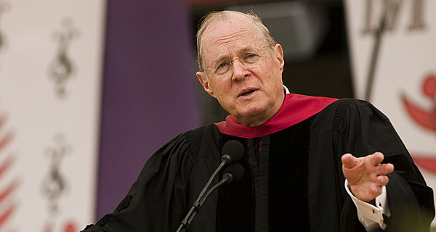
Justice Anthony Kennedy Concurring
In 5-4 decisions, Justice Kennedy more-often-than-not sides with his conservative colleagues. But on occasion, as in this case, he sides with the more liberal members of the Court.
He wrote separately to emphasize that point that transfers must chiefly benefit the public and not the private entity that the land is transferred to.
“A court applying rational-basis review under the Public Use Clause should strike down a taking that, by a clear showing, is intended to favor a particular private party, with only incidental or pretextual public benefits.”
“While there may be categories of cases in which the transfers are so suspicious, or the procedures employed so prone to abuse, or the purported benefits are so trivial or implausible, that courts should presume an impermissible private purpose, no such circumstances are present in this case.”

Slide 45
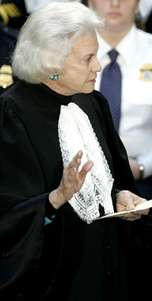
Justice Sandra Day O’Connor Dissenting
“Under the banner of economic development, all private property is now vulnerable to being taken and transferred to another private owner, so long as it might be upgraded—i.e., given to an owner who will use it in a way that the legislature deems more beneficial to the pubic—in the process.” Property could be transferred for “increased tax revenue, more jobs, maybe even aesthetic pleasure.”
She explained that Berman and Midkiff (in which she wrote the majority opinion allowing the taking) were different from this case: “In both those cases, the extraordinary, precondemnation use of the targeted property inflicted affirmative harm on society—in Berman through blight resulting from extreme poverty and in Midkiff through oligopoly resulting from extreme wealth. And in both cases, the relevant legislative body had found that eliminating the existing property use was necessary to remedy the harm. Thus a public purpose was realized when the harmful use was eliminated. Because each taking directly achieved a public benefit, it did not matter that the property was turned over to private use. Here, in contrast, New London does not claim that Susette Kelo’s and Wilhelmina Dery’s well-maintained homes are the source of any social harm.”
Finally, she explained that the majorities call for people to work through their state legislature to protect their property was unrealistic: “The beneficiaries are likely to be those citizens with disproportionate influence and power in the political process, including large corporations and development firms. As for the victims, the government now has license to transfer property from those with fewer resources to those with more. The Founders cannot have intended this perverse result.”

Slide 46
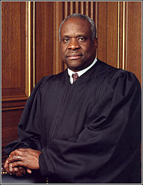
Justice Clarence Thomas Dissenting
As he has done with many areas of the law, Justice Thomas expressed his dissatisfaction with the current debate and his preference for a new approach to this issue.
“I would revisit our Public Use Clause cases and consider returning to the original meaning of the Public Use Clause: that the government may take property only if it actually uses or gives the public a legal right to use the property.”
Echoing Justice O’Connor’s dissent, Thomas portrays the majority as protecting the powerful and uncaring about the poor.
“Allowing the government to take property solely for public purposes is bad enough, but extending the concept of public purpose to encompass any economically beneficial goal guarantees that these losses will fall disproportionately on poor communities. Those communities are not only systematically less likely to put their lands to the highest and best social use, but are also the least politically powerful.”

Slide 47
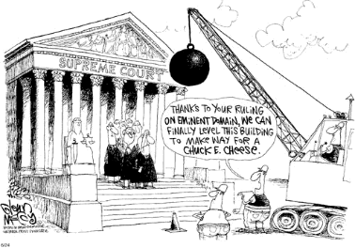
There was considerable public criticism of the Court’s decision.

Slide 48
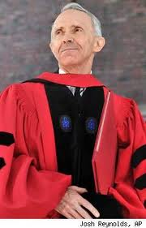
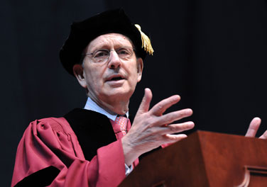
Aftermath: Condemning the Justices
In addition to protective legislation, the decision touched off a storm of protests including some targeted at the justices themselves.
In Weare, New Hampshire, activists secured enough signatures on a petition to place a proposal on the ballot to have the town seize the 200-year-old farmhouse home of Justice David Souter, who voted with the majority. Under the proposal the property would be turned over to private investors who would build an inn to be named the “Lost Liberty Hotel,” featuring the “Just Deserts” café. One supporter said, “It would be more like a bed and breakfast…. There would be nine suites, with a black robe in each of the closets.” The proposal was rejected 1167 to 493.
In a related but also unsuccessful effort, members of the state Libertarian Party urged the city of Plainfield, New Hampshire, to seize a 167-acre vacation retreat owned by Justice Stephen Breyer, also a member of the Kelo majority. In its place they planned to create a “Constitution Park” including monuments to the U.S. and New Hampshire constitutions.

Slide 49
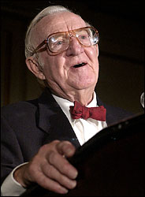
Aftermath: Justice Stevens Speaks
In August 2005, Justice Stevens spoke at a meeting of the American Bar Association. He called his positions in both the medical marijuana case Gonzales v. Raich (2005) and Kelo, “unwise” but explained that “in each I was convinced that the law compelled a result that I would have opposed if I were a legislator.”
In Kelo, he explained that the result he reached as a judge was “entirely divorced from my judgment concerning the wisdom of the program.” He said that his own view on eminent domain was that “the free play of market forces is more likely to produce acceptable results in the long run than the best-intentioned plans of public officials.”
In 2007, Stevens said in an interview, “As you know there are pressure groups that have very strong feelings about property rights. I sympathize with all that, but I thought that was a clear case of what the law compelled. It’s part of the job to write unpopular decisions. No doubt about it.”
Taking a queue from Stevens’ Kelo opinion, 30 state legislatures immediately introduced bill and constitutional amendments to restrict local government’s use of eminent domain. Ten states already had laws baring government seizures of non-blighted private property for economic development purposes.

Slide 50

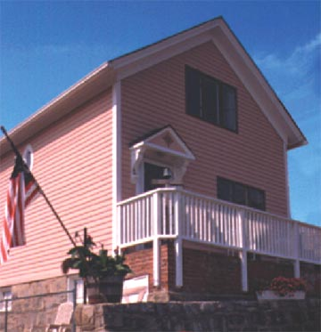
Aftermath: Dery and Kelo
Wilhelmina Dery died in her home, which had yet to be seized by the government, one year after the Court’s decision.
As for Susette Kelo, the New London nurse continued the fight to save her home from government seizure.
During the summer of 2006, Kelo and the city reached a compromise solution.
The city agreed to fund the physical relocation of the house to a nearby lot.
Kelo lost her waterview location, but saved the 1893 home she had spent many years renovating.

Slide 51
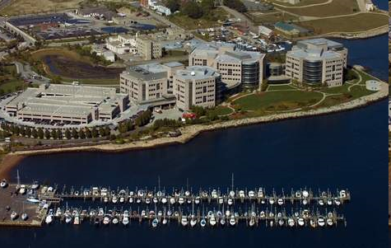
Aftermath: Pfizer
In total, the state paid $78 million to purchase and bulldoze the land for the development project.
Yet in the end, nothing was ever built.
In 2009 Pfizer merged with Wyeth and because both had facilities in Connecticut, one was closed – the original Pfizer research and development campus in New London (above) – and most of the workers were transferred to the other Connecticut facility.
In the aftermath of 2011's Hurricane Irene, the New London development was turned into a dump for storm debris such as tree branches and other vegetation.

