Slide 1
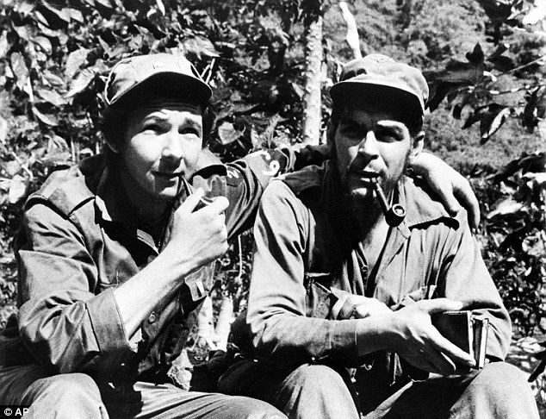
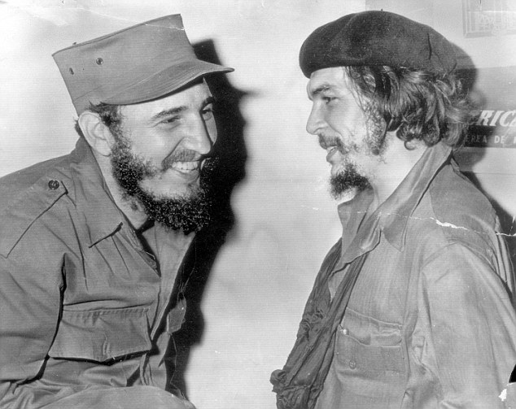
Che Guevara and the Revolutionary Question
Artemus Ward Bill of Rights Institute
Dept. of Political Science Webinar
Northern Illinois University April 27, 2017

Slide 2
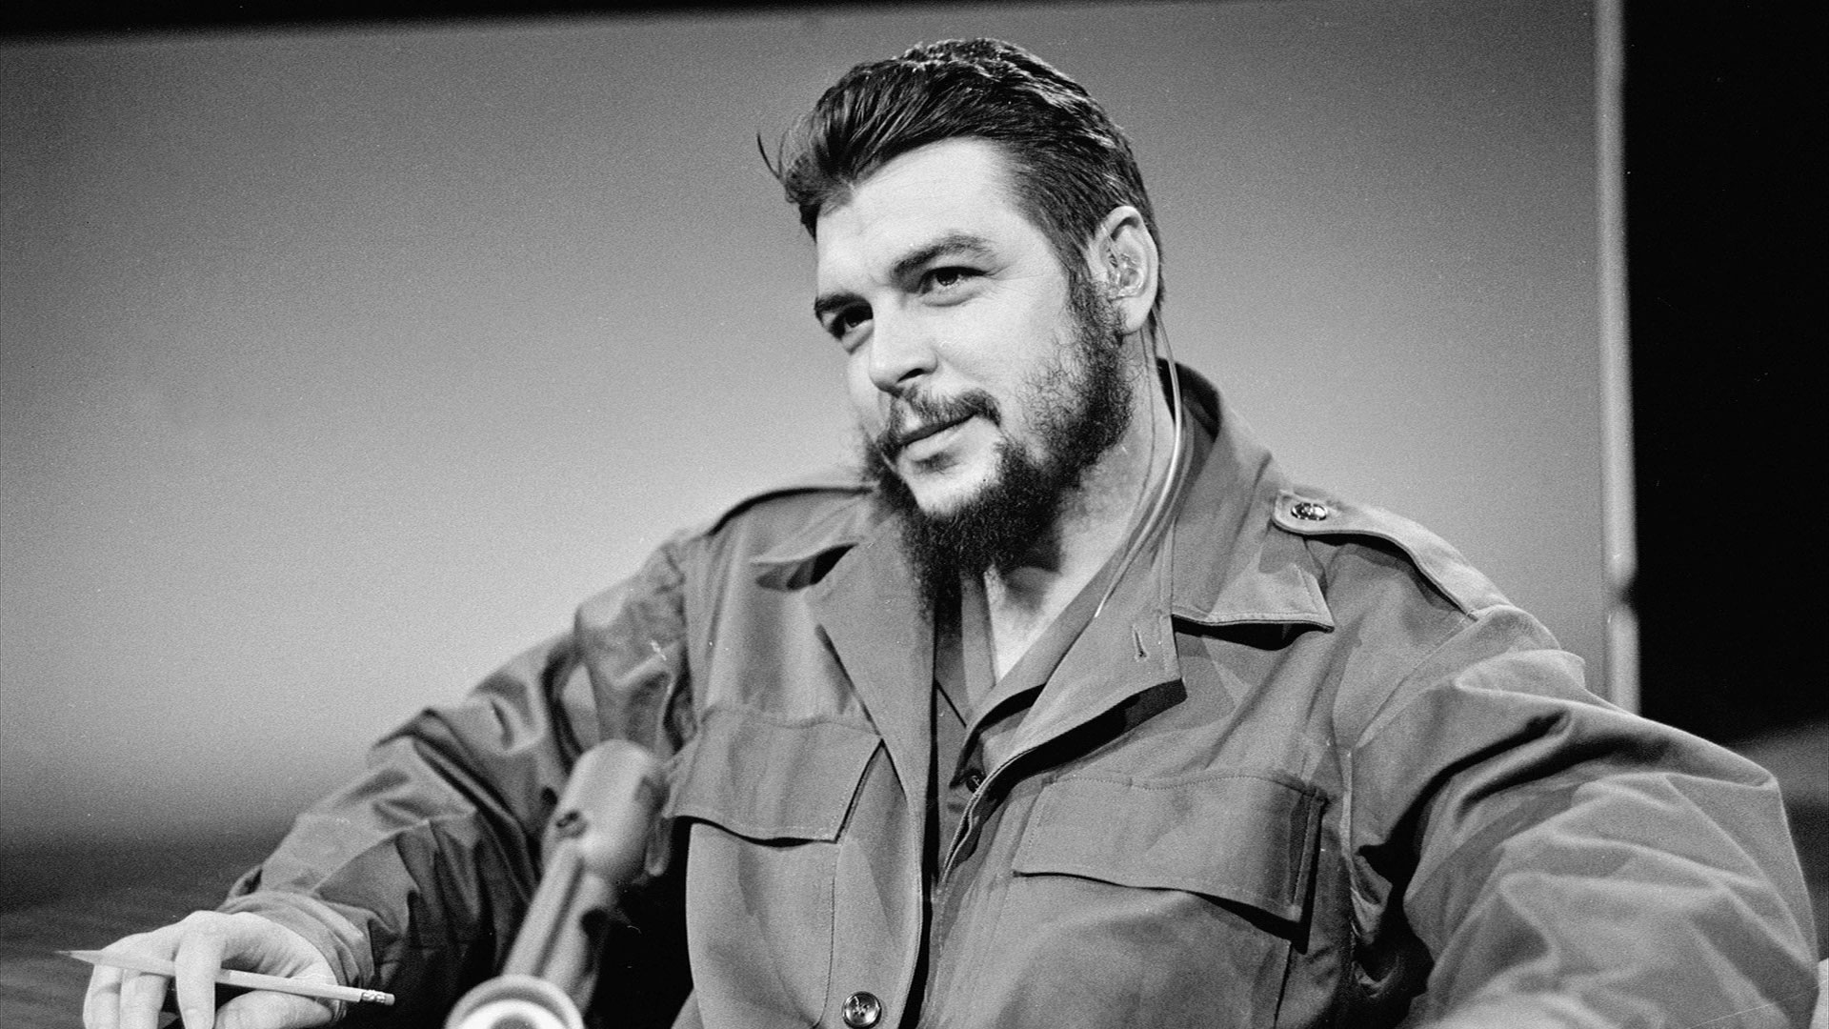
Introduction
It is important that communist revolutionaries such as Che Guevara be seen as complex figures, rather than simply “good” or “evil” as 20th Century capitalist societies routinely—and necessarily—painted them.
Regardless of whether or not you agree with Che’s goals of a socialist society based on classlessness and equality, the means he and other communist revolutionaries used including armed violence and authoritarianism are easy to be critical of.
Yet the question that must be asked is, what was the alternative?
Can you have a communist revolution peacefully and democratically?
Can a communist society be governed peacefully and democratically?
To answer these questions, we will examine Che and the Cuban Revolution in the context of other, similar movements that both preceded and followed it.

Slide 3
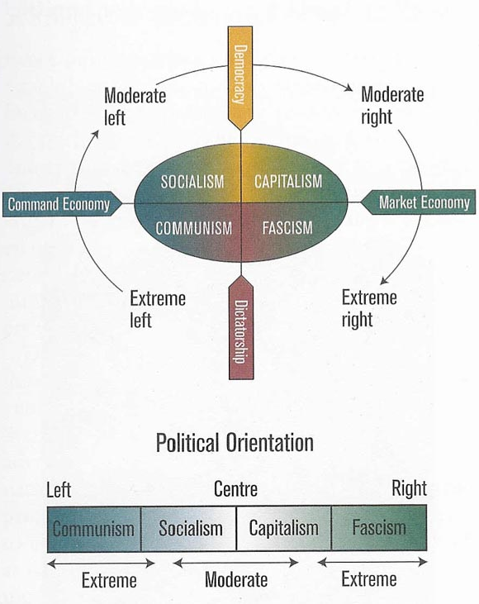
Political & Economic Systems
Karl Marx was a German social scientist who used economics, history, and political philosophy to write, among other things, The Communist Manifesto (1848) in Brussels, Belgium.
Published in London, the book explained the inherent problems of capitalism and argued that class struggle between the haves (bourgeoisie) and have-nots (proletariat) would lead to capitalism’s demise and replacement with socialism where the people own the means of production (rather than private ownership) and there are no social classes. It ultimately urges: “worker’s of the world, unite!” Still, it is not a specific “how to” manual for achieving a socialist revolution.
Socialism and Capitalism are competing economic systems.
Democracy and Authoritarianism (dictatorship) are competing political systems.

Slide 4
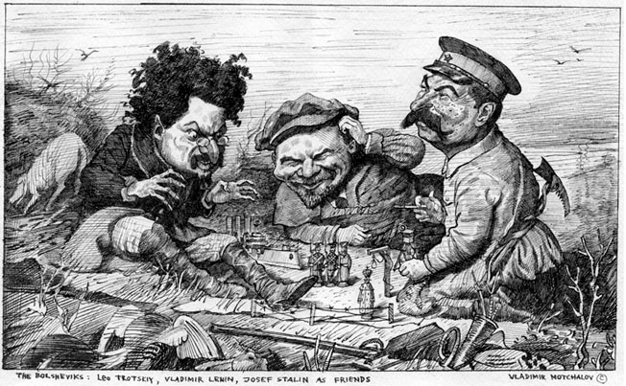

Slide 5
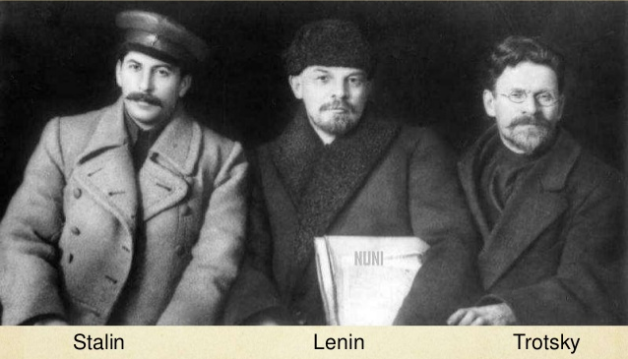
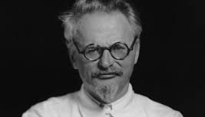
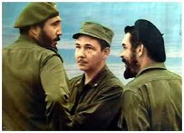
Russian Revolution as Instruction
Ultimately, Che and the Castro Brothers (Fidel and Raul) faced the same decision that Lenin, Trotsky, and Stalin were confronted with: how to replace an imperial capitalist society with a communism.
Marx had theorized that it was inevitable but did not provide a blueprint for making it happen.
In 1905, striking workers and peaceful protesters were fired on outside the palace in St. Petersburg by troops of the Russian Tsar resulting in 1,000 deaths. “Bloody Sunday” marked the start of the Russian Revolution.
Lenin decided that a violent revolution was the solution and the Russian Revolution proceeded accordingly.
Stalin took power following Lenin’s death and governed through increasing violence and authoritarianism. Stalin banished Trotsky—who favored democracy and freedom—from the Soviet Union. In exile, Trotsky ultimately lived in Mexico City where he was assassinated in 1940.
With this knowledge as background, Che and the Castro Brothers decided to follow Lenin’s prescription for a violent revolution.
(l-r) Fidel Castro, Raul Castro, Che Guevara

Slide 6
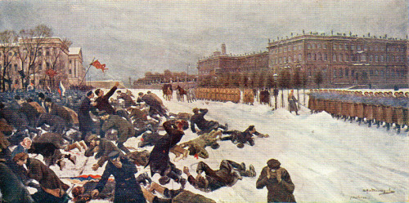
“Bloody Sunday” - Tsarist troops massacre 1,000 protesters outside the palace at St. Petersburg, Russia, January 22, 1905.

Slide 7
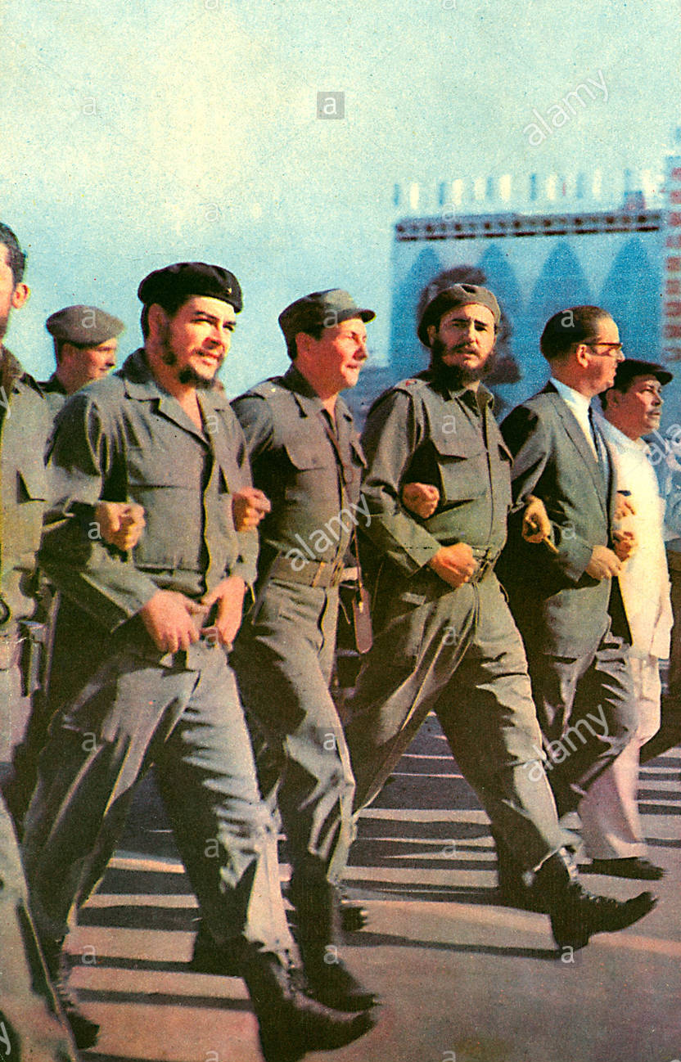
The Cuban Revolution
According to Marx, the key to a communist revolution was class consciousness—the oppressed masses would inevitably rise up and overthrow their oppressors.
But what if the masses lack class consciousness? Marx felt that class consciousness would be a natural outgrowth of the economic oppression and inequality of industrialization. But how would his theories apply to largely rural, agricultural societies who aspired to the riches of industrialization/modernization through capitalist propaganda?
Che and the Castros felt that it was their duty to educate and lead by freeing the people from both their false consciousness and their oppressors (in their case the American-backed Cuban dictator Batista).
They chose violent guerilla warfare believing that it was impossible to work from within a corrupt authoritarian system for peaceful, gradual change.
After two years of this approach, Batista fled Cuba and the revolutionaries took power.
(l-r) Che Guevara, Raul Castro, Fidel Castro
marching through the streets of Havana to
celebrate the Cuban Revolution, 1960.

Slide 8
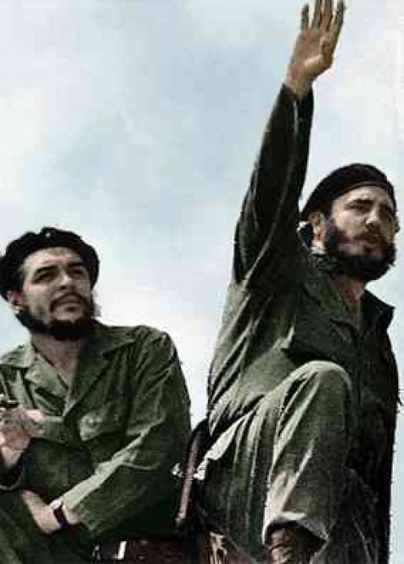
Governing Cuba
Che and the Castro brothers implemented a government modeled after the Lenin and the Bolsheviks following the Russian Revolution.
They used authoritarian tactics including violence to keep their political enemies (capitalists) at bay.
Property and industry were nationalized and civil liberties were curtailed.
Che was a key figure in the government and was central in training the militia forces who repelled the American-led Bay of Pigs Invasion and bringing Soviet nuclear-armed ballistic missiles to Cuba which precipitated the 1962 Cuban Missile Crisis with the U.S.
Che left Cuba in 1965 to foment revolution abroad. In Bolivia he was captured by American-assisted Bolivian forces and summarily executed.
Che Guevara (left) and Fidel Castro.

Slide 9
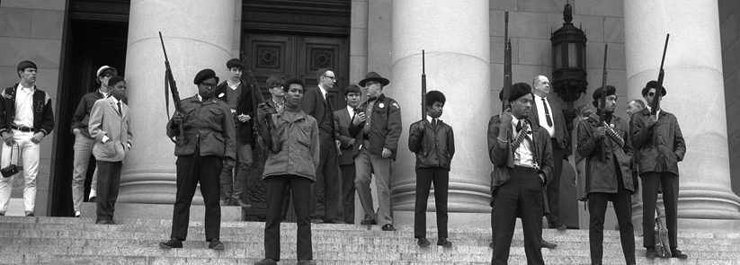
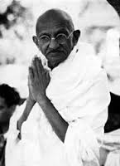
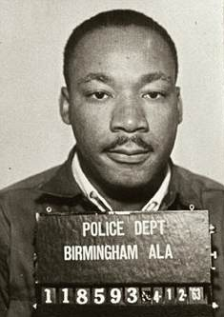
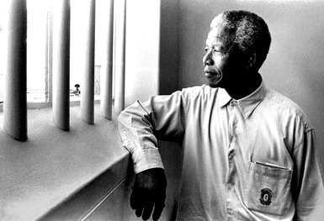
Peaceful Revolution?
Is peaceful revolution on behalf of social
justice and equality possible?
Ghandi thought so, preached and practiced non-violence, and expected the British imperialists to simply walk out of India, which they ultimately did after violence and oppression in the face of mass, peaceful resistance embarrassed them on the world stage.
Martin Luther King, Jr. followed Ghandi’s example. But many African-Americans grew impatient with his non-violent tactics when, despite the passage of favorable legislation like the Civil Rights Act (1964), change had not occurred in practice. The Black Panther Party took the opposite approach and sought change through armed, even violent means. But they failed due to an FBI campaign to undermine and destroy them.
The South African “revolution” against apartheid was prompted by the African National Congress (ANC) who began peacefully, turned to violent guerrilla warfare, and ultimately won fair elections that led to the ANC and Nelson Mandela (who was imprisoned from 1962-1990) peacefully taking power from their white oppressors.

Slide 10
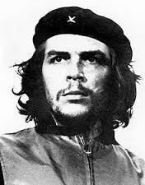
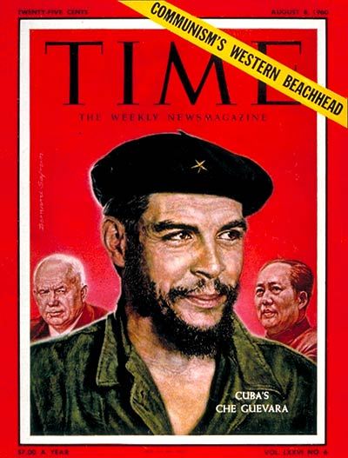
Conclusion
Che Guevara provides an important case study in social change.
The central question for Che, and all would-be agents for change, is whether noble ends can be accomplished peacefully and democratically.
While all social movements begin peacefully, it has been extremely rare, historically, for the change they sought to be achieved without violence.
And even if the revolution occurs peacefully, can its goals be realized democratically?

