Slide 1
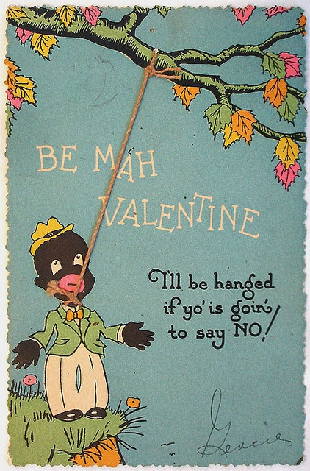
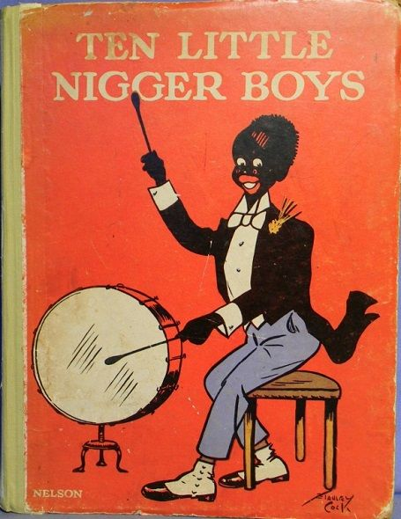
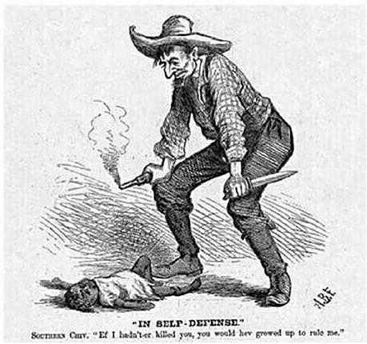
African Americans in the Gilded Age
(Left) Valentine’s card ca. 1900-1930; (Center) nursery book that taught white children to count via caricatures of Black boys who are eliminated by a series of events. For example: “Five little nigger boys made a lion roar; one got swallowed up, and then there were four.” (Right) 1876 cartoon: “IN SELF-DEFENSE.” Southern Cry, “Ef I hadn’t-er killed you, you would hev growed up to rule me.”
Artemus Ward
Dept. of Political Science Northern Illinois University aeward@niu.edu
Bill of Rights Institute Kansas City, KS June 5-6, 2017

Slide 2
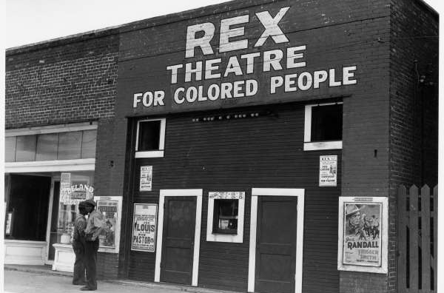
Introduction
The end of the Civil War, the abolition of slavery, and the guarantees of the post-Civil War Amendments (13th, 14th, 15th) created the conditions for women, African Americans, and others to press rights claims.
The U.S. Supreme Court responded by deciding an unprecedented number of constitutional cases. Before the Civil War, the justices had only twice struck down acts of congress as unconstitutional. By the end of the 19th century, they had invalidated 30 acts.
The Court was becoming increasingly self-assured and, as a result, increasingly enmeshed in national controversies.
Yet the Court’s narrow reading of the post-Civil War Amendments and resultant legislation, simply shifted white rage against African Americans from the tyranny of slavery to the oppression of racial segregation.

Slide 3
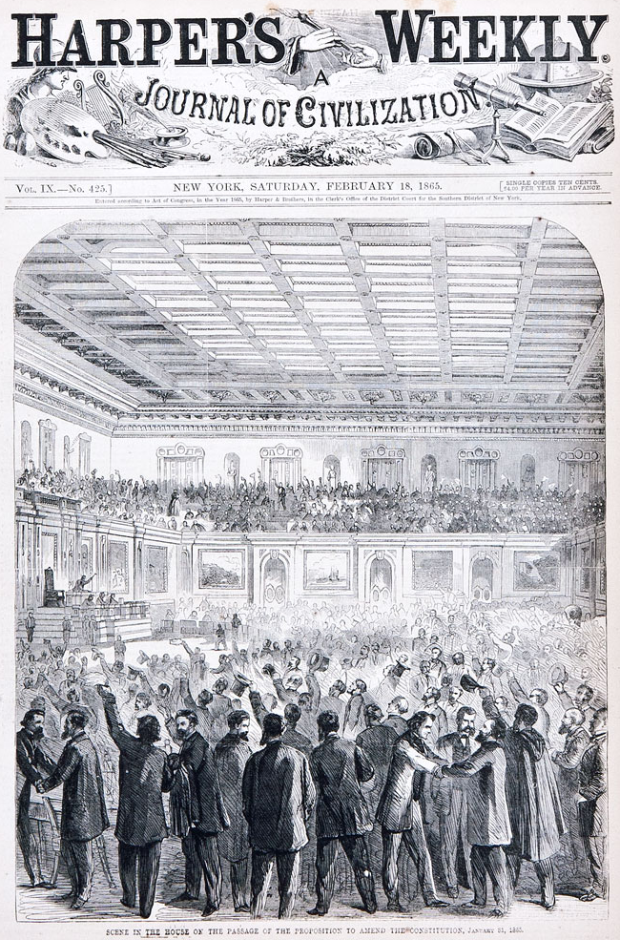
Post-Civil War Amendments (1865-1870)
After the union victory in the Civil War, the Constitution was amended to end slavery via the 13th Amendment (1865), confer full national citizenship on African Americans through the 14th Amendment (1868), and voting rights as specified in the 15th Amendment (1870).
Specifically, the 14th said:
“No state shall make or enforce any law which shall abridge the privileges or immunities of citizens of the United States;
nor shall any state deprive any person of life, liberty, or property, without due process of law;
Nor deny to any person within its jurisdiction the equal protection of the laws.”
Congress moved with dispatch to give force to the new amendments, for example passing the Civil Rights Act (1866) and the second Freedman’s Bureau Act (1866) based on the 13th Amendment.
Still, the nationalists in congress faced stiff opposition from southern racists who sought to perpetuate the racial caste system they felt was a natural way of life.

Slide 4
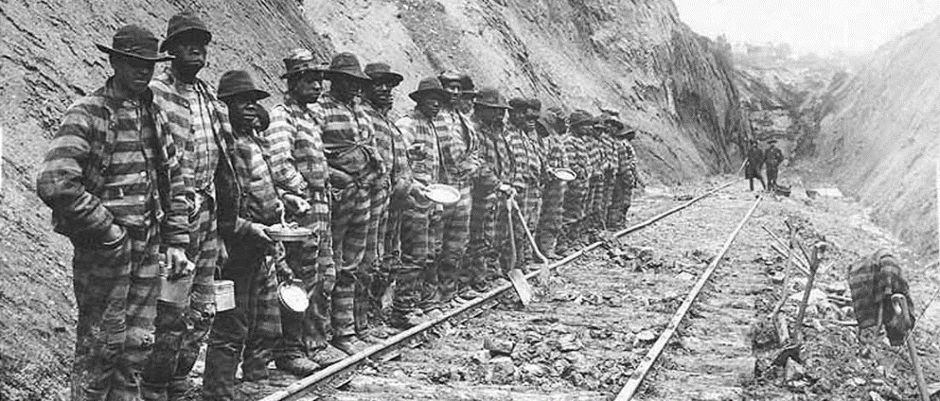
Black Codes (1865-1866)
The North’s victory in the Civil War did not bring peace. Instead, emancipation and Reconstruction brought on the beginning stages of the second phase of white rage against African Americans: Jim Crow – legalized segregation.
The Jim Crow era began when legislatures throughout the South scrambled to reinscribe white supremacy and restore the aura of legitimacy that the anti-slavery campaign had tarnished. The resulting legislation was known as the Black Codes and effectively criminalized blackness, sanctioned forced labor, and undermined democracy.
Mississippi was the first state to pass these laws, with an 1865 statute titled “An Act to confer Civil Rights on Freedmen.” It required black workers to contract with white farmers by January 1 of each year or face punishment for vagrancy.
Following Mississippi’s lead, lawmakers in several states created their own Black Codes. For example, African Americans could be sentenced to forced labor for crimes including petty theft, using obscene language, or selling cotton after sunset.
States passed new, strict vagrancy laws that were selectively enforced against blacks without white protectors. The labor of these convicts was then sold to farms, factories, lumber camps, quarries, and mines. This had the double effect of keeping African Americans away from public spaces and creating a cheap/free labor pool—which of course was the status quo under slavery.

Slide 5
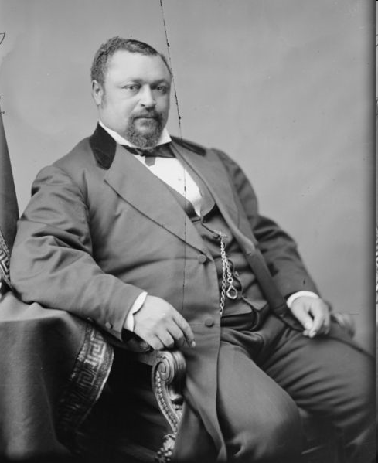
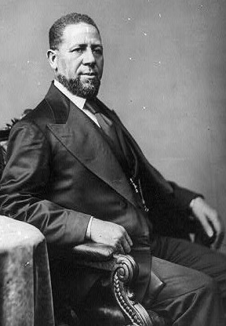
Reconstruction (1866-1877)
For much of the Reconstruction era the federal government assumed political control of the former states of the confederacy.
Voters in the south elected more than 600 African-American state legislators and 16 members of Congress including the first two (and only two) African Americans to serve as United States Senators: Blanche K. Bruce and Hiram Revels, both of Mississippi.
Because blacks in South Carolina vastly outnumbered whites, the newly-enfranchised voters were able to send so many African American representatives to the state assembly that they outnumbered white representatives.
Many were able legislators who worked to rewrite the state constitution and pass laws ensuring aid to public education, universal male franchise, and civil rights for all.
Senator Blanche Bruce
Senator Hiram Revels

Slide 6
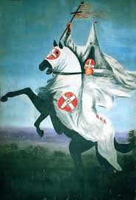
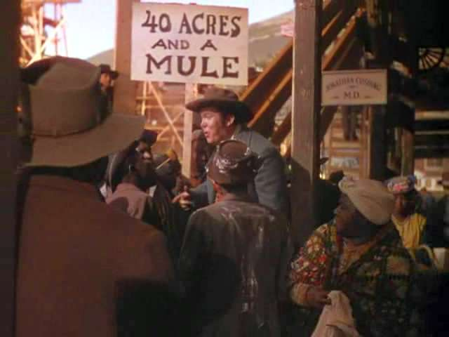
Backlash: White Rage
Despite gains made during Reconstruction, white’s redoubled their efforts to undermine and reverse progress for former slaves.
Influential white legislators such as Rep. Thaddeus Stevens (R-PA) and Sen. Charles Sumner (R-MA) tried to make the nation live its creed, but they were ultimately no match for the swelling resentment that gave rise to the Black Codes, created a white terrorist organization (the Ku Klux Klan), and neutralized the 13th, 14th and 15th amendments and resulting legislation through narrow Supreme Court interpretation.
Even the federal authorities’ promise of “40 acres and a mule” — a slogan for land and property seized from traitors who had tried to destroy the U.S. (famously depicted in the 1939 film Gone with the Wind) — crumbled like dust when white southerners ultimately returned land to their original white owners.

Slide 7
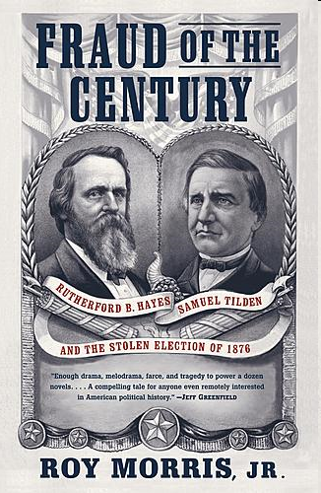
The Supreme Court Weighs In
Although the justices supported the claims of the newly emancipated slaves in some cases, they did not construe the new amendments broadly, nor did they enthusiastically support new legislation designed to enforce them.
In the Slaughterhouse Cases (1873) the Court interpreted the 14th Amendment’s privileges and immunities clause narrowly. A broader view might have provided opportunities for African Americans, women, and other minorities to bring cases based on this clause to the Court.
The disputed Hayes-Tilden presidential election of 1876, in which an electoral commission composed of members of the Court and Congress decided the outcome, resulted in the end of Reconstruction.
The Union Army withdrew from southern states and the old South regained power. Now essentially free to enact and implement discriminatory policies to segregate their societies, the Jim Crow era could truly begin.

Slide 8
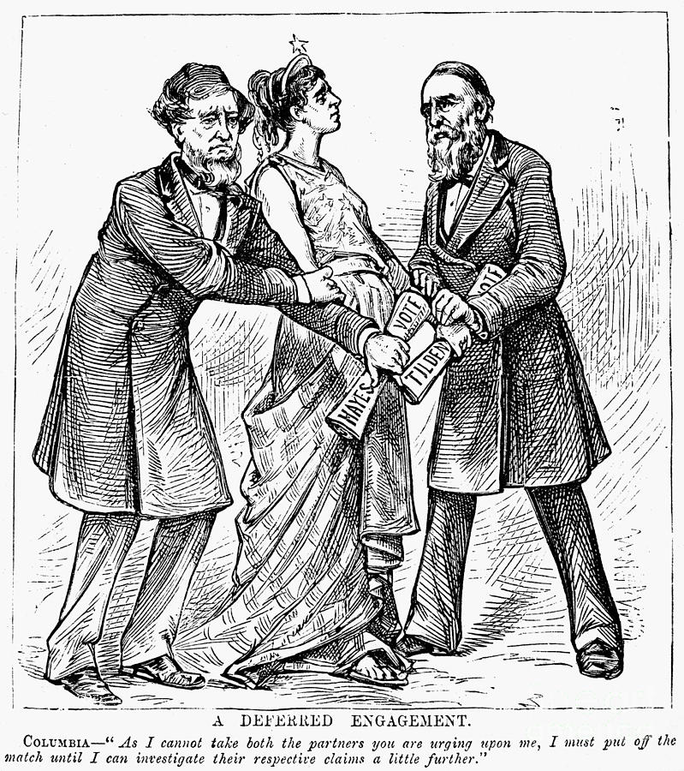
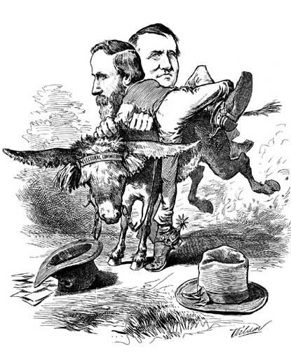
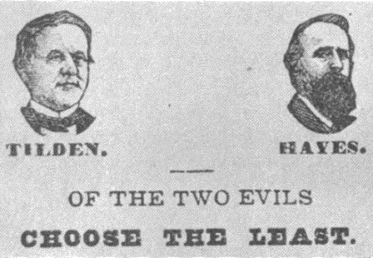

Slide 9
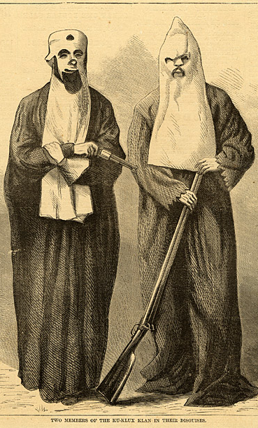
The Supreme Court Weighs In
In United States v. Cruikshank (1876) the Court overturned the convictions of whites who had murdered hundreds of African Americans who had organized for political and civil rights. The Court said that the law the whites were convicted under—the Enforcement Act of 1870 (also known as the First Ku Klux Klan Act or Force Act)—applied only to state action and not private individuals.
Similarly, in United States v. Harris (1883) and the Civil Rights Cases (1883) the Court nullified major provisions of the Ku Klux Klan Act of 1871 and the Civil Rights Act of 1875 for attempting to prevent discriminatory actions by private individuals and institutions. The Court ruled that only public discrimination could be reached by the 13th, 14th, and 15th Amendments.
Still, in Ex parte Yarbrough (1884), the justices held that congress can pass legislation to enforce the voting rights of African-Americans—in this case against intimidation and violence by the Klan.
In Yick Wo v. Hopkins (1886), the Court invalidated a race-neutral law that was administered in a prejudicial manner—in this case an ordinance that prohibited Chinese immigrants from running laundry businesses without a license.
As a result of the losses in Cruikshank, Harris, and the Civil Rights Cases, the federal government effectively withdrew from civil rights enforcement. Indeed, the federal government did not pass another civil rights bill until 1957.

Slide 10
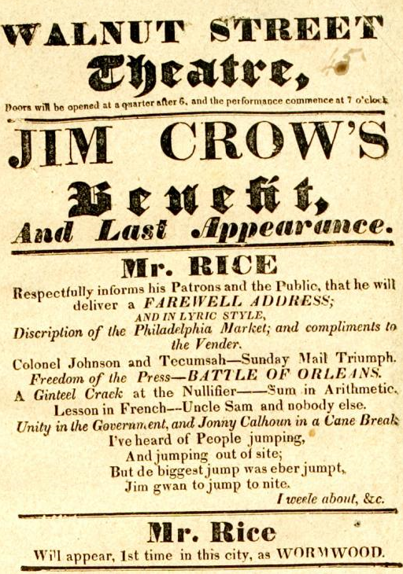
“Jim Crow” Origin
The term Jim Crow is believed to have originated around 1830 when a white, minstrel show performer, Thomas “Daddy” Rice, blackened his face with charcoal paste or burnt cork and danced a ridiculous jig while singing the lyrics to the song, “Jump Jim Crow.”
While traveling in the south, Rice created this character after seeing either a disabled, elderly back man or young black boy dancing and singing a song ending with these chorus words:
“Weel about and turn about and do jis so,
Eb’ry time I weel about I jump Jim Crow.”
Some historians believe that a Mr. Crow owned a slave who inspired Rice’s act—thus the reason for the Jim Crow term in the lyrics.
In any case, Rice incorporated the skit into his minstrel act, and by the 1850s the “Jim Crow” character had become a standard part of the minstrel show scene in America.
The phrase is now commonly used to describe the American system of legalized racial apartheid that replaced slavery.
Youtube: http://youtu.be/T5FpKAxQNKU
Youtube: http://youtu.be/ALTam2L9NhE

Slide 11
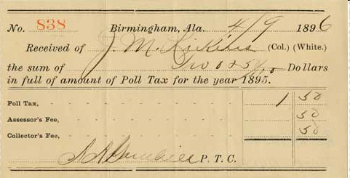
Disenfranchisement
Denying black men the right to vote through intimidation and violence was a first step in taking away their civil rights.
Beginning in the 1890s southern states enacted literacy tests, poll taxes, elaborate registration systems, and eventually white only democratic party primaries to exclude black voters.
In Mississippi, fewer than 9,000 of 147,000 voting age African-Americans were registered after 1890. In Louisiana, where more than 130,000 black voters had been registered in 1896, the number plummeted to 1,342 by 1904.

Slide 12
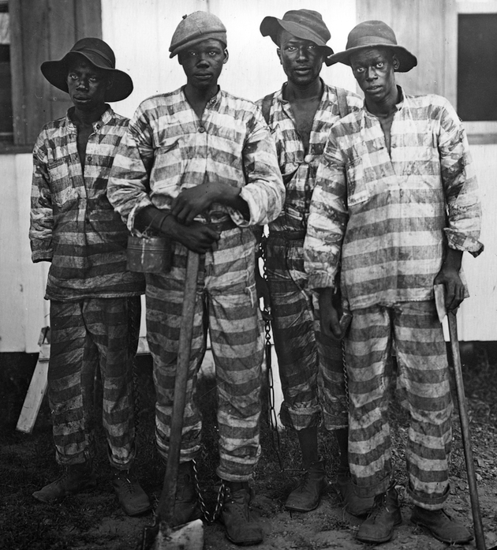
Expansion of Black Codes
On the local level, most southern towns and municipalities dramatically expanded their vagrancy laws to control the influx of black migrants and homeless people who poured into these urban communities in the years after the Civil War.
In Mississippi, for example, whites passed the notorious “Pig Law” of 1876, designed to control vagrant blacks at loose in the community. This law made stealing a pig an act of grand larceny subject to punishment of up to five years in prison. Within two years, the number of convicts in the state penitentiary increased from under three hundred people to over one thousand. It was this law in Mississippi that turned the convict lease system into a profitable business, whereby convicts were leased to contractors who sub-leased them to planters, railroads, levee contractors, and timber jobbers.
Jim Crow laws only spread… Consider some examples:
“Any white woman who shall suffer or permit herself to be got with child by a negro or mulatto…shall be sentenced to the penitentiary for not less than eighteen months.” Maryland 1924
“No colored barber shall serve as a barber to white women or girls.” Atlanta, Georgia, 1926
The photograph (left) depicts convicts leased to harvest timber circa 1915, in Florida.

Slide 13
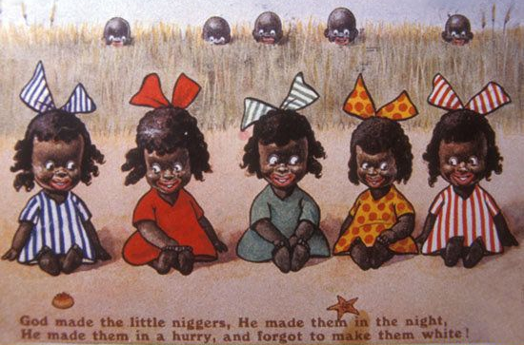
Jim Crow’s Children
Postcard with caption: “God made the little niggers. He made them in the night.
He made them in a hurry, and he forgot to make them white.”
After the Civil War, the establishment of political equality for millions of newly freed black people — through the 13th, 14th and 15th Amendments — meant that a new generation of black children would become adults with equal rights.
And so devaluing black children became central to maintaining racism and inequality in American life.
In the Jim Crow era, black children grew up free citizens and free laborers. Unlike their parents and grandparents, they had no memory of slavery. And so new strategies emerged to contain them, to cast doubt on their rights and intellect, and to demean the value of their labor and their very beings.
Turn-of-the-century pediatric literature features doctors describing how black children’s bodies developed differently from those of white children. According to white researchers, the black fetus had a smaller brain, a wider nose, thicker lips, and “simian” hands and feet.

Slide 14
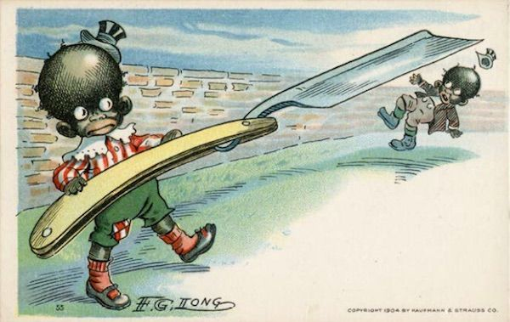
Jim Crow’s Children
Postcard from 1904 illustrating how African American
children have violent tendencies.
Psychologists tested and compared the behaviors of white and black infants and concluded that black babies were born innately inferior and animalistic.
Through brain measurements, doctors and anthropologists set out to prove that black children’s frontal lobes closed up during adolescence. And when that happened, their brains stopped learning and their genitals became over-developed and a sexual threat to whites.
Some politicians openly advocated for the castration of black boys, and in North Carolina, thousands of black girls were forcibly sterilized.
Thus, Jim Crow was far more extensive and damaging for black children than everyday encounters at segregated schools and lunch counters would suggest.
As objects of experimentation by doctors or abuse by the state, babies and other children were exposed to the dehumanizing and violent logic of racial classification and domination. Black parents and educators tried to mitigate these harms and protect their young. Unfortunately, they experienced more setbacks and challenges than successes, but their efforts reveal how even parenting came under assault in the Jim Crow era — and became an important area of resistance.

Slide 15
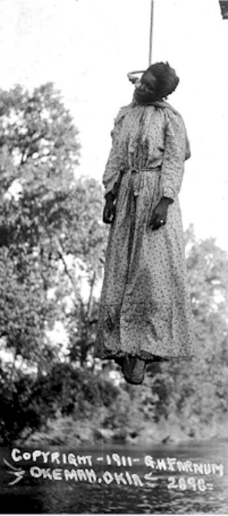
Lynching
As we have discussed, white rage manifested itself in the form slavery, incarceration, and segregation. But it also was regularly on exhibition in the murder of thousands of African Americans.
According to five-year study published in 2015 by the Equal Justice Initiative, 3,959 black men, women, and children were lynched in the 12 southern states between 1877 and 1950.
A Tuskegee Institute study put the number at 3,446 blacks and 1,297 whites lynched between 1882 and 1968.
Extra-judicial murders were a regular feature of early 20th Century life throughout the U.S. It was part of an organized system of terrorism deployed to maintain America’s system of racial apartheid.

Slide 16
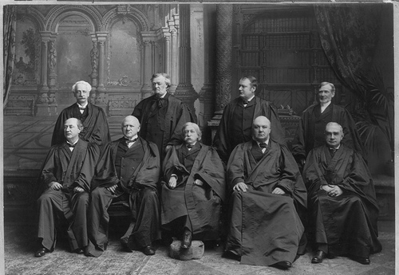
The Fuller Court
1899. (L-R) Top: Rufus Peckham, George Shiras, Edward White, Joseph McKenna; Bottom: David Brewer, John Marshall Harlan, Chief Justice Melville Fuller, Horace Gray, Henry Brown.

Slide 17
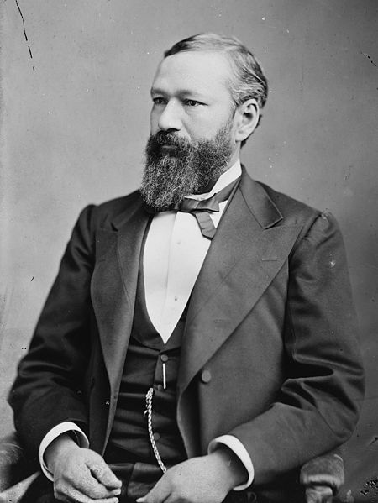
Plessy v. Ferguson (1896)
Homer Plessy’s French-speaking Creole family came to America free from Haiti and France and he was born in New Orleans in 1862 during Northern occupation.
For a time during Reconstruction, Creole and Blacks could marry whomever they chose, sit in any streetcar seat and, briefly, attend integrated schools.
But in 1890 Louisiana passed a law segregating the races on all railroads.
A group of New Orleans residents of African and mixed-race heritage challenged the law.
Their suit was supported by the railroads who found the law too costly to administer as they would have to add additional rail cars to their trains.
The group’s lawyer Albion Tourgee selected Homer Plessy to test the law. Plessy was 7/8 white and 1/8 black—an “octoroon” classified as “black” for the purposes of the law.
Plessy, who appeared to be white, bought a first class ticket, rode the train, and was only arrested when a private detective hired by the group turned him in to authorities.

Slide 18
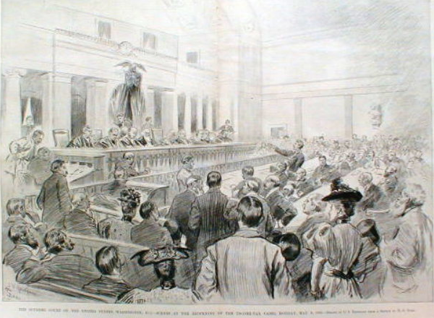
The Fuller Court hears oral argument in the Income Tax Cases, 1895.
The justices would decide Plessy in the same room two years later.
Old Senate Chamber, U.S. Capitol.

Slide 19
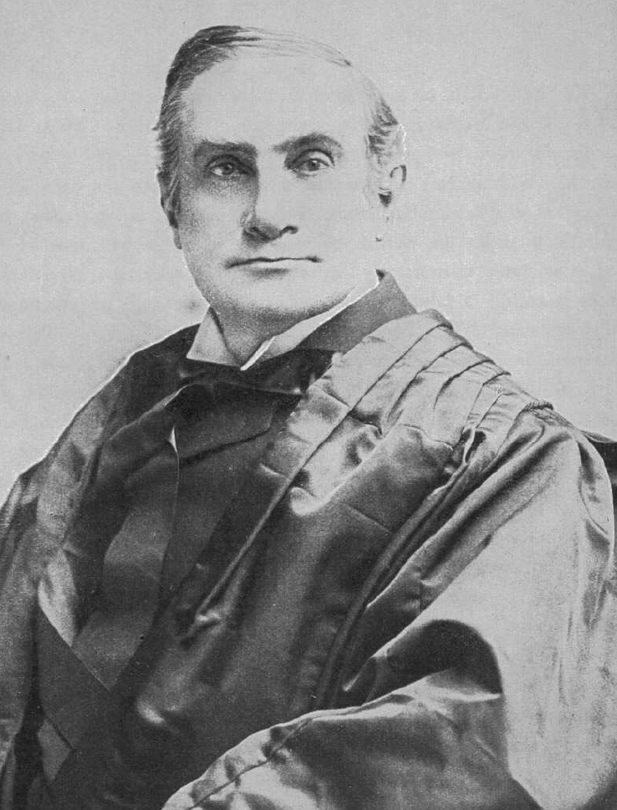
Plessy v. Ferguson (1896)
Writing for the 7-1 majority, Justice Henry Brown (a Lincoln Republican and New Englander who supported the abolitionist movement) said:
“The object of the [14th] amendment was undoubtedly to enforce the absolute equality of the two races before the law, but in the nature of things it could not have been intended to abolish distinctions based upon color, or to enforce social, as distinguished from political equality, or a commingling of the two races upon terms unsatisfactory to either.”
“We consider the underlying fallacy of the plaintiff’s argument to consist in the assumption that the enforced separation of the two races stamps the colored race with a badge of inferiority. If this be so, it is not by reason of anything found in the act, but solely because the colored race chooses to put that construction upon it.”

Slide 20
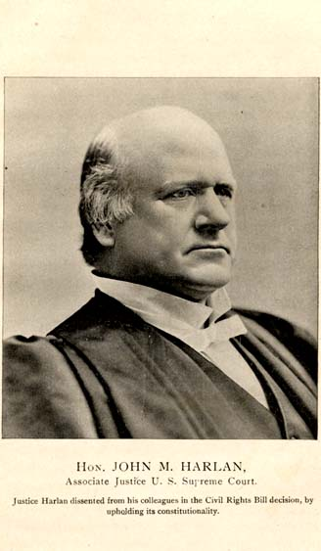
Plessy v. Ferguson (1896)
In dissent was Justice John Marshall Harlan (an aristocratic Kentuckian whose family had owned slaves).
“The Thirteenth Amendment….not only struck down the institution of slavery…but it prevents the imposition of any burdens or disabilities that constitute badges of slavery or servitude….It was followed by the Fourteenth Amendment, which added greatly to the dignity and glory of American citizenship, and to the security of personal liberty.”
“If a State can prescribe…that whites and blacks shall not travel as passengers in the same railroad coach, why may it not so regulate the use of the streets…to compel white citizens to keep on one side of the street and blacks on the other? Sheriffs to assign whites to one side of a courtroom and blacks to the other? Prohibit the commingling of the two races in the galleries of legislative halls or in public assemblages?”
“The white race deems itself to be the dominant race in the country. And so it is, in prestige, in achievements, in education, in wealth, and power. So, I doubt not, it will continue to be for all time, if it remains true to its great heritage….But in view of the Constitution, in the eye of the law, there is in this country no superior, dominant, ruling class of citizens. There is no caste here. Our Constitution is colorblind, and neither knows nor tolerates classes among citizens. In respect of civil rights, all citizens are equal before the law.”

Slide 21
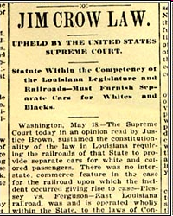
Segregation Bolstered
In response, the legislatures of the South passed segregation laws affecting:
court-rooms, jails and prisons, restaurants, hotels, bars, trains and train stations, buses, streetcars, elevators, lunch counters, swimming pools, beaches, baseball fields, fishing holes, telephone booths, prizefights, pool halls, factories, public toilets, hospitals, cemeteries, schools, parks, water fountains, libraries, recreational facilities, and almost every other public and commercial facility.
These laws, coupled with segregated private lives, inevitably resulted in two separate, and decidedly unequal, societies.

Slide 22
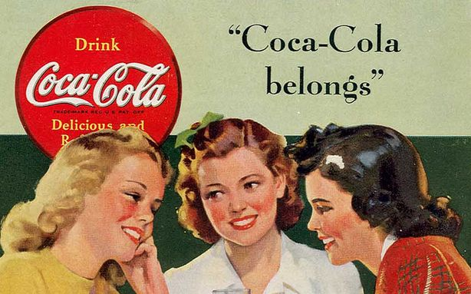
When Jim Crow Drank Coke
There has been a long and often fractious history of soft drinks, prohibition laws and race.
Before Atlanta pharmacist John Pemberton invented Coca Cola, in 1884 he invented “French Wine Coca” – which contained cocaine. It was wildly popular and Atlanta banned alcohol sales the following year. That is why Pemberton invented Coke – which, of course, also contained cocaine.
Across the U.S. support for prohibition was often tied to the desire of native whites to control minorities, and particularly African Americans in the South. Prohibition gave police officers an excuse to arrest African Americans and others on the pretext of intoxication.
At the same time, the soda fountains of Atlanta pharmacies had become fashionable gathering places for middle-class whites as an alternative to bars. Mixed with soda water, Coke quickly caught on as an “intellectual beverage” among well-off whites. In 1891, an Atlanta paper revealed, what everybody already knew, that Coke contained cocaine.
In 1899, Coke began selling its product in bottles (rather than the segregated soda fountains that restricted the market to well-off whites).

Slide 23
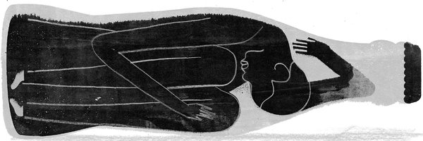
The Pepsi Challenge
Anyone with a nickel, black or white, could now drink the cocaine-infused beverage.
Middle-class whites worried that soft drinks were contributing to what they saw as exploding cocaine use among African-Americans. Southern newspapers reported that “negro cocaine fiends” were raping white women, the police powerless to stop them. By 1903, Coke had bowed to white fears (and a wave of anti-narcotics legislation), removing the cocaine and adding more sugar and caffeine.
Coke did not market to African Americans in the 1920s and 30s and Pepsi filled the vacuum, creating a cheaper, sweeter cola and marketing directly to African Americans. The campaign was so successful that many Americans began using a racial epithet to describe Pepsi.
By 1950, fearing a backlash by white consumers, Pepsi had killed the program, but the image of Coke and Pepsi as “white” and “black” drinks lingered.
Coke quietly began marketing to African Americans and supporting African American organizations. Today, both companies aggressively target African Americans – one of the soft drink industry’s largest demographic markets (nonwhites drink more soda than whites).

Slide 24
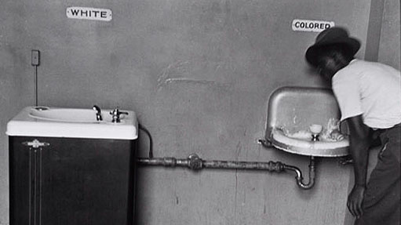
Supreme Court After Plessy
In the years after Plessy, the Court applied the precedent to sustain segregation that did not purport to be “separate but equal” as well as a number of other instances of racial discrimination:
Cumming v. Richmond County Board of Education (1899)—the Court refused to interfere with a county school system that provided high school education for whites but not African-Americans.
Berea College v. Kentucky (1908)—the Court sustained a statute requiring private colleges to exclude African-Americans.
Newberry v. United States (1921)—the Court concluded that party primary elections were private affairs, unknown to the framers and therefore beyond the reach of the Constitution. The decision constitutionalized the “white primary” in the one-party Democratic South.
Gong Lum v. Rice (1927)—the Court affirmed the right of Mississippi to segregate Chinese-Americans from public schools set up for whites.

Slide 25
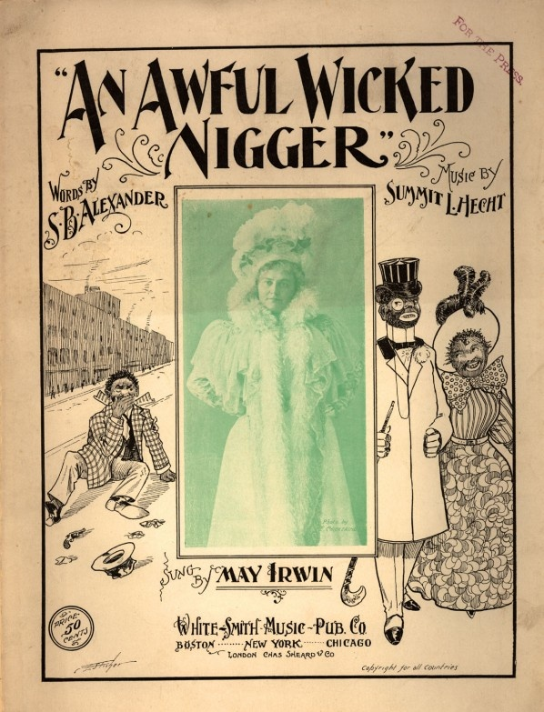
Conclusion
While the Gilded Age was a prosperous era for American capitalists, African Americans suffered as their hopes for equality born from emancipation and reconstruction failed to materialize.
Despite the passage of the post-Civil War Amendments, the Supreme Court constitutionalized racial discrimination and oppression through Plessy and similar cases.
The Civil Rights movement of the 20th century waged a campaign to realize the promise of the post-Civil War Amendments and the backlash of white rage that was the inevitable result.
While legal segregation was outlawed in 1954, racial segregation and racial inequality persisted as white rage moved to its third stage of development: modern-day black codes in the form of criminal justice policy and practice that has resulted in mass incarceration for African Americans. One in three African American males born today can expect to go to prison in his lifetime.

Slide 26
Bibliography
Amar, Akhil, America’s Constitution: A Biography (Random House, 2005).
Anderson, Carol. 2014. “Ferguson Isn’t About Black Rage Against Cops. It’s White Rage Against Progress.” Washington Post, August 29.
Christian, Garna L. 1995. Black Soldiers in Jim Crow Texas, 1899-1917. College Station: Texas A&M University Press.
Einhorn, Robin L., American Taxation, American Slavery (University of Chicago Press, 2008).
Farrow, Anne, Joel Lang, and Jenifer Frank. 2005. Complicity: How the North Promoted, Prolonged, and Profited From Slavery . New York: Ballantine Books.
Finkelman, Paul, Slavery and the Founders: Race and Liberty in the Age of Jefferson (M.E. Sharpe, 1996).
Foner, Eric. 2015. “When the South Wasn’t a Fan of States’ Rights: The strange, often forgotten, history of the Fugitive Slave Law of 1850.” Politico, January 23.
Graber, Mark, Dred Scott and the Problem of Constitutional Evil (Cambridge University Press, 2008).
Hale, Grace Elizabeth. 2013. “When Jim Crow Drank Coke.” New York Times, January 28.
Harper, Peter Allan. 2013. “How Slave Labor Made New York,” The Root, February 5.
Hirshman, Linda. 2015. “To resist a Trump presidency, ask: ‘What would the abolitionists do?’” Washington Post, November 18.
James, Rawn, Jr. 2014. The Double V: How Wars, Protest, and Harry Truman Desegregated America’s Military. New York: Bloomsbury Press.
Patton, Stacey. 2014. “In America, Black Children Don’t Get to Be Children.” Washington Post, November 26.
Richards, Leonard, L., The Slave Power: The Free North and Southern Domination, 1780-1860 (Louisiana State University Press, 2000).
Smith, Gene Allen. 2013. The Slaves’ Gamble: Choosing Sides in the War of 1812. New York: Palgrave Macmillan.
Van Cleve, George William, A Slaveholders’ Union: Slavery, Politics, and the Constitution in the Early American Republic (University of Chicago Press, 2010).
Waldstreicher, David, Slavery’s Constitution: From Revolution to Ratification (Hill and Wang, 2009).

