Slide 1
Student Advisory Safety Committee (SASC)
Presentation to SASC Members
3/20/17

Slide 2

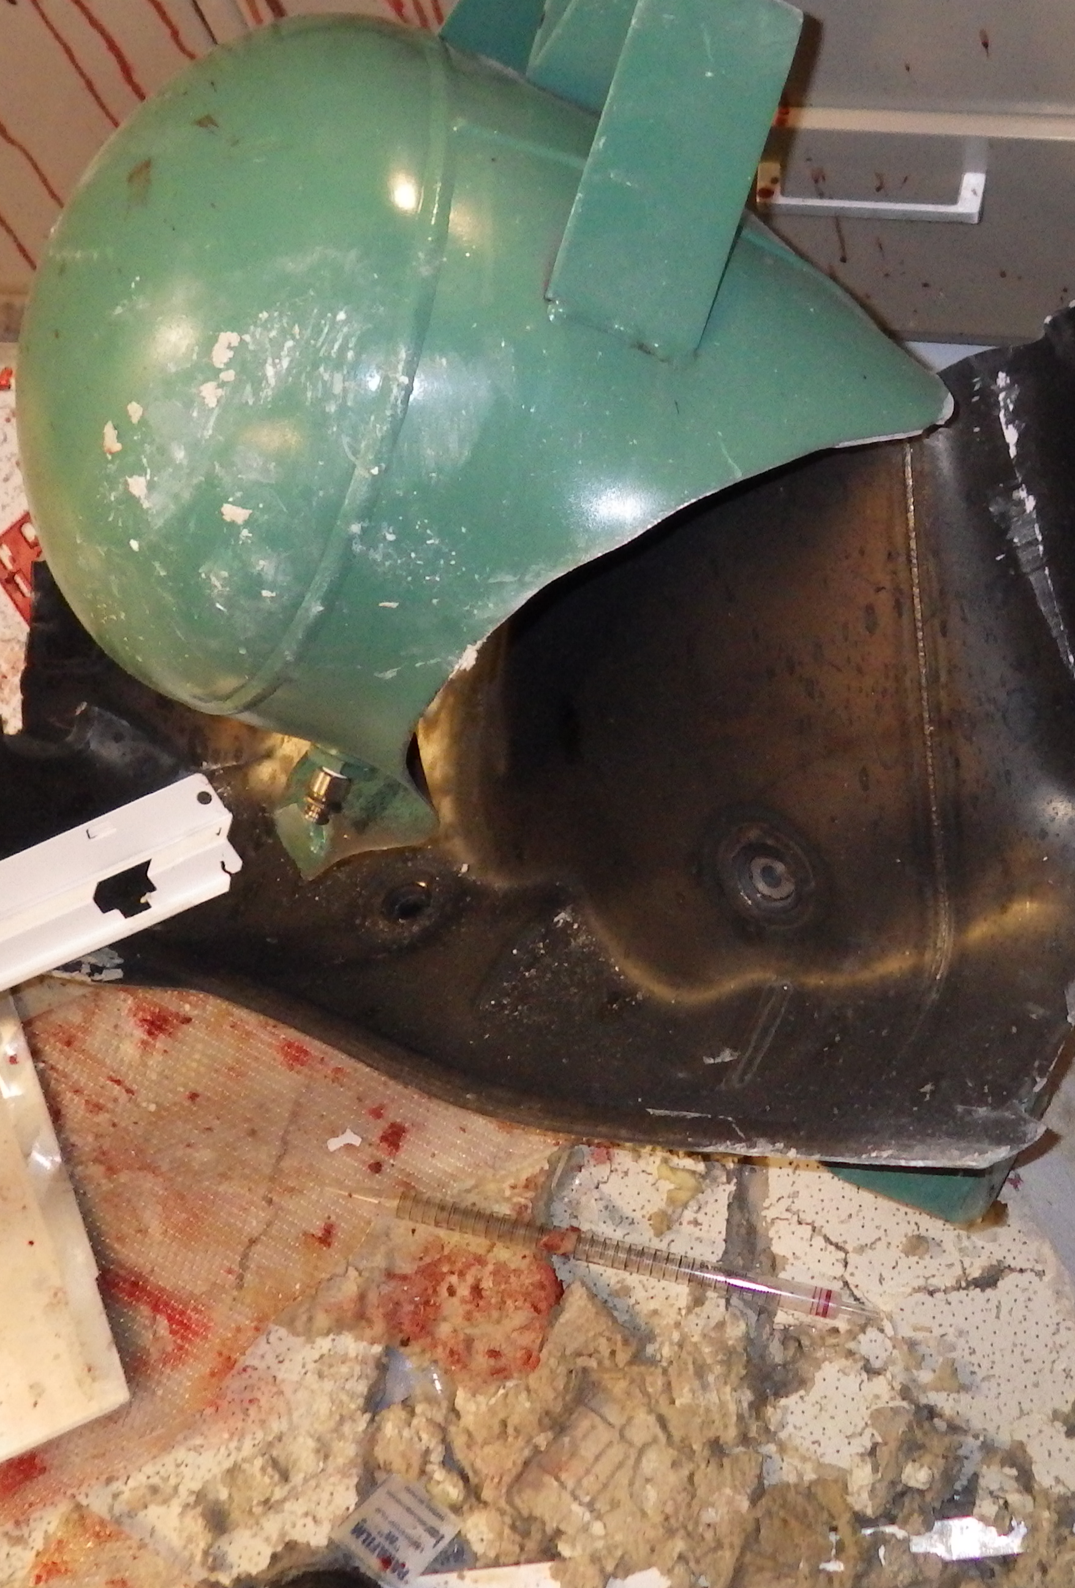
Why are we here?
Prevent incidents such as the explosion at the University of Hawaii
The only graduate student safety committee on campus
Abide by ACS recommendation for laboratory safety
“Beginning 2017 all ACS publications will require experimental details to address and emphasize any unexpected, new, and/or significant hazards or risks associated with the reported work.”
Solicit safety related ideas from YOU
Most of all keep everyone in the department SAFE ☺

Slide 3
Objectives
Improve laboratory safety culture around the department
Help reduce severity/frequency of EHS violations
Encourage student involvement in SASC and SASC related activities
Promote accountability for laboratory safety practices by graduate students
Improve undergraduate students understanding of safety hazards
“Safety is everyone’s responsibility”

Slide 4
Initiatives
Address safety concerns throughout the research presented for defenses, research updates, etc.
01
Prevent wearing lab coats in bathrooms and meeting rooms where food is consumed
02
Spring cleaning of laboratory and lab coats
03
Address safety concerns throughout all labs
04

Slide 5
Plan for this semester
Develop mission statement and finalize structure of SASC
Put together presentation for the fall 2017 semester
Track observations from previous safety audit
Host Bruce Stockmeier April 24th
Chem 690 presentation

Slide 6
SASC Participation
Participate in one event per semester to maintain member status
Annual Shower Testing
Safety moments for undergraduate labs
Invite a speaker
Coordinate a training event
Nominations for safety award
  National Academic Research Safety Award
UNIV 600 Participation
Departmental safety newsletter (1-2 per semester?)

Slide 7
Organization and Rankings
Advisors: Andy Small, Michele Crase, and Jim Gable
Two co-chairs
Treasurer
Communications Administrator
Undergraduate Laboratory Administrator(?)
Research Laboratory Administrator(?)
Each of the above SASC Executive Board members also oversees one event or initiative each semester (in addition to participating in one)

Slide 8
Responsibilities of Members
Co-Chairs (2)
  Responsibilities:
    Direct meetings and presentations
    Encourage Training/Participation
    Maintain safety bulletin board
Treasurer
  Responsibilities:
    Seek Funding for various events
    Coordinate safety award
Communications Administrator
  Responsibilities:
    Meeting moments
    O365
Research Laboratory Administrator(?)
  Responsibilities:
Undergraduate Laboratory Administrator(?)
  Responsibilities:
General Members/ All Members
  Responsibilities:
    Participate in one event

Slide 9
Two Example Safety Moments
Presented at beginning of undergraduate lab classes (perhaps presented by SASC or Chemistry Club members)
Presented at beginning of divisional seminars (?)
Generally 1-3 slides long, 60-90 second presentation

Slide 10


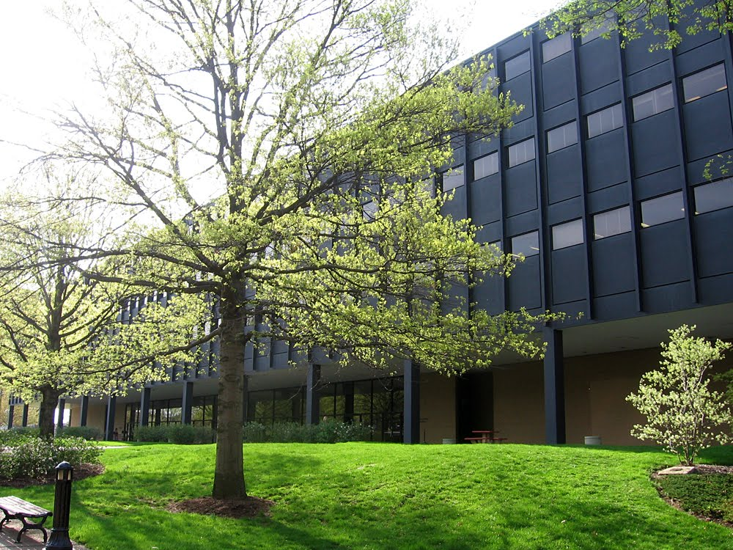





When NOT to wear PPE
Outside
Bathrooms
Offices/ non-lab spaces
When using mobile phones
When using a “gloves off” keyboard
www.jst.umn.edu

Slide 11
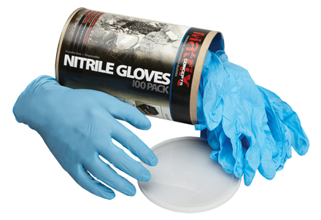
Nitrile Gloves

Slide 12
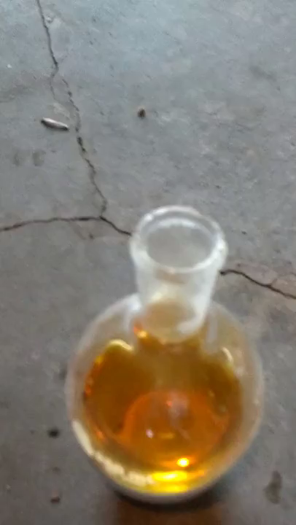
Nitrile Gloves VS Fuming Nitric Acid

Slide 13
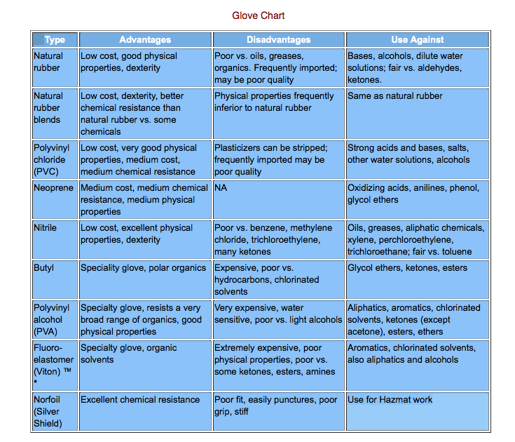
Glove Selection Chart

Slide 14
UNIV 600 Course Development Information
By: Dr. Gary Baker and Michele Crase

Slide 15
Everyone go around room and state a safety concern you witnessed OR a safety initiative you would like to see implemented

