Slide 1


Science Teacher Licensure
http://www.educationnews.org/wp-content/uploads/2014/01/science_teacher.jpg
Paul Fix, Assistant Director,
Secondary Science Educator Licensure

Slide 2
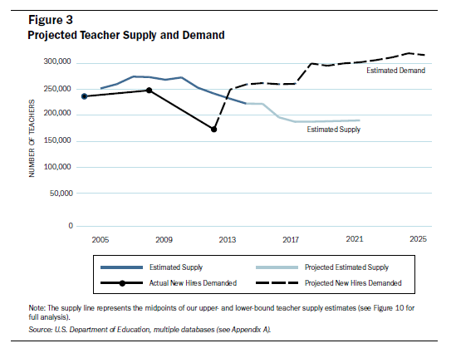
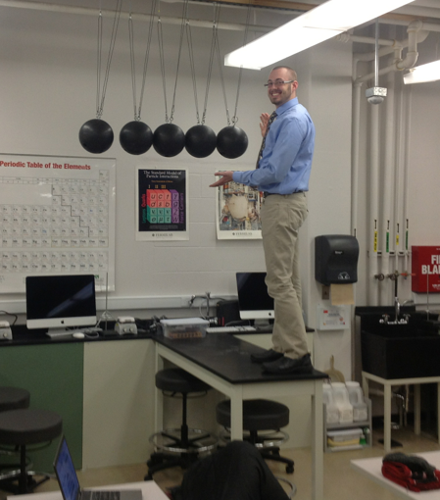
Why Teach High School Science?
Highly rewarding career
Share your love and knowledge of science
Creative and innovative career
Pay and benefits
Remember that amazing teacher you had? That could be YOU!
Nationwide teacher shortages

Slide 3

Would I make a great teacher?
Passionate and knowledgeable about subject
Energized by working with other people/kids
Creative and innovative
Articulate and strong communicators
Patient and understanding
Great at multitasking
Diverse background/experiences

Slide 4
What is the program like?
4 semester program of 8-12 credits/sem.
Cohorts start fall semester start only
Clinical experience every semester
Min. GPA 2.5 in science/math courses
Licensure areas:
  Biology
  Chemistry
  Earth and Space Science
  Environmental Science
  Physics
  Earn IL secondary teaching license concurrently with your B.S. degree

Slide 5
For More Information
Paul Fix
Assist. Director
Secondary Science Educator Licensure
Faraday 326
Office hours: Tu 1-3, Th 8:30-11
753-6819
pfix@niu.edu
www.niu.edu/elss
  Application period is Jan 1st to March 1st 2018.

