Slide 1
A Critical Review of Social-Emotional Progress Monitoring Tools
Second Year, School Psychology Cohort
Northern Illinois University, School Psychology Graduate Program

Slide 2
Goals for Today
Brief Introduction to Progress Monitoring
Dr. Michelle Demaray
Review of six strategies to progress monitor
  Records Data (e.g., SWIS)
  Direct Behavior Ratings
  Devereux Student Strengths Assessment (DESSA) Mini
  Social Emotional Assets and Resilience Scales- Short Forms (SEARS-SF)
  Behavior Intervention Monitoring Assessment System (BIMAS)
  Behavior Assessment System for Children, 2nd Edition Progress Monitor
  AIMSWEB Behavior (utilizing the BESS and SSIS)
Question and Answer Time
Notes:
Why are you here today?

Slide 3
Why Focus on Progress Monitoring
Social-Emotional Behavior?
3
.8% of students are in special education for Emotional Disturbance/Behavior Disorder
20% of students have mental health issues that need attention and many are not getting services (Doll & Cummings, 2008)
Students faced with many stressors, for example, academic frustration, negative relationships with adults and peers, teasing, bullying, gangs, etc. (Osher et al., 2008).
40-60% of students are chronically disengaged (Byrk & Schneider, 2002; Furrer & Skinner, 2003; Kelm & Connell, 2004)
Notes:
3

Slide 4
Why Focus on Progress Monitoring
Social-Emotional Behavior?
4
Students with significant social-emotional and behavioral needs drop out at a rate twice that of other students
Children with better social-emotional and behavioral skills do better academically
Children’s academic and social competencies influence each other (Minke, 2008)
  When you improve children’s social competence you also make it more likely that they will improve academically
Notes:
4

Slide 5
Why Screen and Monitor for Behavior?
Prevention and Intervention Works!
5
Programs that developed students’ skills and promoted positive school climates demonstrated improved interpersonal relationships, improved academic achievement, and reductions in problem behaviors (e.g., truancy, substance use, violence) among students (Catalono et al., 2002).
Primary prevention programs in school settings can enhance interpersonal competencies and prevent externalizing and internalizing problems (Durlak & Wells, 1997).
Kathleen Minke, 2008; Greenberg et al., 2003
Notes:
5

Slide 6
Creating Successful Schools
6
Requires both academic supports and development and provision of social-emotional supports (Osher et al., 2008)
  Need to screen for behavioral and social-emotional concerns
  Use these data to provide necessary behavioral and social-emotional supports universally and for individual students
  Need to MONITOR PROGRESS
    Best practices and sometimes the law!
Notes:
6

Slide 7
What is Progress Monitoring?
Scientifically-based practice used for assessing child progress and thus, intervention effectiveness
Allows for documentation of progress and gives us the ability to adjust the intervention to meet intervention goals
Provides data on intervention effectiveness that can be provided to a wide audience (administrators, parents, researchers, funders)
Part of the Response to Intervention (RTI) Framework
Notes:
National Center on Student Progress Monitoring

Slide 8
Multiple Tiers Implemented Through Progress
Monitoring and Formative Evaluation (Sugai, Horner, & Gresham, 2002)
Academic Systems
Intensive, Individual Interventions
Individual and Small Groups
Intense, Prolonged Intervention
5-10%
Targeted Group Interventions
Some students (at-risk)
Standard protocol reading
interventions
10-15%
Universal Interventions
Effective Academic In-
struction
80-85%
8
Notes:
8

Slide 9
Multiple Tiers Implemented Through Progress
Monitoring and Formative Evaluation (Sugai, Horner, & Gresham, 2002)
Academic Systems
Behavioral Systems
Intensive, Individual Interventions
Individual and Small Groups
Intense, Prolonged Intervention
Intensive, Individual Interventions
Individual and Small Groups
Intense, Prolonged Interventions
5-10%
5-10%
10-15%
Targeted Group Interventions
Some students (at-risk)
Standard protocol reading
interventions
10-15%
Targeted Small Group or Individual
Interventions
Some students (at-risk)
Targeted Individual Behavior
Interventions
Universal Interventions
Effective Academic In-
struction
80-85%
80-85%
Universal Interventions
School-wide positive
Behavior
Effective classroom and
Behavior management
9
Notes:
9

Slide 10
Is Progress Monitoring more Difficult with Social Behavior?
Yes!
Why?
  Broad, heterogenous construct
  Less availability of well-developed tools
  Need to customize tools
  Make sure there is fidelity to implementation of intervention

Slide 11
Assessment within the
Three-Tier Model
Screening
Diagnostic Assessment for Intervention Planning
Progress Monitoring
Outcome Evaluation for Accountability and Program Evaluation
Evaluating fidelity of intervention

Slide 12
Assessment within the
Three-Tier Model
Screening
Diagnostic Assessment for Intervention Planning
Progress Monitoring
Outcome Evaluation for Accountability and Program Evaluation
Evaluating fidelity of intervention

Slide 13
Progress Monitoring..
Measures should occur on a regular, frequent basis
Should be brief and easy to administer
Should be sensitive to the intervention after relatively short periods of time
Should provide information that is readily understandable to a range of individuals (administrators, parents, etc)
Should allow for monitoring progress of individual children, and groups of children
Should be part of a system for collecting and utilizing progress monitoring data

Slide 14
Considerations in Choosing a Progress Monitoring Tool
Child’s developmental Level and Behavior
Ease of use
Cost considerations
Provisions for reporting and interpreting results
Generalizability

Slide 15
Reviews - Today
Six strategies to monitor progress:
  Direct Behavior Ratings
  Records Data (e.g., SWIS)
  Devereux Student Strengths Assessment (DESSA) Mini
  Behavior Intervention Monitoring Assessment System (BIMAS)
  Behavior Assessment System for Children, 2nd Edition Progress Monitor
  AIMSWEB Behavior (utilizing the BESS and SSIS)S)
Content of Reviews:
  Overview and Description
  Materials
  Procedures
  Evidence for Psychometric Support
  Advantages and Disadvantages

Slide 16
Records Data
Melissa Terry

Slide 17
Description
Operational Definition: Any data that is already accessible in the school that can be used to progress monitor school-wide or individual behaviors
Records data (sometimes called permanent products) can include*:
  attendance and absences
  office discipline referrals (ODRs)
  suspension rates
  homework completion rates
  behavioral data collected as part of an existing behavior plan
  (*Riley-Tillman, Kalberer, Chafouleas, 2005)

Slide 18
Description
Behaviors Monitored: externalizing behaviors
Format: data can be drawn from the school’s existing data collection system
Ranges from a simple spreadsheet to more complex online data collection systems
  Teachers: grade books, homework completion, behavior plans
  Support staff: ODRs, attendance
  Administrators: suspensions, school-wide screening

Slide 19


Population
Everyone!
Can be collected across all ages, grades and educational needs

Slide 20
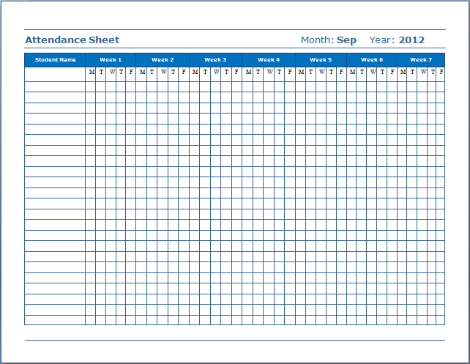
Materials
Cost: FREE! (or at least very cheap)
Standard programs available on PCs and Macs

Slide 21

Materials
Data collection programs are available for purchase
  Ex: School Wide Information System (SWIS) (May, et al, 2000)
Web-based software system that aids in organizing and reporting school records data
$250 per school per year
School must meet certain readiness standards as assessed by a SWIS facilitator

Slide 22
SWIS
Uses office referral and attendance data to generate individual, classroom, or school-wide reports
According to www.swis.org, SWIS is primarily used to track:
  Number of office discipline referrals per month
  Type of problem behaviors leading to office referrals
  Locations of problem behavior events
  Problem behavior events by time of day
  Students contributing to office discipline referrals
Bottom line: Primarily designed for school-wide screening

Slide 23
Procedures
Data are already collected by teachers and school support personnel
Data should be accessible to all teachers and school personnel who need to review the information
  Requires a secure network or online system
Data is processed and analyzed per the progress monitoring plan
  Ex: Graph of homework completion rates distributed to appropriate personnel on a bi-weekly basis
  Ex: Principal generates quarterly ODR reports to monitor school-wide progress in response to a Tier 1 PBIS intervention

Slide 24
Sample Case #1
Timmy
  1st grader
  Poor social interactions with peers
  Results in angry outbursts 5-10 times per day
  No behavior plan data
Would records data be useful for monitoring Timmy’s progress?

Slide 25


Sample Case #1
Timmy
  1st grader
  Poor social interactions with peers
  Results in angry outbursts 5-10 times per day
  No behavior plan data
Would records data be useful for monitoring Timmy’s progress?

Slide 26
Sample Case #2
Mary
  9th grader
  Struggles with organization, managing a locker
  Results in tardiness to class
Would records data be useful for monitoring Mary’s progress?

Slide 27

Sample Case #2
Mary
  9th grader
  Struggles with organization, managing a locker
  Results in tardiness to class
Would records data be useful for monitoring Mary’s progress?

Slide 28
Evidence of Psychometric Support
No known standardization samples or tests of reliability and validity for records data
Reliability is only as good as the accuracy and consistency of the person entering the data
Validity of ODRs as an indicator of problem behaviors?
  Yes. Moderate convergent and discriminant validity for two sources of ODR data (teacher report & SWIS) with behavior ratings (TOCA) (Pas, Bradshaw, & Mitchell, 2011)
  No. Poor reliability unless there is a systematic plan, a clear operational definition of behaviors, and procedures implemented with fidelity (Kalberg, Lane & Menzies, 2010)

Slide 29
Disadvantages
  Does not capture qualitative information about antecedents, consequences, duration, or intensity of a behavior
  Does not track complex or internalizing behaviors
  Is not flexible, difficult to customize or adapt for some behaviors
  No student involvement in monitoring their own behavior
  Data can be easily skewed by inconsistent collection

Slide 30
Advantages
  Simplicity, ease of use, and ease of access
  Requires no new systems or training
  Low cost and low intrusiveness in the daily classroom setting
  Provides both individual and school-wide data
  Provides objective data for high-stakes decisions about performance and academic placements
  Records data is a good first option for progress monitoring straight-forward, externalizing behaviors. It will not be adequate for every case, but can provide a simple, cheap means by which to track some behaviors.

Slide 31
References
Kalberg, J. R., Lane, K. L., & Menzies, H. M. (2010). Using systematic screening procedures to identify students who are nonresponsive to primary prevention efforts: Integrating academic and behavioral measures. Education and Treatment of Children, 33(4), 561-584.
May, S., Ard, W., III, Todd, A. W., Horner, R. H., Glasgow, A., Sugai, G., et al. (2000). School-Wide Information System (SWIS). University of Oregon, Educational and Community Supports.
Pas, E. T., Bradshaw, C. P., & Mitchell, M. M. (2011). Examining the validity of office discipline referrals as an indicator of student behavior problems. Psychology in the Schools, 48(6), 541-555.
Riley-Tillman, T. C., Kalberer, S. M., & Chafouleas, S. M. (2005). Selecting the right tool for the job: A review of behavior monitoring tools used to assess student response to intervention. California School Psychologist, 10, 81-91.

Slide 32
Direct Behavior Rating
By Megan Leino

Slide 33
Overview
Direct Behavior Ratings were originally developed to capture the benefits of two other assessment methods: direct observation and rating scales
  Direct observation: repeated measurement and flexibility
  Rating scales: efficiency
Notes:
As an assessment method, DBRs were developed to capture the benefits of two other assessment methods: direct observation and rating scales (Chafouleas, Riley-Tilman, & Christ, 2009). Direct observation allows for repeated measurement and also flexibility in that many different types of behavior can be measured in many different ways. However, it is not always an efficient method as it takes time and resources to conduct a direct observation of student behavior, especially if there are many students who need to be monitored. Thus, this method has been combined with the rating scale method to increase efficiency. Rating scales are typically used as an indirect method to inquire about behaviors in the past, but when combined with direct observation, the DBR method assesses behavior directly after a specified observation period.

Slide 34
Overview
Two different methods of Direct Behavior Ratings:
  Daily Behavior Report Cards (DBRC)
    Usually completed by the teacher
    Best for externalizing behaviors
  Self-Monitoring
    Completed by the student
    Best for internalizing behaviors, but can also be used for externalizing behaviors as well
Both methods can be used within a problem-solving framework as an assessment tool, but also as an intervention as well.
Notes:
There are two different methods of Daily Behavior Ratings which will be discussed in this section. The first is Daily Behavior Report Cards in which the teacher rates the students behavior after a specified time period. This is best for externalizing behaviors because you can see these behaviors and they can be operationally defined. Examples: Time on task, hyperactive behaviors, homework completion, aggressive, social, or verbal behaviors. Harder for internalizing behaviors because the teacher would then have to speculate about the inner feelings of the student.
The other method for a Daily Behavior Rating is Self-monitoring in which the student rates their own behavior, also at specified time periods throughout the day. The student can report on their own inner feelings this way, with no other judgm ents made by others. These can include feelings of depression or anxiety. Students are also capable of reporting on their external behaviors as well. When reporting external behaviors, it is common for both the teacher and the student to monitor the student’s external behaviors to ensure consistency when first beginning as a sort of training for the student to learn to accurately monitor their own behaviors. To provide motivation for the student to be an accurate rater, the student can be rewarded for having their rating match the teacher’s rating of their behavior, either exactly or within 1 point of the teacher’s rating. Once consistency has been achieved, the student can monitor their own behavior alone with random consistency checks made by the teacher.

Slide 35
Population
Direct Behavior Ratings can be used with any population for both DBRC and for self-monitoring
  Pre-K through high school
Specifically, self-monitoring can also be used with many different types of populations as well, from elementary school through high school (Gardner & Cole, 1988)
Notes:
DBRC: Teachers can rate externalizing behaviors for students of any age.
Self-monitoring: Students of any age can also be trained to self-monitor, as has been suggested previously. It seems intuitive that older children would be more likely to suited to self-monitoring; however the evidence suggests that self-monitoring can be effective with a range of students in elementary and secondary school programs: students with intellectual disabilities, learning disorders, behavior disorders, hyperactivity, psychiatric impairment, and juvenile offenders

Slide 36
Description
A single item scale (DBR-SIS) or multi-item scale (DBR-MIS) rating of a student’s behavior or feelings after a specified period of time
There are 3 essential components which must be present for a DBR to be effective:
  The rating must occur in close proximity to the observation period
  The rater must have first-hand experience in observing the student’s behaviors
  The rater should not interfere with the student’s behavior during the observation period in order to collect data about the student’s functioning
Notes:
There are three components that must be present for a DBRC to be effective: 1) the rating must occur in close proximity to the observation period, 2) the rater must have first-hand experience in observing the student’s behavior(s), and 3) the rater should not interfere with the student’s behavior during the observation period in order to collect data about the students functioning (Chafouleas, et al., 2009)
The meat- what it is
Format of what it is
“web based questionnaire”
What do we receive from this?
What does this show us?
What do we get out of it?

Slide 37
Materials
Direct Behavior Ratings can be created by the teacher or school psychologist or they can generated online at
  http://www.interventioncentral.org/tools/behavior-report-card-generator
Takes very little time to create the materials
No cost!

Slide 38
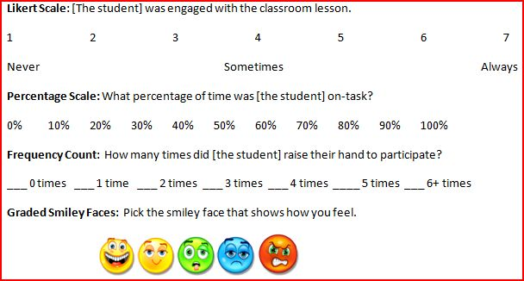
Procedures
Operationalize the behavior to be monitored.
Collect baseline data.
Choose a goal statement.
Decide how to rate the behavior. Examples:
Notes:
I am going to go over the procedures for creating a Direct Behavior Rating and then the recommendations for what has been found to yield the most accurate ratings.
It is best to choose only between 1-3 behaviors to monitor because the ratings will be more accurate for the teacher and/or the student to record.
What is the student’s goal?
How do you want to collect the data? Likert scale, Frequency counts, graded smiley faces can be adapted for children.
Recommendations:
A literature review supported that the scales should have at least 6 gradients and that 10 gradients was optimal when analyzing data and assessing growth.
More scales are not necessarily more reliable or accurate than a single rating. In other words, more scales might not give more information.
There are mixed findings as to whether more or less anchors are recommended. One study found that anchors at each or most regions on the scale are best (Christ, Tillman, Chaouflas, 2009), however, another study recommended few anchors (Chafouleas, 2011).
The observation period can be flexibly determined (single period, half day, the end of the day).
If possible, the wording of the statements should be positive in nature.

Slide 39
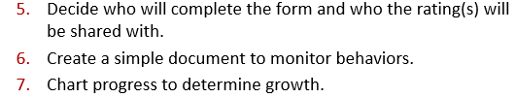
Procedures
Notes:
4. DBRC – the teacher
Self-monitoring – the student
Who will the child share the card with? SHARE DATA WITH SCHOOL PSYCHOLOGIST
DBRC – the Usually the teacher, but can be used with parents as well. Usually the child will bring the DBRC home to share with their parents and the teacher will share the data with the school psychologist
5. Can create your own or use an online generator
6. Is the student making progress with the intervention? Does the intervention need to be modified?

Slide 40
Recommendations for Scale Development
(Chafouleas, 2011)
    The scales should have at least 6 gradients, but 10 gradients is optimal when analyzing data and assessing growth.
    There are mixed findings as to whether more or less anchors are recommended.
    If possible, the wording of the scales should be positive in nature.
    More scales are not necessarily more reliable or accurate than a single scale.
    The observation period can be flexibly determined.
Notes:
1.
2. One study found that anchors at each or most regions on the scale are best (Christ, Tillman, Chaouflas, 2009), however, another review recommended few anchors (Chafouleas, 2011).
3. In other words, more scales might not give more information
4. After class period, half day, end of the day. But the sooner, the better.
5. Positive – stayed in seat vs got out of seat frequently

Slide 41
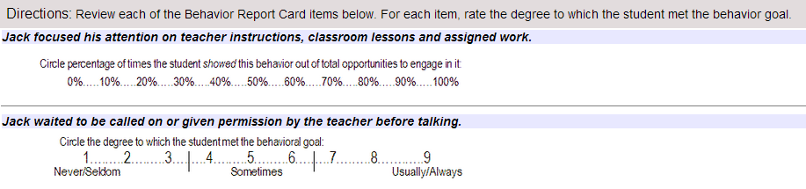
Sample Case Study - DBRC
Jack is a 6th grade boy who displays problems, primarily in math class.
  Specifically, he has problems with paying attention and blurting out inappropriately.
His teacher and the school psychologist have decided to monitor these two behaviors with an DBRC generated online. His teacher will rate these two behaviors after each math period and chart his progress.

Slide 42
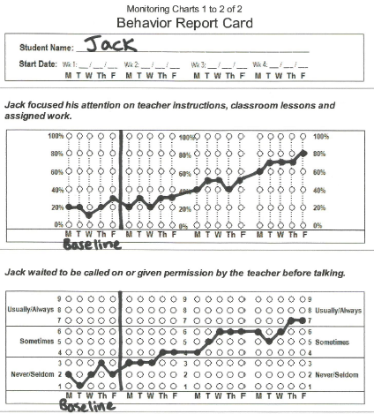

Slide 43
Evidence of Psychometric Support - DBRC
Psychometric support is limited
Data collected on DBRC are correlated with direct observation data (Briesch & Volpe, 2007) and are likely to result in similar intervention decisions when data is displayed graphically (Christ, Riley-Tillman, & Chafouleas, 2009)
Inter-rater reliability estimated at .67-.87 (Chafouleas, Riley-Tillman, & McDougal, 2002)

Slide 44
Evidence of Psychometric Support - Self-Monitoring
Generally, child-observer levels have been shown to be at least .80 across a range of children and adolescents (Garnder & Cole, 1988).
Self-monitors are more likely to be accurate when they know that their data will be checked by an external observer (Lipinski & Nelson, 1974).
  Aware of being observed by an external rater: .86 agreement
  Not aware of being observed by an external rater: .52 agreement
Accuracy has been shown to be higher with explicit training (Mahoney, 1977).
Notes:
Self-monitoring psychometric support can be measured by the agreement between the child and the external observer, ie, the accuracy of the child is reporting their own behaviors.
Explicit definitions of target behaviors and examples should be provided
Self-monitoring instructions should be made explicit
Appropriate use of self-recording instruments should be modeled by the therapist
The definitions of target behaviors and self-monitoring instructions should be repeated by the client
Several occurrences of the target behavior as defined within the assessment should be monitored by the client

Slide 45
Disadvantages
Subject to rater bias
Training
Compile/graph data on your own
Usually completed daily (but not always)
DBRC
  Not effective with internalizing behaviors
  More difficult to use if the teacher must monitor multiple students on different types of behaviors
Self-Monitoring
  Need external observer to check agreement for externalizing behaviors
Notes:
Subject to rater bias – can try to minimize with training and external checks

Slide 46
Advantages
Inexpensive
Efficient
Customizable
High acceptability among teachers
Provides feedback to students at regular intervals and helps get students involved in the process
Supports the home-school connection
Can serve as a PM tool and also an intervention

Slide 47
References
Briesch, A. M., & Volpe, R. J. (2007). Important considerations in the selection of progress monitoring measures for classroom behaviors. School Psychology Forum, 1, 59-74.
Chafouleas, S. M. (2011). Direct Behavior Rating: A review of the issues and research in its development. Education and Treatment of Children, 34(4), 575-591.
Chafouleas, S. M., Riley-Tillman, T., McDougal, J. L. (2002). Good, bad, or in-between: How does the daily behavior report card rate? Psychology in the Schools, 39(2), 157-169.
Christ, T. J., Riley-Tillman, T.C., & Chafouleas, S.M. (2009). Foundation for the development and use of Direct Behavior Rating (DBR) to assess and evaluate student behavior. Assessment for Effective Intervention, 34, 201-213.
Gardner, W. I. & Cole, C. L. (1988). Self-monitoring procedures. In E. S. Shapiro & T. R. Kratochwill (Eds.), Behavioral Assessment in Schools: Conceptual Foundations and Practical Applications. New York: Guilford Press.
Lipinski, D., & Nelson, R. (1974). Problems in the use of naturalistic observation as a means of behavioral assessment. Behavior Therapy, 5(3), 341-351.
Mahoney, M. J. (1977). Publication prejudices: An experimental study of confirmatory bias in the peer review system. Cognitive Therapy and Research, 1(2), 161-175.

Slide 48
DESSA-Mini
Devereux Student Strengths Assessment
Jack A. Naglieri, Paul A. LeBuffe, and Valerie B. Shapiro
By Erin Mars
Notes:
A strength based s-e pm tool

Slide 49
Overview
Strength-Based
Devereux Center for Resilient Children (DCRC, 1996)
  Devereux Student Strengths Assessment (DESSA, 2009) Assessment
    Devereux Student Strengths Assessment- Mini (DESSA-mini, 2011) Universal Screening and Progress Monitoring
Notes:
All of the assessments, resources and services are focused on building the soc-emo strengths and skills of all children. The items query positive behaviors (gets along with others) rather than maladaptive ones (annoys others)
DCRC began by focusing on promotion of socio-emo competence and resilience, and believes in promoting this competence in all children.
The DESSA Comprehensive System is comprised of two innovative rating scales designed to screen, assess, guide intervention planning, monitor progress, and evaluate outcomes related to social-emotional competence and resilience of students grades K-8.
TO support the goal of competence, the DESSA-mini was developed as an efficient, practical, and scientifically sound system for assessing and monitoring the social-emo strengths of all children.
-the DESSA-mini can be used to screen children, the DESSA can give a more complete profile of a child’s social-emotional competence, resilience, and academic success, then the mini can be used again to PM

Slide 50
Description
Measures predictors of social-emotional competencies
  Protective factors
  Provides a way to quantify social-emotional competence
Eight Items, Four Parallel Forms
  5 Point Likert Scale “Never” to “Very Frequently”
  Lower scores mean more At-Risk
  Social-Emotional Total Score (SET)
  Users
Notes:
DESSA mini in a technically sound, user-friendly screening and PM tool developed to efficiently measure and track a subset of predictors of future mental, emo, bhvrl disorders to make early intervention more possible.
social emo competencies serve as protective factors, either moderating or buffering the impact of risk or adversity, leading to more positive outcomes for children than otherwise expected. Protective factors help children be more resilient
The scores on the DESSA-mini as a screener help adults determine which children may need s-e instruction, provides a method for monitoring the prgoress of children receiving preventative interventions, evaluates outcomes at the child and program level.
The 8 item form is brief enough to screen many children. The authors suggest perhaps assessing those children w/ low scores on the full DESSA.
there are 4 parallel forms designed to be used on a universal basis to determine need for s-e intervention. These 4 forms all measure the same constructs, which is a unique feature. All forms are stndrdzd, norm-referenced. For each item, the rater indicates how often the student engaged in the behavior in the past four weeks.
Yields a single score, the social emotional total score, providing an indication of the strength of the childs s-e competence based on a comparison to national norms. Can be used to compare ratings btw teachers or across time. Raters can be administrators, counselors, teachers, psychologists, sch psychs, SWs

Slide 51
Description
DESSA-mini constructed by selecting items from the DESSA
DESSA and DESSA-mini each produce 8 scales
  Personal Responsibility
  Optimistic Thinking
  Goal-Directed Behavior
  Social Awareness
  Decision Making
  Relationship Skills
  Self-Awareness
  Self-Management
Notes:
Literature rvw, noted bhvrl predictors of s-e competence in children. Examined other strength based assessments (DECA), condensed items

Slide 52
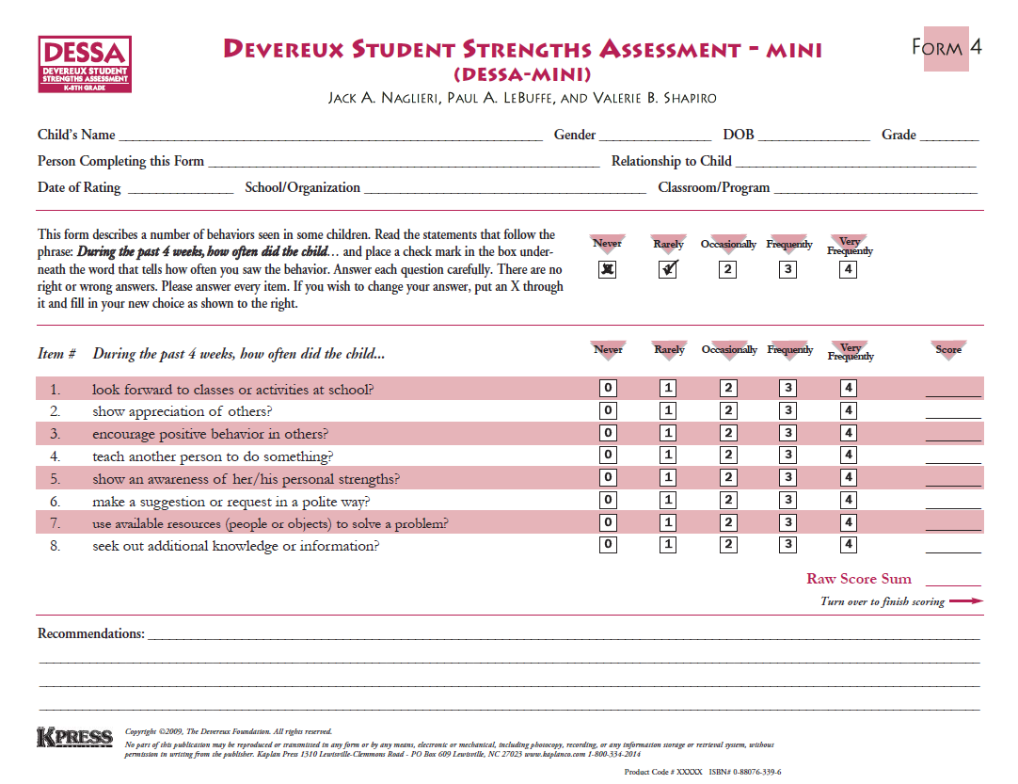
Description
Notes:
Here is an image of Form 4
You can see how brief the PM scale is.

Slide 53
Description
Sample Questions:
  Accept responsibility for what he/she did?
  Do something nice for somebody?
  Speak about positive things?
  Pay attention?
  Contribute to group efforts?
  Perform the steps of a task in order?
  Show care when doing a project or school work?
  Follow the advice of a trusted adult?

Slide 54

Population
K- 8
Students at-risk or already exhibiting maladaptive social-emotional behaviors
Raters can be any school staff that interacts with the child
Notes:
Ages 4-14. screen all kids, PM those at risk

Slide 55
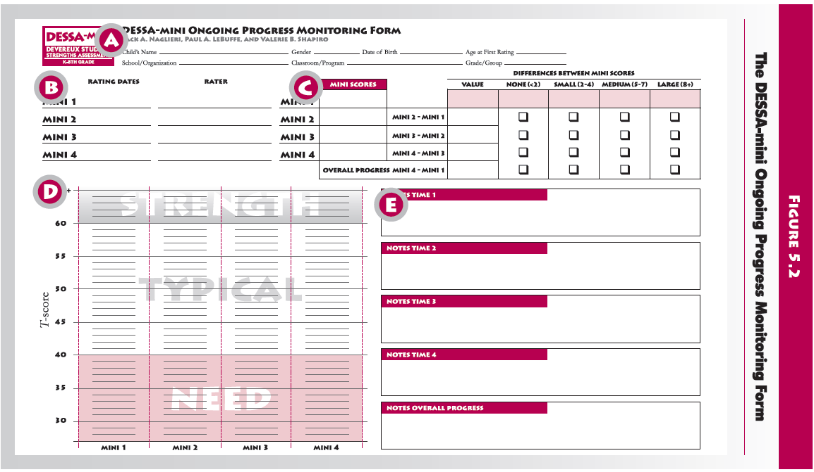
Procedures
T scores
  Mean of 50, SD of 10
  > 60 = Strength, 41-59 Typical, < 40 Need for Instruction
Notes:
Admin DESSA-mini to each child to screen, give those children who score in the need category the dessa to get a full picture of what specific interventions are needed, then ongoing progress monitoring
When you fill out the PM rating scale once a weekA. Child’s name B. rating dates C. DESSA-mini score D. graph E. Notes on each administration

Slide 56
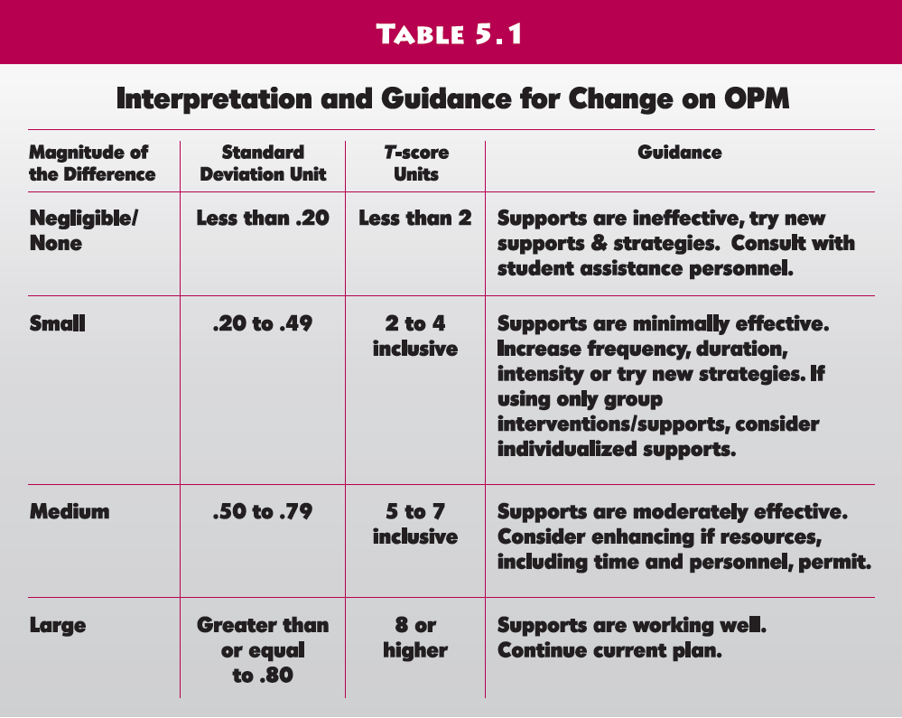
Response to Instruction
Notes:
Here is a chart of the child’s response to instruction and recommendations for support and intervention

Slide 57
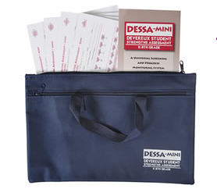
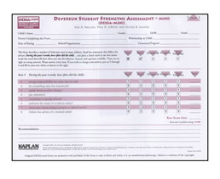
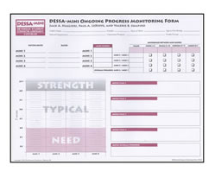
Materials
DESSA-mini Kit - $104.95
DESSA-mini form (1-4) pad - $7.95
DESSA-mini Progress Monitoring Form $7.95
Notes:
The DESSA-mini Kit includes a the DESSA-mini manual, 25 copies of each of the four DESSA-mini forms(Form One, Form Two, Form Three, Form Four), 25 copies of the Ongoing Progress Monitoring Form, and a nylon carrying case.
You can also purchase extra pads of each of the 4 forms of the DESSA-mini, which come with 25 forms for $7.95. Each pad is 7.95
The PM forms are sold in a pad of 25 forms for $7.95 as well.
PICTURES ☺
Visuals
Mention Cost or how to purchase

Slide 58
Evidence of Psychometric Support
DESSA-mini Normative group
  Standardization Sample for Teacher Raters (N=1,249)
  Region: NE = 24.6%; South = 39.1%; Midwest = 22.3%; West = 14.0%
  50.8% Males, 49.2% Females
  Grades Kindergarten through 8
Notes:
The standardization sample was very large and representative of the US population, reflects the diversity of children today.
1249 for DESSA mini and 2500 for DESSA

Slide 59
Evidence of Psychometric Support
Internal Reliability | Excellent
Test-Retest Reliabilty | Excellent
Inter-Rater Reliability | Excellent
Alternate Form Reliability | Excellent
Convergent/Discriminant Validity | Excellent

Slide 60
Disadvantages
Not customizable
Does not measure maladaptive behaviors
Copyrighted material
Subject to rater bias
No self reports
Not able to upload data to a software system
Not very sensitive to change/ global
Brief
Notes:
The forms are not customizable, the questions are fixed for each child.
All material is copyrighted, and thus may not be reproduced or transmitted in any form without written permission from the Devereux Foundation.
Like most rating scales, subject to rater bias.
There are no self reports, which may be helpful to compare to teacher ratings
The system does not have a software, but you could always graph the data using Microsoft Excel.
Due to the brevity of questions on the DESSA mini that are so global, the measure may not be very sensitive to change over time
The brevity of the system is a disadvantage because it does not measure as much as other systems

Slide 61
Advantages
Focuses on positive
Little interference on part of the observer
Quick, easy, and efficient
Can be used as a screener
Aligned with a three-tiered model
Excellent reliability and validity
Notes:
The focus on positive is unique and a good thing for students and teachers to measure the good qualities in a student, instead of a focus on maladative behavior
Little interference on part of the observer- students are not aware they are being monitored
Takes 1-2 minutes per student! Excellent validity and reliability
Can be used as a screener, but you do not need to use it to screen the entire school.
Aligned with the 3 tiered model, shows you when students are “at-risk” or displaying a lack of s-e competencies.

Slide 62
References
Naglieri, J.A., LeBuffe, P.A., & Shapiro, V. (2011). DESSA-mini, Devereux Student Stregnths Assessment. Lewisville, NC.

Slide 63
Some Considerations for Setting Behavior and Social Emotional Goals
A very brief commercial break!
Christine Malecki
Northern Illinois University
cmalecki@niu.edu

Slide 64
Progress Monitoring Tools
Reliable and Valid!!
Simple and Time-Efficient
Provides a picture of performance over time
  COMPARES APPLES TO APPLES

Slide 65
General Outcomes Measures (GOMs)
GOMs are repeatedly sampling performance on the same task over time.
We typically think about GOMs in academic skills but similar principals apply for behavior when we are talking about long-term IEP goals…
We must measure in a way that allows for growth and flexibility across an entire year.
Shorter-term goals can be more “mastery monitoring goals” on a more discreet behavior.

Slide 66
Components of Goal Writing
Write the Goal
  Present Level of Performance
  Specify desired behavior
  Specify measurement conditions
  Specify criterion for success
  Check: Could you graph this goal?
Notes:
Specify Desired Behavior:
Use a replacement behavior.
Should be incompatible with the problem behavior.
Should pass the dead man’s test.
First consider trying to increase a desirable behavior . (e.g., work completion)
If trying to decrease a non-desired behavior makes more sense (e.g., decrease hitting), be sure to:
Make an extra effort to ensure implementation integrity.
Include the development of a replacement behavior in the plan.
Specify Measurement Conditions:
Include:
Time frame (e.g., 4 weeks)
Measurement material
Grade level (e.g., 3rd grade text)
Curriculum (e.g., Read Naturally probes)
Observation (e.g., time on task)
Setting (e.g., randomly selected passage, in Social Studies)
Specify Criterion for Success
Consider performance standard with which you developed your discrepancy statement.
Consider expected rate of progress (e.g, 2 words per week, 10% improvement of behavior per week).
Be realistic.
State final level of expected performance (e.g., 100 WRC, 85% on task).
Check: Could you graph this goal?
Is the behavior to be measured defined?
Are the measurement conditions clear?
Are the criterion for success designated?

Slide 67
Example:
In (number) weeks, when (condition) occurs, (learner) will (behavior) to a (criterion).
Example:
  In 32 weeks, when observed for 5 minutes during teacher-led math instruction (once every other week), Bradley will be on-task >75% of the time on three consecutive observations.
Nonexample:
  Bradley will increase his on-task behavior to at least 75%.

Slide 68
Evaluate:
Evaluating a well written goal statement:
Is the behavior to be measured defined?
Are the measurement conditions clear?
Are the criterion for success designated?
Can it be graphed?

Slide 69
Setting the Goal…
Based on a standard or expectation (no fighting is the standard, an acceptable rate of on-task behavior, etc.)
Based on norms (local or national)
Based on rates of improvement (is the goal realistic over time?)

Slide 70
Combining data
PLEP: Currently, Luke is using appropriate friendship skills as measured by his Daily Behavior Report Card (DBRC) rating an average of 3 on a 5 point scale and has an average of 6 Office Disciplinary Referrals each month.
Over 32 weeks, as measured by average DBRC ratings (see attached DBRC), Luke will use appropriate friendship skills as evidenced by an average of 4.5 on his DBRC and will have an average of less than 2 Office Disciplinary Referrals each month.

Slide 71
SEARS-SF
Social Emotional Assets and Resilience Scales-Short Forms
By Kenneth W. Merrell
Rike Frangos

Slide 72
Strength-Based Approach
Why opt for a strength-based measure?
  Less stigmatizing than pathology-based measures
  Captures increase in competencies and skills
  Can build on strengths during intervention planning
Measures social-emotional behavior that is important for student success across settings and tasks, including:
  Friendship skills, empathy, interpersonal skills, social support, problem solving, emotional competence, social maturity, self-concept, self-management, social independence, cognitive strategies, and resilience
Notes:
Self-perceptions of wellbeing and freedom of pathology relate to student outcomes (Suldo & Shafer, 2008)

Slide 73
Description
Social-Emotional progress monitoring scales for 5-18 year-olds
Multiple informants across settings
Items stated positively (e.g., “I think before I act.”)
Higher scores indicate higher competence
Scores map onto three-tier RtI model
  Tier 1 = strong skills
  Tier 2=some skill deficits
  Tier 3= significant deficits

Slide 74

Description
12-item Short Forms were derived from the original 37-41 item full scales for progress monitoring purposes
12 items chosen based on item-total score correlations and collective representativeness of the total construct
    Items on each scale reflect unique informant contexts
    SEARS-Child Short Form (3rd -6th grade)
    SEARS-Adolescent Short Form (7th -12th grade)
    SEARS-Teacher Short Form
    SEARS-Parent Short Form
    *Available in Spanish

Slide 75

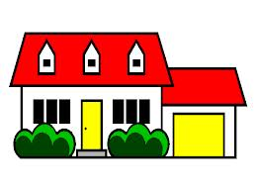
Population
School-aged children and adolescents (5-18)
Appropriate for school and home settings
Children with variety of clinical problems or at high risk for developing disorders, including
  High functioning autism, conduct disorder, ADHD, & internalizing disorder

Slide 76


Materials
Published by PAR:
  www.parinc.com
Item | Price
SEARS Manual | $56 or $48 for e-manual
Sears-Child-SF (pkg/25) | $21
Sears-Adolescent-SF (pkg/25) | $21
Sears-Parent-SF (pkg/25) | $21
Sears-Teacher-SF (pkg/25) | $21
Sears-Parent Spanish-SF (pkg/25) | $21
Sears Scoring Program (Sears-SP) - Optional | $145 w/CD or $125 for download

Slide 77
Procedures
ADMINISTRATION
Can administer individually or in group
Takes 1-2 minutes
Informant answers 12 questions using a four point scale ranging from 0=never to 3=always
SCORING
Short forms can be scored directly on the answer sheet
Sum answers to get raw score
Find the corresponding T-score, percentile, confidence interval and tier in appendix of manual; record on answer sheet
OR use optional scoring software

Slide 78
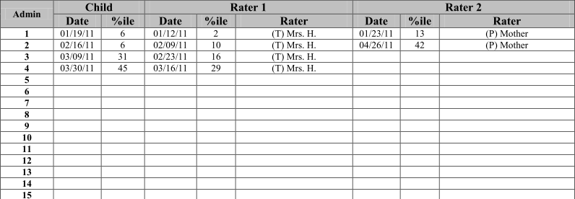
Procedures
GRAPHING
Option 1: Purchase Scoring Program (SEARS-SP)
  Includes Excel-like progress monitoring tables for multiple informants and time points and automatically graphs information
Option 2: Create tables and graphs with basic Excel skills
Example of a table in the SEARS-SP:

Slide 79
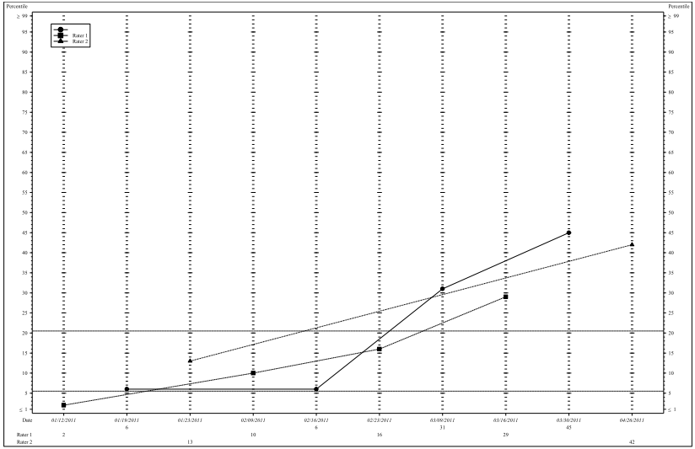
Procedures
Example of a summary graph in the SEARS-SP:
Child
Parent
Teacher

Slide 80
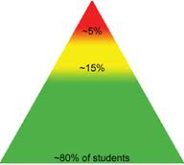
Procedures
INTERPRETATION
Higher T-scores & percentiles indicate higher functioning
Tiers
  Tier 1
    21st to 99th %ile (80% of normative sample)
  Tier 2
    6th to 20th %ile (15% of normative sample)
  Tier3
    Below 6th %ile (5 % of normative sample)

Slide 81
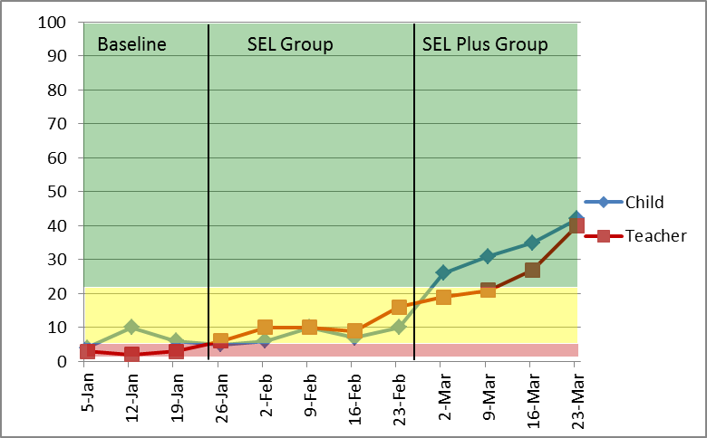
Sample Case
Mick is a fifth grade boy with deficits in social-emotional assets and resilience. His teacher referred Mick to a social-emotional learning intervention, which he attended for 5 weeks before switching into a more intensive intervention. His progress was tracked weekly with SEARS-Child and Teacher Short Forms and graphed in Excel:
Percentile

Slide 82
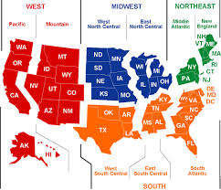
Psychometric Properties
NORMATIVE SAMPLES
Collected in 2009, representative of U.S. for age, gender, ethnicity, and geographic region (9 representative states)
Separate norms were collected for each informant
    SEARS-C (n=1,224)
    SEARS-A (n=1,727)
    SEARS-T (n=1,400)
    SEARS-P (n=1,204)

Slide 83
Psychometric Properties
***Reliability and validity information presented is based on the short forms
(short form psychometric properties are very similar to long forms)
Internal Reliability | Good - Excellent Alpha = .82-.93
Test-Retest Reliability | Adequate - Excellent At 2-week interval better for parents (.92) & teachers (.90) than self-report (.74-.84)
Short form w/full scale correlations | Excellent Ranged from .93-.98
Convergent/ Discriminant Validity | Adequate Short forms show same adequate relationships with other measures as the long forms

Slide 84
Disadvantages
Copyrighted forms can get pricey ($0.84 per form)
No subscales in short forms - 12 items may not be sensitive enough to change
Subject to rater bias
Does not measure maladaptive behaviors
Not customizable

Slide 85
Advantages
Fast (1-2 minutes)
Multi-informant options
Spanish parent form
Has optional scoring software
Direct link to RTI
Empirically based; strong psychometric properties
Can use accompanying long forms as screeners and outcome measures
Strengths-based (less stigmatizing, measures growth in competencies)

Slide 86
Reference
Merrell, K. W. (2011). Social Emotional Assets and Resilience
Scales – Professional Manual. Lutz, Florida: PAR Inc.

Slide 87
Behavior Intervention Monitoring Assessment System (BIMAS)
By James L. McDougal, Psy. D., Achilles N. Bardos, Ph.D., & Scott T. Meier, Ph.D.
Linda Huber, B.S.

Slide 88
Description
Behavioral Progress Monitoring System
Designed for use within a three-tiered RTI model
Screening and progress monitoring to assess changes in response to behavior intervention
BIMAS Standard & BIMAS Flex
Data Management System
  Online administration and scoring (paper and pencil available)
  Data analysis-graphing and reporting options

Slide 89
Description
BIMAS Standard
  screening device
  baseline data
Behavior concern scales (used to identify Risk)
  Conduct (9 items)
  Negative Affect (7 items)
  Cognitive/Attention (7 items)
Adaptive Scales (used to identify areas of strengths and improvement)
Social functioning (6 items)
Academic functioning (5 items)
BIMAS Flex
  progress monitoring
  specific targeted interventions

Slide 90
Population
School-aged children and adolescents (5-18)
Students ranging from no risk, at risk, and to chronic and intense behavioral and/or adaptive functioning difficulties
Students with Anxiety disorders, PTSD, ADHD, BiPolar Disorder, ODD, CD, Autism, etc.

Slide 91
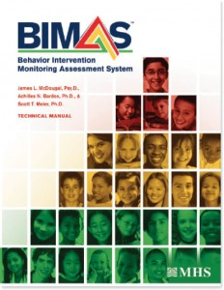

Materials
https://ecom.mhs.com/(S(nhzr0db0pvwgrqzkc3omlzaa))/inventory.aspx?gr=edu&prod=bimas&id=pricing&RptGrpID=bim
Name | Price
BIMAS Manual Paper | $99.00
BIMAS Annual Site License (Min. purchase of 25 Students/Clients) | $4.00
BIMAS Annual Site License Renewal (Min. purchase of 25 Students/Clients) | $4.00
Volume Discount: 1 to 9,999(minimum purchase 25) $4.00 | $4.00
10,000 to 39,999 $3.00 | $3.00
40,000+ | $2.00

Slide 92
Procedures
Intervention Planning
Progress monitoring (Tier 2 & Tier 3)
  6-10 weeks
  BIMAS Flex (tailored to the students specific behavioral/emotional or adaptive concerns)
Program Evaluation

Slide 93
Procedures
Progress Monitoring:
Choose and administer the BIMAS Flex items that are tailored to the student
Assign a particular user ID/file for the student
A link is emailed to the or student or the student directly logs on to the BIMAS website online with a user account
The questionnaire/scale is scored online automatically
Reports generated online

Slide 94
Procedures
Record Keeping:
Provides list of all students history
Includes student profile and assessment history
Can be set up with reminders for student follow up
Includes a notes section for general comments
Student information saved for any future administrations

Slide 95
Sample Case Study
Student: Nathan
Gender: Male
Age: 12
Date: September 3rd, 2012
Universal Screening scores were within the Low Risk range with the exception of the Behavior Concerns Scale-Conduct:
SR-Behavior Concerns Scale:
Scales | Score | Risk Level
Conduct | 75 | High Risk
Negative Affect | 59 | Low Risk
Cognitive/Attention | 55 | Low Risk

Slide 96
Sample Case Study
Teacher report : Confirms High Risk for Conduct
Progress monitoring choice: BIMAS Flex Teacher and Self Report, Behavior Concerns Scale with specific Conduct Items
Date intervention began: October 1, 2012
Progress monitoring: Once a week over 10 weeks
TR-Behavior Concerns Scale:
Scales | Score | Risk Level
Conduct | 78 | High Risk
Negative Affect | 59 | Low Risk
Cognitive/Attention | 58 | Low Risk

Slide 97
Nathan’s Case Study
Conduct Scale

Slide 98
Nathan’s Case Study
Behavior Concerns Scale

Slide 99
Psychometric Properties
Internal Reliability | Excellent
Test-Retest Reliability | Excellent
Inter-rater Reliability | Adequate-Excellent
Convergent/Discriminant Validity | Adequate

Slide 100
Disadvantages
Need access to computers (unless doing the paper and pencil)
If administering the paper and pencil you need to upload it for scoring (can’t hand score)
Unclear what interventions could be linked to the BIMAS

Slide 101
Advantages
Online data management system which makes it easy to manage large data sets
Can generate reports online
Time efficient (5-10 minutes)
Inexpensive
Can be customized for a behavior intervention goal
Direct link to RTI
Empirically based
Sensitive to change
The BIMAS is a screening and progress monitoring system for use within Response to Intervention that assesses adaptive functioning and behavioral difficulties.

Slide 102
References
McDougal, J. L., Bardos, A. N., & Meier, S. T. (2011). Behavior Intervention Monitoring Assessment System. New York: Multi-Health Systems Inc.
MHS (2012) BIMAS Behavior Intervention Monitoring Assessment System Retrieved December 15, 2012 from https://ecom.mhs.com/(S (o52nxwyh5cyydyyjh323miy2))/inventory.aspx? gr=edu&prod=bimas&id=pricing&RptGrpID=bim

Slide 103

BASCTM-2 Progress Monitor
(Behavior Assessment System for Children, Second Edition)
Authors: Cecil R. Reynolds, PhD &Randy Kamphaus, PhD
By: Sonia Nowakowska

Slide 104
Description
Part of the BASC-2 System
Reliable forms used to monitor the status of behavioral and emotional problems across multiple perspectives (teachers, parents, and children/adolescents) and environments (school, home)
Forms are targeted to evaluate specific problems
Forms are sensitive to change
Each form ranges from 15-20 items
  Never, Sometimes, Often, Always
Only a few minutes to complete, requiring a 4th grade reading level for self-report and 7th grade for parent report

Slide 105
Description
Forms can be repeated every 2-4 weeks
Normative Scores are provided
  T scores and percentiles
  Clinically Significant, At-risk, Average, Below Average
  Combined-Sex Norms or Separate-Sex Norms
Scores will indicate a change in behavior
Scores can indicate their extremeness as compared to the norms
Scores can indicate whether a child’s behavior and emotional functioning is within a normal or acceptable level

Slide 106
Population
Teachers, parents forms for preschool (ages 2-5) and child/adolescent (grades K-12)
Student forms for grades 3-12
Types of Problems:
Externalizing & ADHD Problems | Internalizing Problems | Social Withdrawal | Adaptive Skills
Aggression | Anxiety | Atypicality | Daily Living
Attention | Depression | Social Skills | Adaptability
Conduct | Somatization | Withdrawal | Functional Communication
Hyperactivity |  |  | Leadership
 |  |  | Social Skills
 |  |  | Study Skills

Slide 107
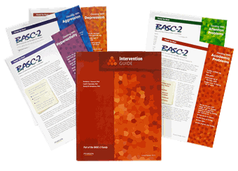
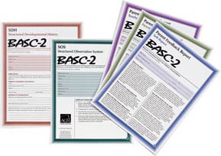
Materials
BASC-2 Progress Monitor- Starter Set $219
Or specific domains $147-168
BASC-2 Progress Monitor- ASSISTTM Software $230
BASC-2 Progress Monitor- Manual $83
Package of 25 Forms $34
Spanish Forms are Available
Notes:
$1.36 per form

Slide 108
Procedures
Select form that is targeted for improvement
Select raters
  Explain responses
  Provide a brief description
  Provide children with a quiet, controlled setting.
Check completed forms

Slide 109
Procedures
Establish a baseline to determine level of functioning prior to the start of the intervention program
Determine the Frequency of Testing
  Every 2 to 4 weeks
  Minimum of 3 data points (pre-, post-, and follow-up assessment)
6. Scoring Completed Teacher, Parent, and Student Forms.
  BASC-2 Progress Monitor ASSISTTM software or hand score
    Individual Reports, Multi-rater reports, Progress reports
  Each form produces a single score (Total Score), which provided an overall indication of the student’s overall level of functioning
  Transfer raw score to the Score Summary section to determine the T score and percentile associated with the raw score value

Slide 110
Sample Case Study
Wilbur, a 10-year-old student, was referred for his disruptive behaviors in the classroom and difficulty concentrating on classwork
BASC-2 (parent and teacher) indicated Wilbur’s scores of Hyperactivity and Attention problems fell within the clinically significant range when compared to same-sex peers
  Wilbur’s scores of Aggression and Conduct Problems were in the At-Risk range when compare to same-sex peers

Slide 111
Sample Case Study

Slide 112
Evidence of Psychometric Support
Standardization was conducted from August 2002 through May 2004
  More than 12,000 forms
  Collected from 177 cities in 40 states
  Children and adolescents from various settings
  Adequate representation of U.S. population
  Gender was evenly distributed

Slide 113
Evidence of Psychometric Support
Internal Reliability | Excellent
Test-Retest Reliability | Excellent
Inter-Rater Reliability | Adequate-Excellent (Preschool) Adequate-Excellent (Child/Adolescent)
Convergent/Discriminant Validity | Adequate-Excellent
*Validity were taken from the BASC-2, ASEBA Child Behavior Checklist, Conner’s Rating Scales, Behavior Rating of Executive Functioning, Vineland-II Forms, Children’s Depression Inventory, & Children’s Manifest Anxiety Scale

Slide 114
Disadvantages
Cost-
  $1.36 per rater form.
  3 time points with 3 raters will cost $12.24
  Software
Standardization sample is over 8 years old
Subject to rater bias
Not customizable within area

Slide 115
Advantages
Specific forms for specific areas of concern
Linked with BASC-2
Progress monitors negative and positive changes
Monitors child through multiple viewpoints and multiple environments
    Software compiles Individual Reports, Multi-rater reports, Progress reports
Both English and Spanish versions
BASC 2- Progress Monitor is an easy, efficient, and effective way to track and evaluate changes.

Slide 116
References
Reynolds, C. R. & Kamphaus, R. W. (2009). BASC-2 Behavioral and Emotional Screening System. Minneapolis, MN: NCS Pearson.

Slide 117
AIMSweb Behavior
Pearson Assessments
By Christina Piccirillo

Slide 118
Overview
AIMSweb behavior can be used as a universal screener or progress monitoring tool of student’s social-emotional needs
  Both schoolwide and individual level
Within Tiers 2 and 3, AIMSweb behavior can be used to target problems, provide strategies for improving student behaviors, and track students performance over time.
  Includes wide range of social-emotional and behavioral problems as well as options to customize progress monitoring tools based on school or individual student needs

Slide 119
Overview
Includes three primary components:
Screening/Benchmarking
Action Plan
Progress Monitoring

Slide 120
Overview
Includes three primary components:
Screening/Benchmarking
Action Plan
Progress Monitoring
Screening/Benchmarking- Conducted using one or more of the Behavioral and Emotional Screening System (BESS) Teacher and Student Forms and Social Skills Improvement System (SSIS) Performance Screening Guide Motivation and Prosocial Behavior screening tools to identify students at risk for or currently experiencing behavioral and/or social-emotional problems.
Notes:
Screening is one of the three componants, however, it will not be discussed in this presentation.
Screning and benchmarking requires users to complete an entire form of the BESS or SSIS screeners
-These screeners are not used in its entirety to progress monitor student behavior over time.
More information on these progress monitoring tools will be discussed in the Social-Emotional Screener showcase

Slide 121
Overview
Includes three primary components:
Screening/Benchmarking
Action Plan
Progress Monitoring
Action Plan- Users can select specific behaviors for remediation and monitoring. Effective intervention strategies are provided with instructions for implementation based on BASC-2 Classroom Intervention Guide and SSIS Intervention Guide

Slide 122
Overview
Includes three primary components:
Screening/Benchmarking
Action Plan
Progress Monitoring
Progress Monitoring- Users can create custom progress monitoring forms and generate reports to track performance over time and across multiple interventions.

Slide 123
Evidence of Psychometric Support
BESS
Internal Reliability | Excellent
Test-Retest Reliability | Excellent
Inter-rater Reliability | Excellent
Convergent/Discriminant Validity | Excellent
SSIS
Internal Reliability | N/A
Test-Retest Reliability | Adequate
Inter-rater Reliability | Adequate
Convergent/Discriminant Validity | Limited
*NOTE: Information about AIMSweb Behavior Screeners
(not customized progress monitoring tools)
Notes:
Psychometric support in the AIMSweb behavior manual focuses on the AIMSweb behavior screeners in reporting reliability and validity
These descriptions of psychmetric support may be less relevant when analyzing AIMSweb Behavior as a progress monitoring tool. When using AIMSweb Behavior and a progress monitoring tool, users select individual items or customize items based on school or individual student need. As a result, information on reliability and validity cannot be determined based on individualized progress monitoring forms since each form is customized for school or individual need.
However, information on reliability and validity of the BESS and SSIS social-emotional screeners are provided.
*Internal reliability is not available for the SSIS because each form contains only one item.

Slide 124
Description
Forms can include one or multiple items from the BESS or SSIS screeners
  BESS- internalizing problems, externalizing problems, school problems, and adaptive skills
    Related to BASC-2 Teacher and Student forms
  SSIS- criterion referenced rating scale assessing student’s prosocial behavior and motivation to learn
Focus on specific or related items identified as problematic
Customize rating forms to include items not assessed on BESS or SSIS to meet school or individual student needs (e.g., atypical behaviors)
  Maladaptive behavior
  Schoolwide expectations
  Prosocial behavior

Slide 125
Description
Progress monitoring forms can be computer or paper based.
Generates computer-based reports on student progress that can be accessed at any time

Slide 126
Description
  Reports Include:
  Graph of students progress (i.e., baseline data, goal, rate of improvement)
  Individual graphs of student behavior
    Setting specific (across multiple settings)
    Specific behaviors (multiple behaviors)
    Changes in interventions are noted (i.e., change lines are provided on graphs)
  Qualitative information
    Intervention implementation
    Atypical behavior
    Changes in interventions
  Information replacement behaviors (FBA)

Slide 127
Population
Progress monitoring at school-wide or individual level
Age Range:
  Teacher reports- Kindergarten to 12th grade
  Student report- 3rd to 12th grade
Monitors wide range of social-emotional and behavioral problems
  BESS- internalizing problems, externalizing problems, school problems and adaptive skills
  SSIS- prosocial behaviors and motivation to learn
  Progress monitoring tools can be customized to fit school or individual student needs

Slide 128
Materials
Costs
  Additional $1.00 per student per year for AIMSweb academic customers
  Additional $4.00 per student for new users
Forms can be paper-based or computer-based
Does not require local software installation
  Web-based access

Slide 129
Procedures
Identification of students using universal screening data, teacher/PST nomination, PBIS data, Office Discipline Referrals etc.
*Do not need to use screening/benchmarking
to use as a progress monitoring tool*
Notes:
This is an example of results from a BESS student form
This student fell within the YELLOW range or AT-RISK on the BESS, the student can be selected for intervention.
*While this image shows how AIMSweb Behavior screeners can be utilized to select students for interventions, users DO NOT need to use the universal screeners to identify students in need of a S/E or Beh intervention and progress monitoring

Slide 130
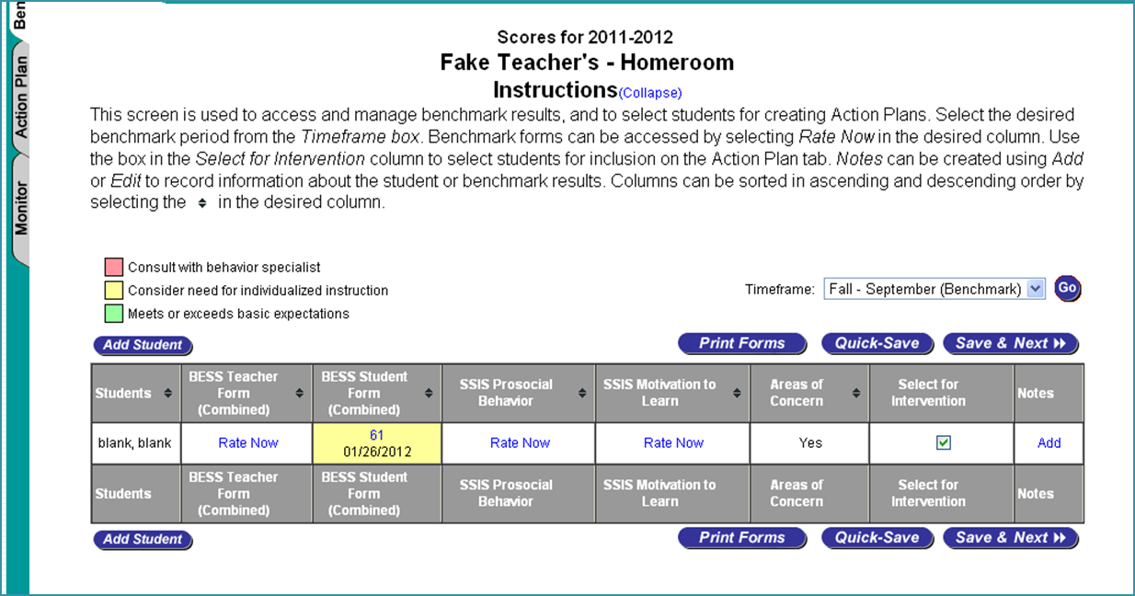
Procedures
Identification
Notes:
This is an example of results from a BESS student form
This student fell within the YELLOW range or AT-RISK on the BESS, the student can be selected for intervention.
*While this image shows how AIMSweb Behavior screeners can be utilized to select students for interventions, users DO NOT need to use the universal screeners to identify students in need of a S/E or Beh intervention and progress monitoring

Slide 131
Procedures
Action Plan is created for students who require social-emotional or behavioral interventions
Notes:
Step 1- two basic options provided (these can be customized for each individual student and school)
Step 2- Three basic types of rating scales
Rating scales- used when descriptive ratings of behaviors are desired
Frequency Forms- chosen when count of number of times a behavior occurs is desired
i.e., number of times student turns in homework)
Interval form- chosen when a percentage of time a behavior occurs is desired
Percent of time a student remains on task during a class period

Slide 132
Procedures
Action Plan
Step 1- Select Action Plan Type (two options)
  Develop an individualized behavior plan based on assessment and referral data
  Choose behaviors consistent with school-wide expectation program (e.g., PBIS)
Notes:
Step 1- two basic options provided (these can be customized for each individual student and school)
Step 2- Three basic types of rating scales
Rating scales- used when descriptive ratings of behaviors are desired
Frequency Forms- chosen when count of number of times a behavior occurs is desired
i.e., number of times student turns in homework)
Interval form- chosen when a percentage of time a behavior occurs is desired
Percent of time a student remains on task during a class period

Slide 133
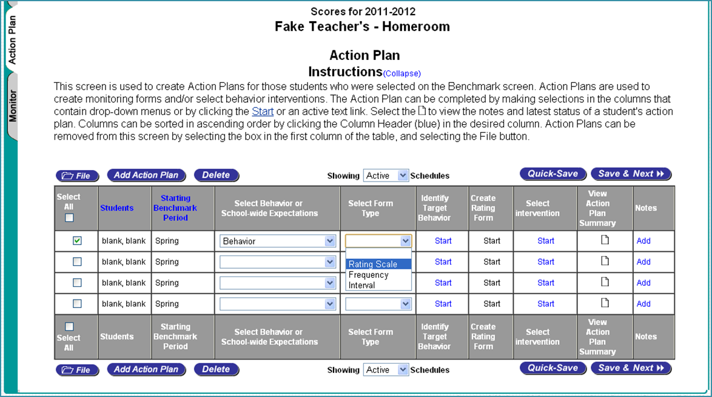
Procedures
Step 1
Notes:
This example will show how to use AIMSweb Behavior using rating scales as progress monitoring tools.

Slide 134
Procedures
Action Plan
Step 2- Select Rating Form Type (three basic types)
  Rating Scale form
  Frequency Form
  Interval Form
Notes:
Step 1- two basic options provided (these can be customized for each individual student and school)
Step 2- Three basic types of rating scales
Rating scales- used when descriptive ratings of behaviors are desired
Frequency Forms- chosen when count of number of times a behavior occurs is desired
i.e., number of times student turns in homework)
Interval form- chosen when a percentage of time a behavior occurs is desired
Percent of time a student remains on task during a class period

Slide 135
Procedures
Step 2
Notes:
This example will show how to use AIMSweb Behavior using rating scales as progress monitoring tools.

Slide 136
Procedures
Action Plan
Step 3- Identify Target Behaviors
  Options presented are based on screening results
  AIMSweb provides user with common student behaviors
    Behaviors rated as most problematic across one or more screenings are presented first
    Common classroom behaviors (both positive and negative) are presented for creating progress monitoring forms
    User can identify additional customized behaviors to be monitored
Notes:
Step 3- used to determine the specific student behaviors that will be included on the PM rating form

Slide 137
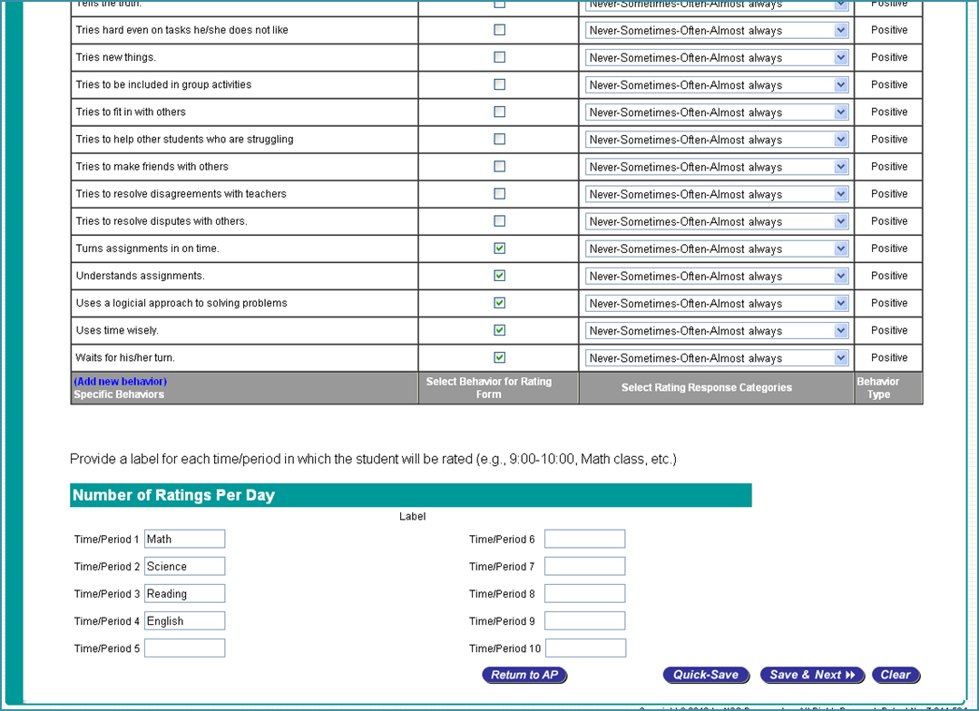
Procedures
Step 3
Notes:
Note- This also shows if the behavior that is being monitored is “positive” or “Negative”

Slide 138
Procedures
Individualized Behavior Plan Rating Scale Response Options
Schoolwide Expectation Rating Scale Response Options

Slide 139
Procedures
Action Plan
Step 4- Create Rating Form
  Finalize progress monitoring form
    Users can select name for form (helpful if using multiple forms)
  Determine a schedule for completion
  Optional information
    Behavioral goal
    Targeted replacement behaviors
    An initial target behavior goal
Notes:
Step 4- finalize information that will appear on progress monitoring form
Finalize form(USER CAN PREVIEW FORM)
Determine schedule for completion- (i.e., form will be completed twice a day for 4 weeks)
A tion Plan Summary report-
can add comments throughout course of action plan
Summary report includes notes that have been entered during benchmark or action plan stages
Provides summary of benchmark, intervention, and progress monitoring results

Slide 140
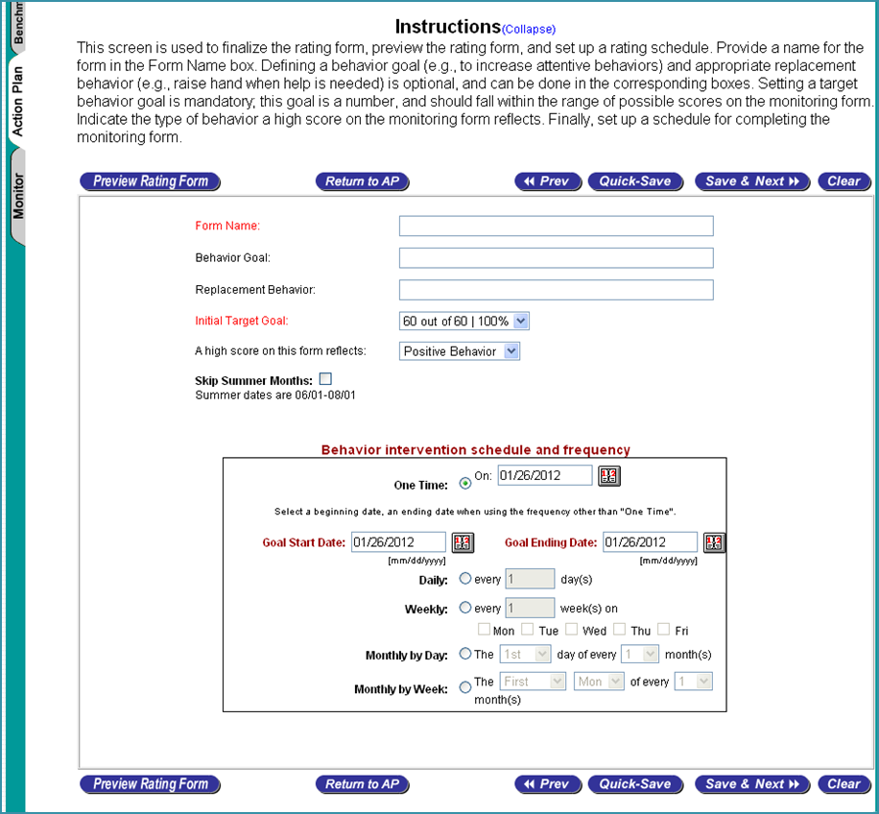
Procedures

Slide 141
Procedures
Action Plan
Step 5- Select an Intervention (optional)
  Evidence based interventions from BASC-2 Classroom Intervention Guide and SSIS Intervention Guide
  Broad Categories include:
    Disruptive behavior problems
    School/learning problems,
    Social problems
    Emotional/confidence problems
Notes:
Lesson plans- classroom or small group use
Curriculum for teaching skill
Skill Steps
Individual or small group
Tell-Show-Do-Practice model for teaching social skills
Strategies- individual or small group use
Step-by-step approach and illistrations for reducing problem behaviors

Slide 142
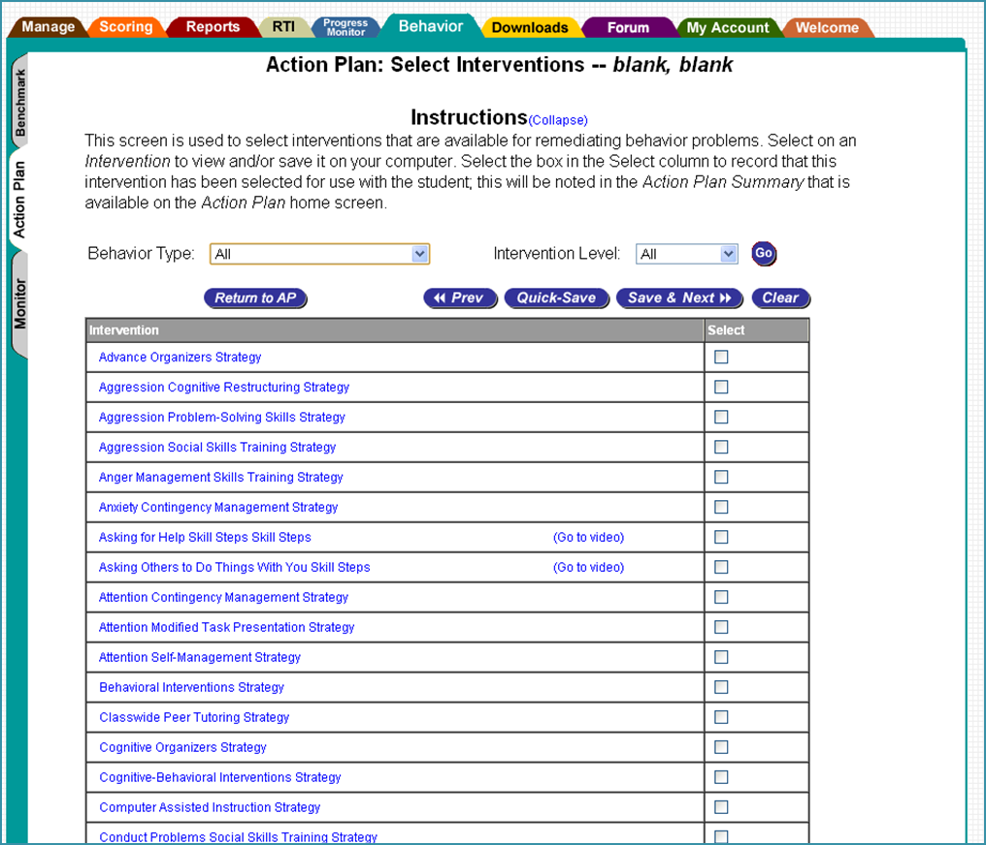
Procedures

Slide 143
Procedures
Action Plan
Step 5- Select an Intervention (optional)
  Universal screenings can be used to match interventions to student’s individual needs problems
  Includes materials for monitoring intervention implementation and FBA
  Record intervention strategies
    School-wide expectation programs
    Individualized interventions
Notes:
Lesson plans- classroom or small group use
Curriculum for teaching skill
Skill Steps
Individual or small group
Tell-Show-Do-Practice model for teaching social skills
Strategies- individual or small group use
Step-by-step approach and illistrations for reducing problem behaviors

Slide 144
Procedures
Progress Monitoring- view and manage students’ progress monitoring schedules and reports

Slide 145
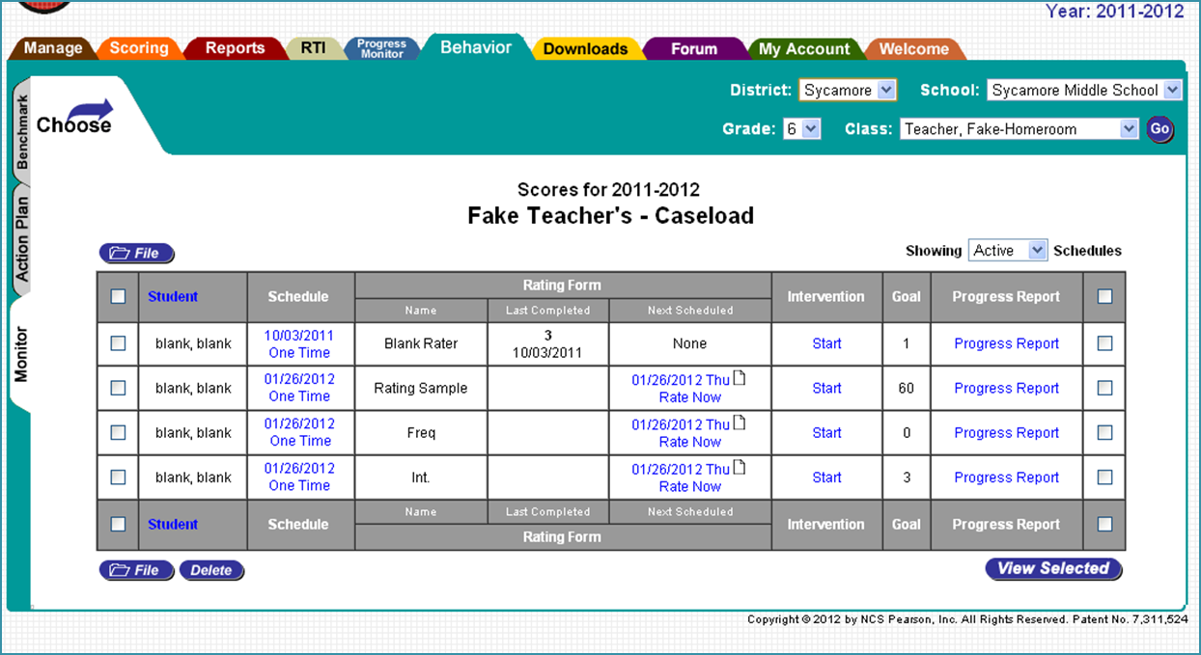
Procedures
Progress Monitoring
Presents table of progress monitoring information for individual students
  Defined in Action plan
  Can be modified by user at any time

Slide 146
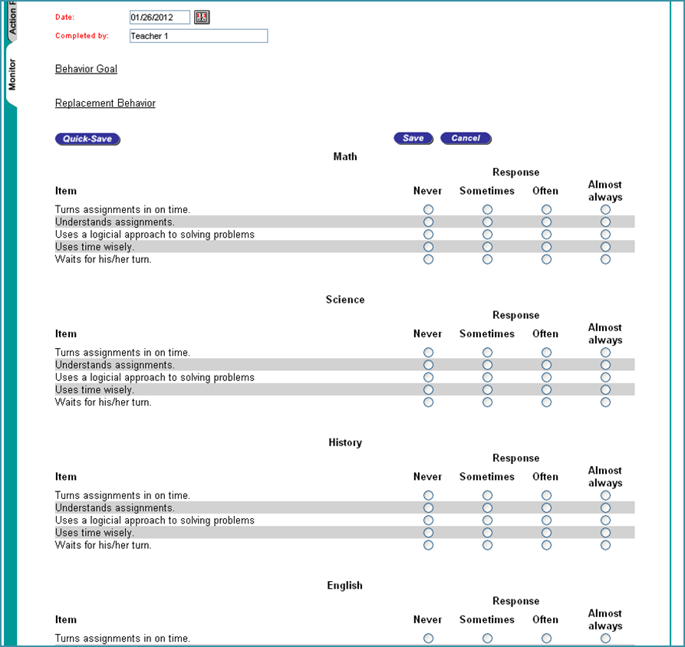
Procedures

Slide 147
Procedures
Progress Monitoring
Progress monitoring table includes the name of the progress monitoring form, the score obtained on previous rating (if applicable), and the date of next rating to be completed

Slide 148
Procedures
Progress Monitoring
Provides information on behavioral goal

Slide 149
Procedures
Progress Monitoring
Intervention information is available and can be updated at any time
  Users can include notes regarding intervention implementation

Slide 150
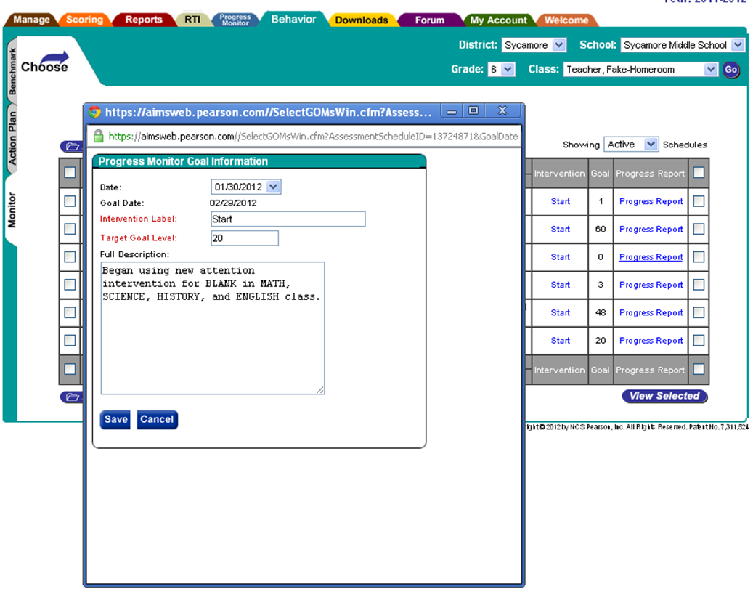
Procedures

Slide 151
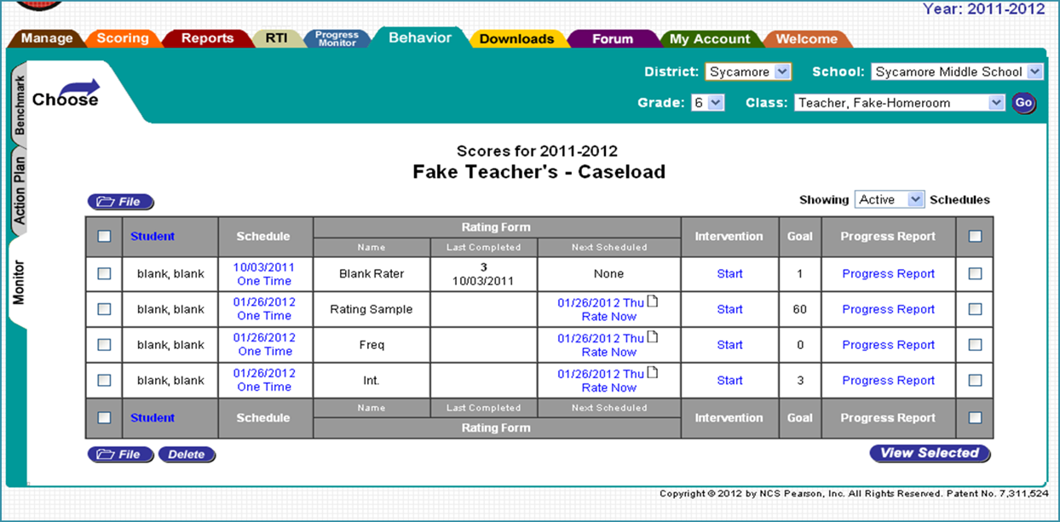
Procedures
Progress Monitoring
Users can create progress monitoring reports that provide information on student progress over time.

Slide 152
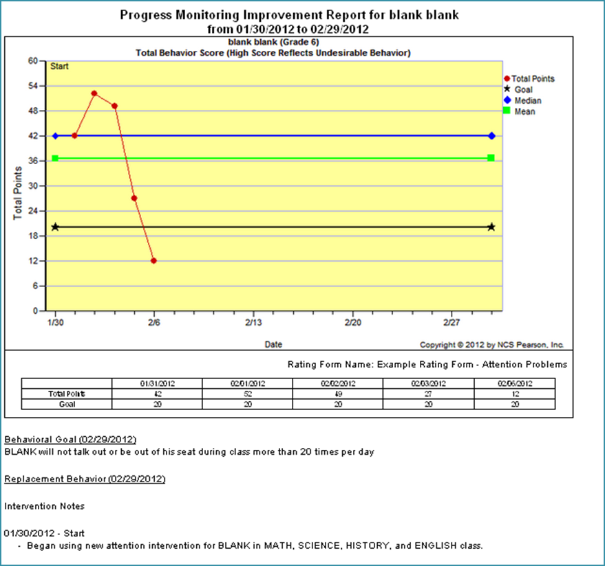
Procedures

Slide 153
Disadvantages
Requires additional cost per student
Still vulnerable to implementation or fidelity issues
Requires staff buy-in for success (i.e., completing forms in timely and regular fashion)
Requires expertise to select appropriate interventions, implement interventions, modify interventions, and make evidence based decisions based on data
Potentially oversimplifies RTI process such that schools may implement interventions and monitor progress without understanding identification/intervention process
Progress monitoring could be replicated by knowledgeable school personnel (e.g., school psychologist) with basic Microsoft Excel skills at no cost

Slide 154
Advantages
Comprehensive system for creating progress monitoring tools and organizing data
Generates comprehensive and easy to read reports with minimal effort
Connects universal screening data to interventions and progress monitoring
Users can easily view connections between academics, behavior, and social-emotional skills
Many schools are already familiar with AIMSweb for academic screening and progress monitoring
Simple for school personnel to enter progress monitoring data and generate report

Slide 155
Advantages
Incorporates a wide variety of behaviors to modify as well as the option to customize progress monitoring for individual students
Flexible to monitor a variety of interventions
Very time efficient once action plan decisions have been made (e.g., easy to enter weekly data and generate reports)
AIMSweb Behavior is a complete program for screening, intervening and monitoring social-emotional and/or behavioral progress for at-risk students that is highly customizable to meet individual or school needs.

Slide 156
References
AIMSweb Behavior Manual
Pearson (2010). AIMSweb Behavior: Administration and
Technical Manual. Retrieved from: http://aimsweb-
qa.ratchet.com/uploads/pdfs/Manuals/AIMSweb_Behavi
or_Manual.pdf. PsychCorp. Bloomington, MN
AIMSweb Behavior Website
http://www.aimsweb.com/behavior

