Slide 1
Planning for Fall 2021
Academic Affairs, Student Affairs and Personnel
May 13, 2021
Beth Ingram, Executive Vice President & Provost

Slide 2
Goals and Expectations
Protect the health and safety of faculty, staff and students
Provide a robust on-campus experience for our students
Return to normal research activities for our faculty
Maintain flexibility to respect the needs of employees and units

Slide 3
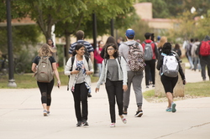
Classes
The majority of our courses will be face-to-face
Percentage of courses face-to-face or staggered
Lower division is 79%
Upper division is 69%
Graduate is 66%
Hybrid with some face-to-face
Lower division is 4%
Upper division is 12%
Graduate is 5%

Slide 4
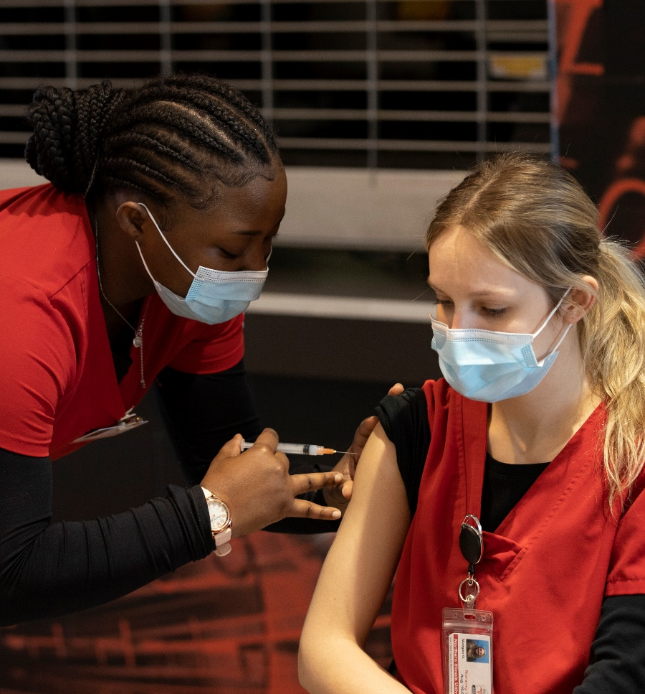
Testing and Surveillance
The following groups will be tested if they have not been fully vaccinated:
Faculty and students in face-to-face classes
Residential students (on arrival day and then weekly)
Employees in some specific areas (Housing and Dining, Childcare Center, etc.)
Students and employees can also choose to be included in testing.

Slide 5
Classrooms and Technology
Created classroom inventory
Fully using 25Live classroom scheduler
Enhancing classrooms to support lecture-capture, two-way collaboration and streaming capability
Adding components such as cameras and microphones to classrooms (approximately 45 rooms)
Replacing outdated equipment in rooms that will be highly utilized in the fall
Cleaning policies

Slide 6
Student Support and Engagement

Slide 7
Student Support Services
Library
Bursar and Financial Aid
Center for Student Assistance
Counseling Services

Slide 8
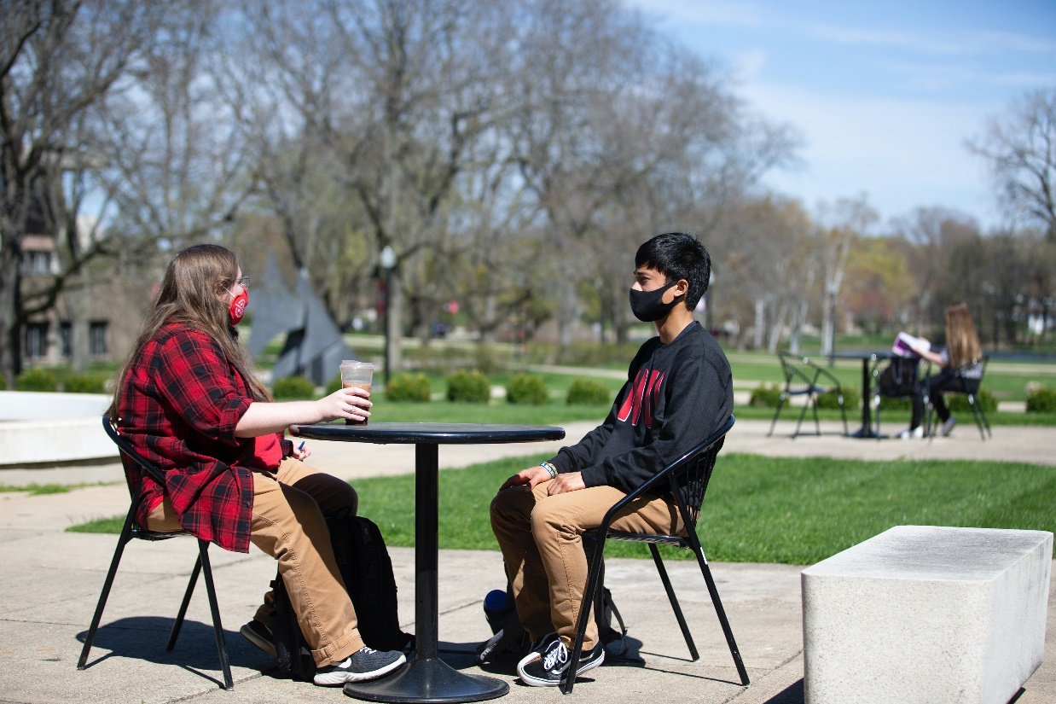
Huskie Academic Support Center
Provide comprehensive academic support services in collaboration with campus partners.
Change approach to advising
Implement campus-wide appointment scheduling system for all academic services
Merge university writing center and content-based tutoring and supplemental instruction
Hire additional peer academic coaches
Develop online support materials and tutorials

Slide 9
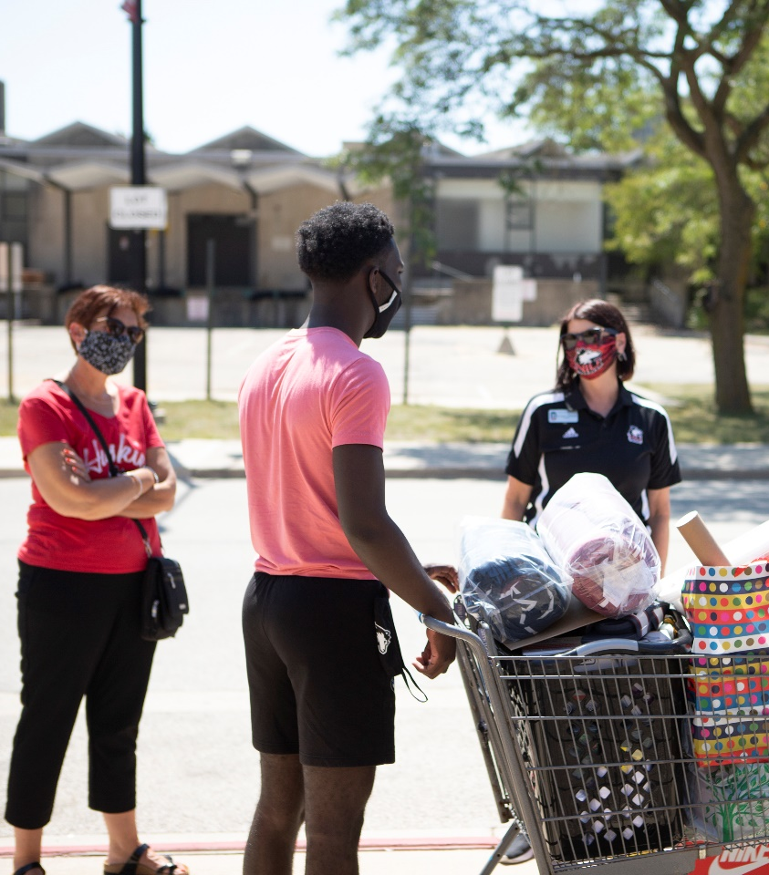
Fall On-Campus Housing Plans
Roommates return – double room occupancy is an option!
Move-In will be by appointment
Continued enhanced cleaning and disinfecting plans

Slide 10
Dining
In-person dining for residents
Follow IDPH guidelines for cleaning, masks, and other safety measures
Retail options re-opening:
3-Sons Bistro in College of Business
Dog Pound Deli and C-Store in Stevenson
Qdoba (a reintroduction)
Return to more normal operation hours

Slide 11
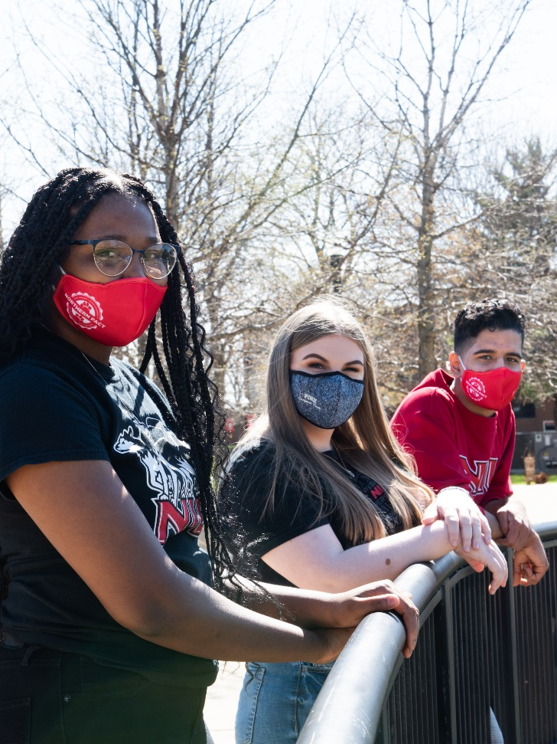
Student Activities
Reintroduce students to campus
Offer summer programming – both virtual and in-person options
Provide a variety of enriching events
Celebrate Week of Welcome and Homecoming
Return to normal recruitment for Greek Life chapters (including first-year recruitment)

Slide 12
Athletics
Protocol is similar to university
Staff and students who are not fully vaccinated participate in gateway and surveillance testing
Follow NCAA protocols as they are released
Attendance determined by Illinois Mitigation stage: anticipate either 60% (Phase 5 bridge) or 100% (Phase 5)
Will follow IPHD mitigation strategies (mask wearing, cleaning, etc.)
Return to normal travel and meal protocols for competitions and recruiting
Continue on-line student athlete tutoring and advising as needed

Slide 13
Conclusion
We remain committed to the health and safety of students, staff and faculty
We anticipate a year that more closely resembles our pre-pandemic campus
We are building on the positive lessons learned as we look ahead to Fall 2021 and beyond

